Slide 1
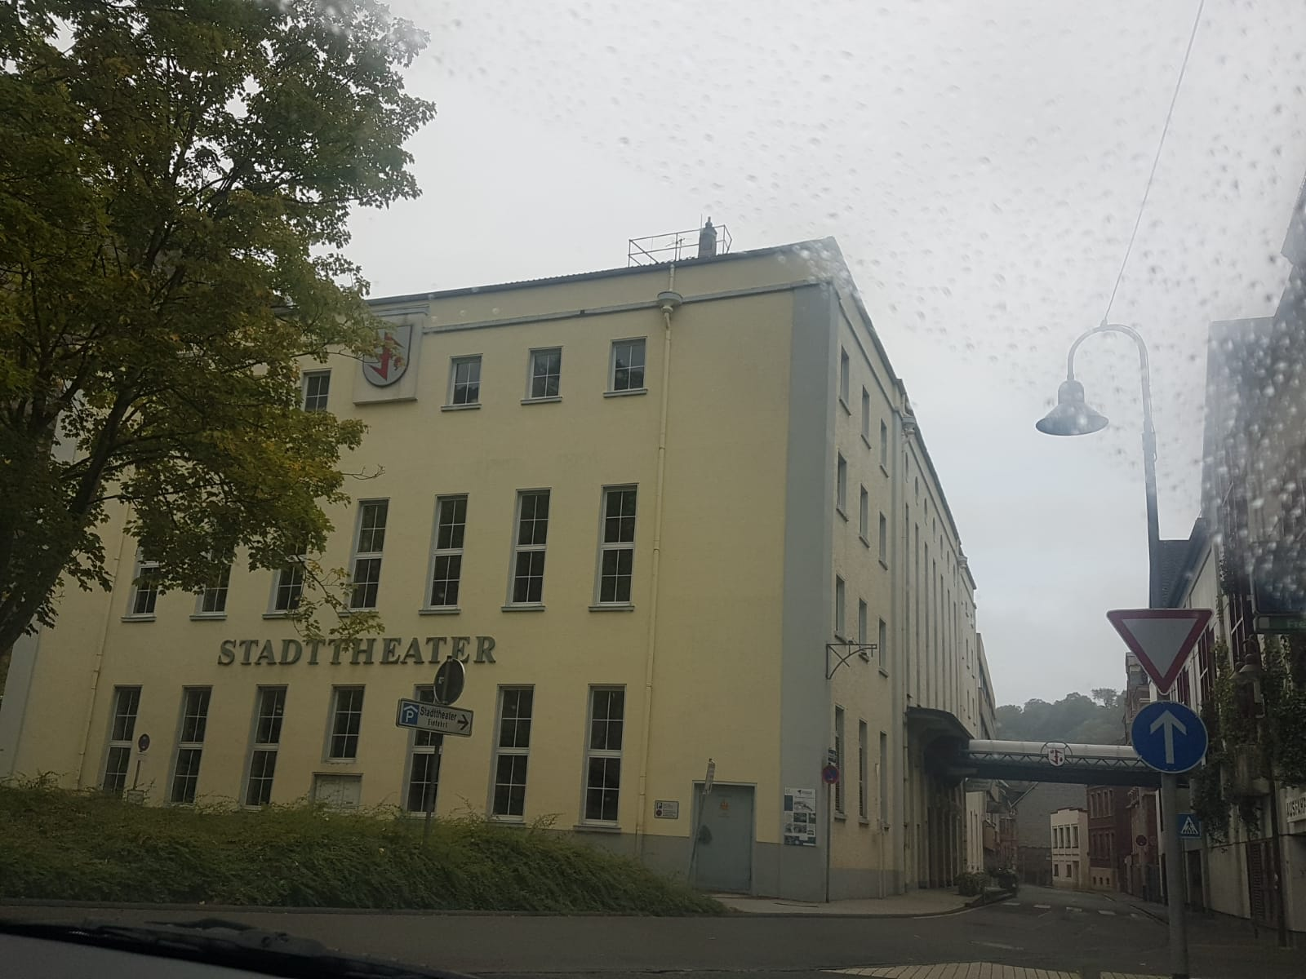
City Theater
of Idar-Oberstein

Slide 2
Built in 10th december, 1999
600seats (+ 300 in an additional room)
Nearly every weekend, there are played stage plays
it has a big amount of variation, for example:
- The history of the „Felsenkirche“, or „Me and the devil“

Slide 3
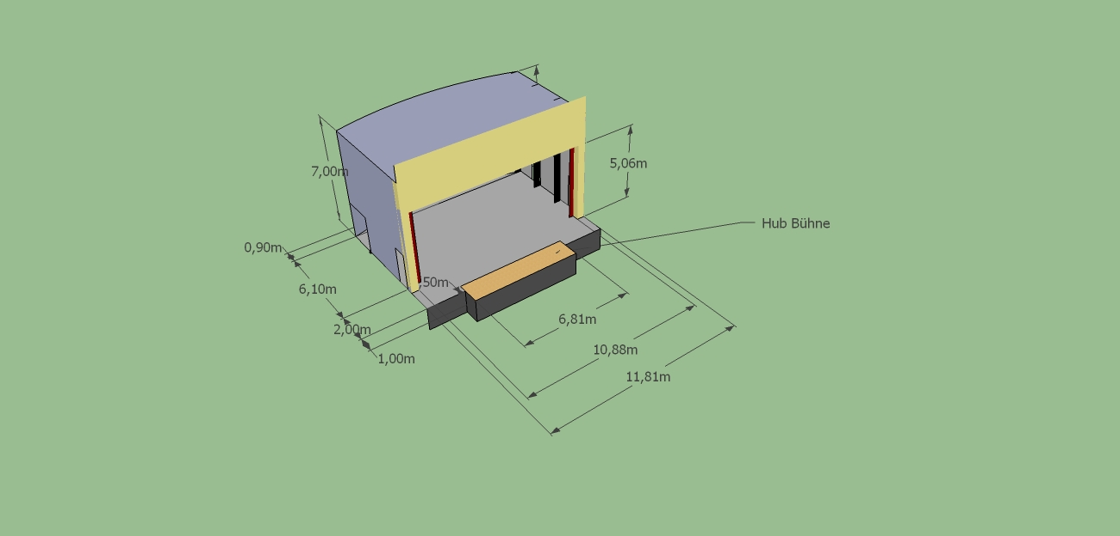

Slide 5
