Slide 1
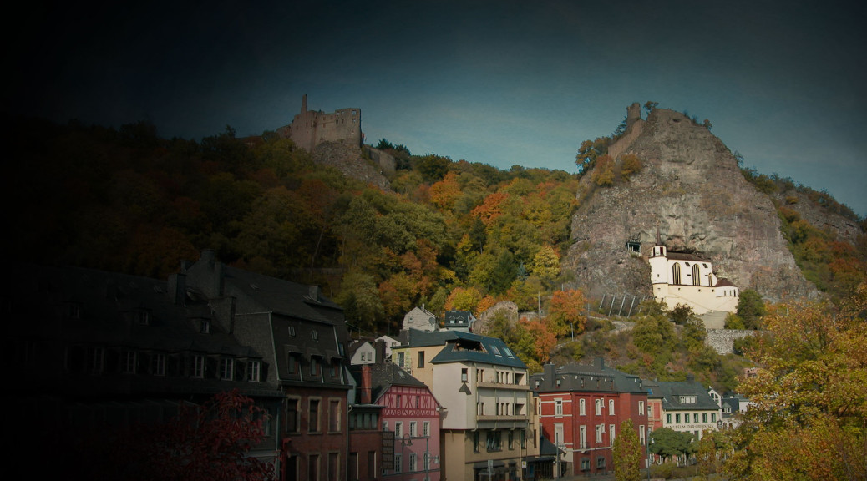
Idar Oberstein & Region
A short Presentation of our little beautiful city & and our neighbours

Slide 2
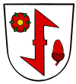
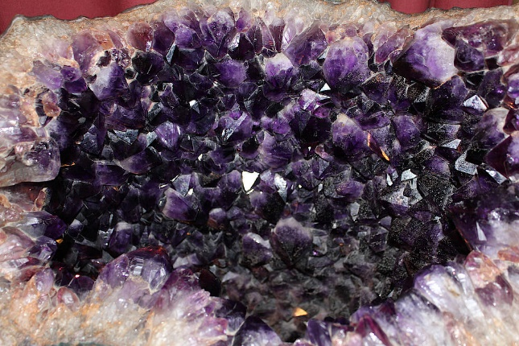
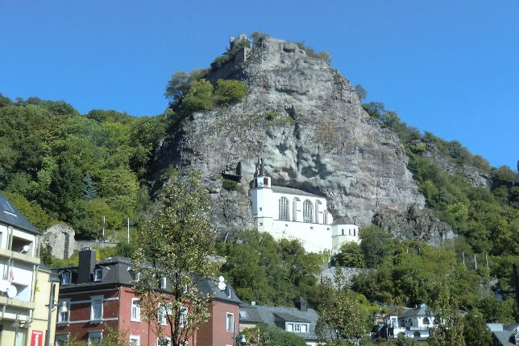
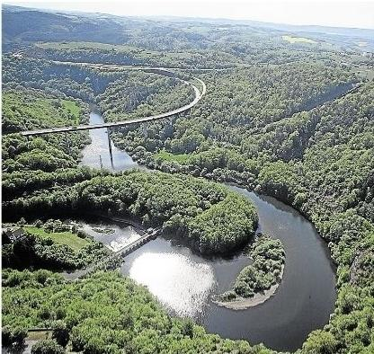
Idar Oberstein: The Gem City
In the 19th century, Idar- Oberstein
Was one of the fourth biggest and
important jewelry centers in
Germany
This picture is from our
Felsenkirche and it´s the
City emblem
The river Nahe

Slide 3
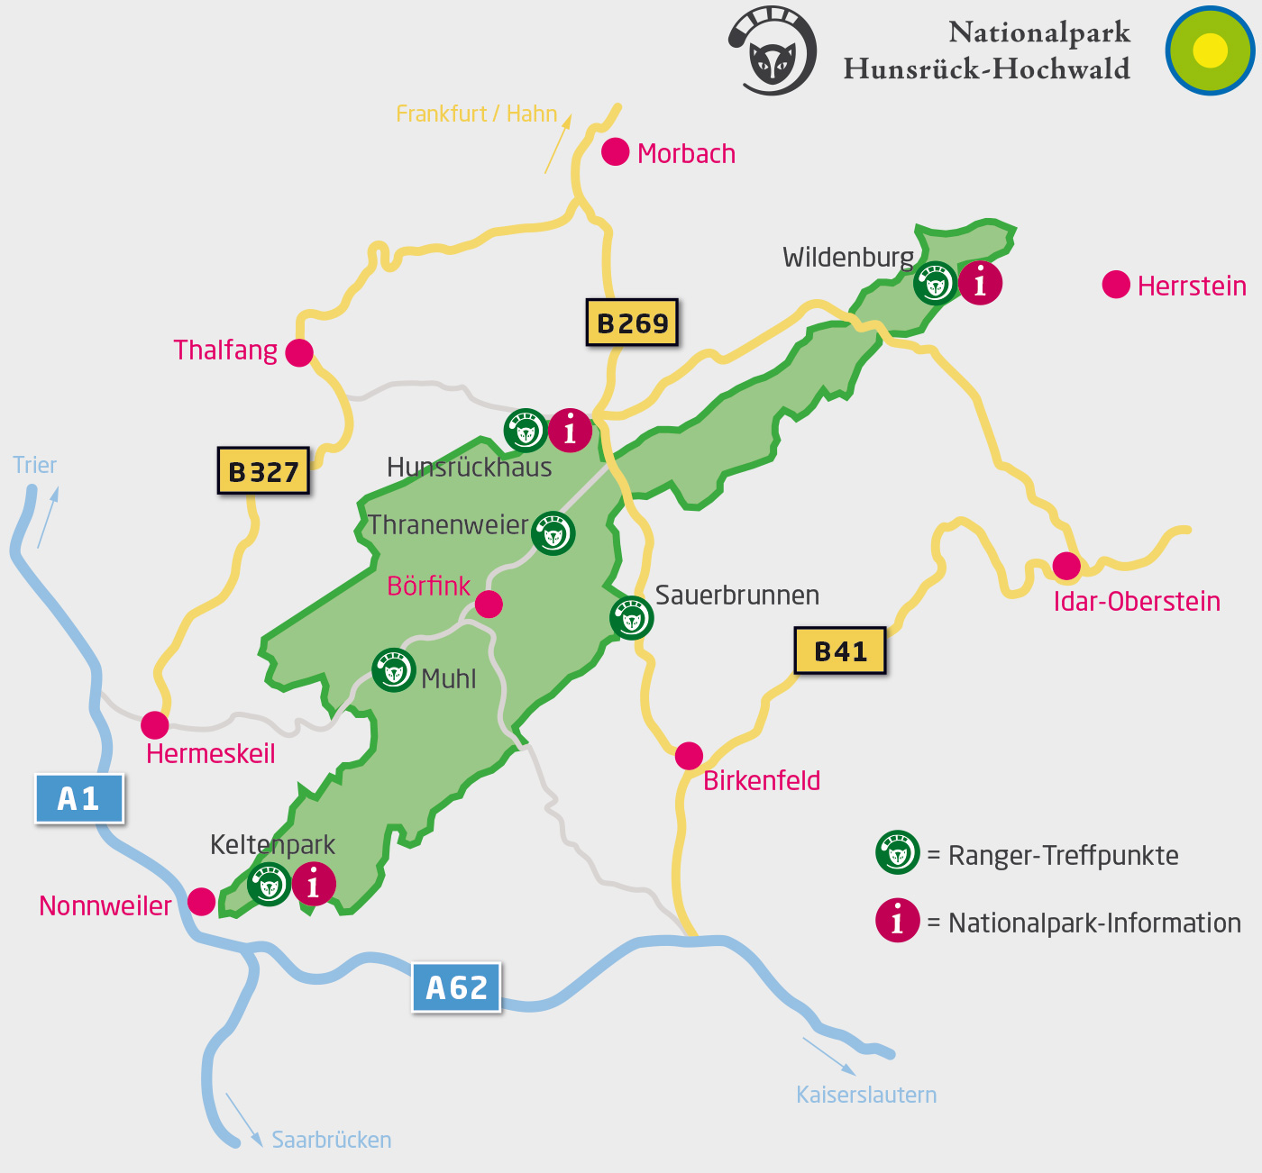
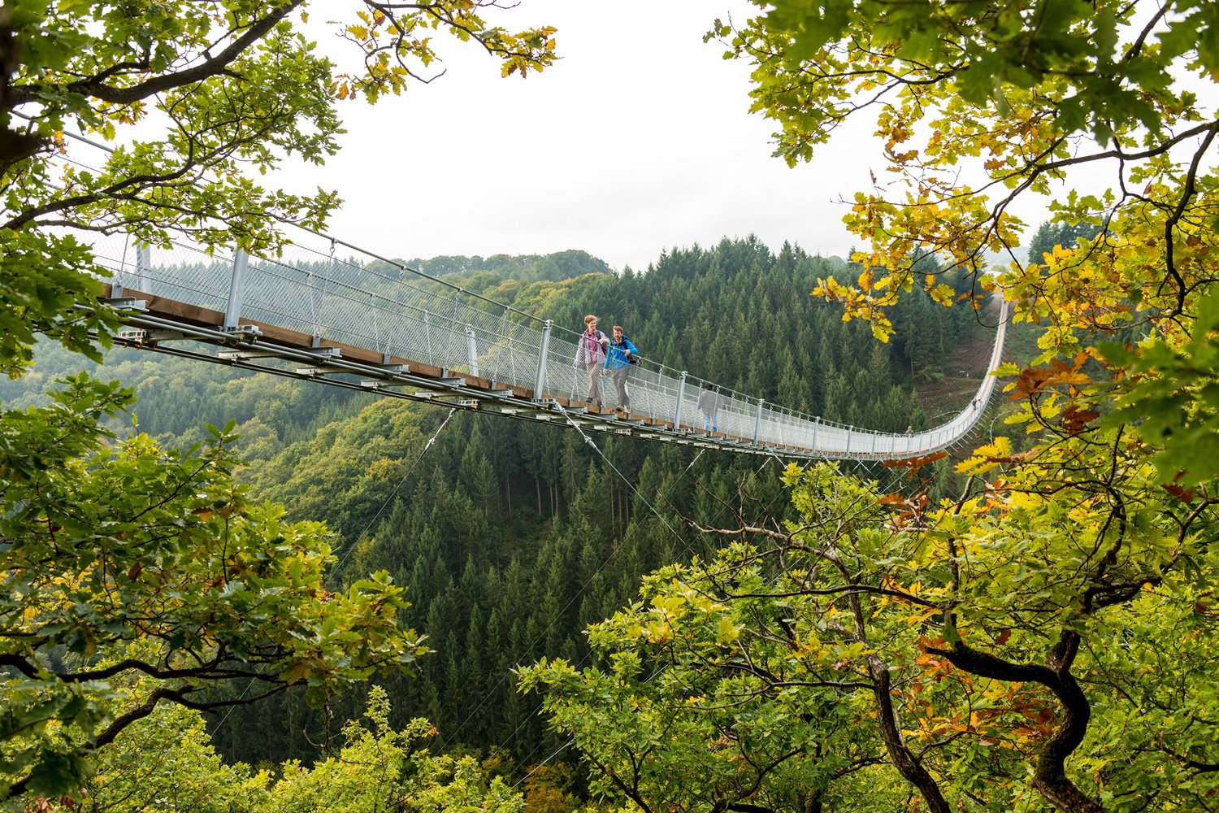
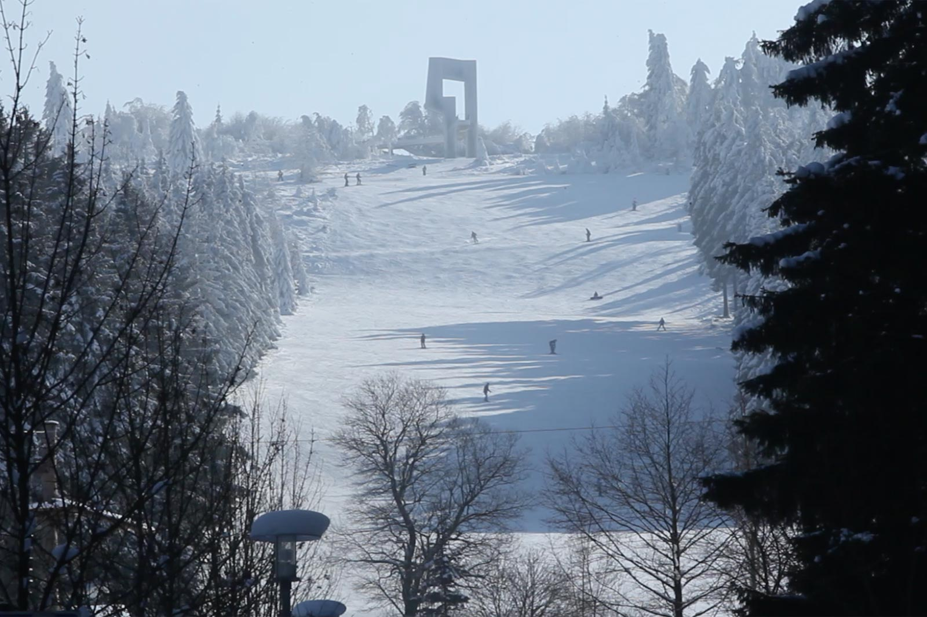
Hunsrück
This is Hunsrücks suspension
bridge, which has a height of
100 meters and a lenght of
360 meters
This is a picture of the
highest mountain of Hunsrück.
It´s called Erbeskopf and has
A height of 816 meters

Slide 4
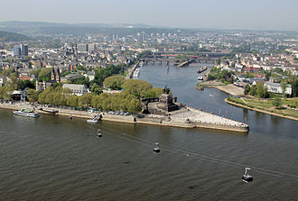
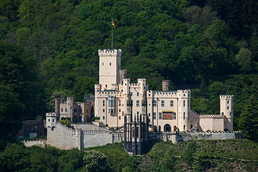
Koblenz
This is the german corner (Das Deutsche Eck) and it is famous for their
crossover with the river "Mosel" and "Rhein". As you can see the
"Mosel" is much darker than the "Rhein".
The "Schloss Stolzenfels" is a castle in Koblenz and it is on the
left side of the "Rhein"

