Slide 1

2^{ο} ΕΠΑΛ Ηρακλείου
2nd Vocational School of Heraklion

Slide 2
European Parliament Senior Ambassadors
Velidakis Georgios (IT teacher)
Pachiadaki Eleftheria (English teacher)
Gioukaki Maria(IT teacher)

Slide 3
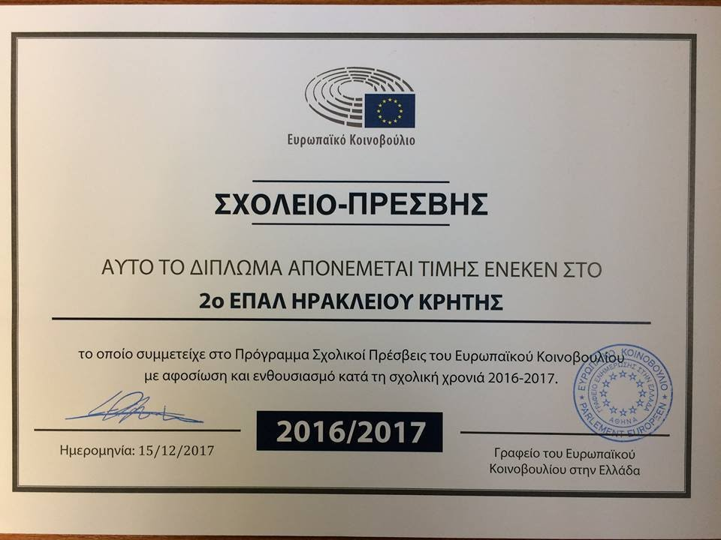
Certificate of participation as EPASchool

Slide 4
Activities for EPAS Programme
2016-2017

Slide 5
Visit of Europe Direct Crete
to inform our students about mobilities around Europe, finding job as an EU citizen and
Erasmus+ programme

Slide 6
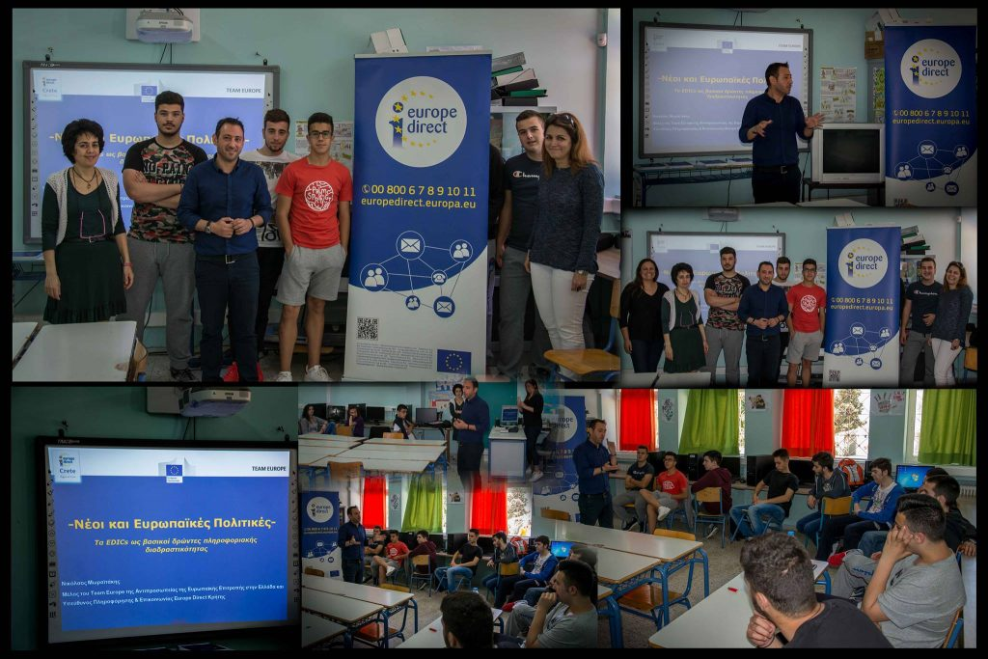

Slide 7
Presentations in the field of internet safety was made by European Union Agency for Network and Information Security (ENISA) researchers in the subject area

Slide 8
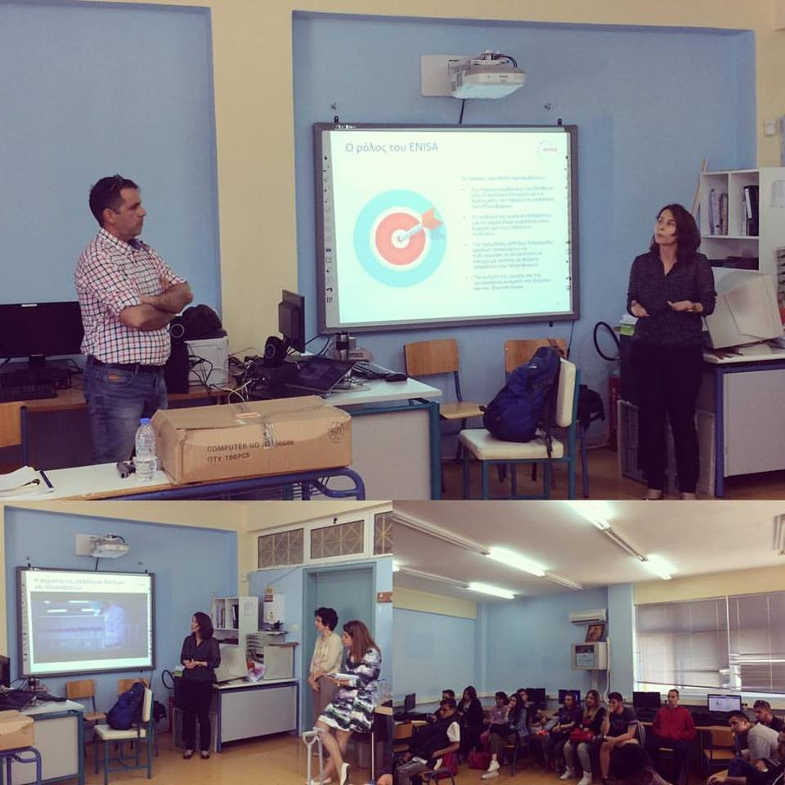

Slide 9
Skype conference with the member of the European Parliament
Mr. Androulakis Nikolaos

Slide 10
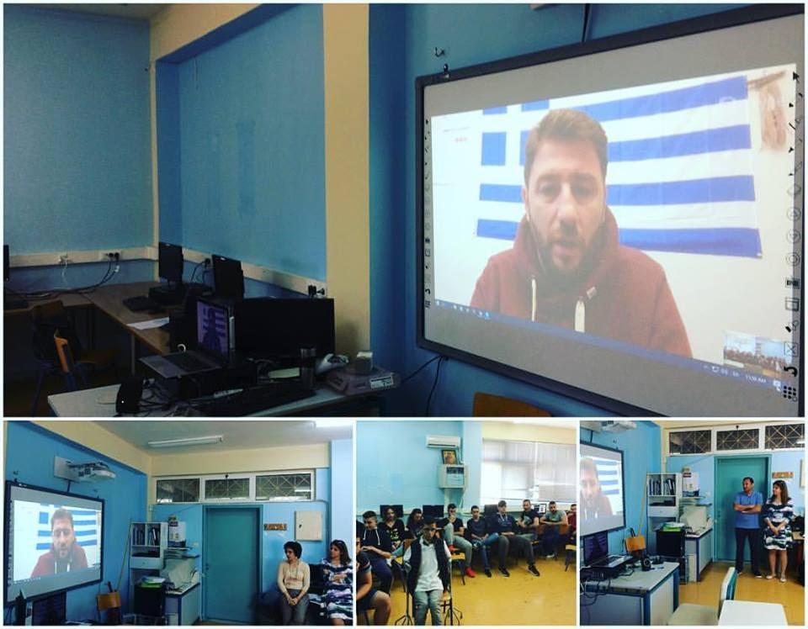

Slide 11
Activities for EPAS Programme
2017-2018

Slide 12
Visit to Region of Crete, Regional Unit of Heraklion.
Presentation by Europe Direct Crete about the opportunities that EU offers to young people.

Slide 13
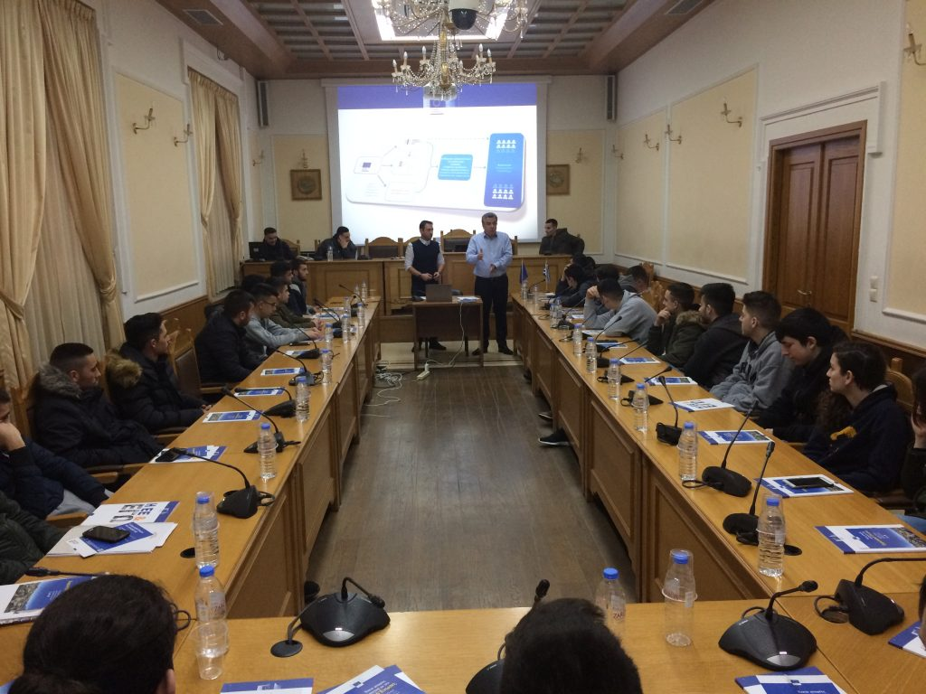

Slide 14
Creation and distribution of flyers about EU
(countries, currency, regimes and constitutions) by our junior ambassadors to teachers and students of our school and to fellow inhabitants and neighbours.

Slide 15
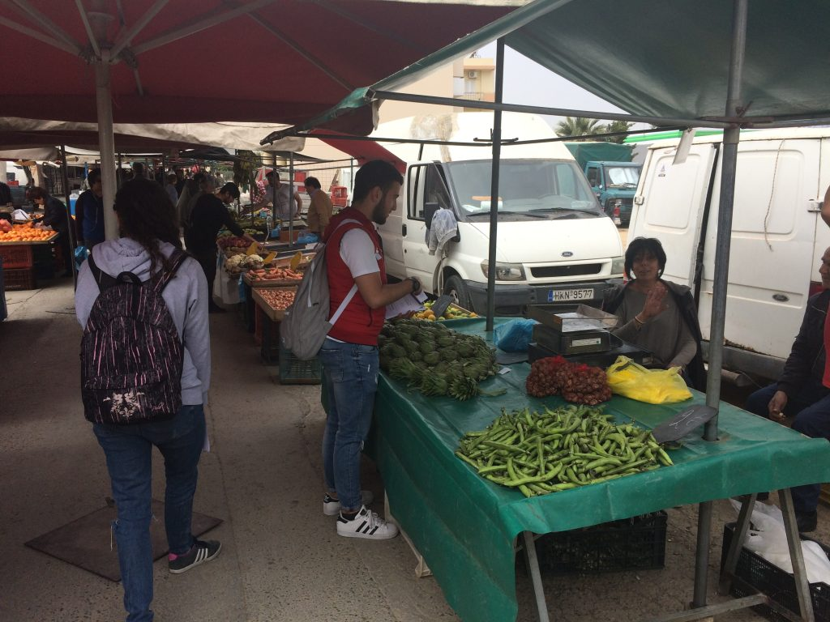
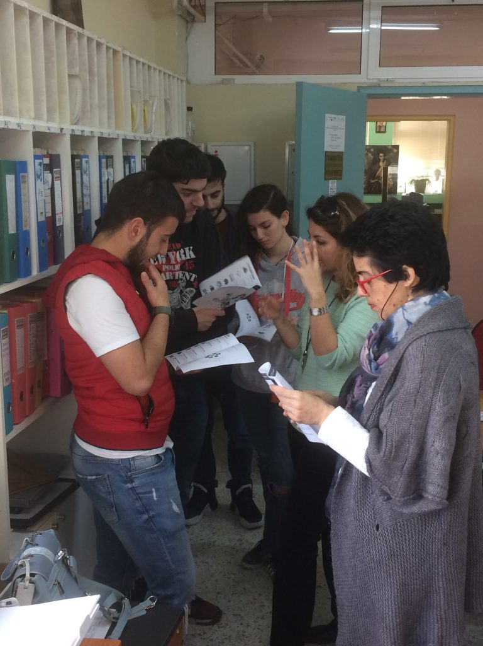

Slide 16
Skype meetings with EPAS schools from Portugal, Lithuania and northern part of Greece.
Discussion about sports, common concerns and communication among young Europeans

Slide 17
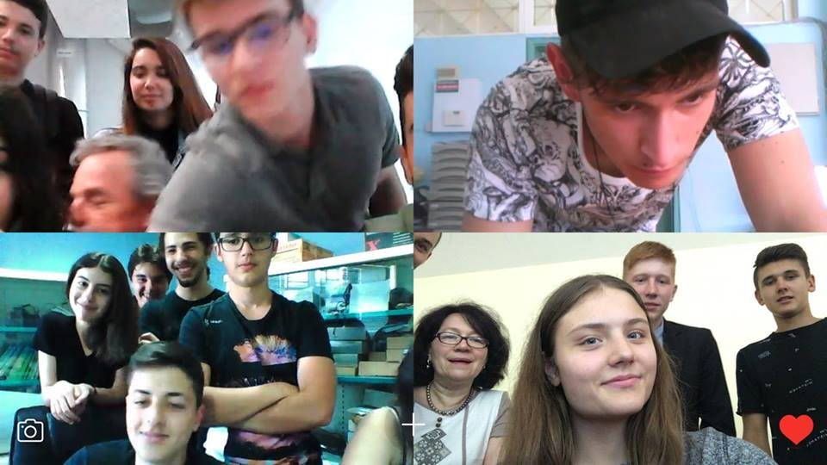
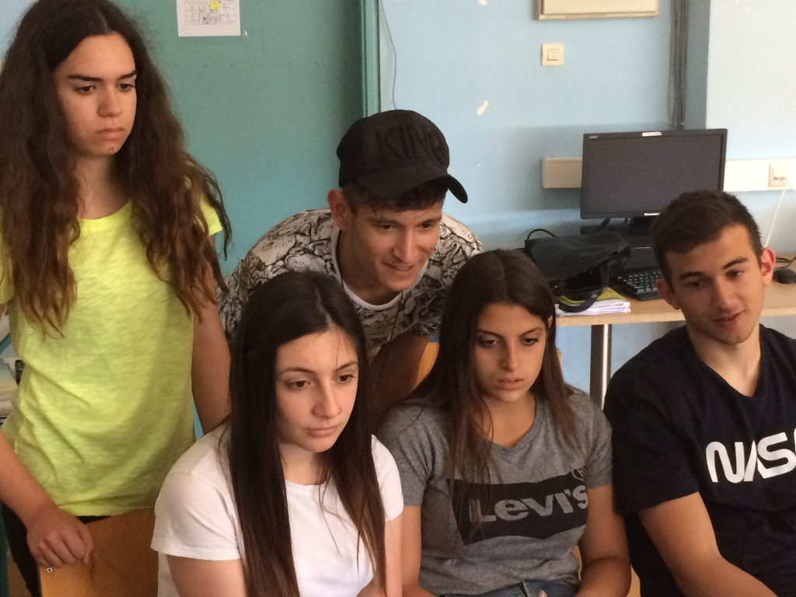

Slide 18
Celebration of Europe’s day with treasure hunt games and quizzes to get to know Europe better.

Slide 19
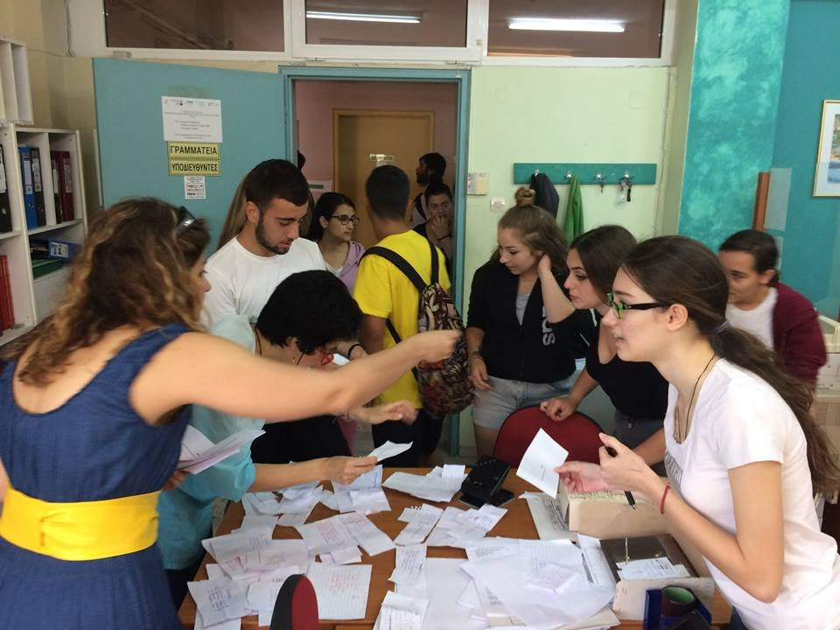
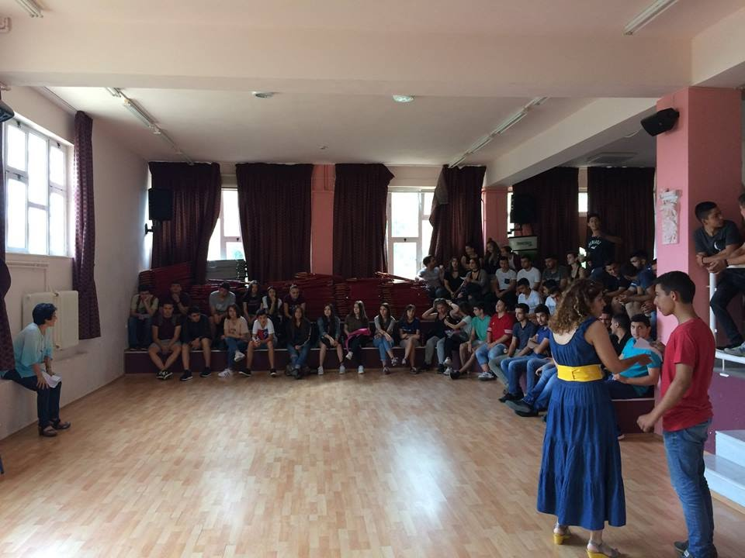
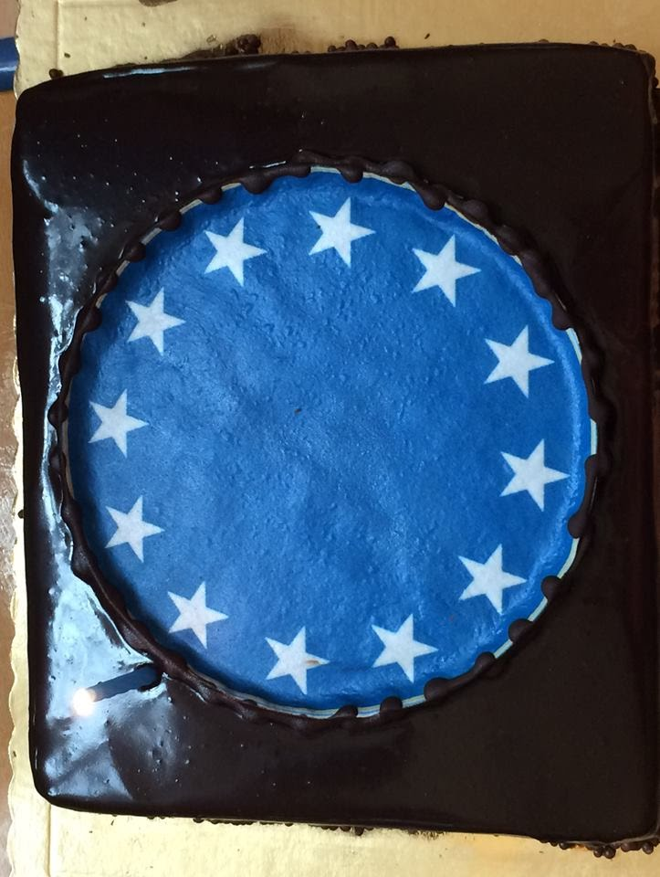

Slide 20
Presentations of our students

Slide 21
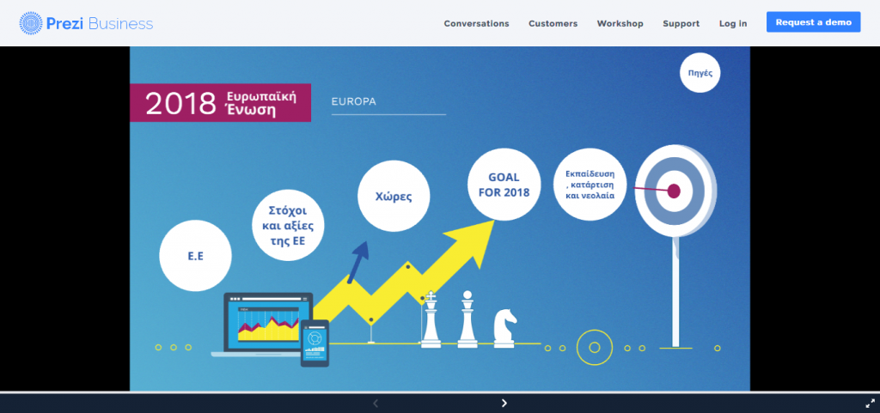
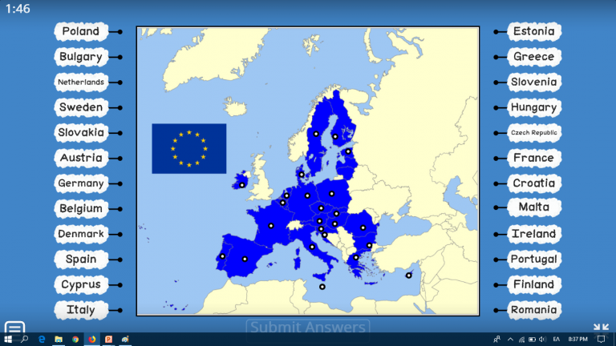
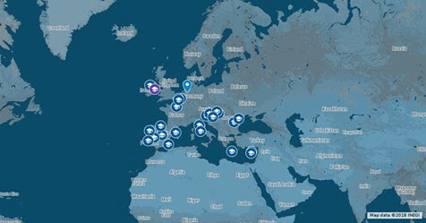
Presentation about EU
Quiz about EU
https://wordwall.net/resource/251650
Map of EU monuments
Interactive map of EPASchools.

Slide 22
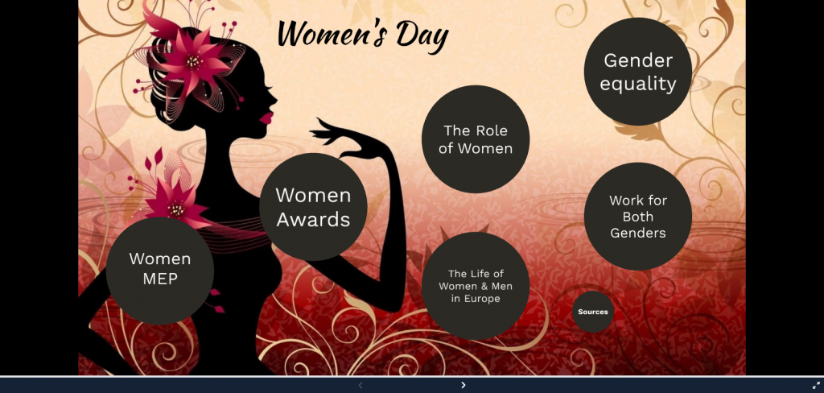
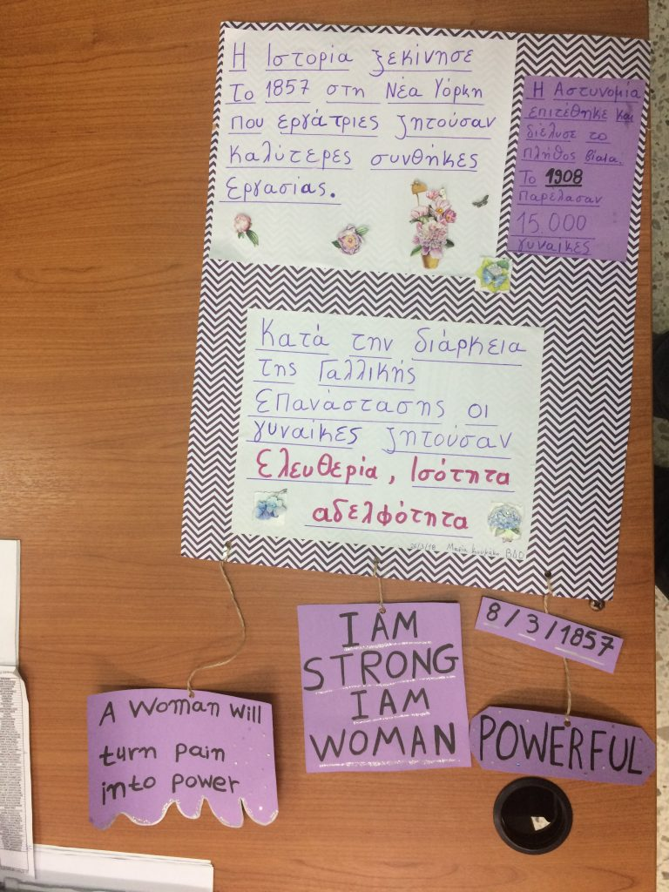
Presentations about women in EU
Woman’s Position in the EU
Women in EU
Poster about Women in EU

Slide 23
Visit to European Parliament in Brussels

Slide 24
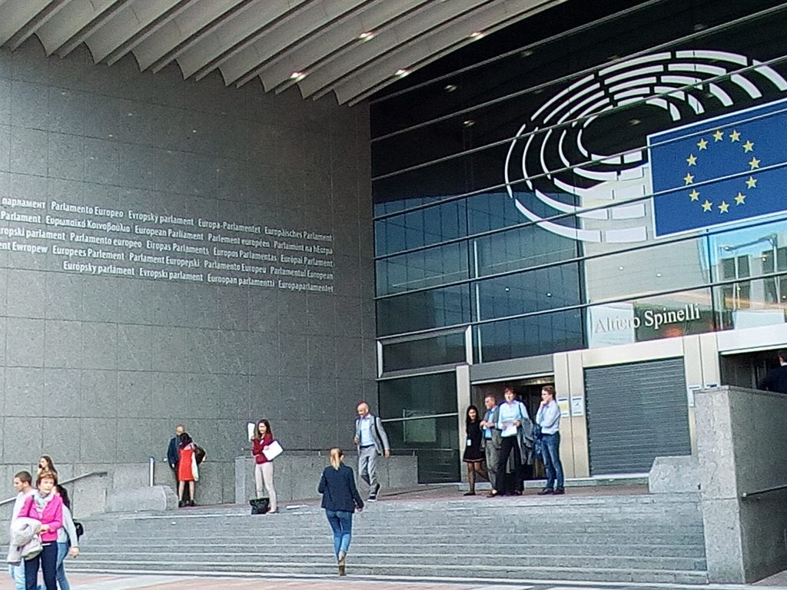
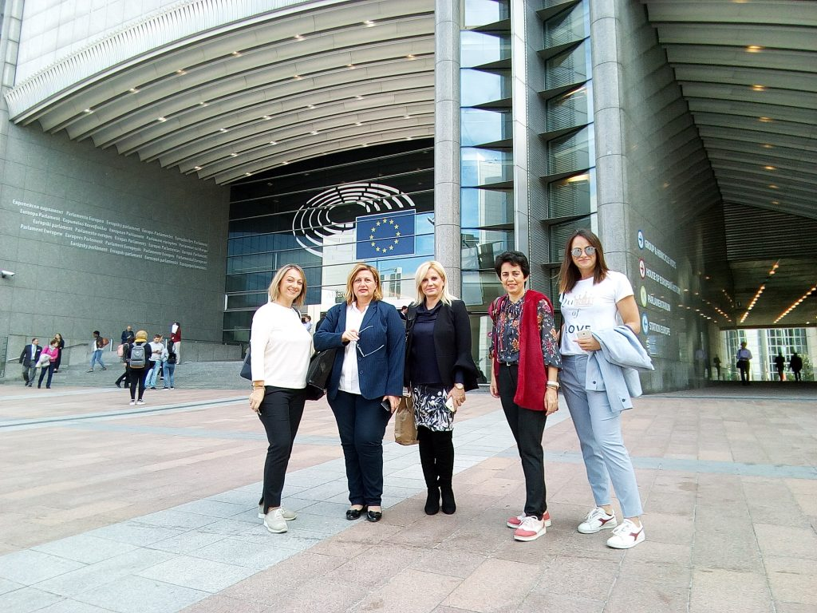
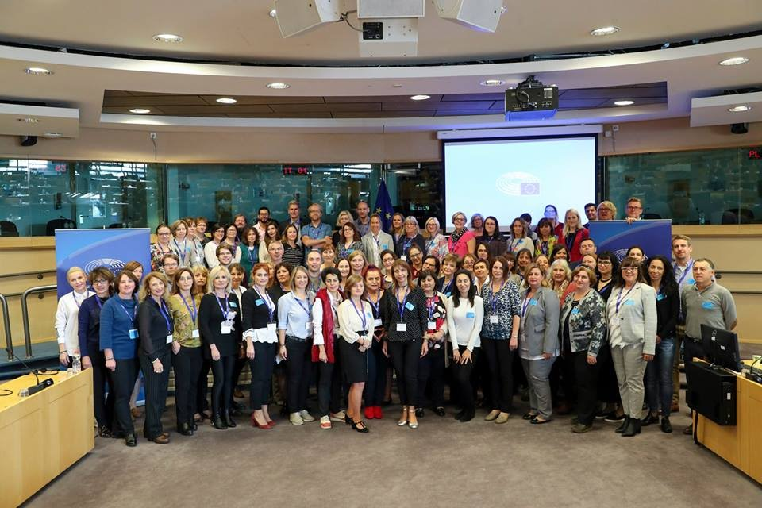

Slide 25
Activities for EPAS Programme
2018-2019

Slide 26
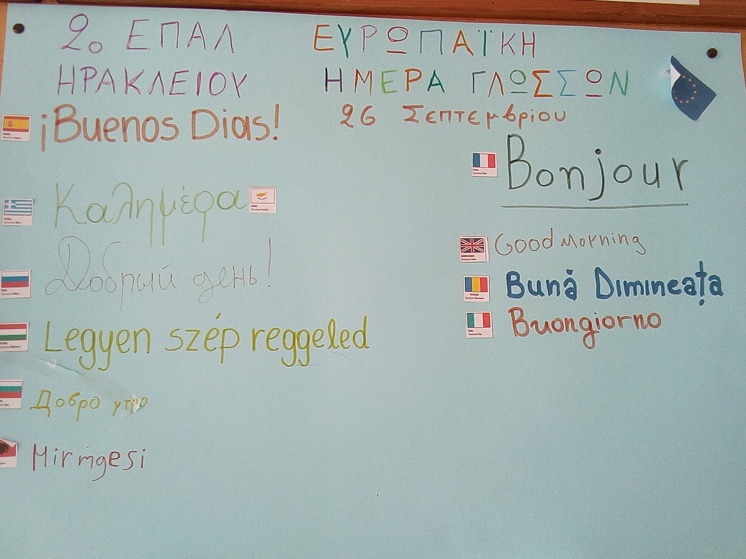
European Languages Day

Slide 27
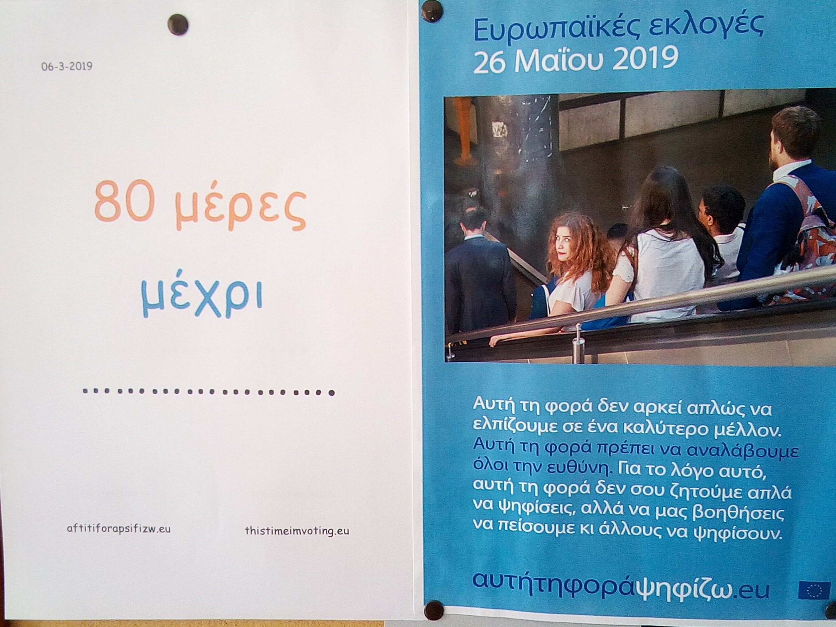
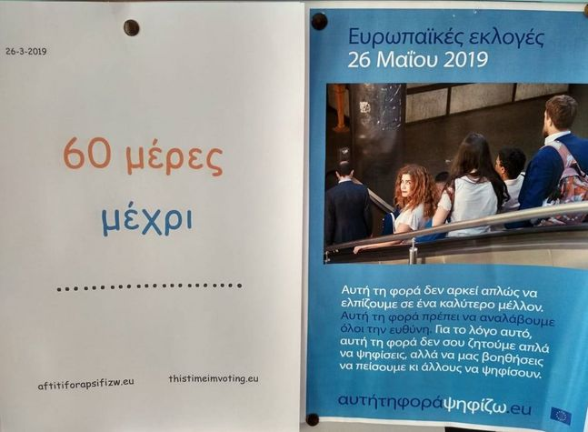
Elections Day Countdown

Slide 28
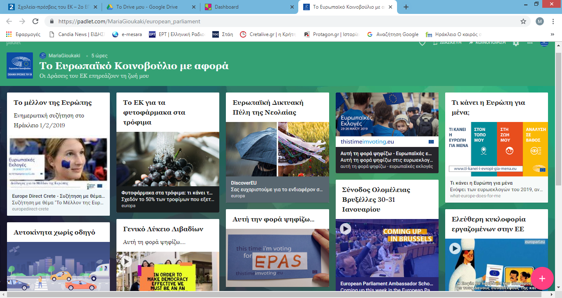
Padlet newspaper about European Parliament Actions affecting our lives

Slide 29
Video to promote participation to the Elections for the European Parliament
https://www.facebook.com/2EpalHeraklion/videos/395740661267744/

Slide 30
Celebration of Europe’s day
Europe's day celebration (video)

Slide 31
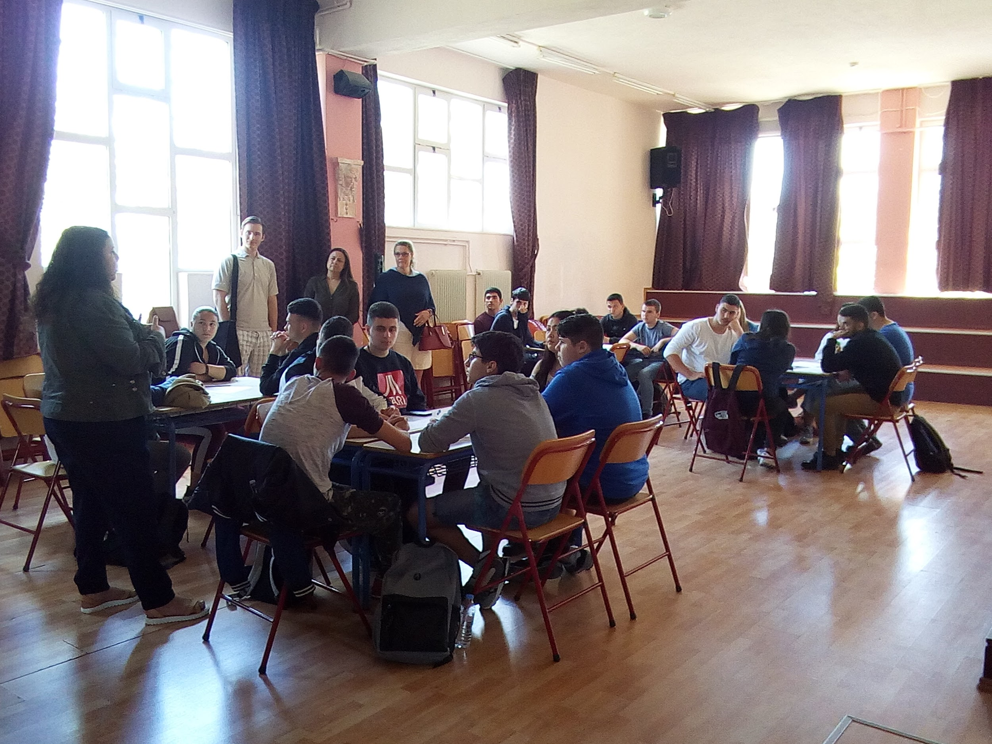
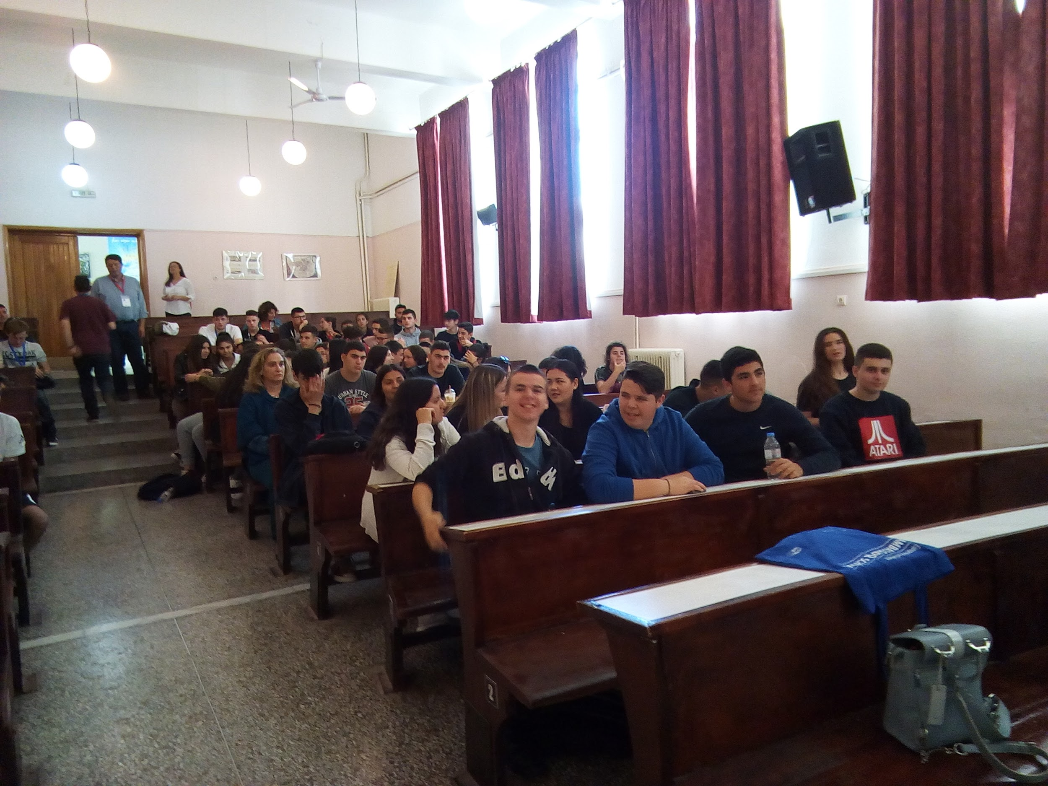
Collaboration with other EPASchools
Students from our school, 6th Vocational School of Heraklion, 3rd General High School of Heraklion, Uddevallas Upper Secondary School (Sweden) discussed about EU future. They talked about
immigration
environmental change
social inequality
education and employment.

Slide 32
Poster creation
Europe means :
Collaboration
Rights
Friendship
Opportunities
Erasmus
Unity
Trips
Education
Equallity

Slide 33
Poster creation
This Time I’m Voting for
my Rights
Peace
a Better Future
my Children
This Time I’m Voting because
I Can
I Care
my vote Matters

Slide 34
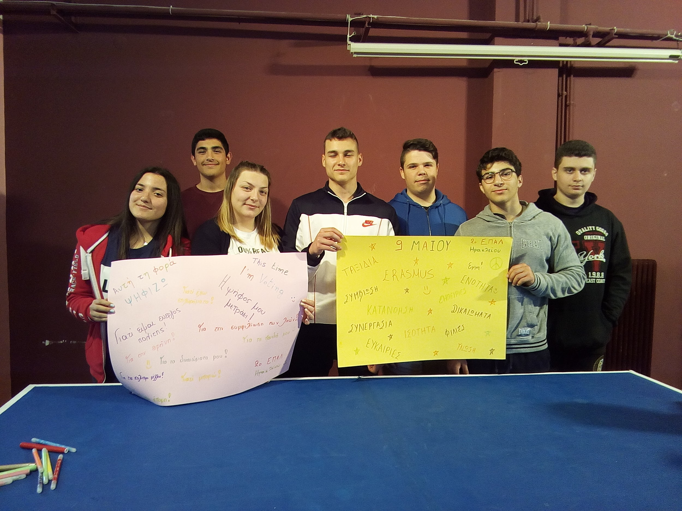
Poster creation

Slide 35
You can find all EPAS activities in our school site
http://2epal-irakl.ira.sch.gr/
or on facebook and twitter

