Slide 1
Tree of English Words
WORDS OF OCTOBER

Slide 2
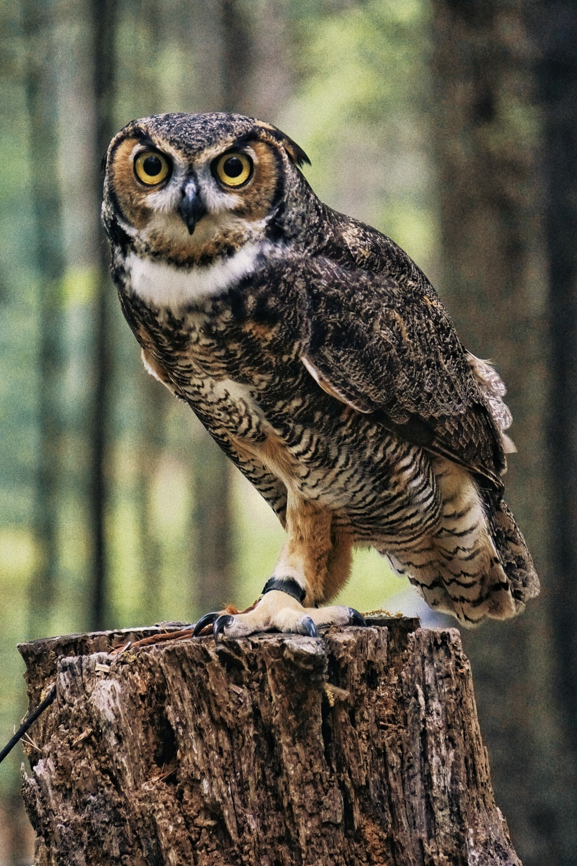
OWL

Slide 3
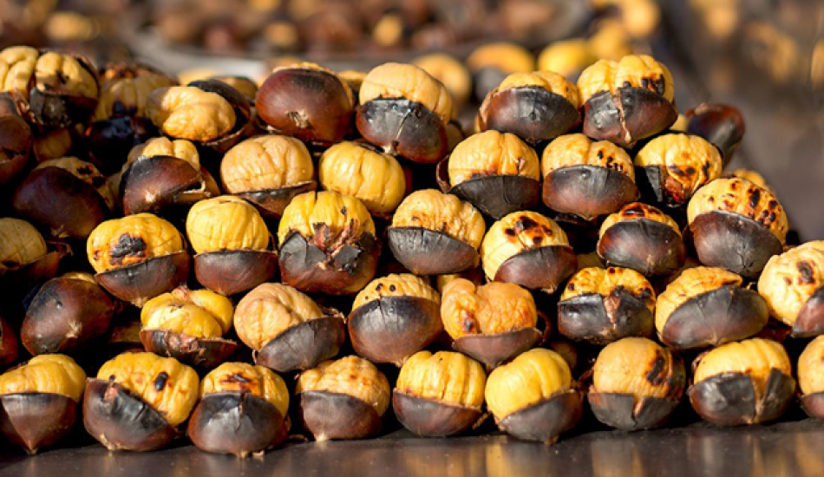
CHESTNUT

Slide 4
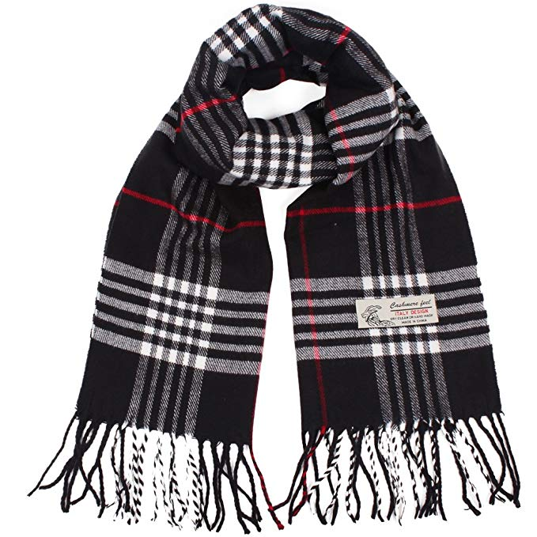
SCARF

Slide 5
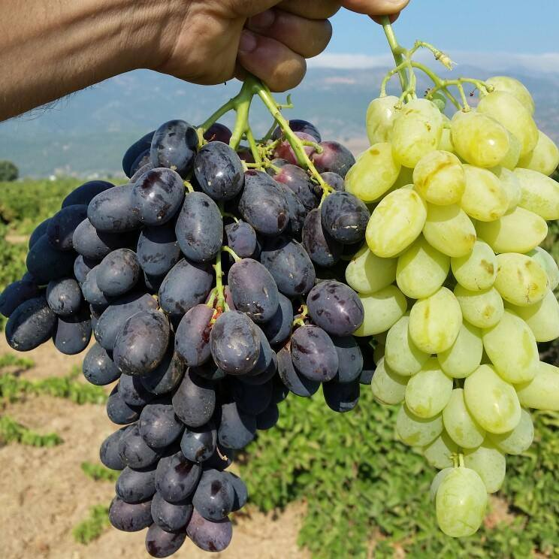
GRAPES

Slide 6
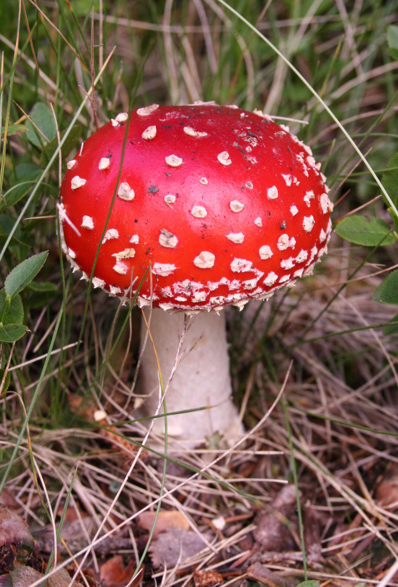
MUSHROOM

Slide 7
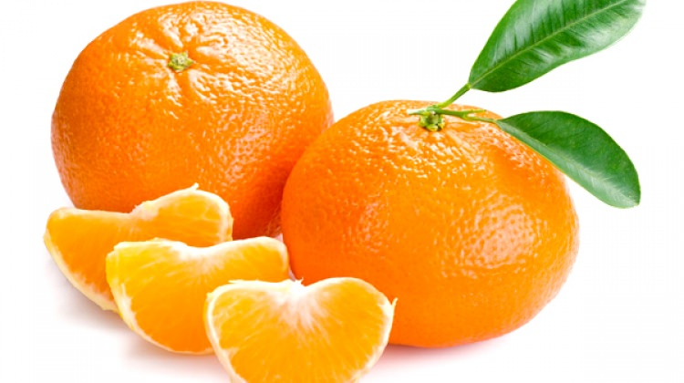
TANGERINE

Slide 8
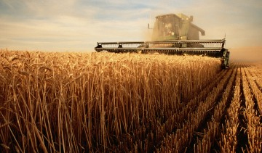
HARVEST

Slide 9
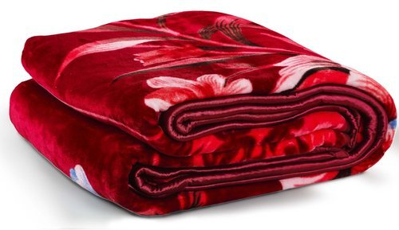
BLANKET

Slide 10
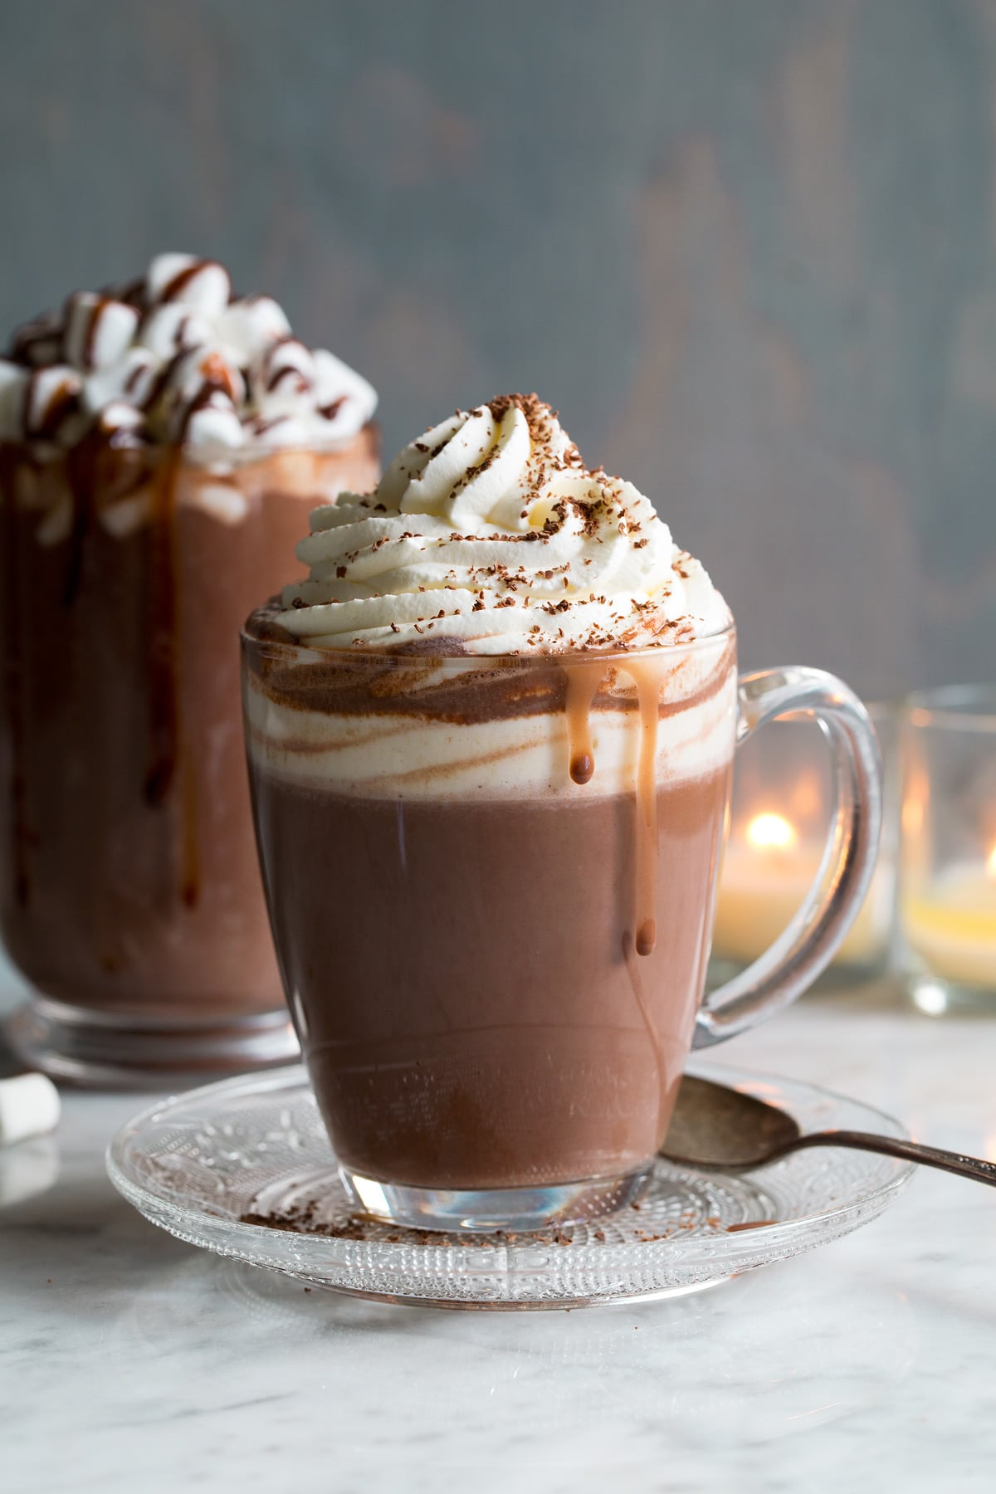
HOT CHOCOLATE

Slide 11
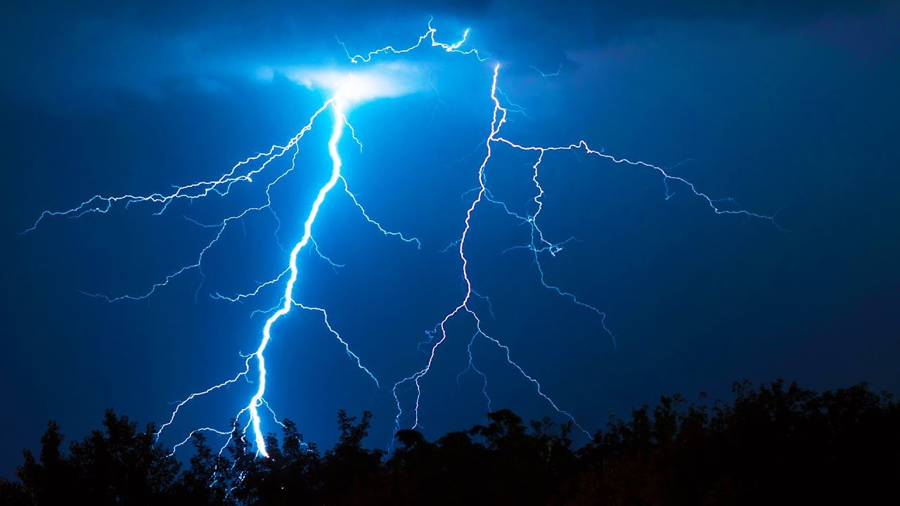
THUNDER

