Slide 1
Dido and Aeneas
  The Aeneid

Slide 2
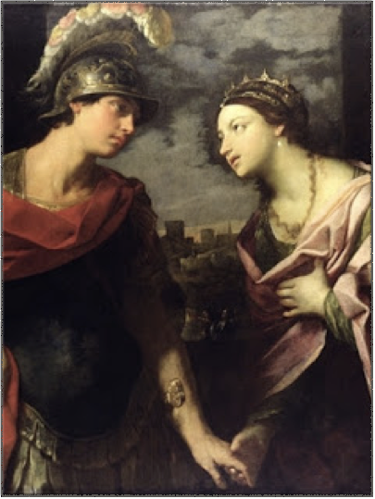
Mens immota manet, lacrimae volvuntur inanes.
The mind stays still,
tears fall without an effect.

Slide 3
The flames consumed her cries
because he left her with a broken heart.
As coal clouds filled the skies,
her youth was being torn apart.
Unloving eyes that watched her insanity,
ironically those being her remedy.
He then left minding his own faith,
making her face her own wraith.

Slide 4
The Poem
The poem is based on the part where Aeneas has to leave Dido behind.
She is heart-broken and she feels that the world is no longer positive or helpful. Everything is blue without him.
The second paragraph talks a bit about Aeneas feelings as he knows that although he is the only one that could eventually help her, he can’t, he has to continue with his own challenge. He has to face his destiny.
The last line might seem a bit confusing but after reading carefully Dido´s cries, you can only think that she is so ridiculously in love but yet so mad, she could even commit suicide.

