Slide 1
Hello school presents

Slide 2
Where we are
Ostrava –– Návsí = 60 km
Boleslawiec = 350 km
Humenné = 393 km
Zagreb = 701 km
Sincel = 1028 km
OSTRAVA

Slide 3
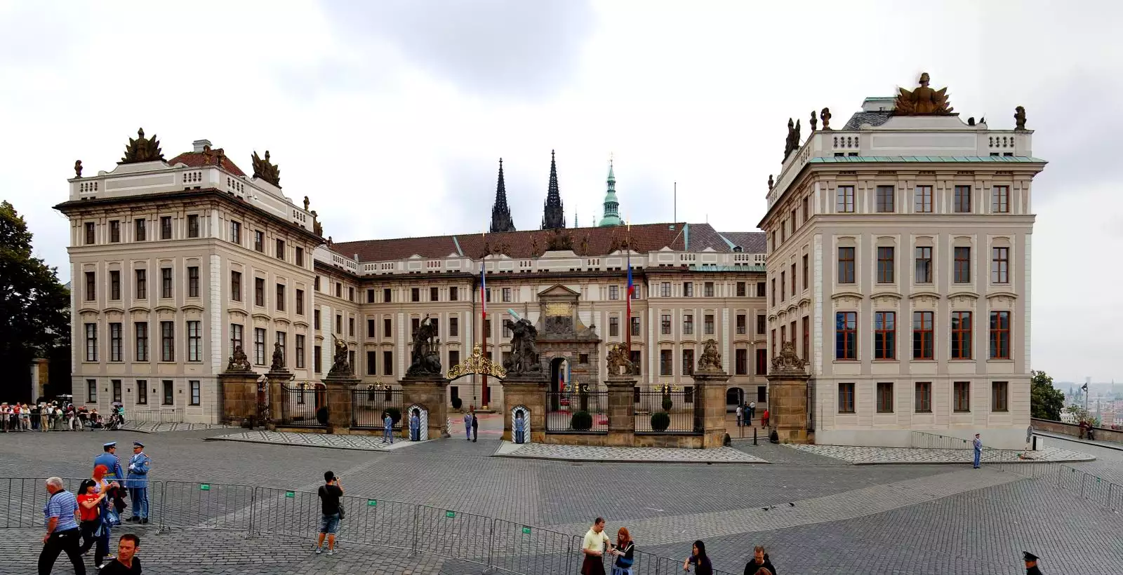
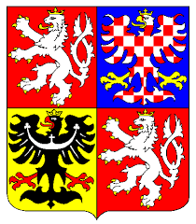
CZECH REPUBLIC – basic facts
CAPITAL CITY: PRAGUE
POPULATION: 10,5 MIL
CURRENCY: czech crowns (CZK)
ANTHEM: Kde domov můj
Notes:
State emblem – státní znak
Orlice = eagle
Vlajka: bílá = like a dove (holubice) that represents a peace
Red = means a blood that was spilled in a battles
Blue =

Slide 4
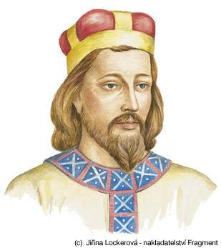
Important historical moments
28th September: St. Wenceslas
28th October: 1918 was established Czechoslovakia
1st January 1993 – separated from Slovakia = Czech Republic
1316 – emperor Karel IV was born

Slide 5
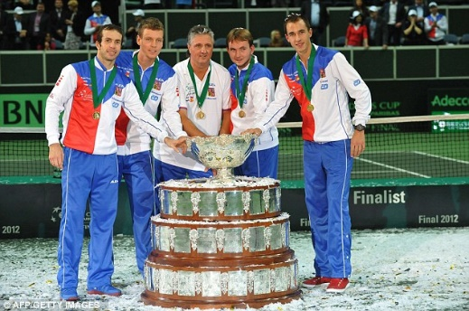
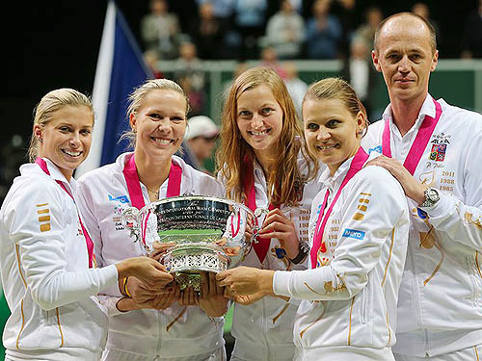
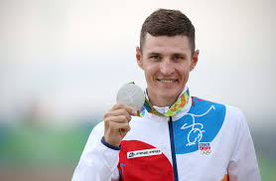
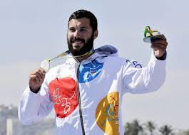
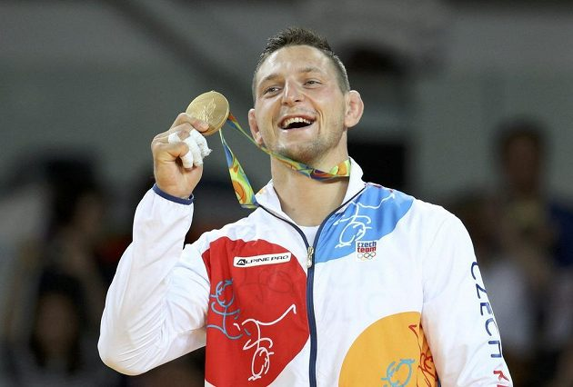
SPORT
One of the best ice hockey teams in the world
Succesfull tennis players and also Fed Cup team and Davis Cup team
Olympics medals 2016:
Judo - 1
Water sports – 3
Tennis – 3
Mountain biking - 1

Slide 6
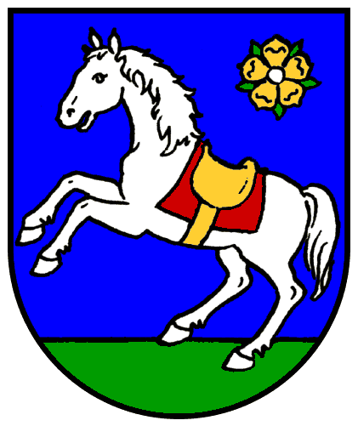
about ostrava
Its name comes from river Ostravice
3rd biggest city in Czech Republic
300 thousand inhabitants
Rich mining history- and today‘s unique technical monuments (e.g. Landek)

Slide 7
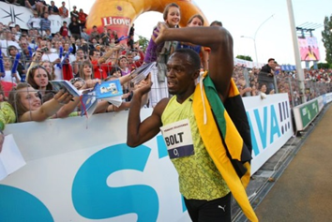
life in ostrava
Home to many famous sporting events - e.g. Golden Tretra
Festival Colours of Ostrava takes place since 2002
5 theatres, many museums and other cultural events
Dark and industrial x green and cultural

Slide 8
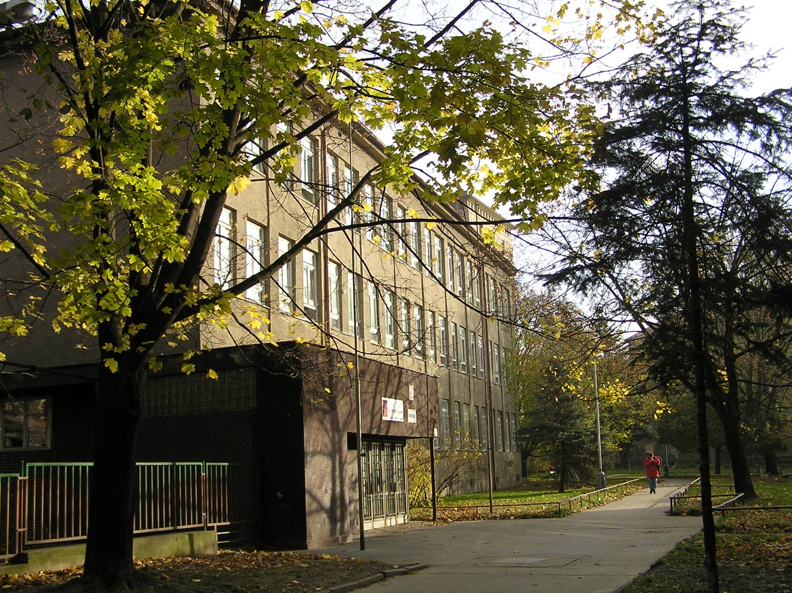
Our school
Our school is bilingual = Maths, Biology, Geography partly in English
About 10 students in each class
Nearly 100 students in whole primary school
Some days we start at 9 o‘clock.
We study 2 foreign languages: spanish and english

Slide 9
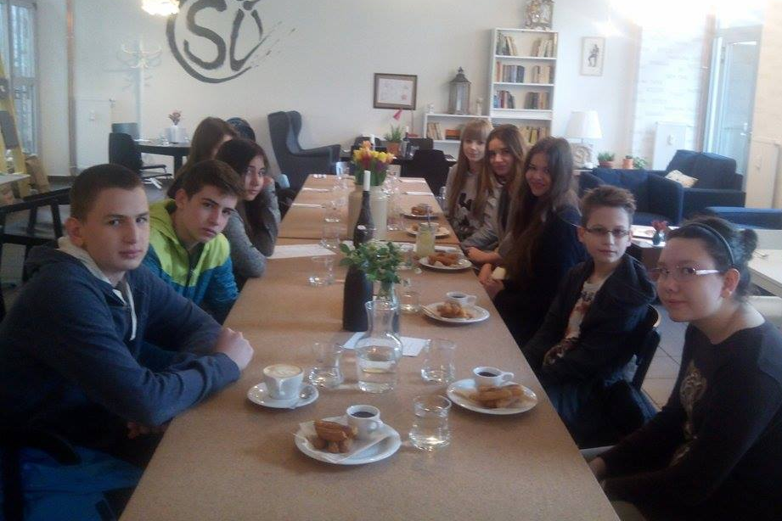
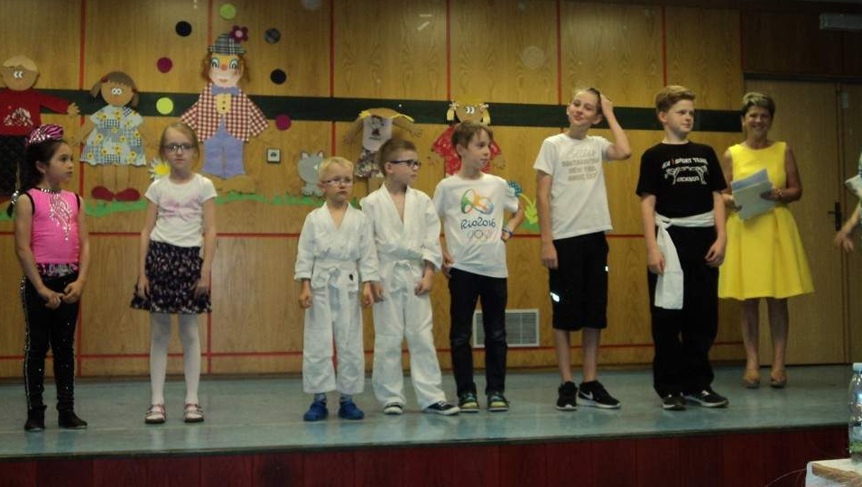
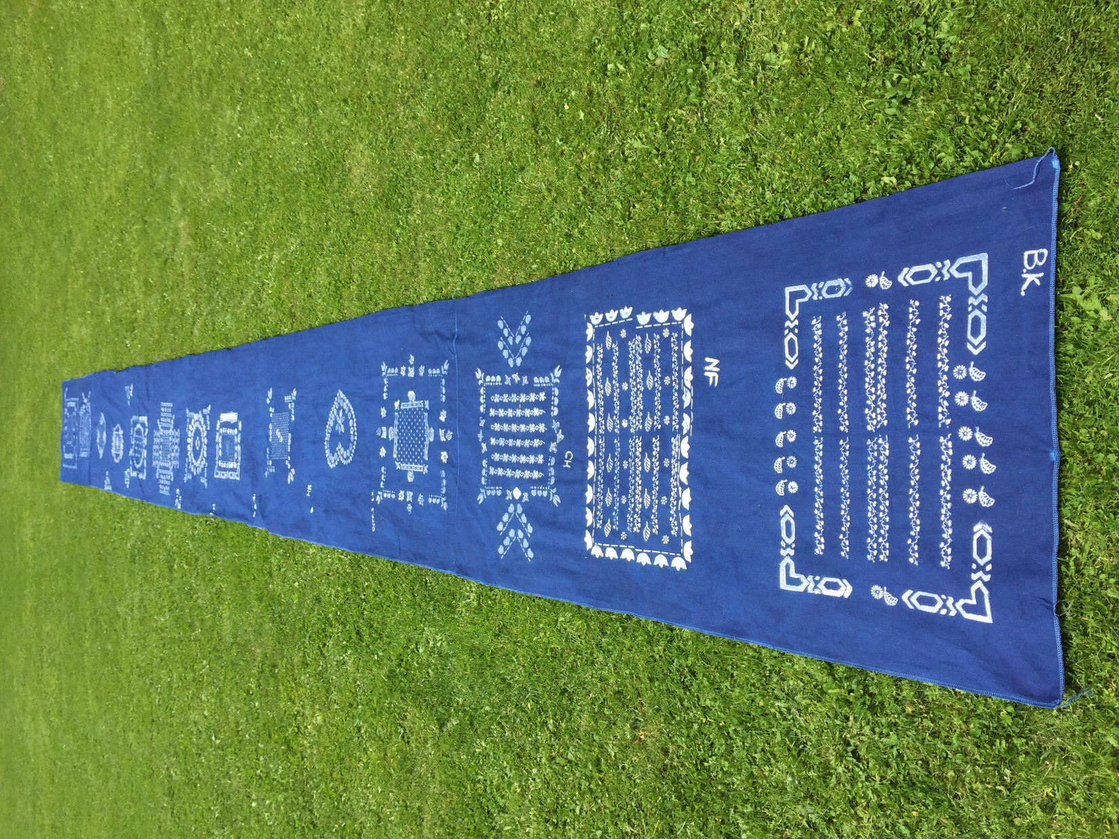
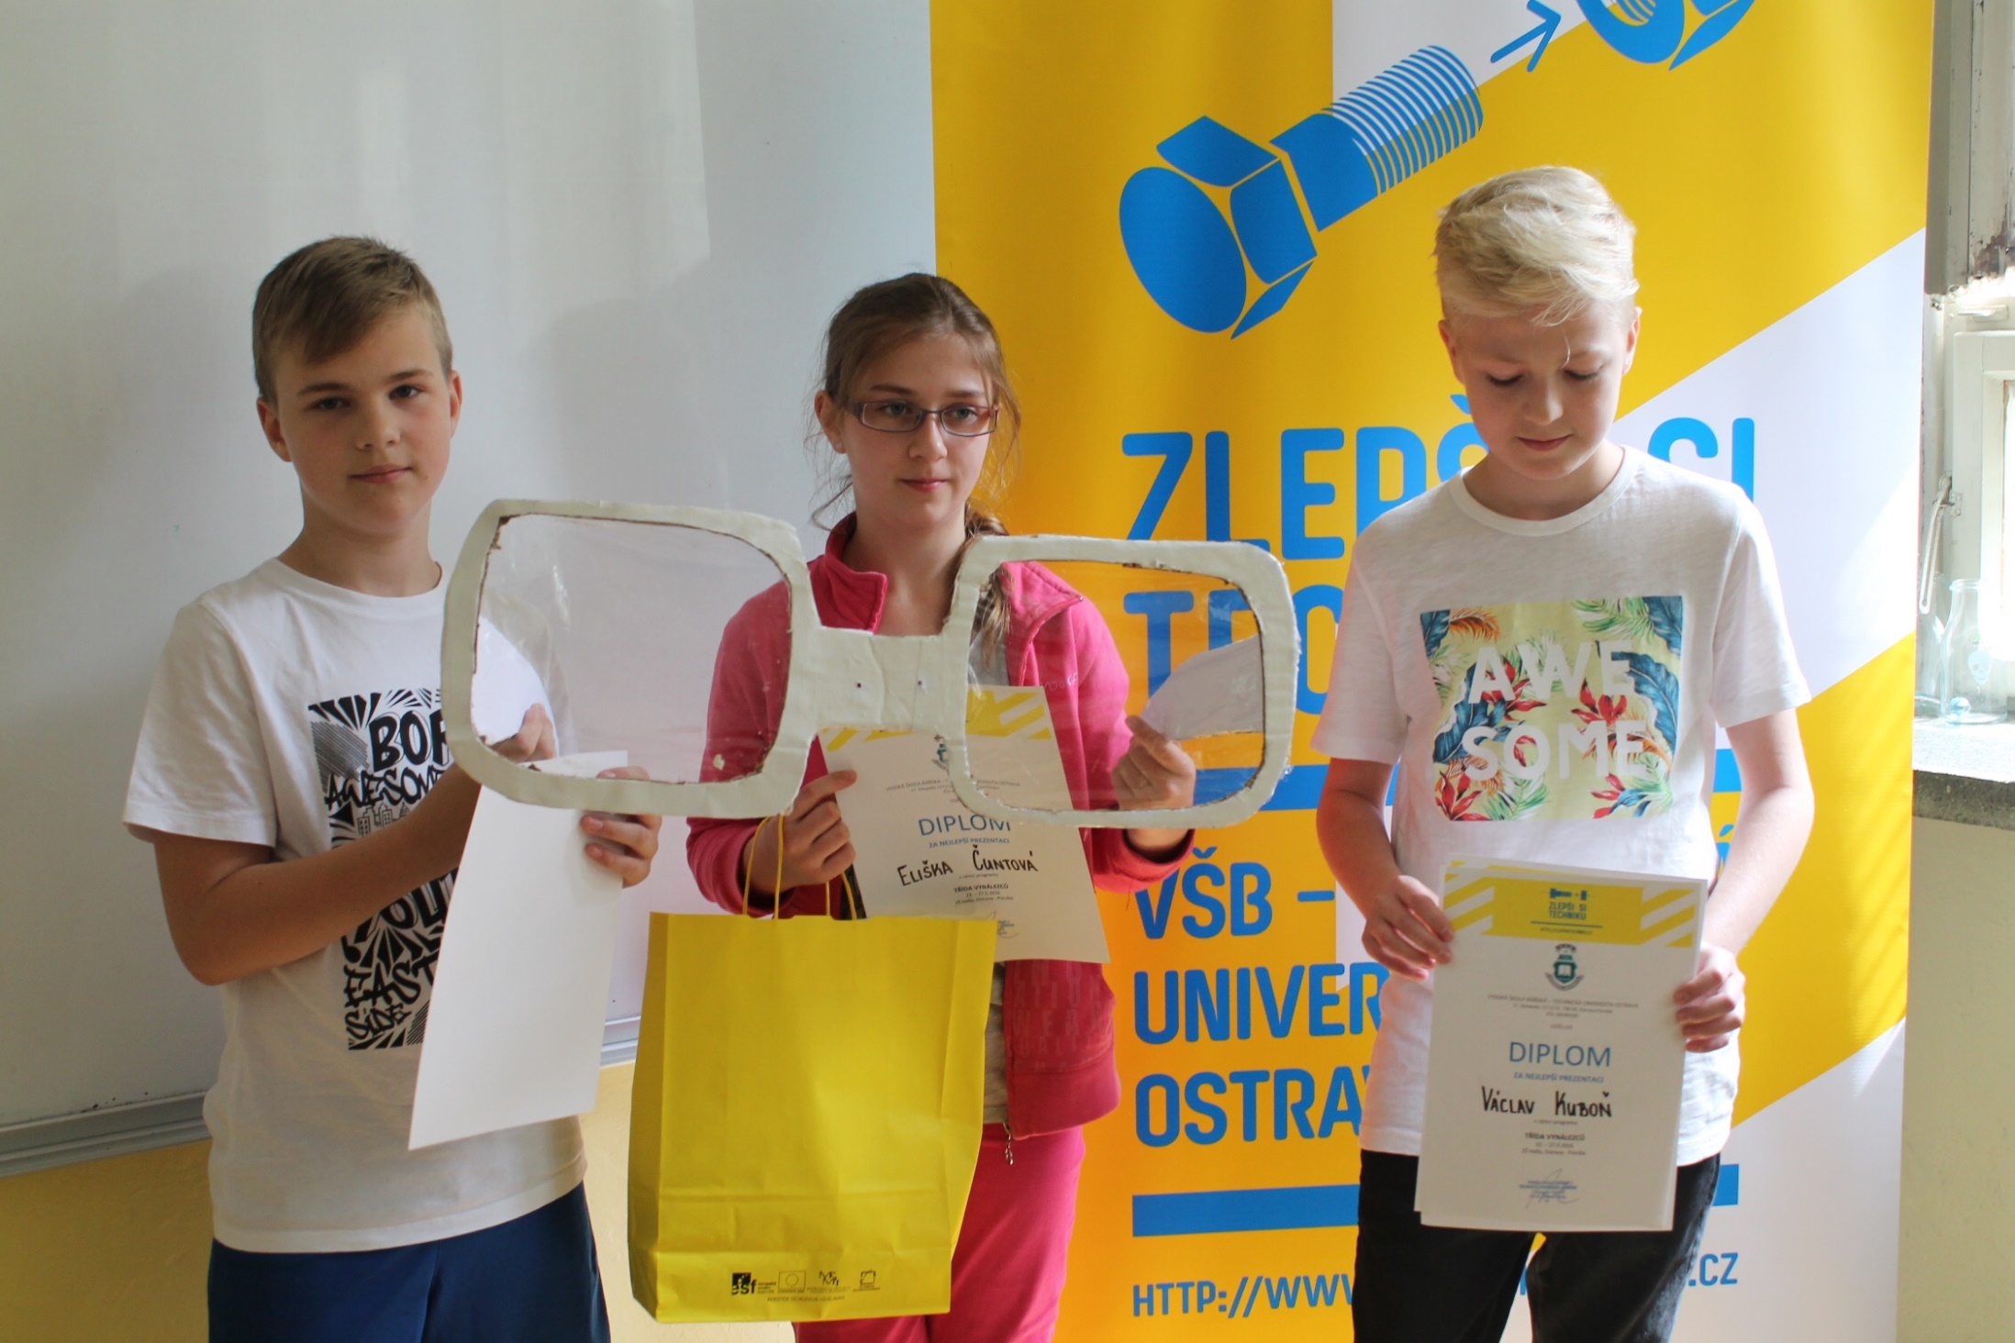
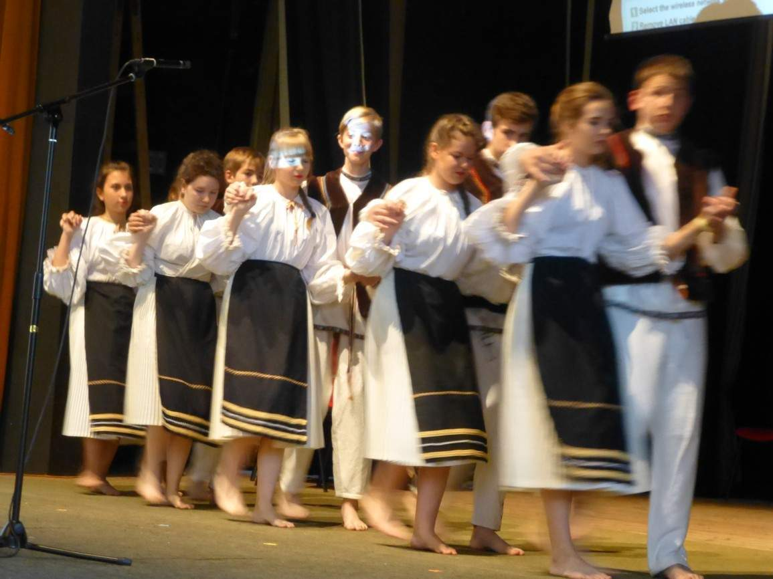
School activities, events and competitions
April: blueprinting workshop
May: Spanish day
June: Hello talent
May: week of inventors
June: Final year performance

Slide 10
Our team
Only girls
13-14
All live in Ostrava city
3 pet lovers + 2 dancers
Don´t like physics
Spanish - 2nd lang.

Slide 11
THANK YOU FOR ATTENTION

