Slide 1
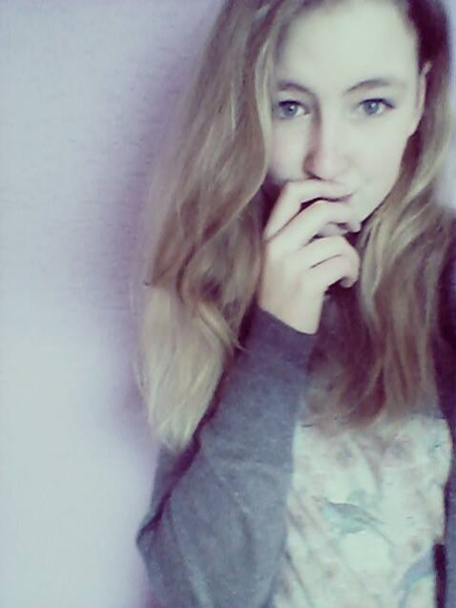
Hi, I´m Maja! I´m 14, I´m crazy, but a little bit shy.
I like dancing, rollerblading, skiing, drawing, playing volleyball and listening to music. I can eat everything and I love kofola :33

