Slide 1
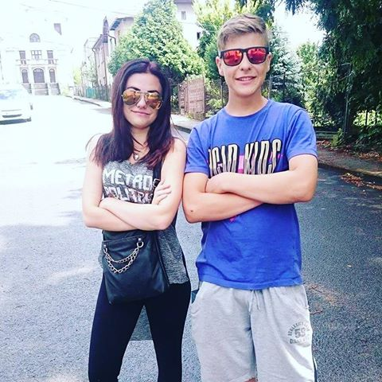
Klučinec Jan Josef

Slide 2
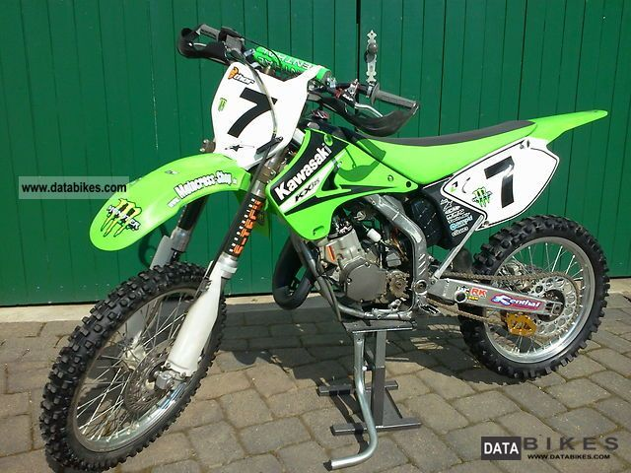
Hello im John im 13 years old i like ride on my motocross bike or do fight.
I have 2 dogs and lizards.

