Slide 1
My name‘s Alex And i welcome you to my presentation
Hi

Slide 2
My full name is Alexej Beňuš. I‘m 13 years old I live in house in Návsí. I have 1 sister and 1 brother. I like riding a bike or playing pc games but i don‘t like skiing and football… My elementary school is MZŠ Návsí.
Something about me…

Slide 3
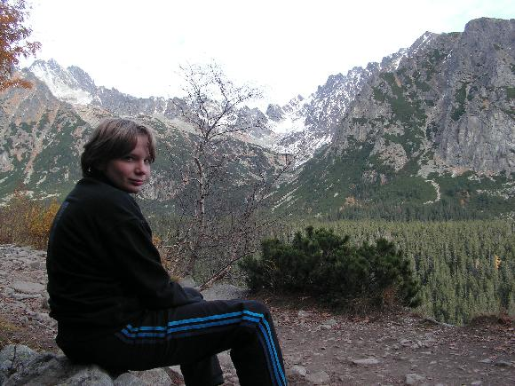
And that‘s how i look:

Slide 4
Thanks for watching… I hope that you enjoyed!
…I know that you didn‘t…

