Slide 1
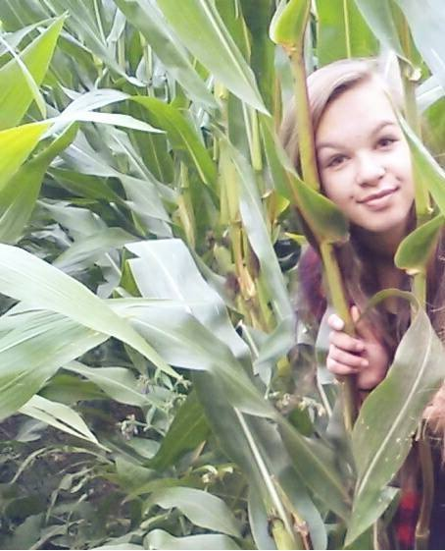
Hello, my name is Katka. I am 14 years old. My hobbies are longboarding, dancing and singing. I love music and my friends. I have one older brother.

