Slide 1
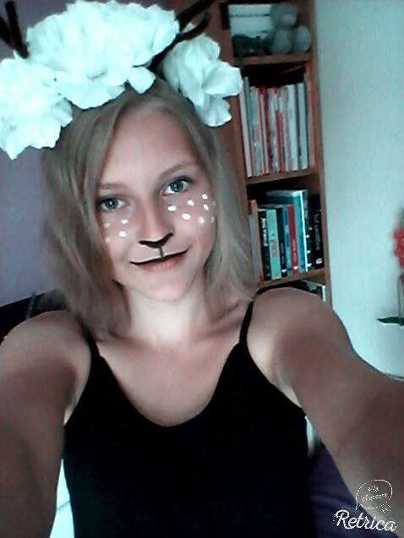
Hi, I´m Aneta! :D I´m 14 years old. I´m very funny (propably) and crazy. I love drawing, singing in the car, dancing, reading, rollerblading and sports. I love listening to music. I often listen EDM, sometimes rock and rap. In future I would like to travel to other countries.

