Slide 1
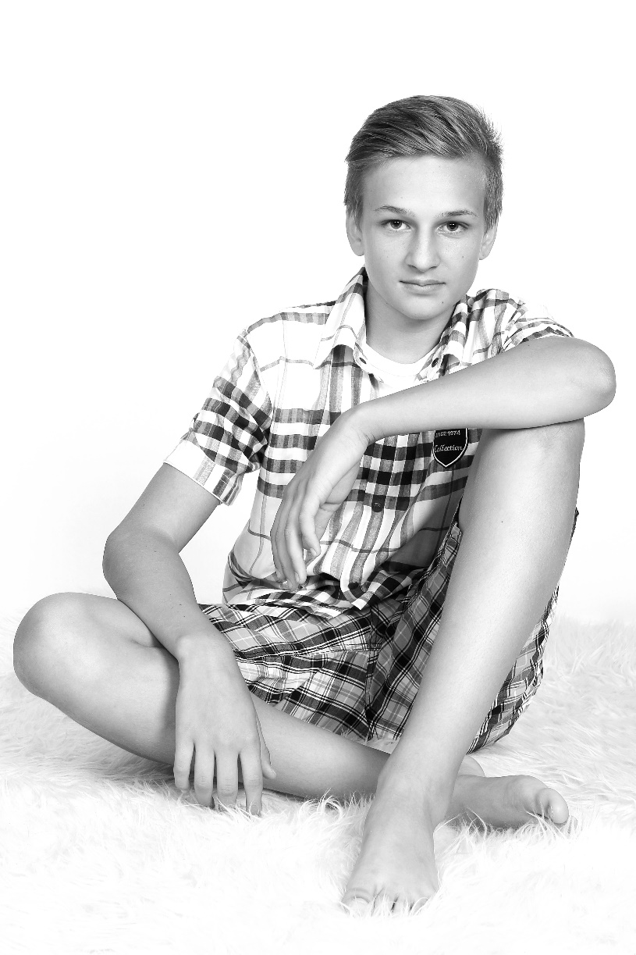
Vojtěch Bulava
I´m 14 years old
My favorite hobbies are fishing, volleyball and football

