Slide 1
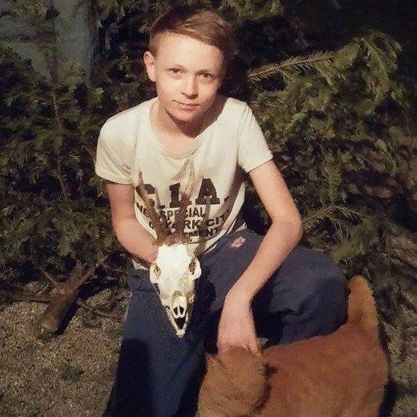
I am Pavel Sztefek, I am 14 years old, my hobbies are rollerblading, playing PC games and watching films. I have two sisters who are older nine and ten years.

