Slide 1
QUIZ
Wooden objects
Click on the correct photo.

Slide 2
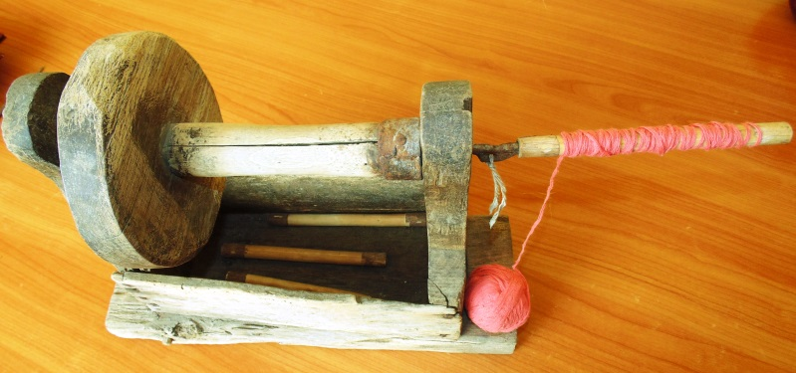
QUESTION 1
I am a wooden reel.
A.
B.

Slide 3
Well done! Let’s move on to the
next question

Slide 4
Ooops! That’s wrong! Try again?
YES NO

Slide 5
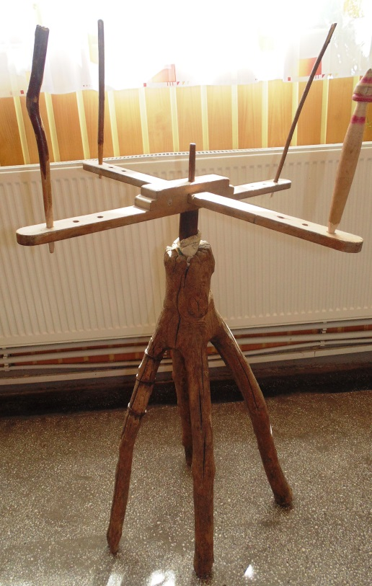
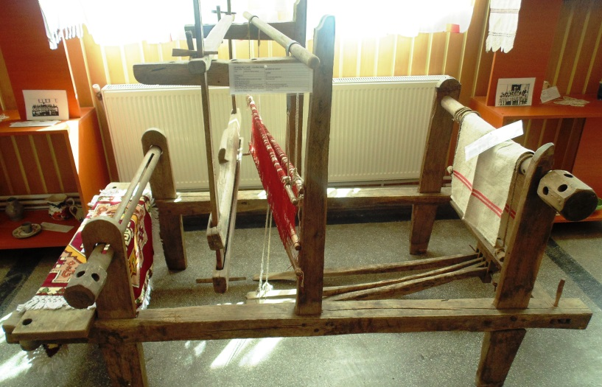
QUESTION 2
I am a LOOM.
A.
B.

Slide 6
Well done! Let’s move on to the
next question

Slide 7
Ooops! That’s wrong! Try again?
YES NO

Slide 8
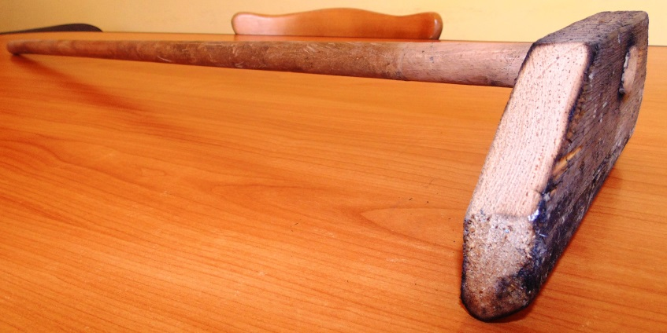
QUESTION 3
I am a SPINDLE.
A.
B.

Slide 9
Well done! Let’s move on to the
next question

Slide 10
Ooops! That’s wrong! Try again?
YES NO

Slide 11
QUESTION 4
I am AN ALPHORN.
A.
B.

Slide 12
Well done! Let’s move on to the
next question

Slide 13
Ooops! That’s wrong! Try again?
YES NO

Slide 14
QUESTION 5
I am a Spinning wheel.
A.
B.

Slide 15
Well done! Let’s move on to the
next question

Slide 16
Ooops! That’s wrong! Try again?
YES NO

Slide 17
QUESTION 6
I am a WOODEN SHUTTLE.
A.
B.

Slide 18
Well done! GOOD BYE!!!

Slide 19
Ooops! That’s wrong! Try again?
YES NO

Slide 20
THANK YOU!
Hope you enjoyed the quiz!

