Slide 1
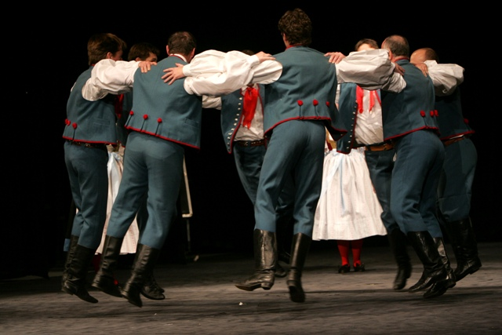
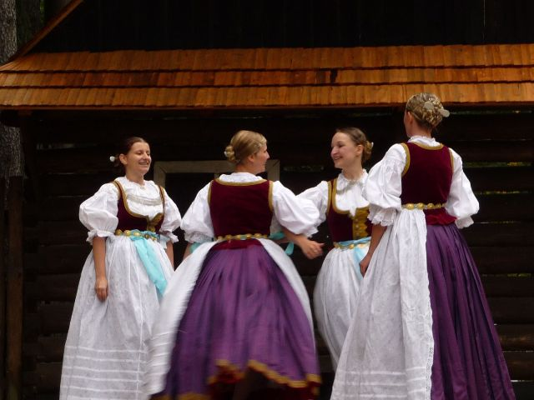
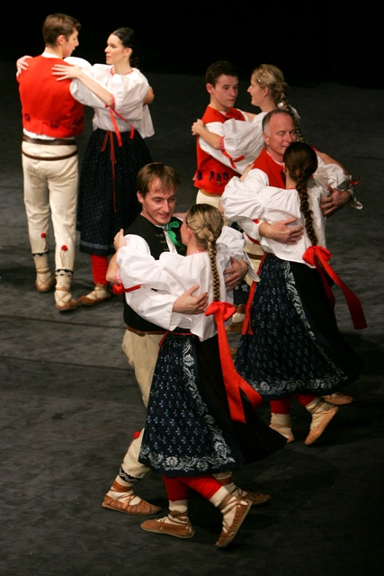
Collection of traditional dances
Simona Hermanová, Ivana Krnošová

Slide 2
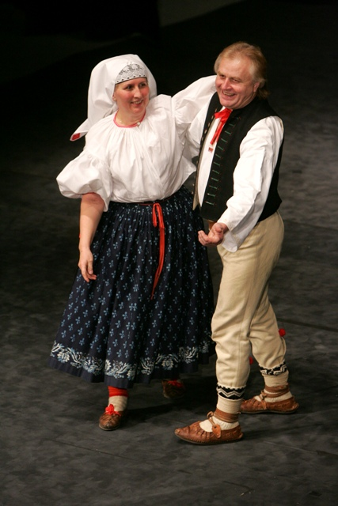
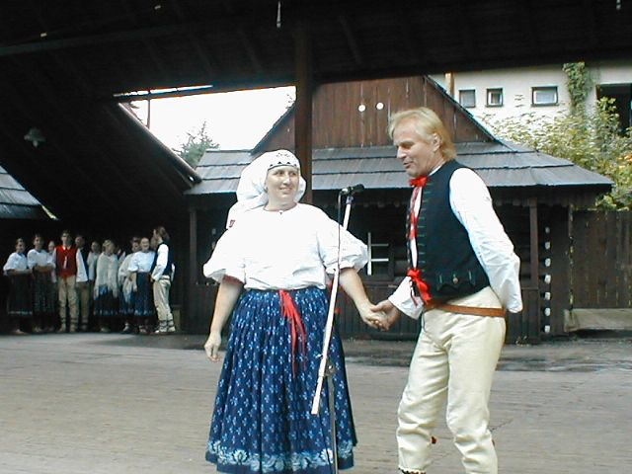
„OVĚNŽOK“
•Typical rotary dance goral (from the mountainous areas Jablunkov)
•Authentic dance from Hrčava for one or three pairs

Slide 3
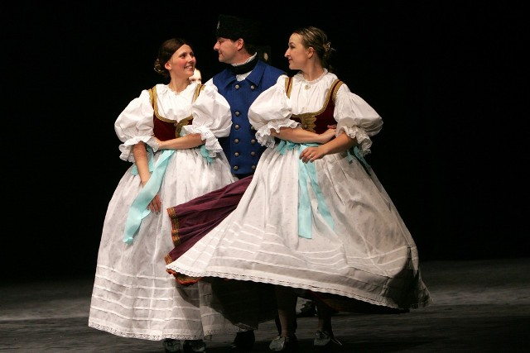
„POŽEGNANY”
Figural dance for one dancer and two dancers

Slide 4
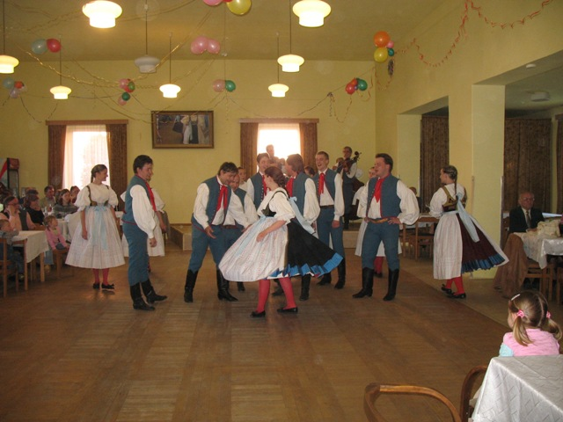
„ŠUSTKA”
Polka for several pairs

Slide 5
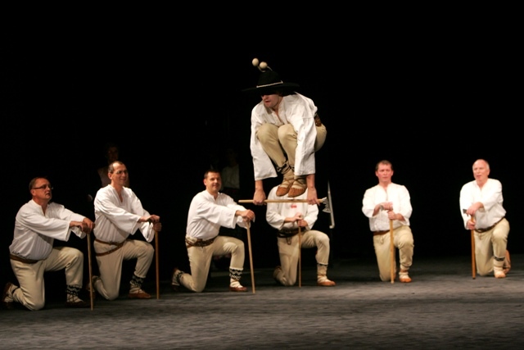
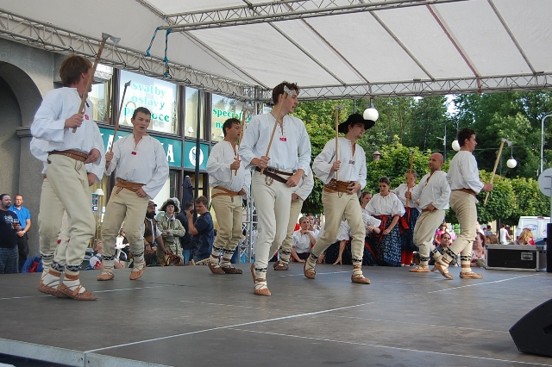
„ONDRÁŠ”
Bandit male dance

Slide 6
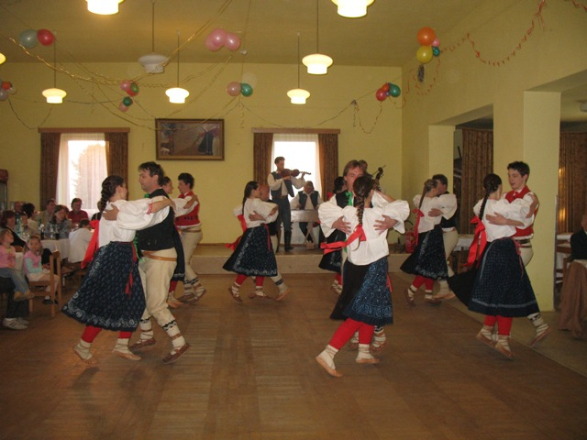
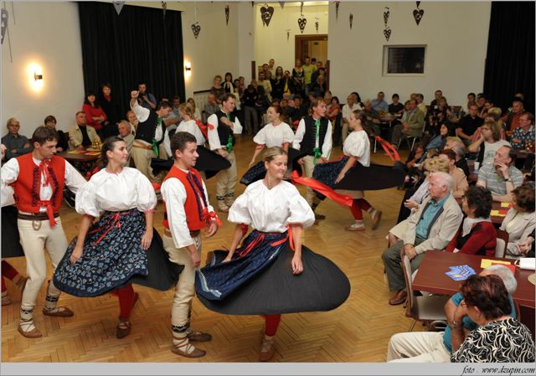
„LITERY”
Figural dance for several couples

Slide 7
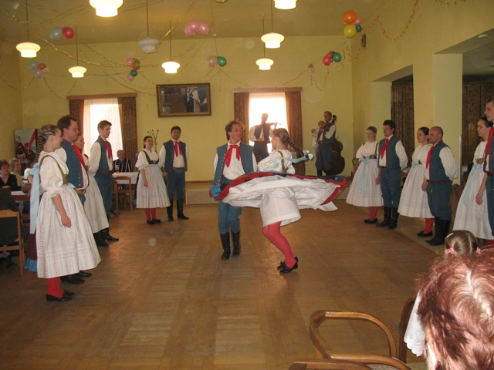
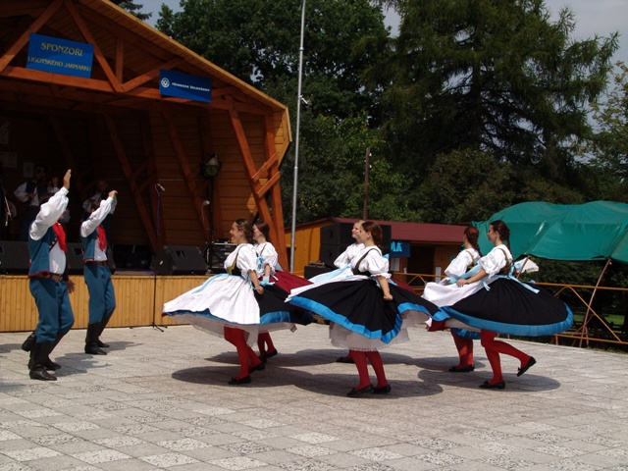
„KOŁOMAJKI”
Polka dance figural type for more pairs

Slide 8
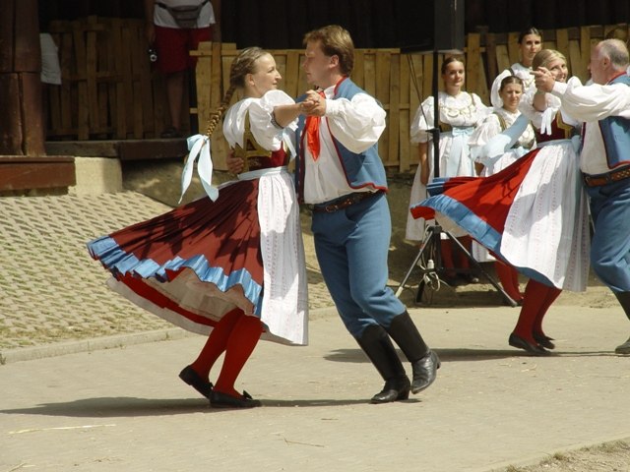
Thank you for your attention!

