Slide 1
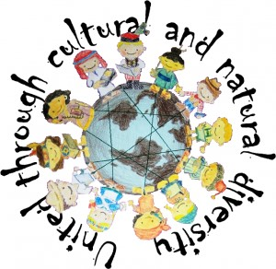
Songs and dances
Presentation including samples of songs and dances performed by participants of project United through cultural and natural diversities
2015-1-HR01-KA219-013057_5

Slide 2
Task no. 1A – SONGS
In your group, read the english translation of one song and find out whether there is mentioned one of the topics listed bellow.
Specific location or place
God
Love or related areas like wedding or break up
Death
Parts of body
Musical instruments
Living in the village
Seasons of the year

Slide 3
Slovak song – translated by school from Humenné
Cherry tree author: unknown
Cherry tree, hey green cherry tree,
Who´s bride I am going to be, oh my God.
Standing on the rock, I wanted to kill myself.
But I was sorry to leave my boyfriend here alone.
I was rushing with love, now I am sorry for that.
So much sorry that I have a headache.

Slide 4
Czech song I – translated by school from Návsí
Pod češinskim mostym Autor: neznámý
Pod češinskim mostym čeče voda skokym nimožym jum zastavič. Mjala žech milego, rozgňyvala žech go, nimožym go udobřič, udobřič.
A jo za nim pujdym a go prošič bedym by se na mě něgňyvol, že je me serdečko zarmucune všecko, aby mi go rozebrol.
Švjyčilo slunečko, v moje okjynečko, o pulnocy měšunček. Ej, zaros mi, zaros čyrnim a bodlačim ku mej milej chodniček.
Under Těšin´s bridge Author: unknown
Under Těšín bridge water flows fast, I can´t stop it
I had a boyfriend but I made him angry
I can´t reconcile him.
I will go to him and I will beg him that he will not be angry. That is my heart, saddened, that he will dismantle.
Sun was shining to my window, moon in the middle of the night. Ej, become overgrown, become overgrown, thorns and thistles footway to my dear.

Slide 5
Czech song II – translated by school from Ostrava
Beskydy mountains Author: unknown
Beskydy mountains, who’s going up on you,
black-eyed shepherd, he’s leading the sheep.
Ayy shepherd, our shepherd you’ve got a black shirt. Who’s going to wash it up, when you’ve got no mummy.
I have got no mummy, but I have a girlfriend,
She will wash the black shirt for me
She’s going to wash it, and she’s going to iron it
When I will go dancing, everyone will praise it

Slide 6
Romanian song – translated by school from Sincel
Hora Unirii
Author: Vasile Alecsandri
Hai să dăm mână cu mână Cei cu inima română, Sa-nvârtim hora frăției Pe pământul României!
Iarba rea din holde piară! Piară dușmănia-n țară! Între noi să nu mai fie Decât flori și omenie!
Măi muntene, măi vecine, Vino să te prinzi cu mine Și la viață cu unire Și la moarte cu-nfrățire!
Unde-i unul nu-i putere La nevoi și la durere, Unde-s doi puterea crește, Și dușmanul nu sporește!
The dance of Unity
Author: Vasile Alecsandri
Let's join hands,
Those with Romanian hearts Let’s go round the dance of brotherhood On Romanian land!
May the bad seed disappear
May the enmity in the country be gone
Let there only be Flowers and kindness among us!
Hey mountaineer, hey neighbor
Come join me In unity through life
And in brotherhood through death!
A single man is weak During sorrows and pains Where there are more The enemy can't overcome!

Slide 7
Croatian song – translated by Skola Odra
Posavina Author: unknown
I am a child of Posavina, too
a Posavina girl from head to toe.
Oh you shiny starts in the sky,
Greet your sweet little child.
Many villages near sava you can see,
but none is like the one from which we are.

Slide 8
Polish song – translated by school from Boleslawiec
4 miles from Oława
Author: unknown
Four miles from Oława, hey duli duli dum dum dum a sparrow married a jackdaw, hey duli duli dum dum dum/
They invited every bird, hey duli duli… only an owl they’ve forgot, hey duli duli … / 2x
When the owl found out about it, hey duli duli… she arrived to wedding party, hey duli duli…/ 2x
The sparrow invited her to the dance, hey duli duli… He trod on her hurted toe, hey duli duli…/ 2x
You, cheecky sparrow, hey duli duli… don’t tread on my hurted toe, hey duli duli…/ 2x
You uninvited owl, hey duli duli… better stay with your hurted toe at home, hey duli duli…/ 2x

Slide 9
Task no. 1B – SONGS
Discuss your findings with other groups, compare results.
Have you found any other common signs for all traditional songs? (e.g. animals or clothes are often mentioned…)
Remind traditional folk songs from your country/region. Are there mentioned similiar topics?
Are all the submitted songs really traditional folk songs? What is one of the important signs you have to take into account when judging this?
Can you summarize what are main charakteristics of traditional folk songs?

Slide 10
Task no.2A – MUSICAL INSTRUMENTS
Listen to the samples of music.
What musical instruments can you hear?
Make a notes.
POLAND
SLOVAKIA
ROMANIA
CROATIA
CZECH REPUBLIC

Slide 11
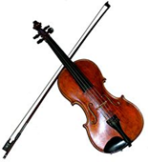
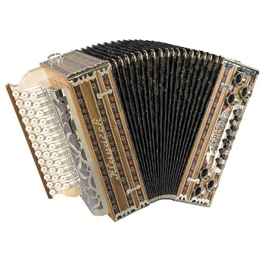
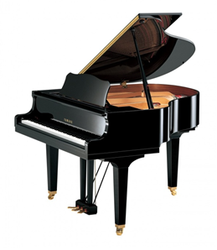
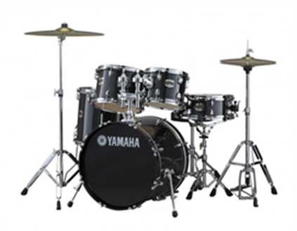
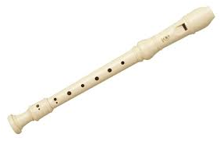
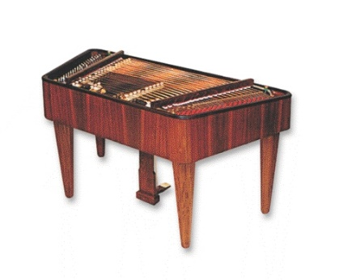
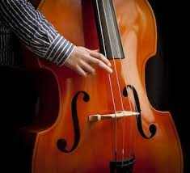
Task no.2B – MUSICAL INSTRUMENTS
2
3
1
Which of these instruments are not typical for traditional folk music? Why?
Match pictures with its names:
6
4
5
Contrabass
Violin
Drums
Flute
Accordion
Electric quitar
Piano
Dulcimer
7
8

Slide 12
Task 3A - DANCES
Watch samples of the dances from different countries.
Try to find out charakteristics for folk dance. To be noticed:
the way of holding
formation (dancing in couples x in a circle)
choreography (dance figures and its repetion, story acting, using properties etc.)
Based upon seen dances and your previous knowledge – can you make conclusion regarding the biggest difference between dances typical for south european nations and central european nations?
POLKA_CZECH REPUBLIC
SLOVAKIA
ROMANIA
CROATIA
POLAND

Slide 13
Task 3B - MUSIC
Listen to the songs again and focus on the rhythm this time. Do you think it is possible to define typical rhythm for traditional folk songs? Look at the music records if necessary and consider bigger sample if needed. If there is not a typical one, can we say which one is most common one?

Slide 14
Task 4 - optional
Some famous composers got inspired by folk songs. Bedřich Smetana and Leoš Janáček from Czech Republic belongs to them. Their operas are well known worldwide. See the video from „Prodaná nevěsta“ (Sold Bride). The song is called „Proč bychom se netěšili“ (Why not to rejoice). Enjoy its dynamics, try to dance if you like.
Do you know any composers (or writers) from your country that also got inspired by folk songs?

