Slide 1
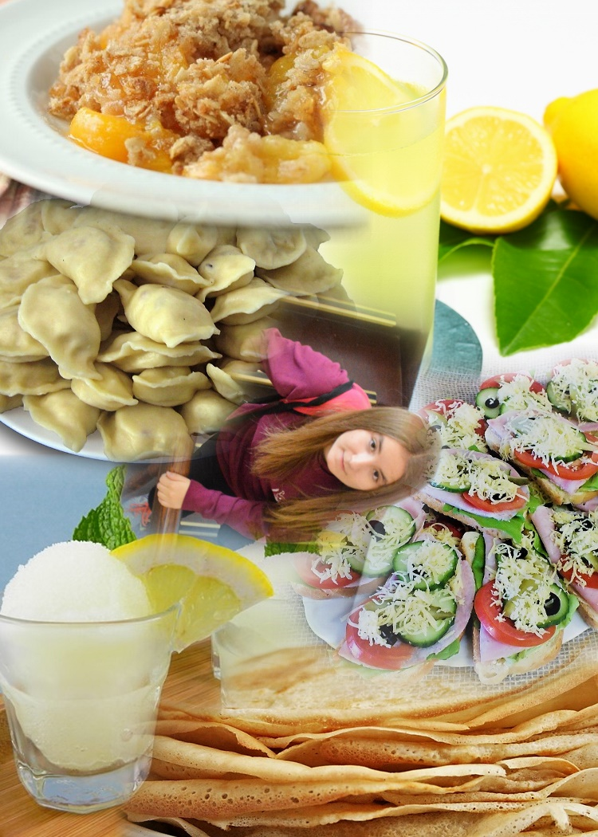
My recipes
by Oliwia

Slide 2
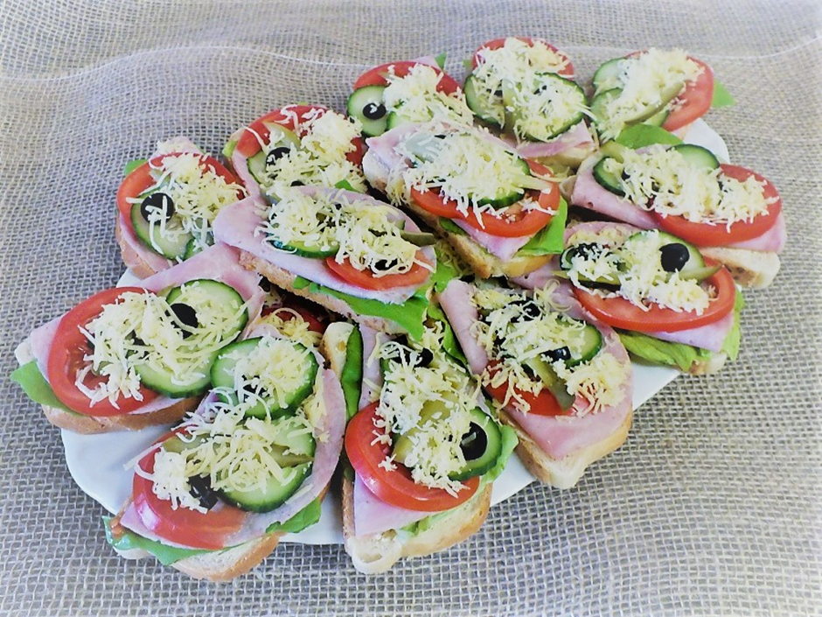
Kanapki
bread or roll
butter
cold cuts
cheese
tomatoe / cucumber
lettuce
Cut the bread / cut the roll in half, spread some butter on every piece. Put a leave of lettuce on your bread, then put some cheese and cold cuts on. Slice and add the cucumber or tomatoe, sprinkle the chive on the top add salt and pepper to taste.
Kanapki are commonly used for breakfast, lunch, and supper in Poland, and they may be composed of different kinds of cheese, meat, and vegetables depending from individual tastes.
Kanapki derive from a the Middle Ages, when people used a thick slice of bread as a plate.

Slide 3
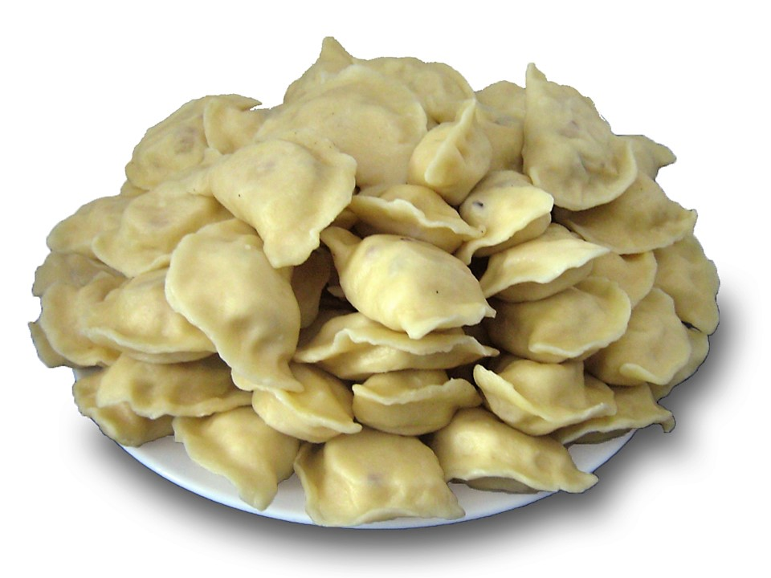

Slide 4
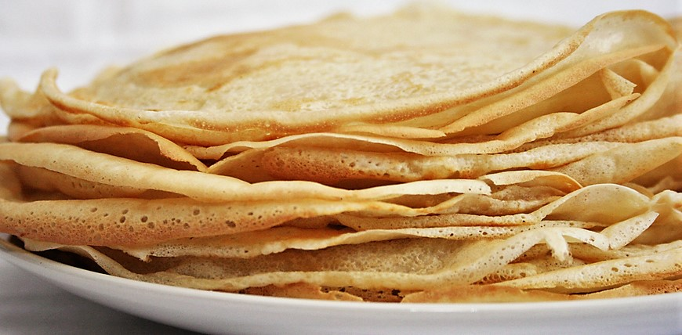

Slide 5
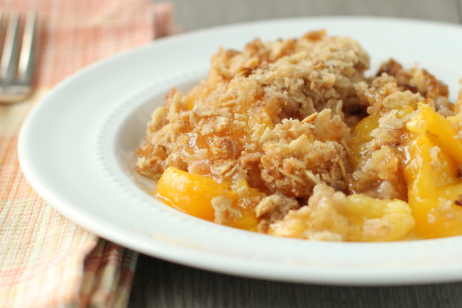

Slide 6
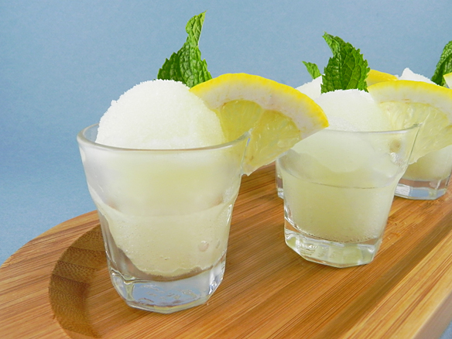

Slide 7


