Slide 1
Heat transfer mechanisms
How can we keep our drink hot for a longer period of time?

Slide 2
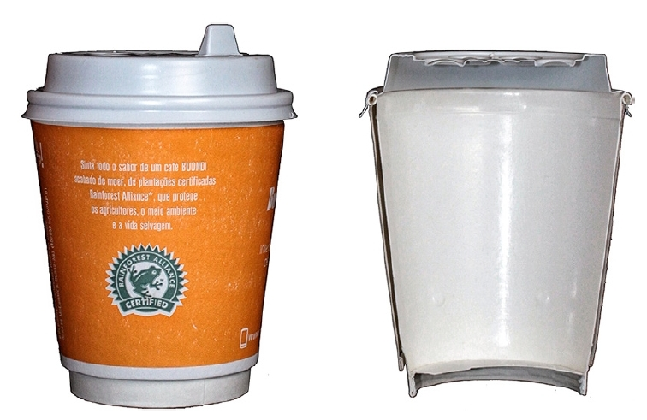
Double-wall paper cup

Slide 3
Testing the heat transfer mechanisms
Control Conduction Convection Radiation

Slide 4
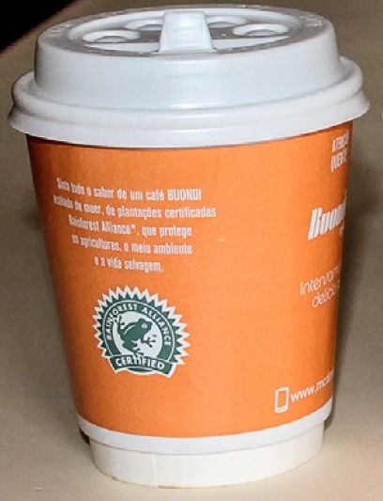
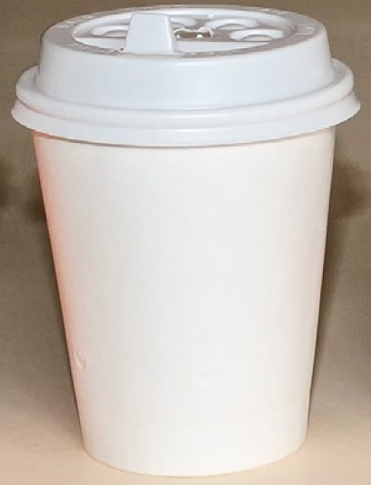
Conduction

Slide 5
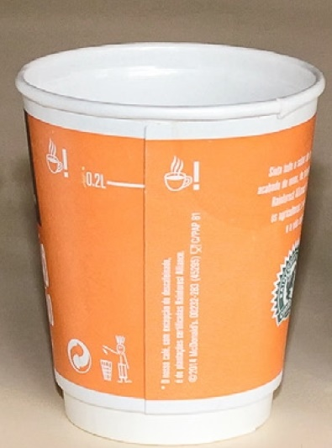
Convection

Slide 6
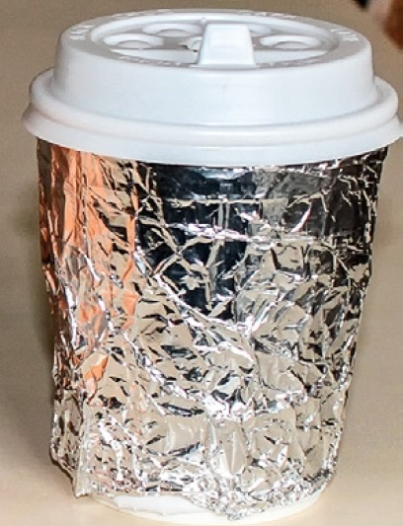
Radiation

Slide 7
The experimental set-up

Slide 8
Procedure
Each group has a control cup and a test cup.
First the control cup is filled with hot water and the thermometer is inserted through a hole in the lid until its tip reaches approximately the centre of the cup.
Once the water reaches a temperature of 85°C, measure the water’s temperature every minute for 20 minutes.

Slide 9
- Repeat the procedure with the test cup, using the same volume of hot water and the thermometer inserted in the same way as before.

