Slide 1
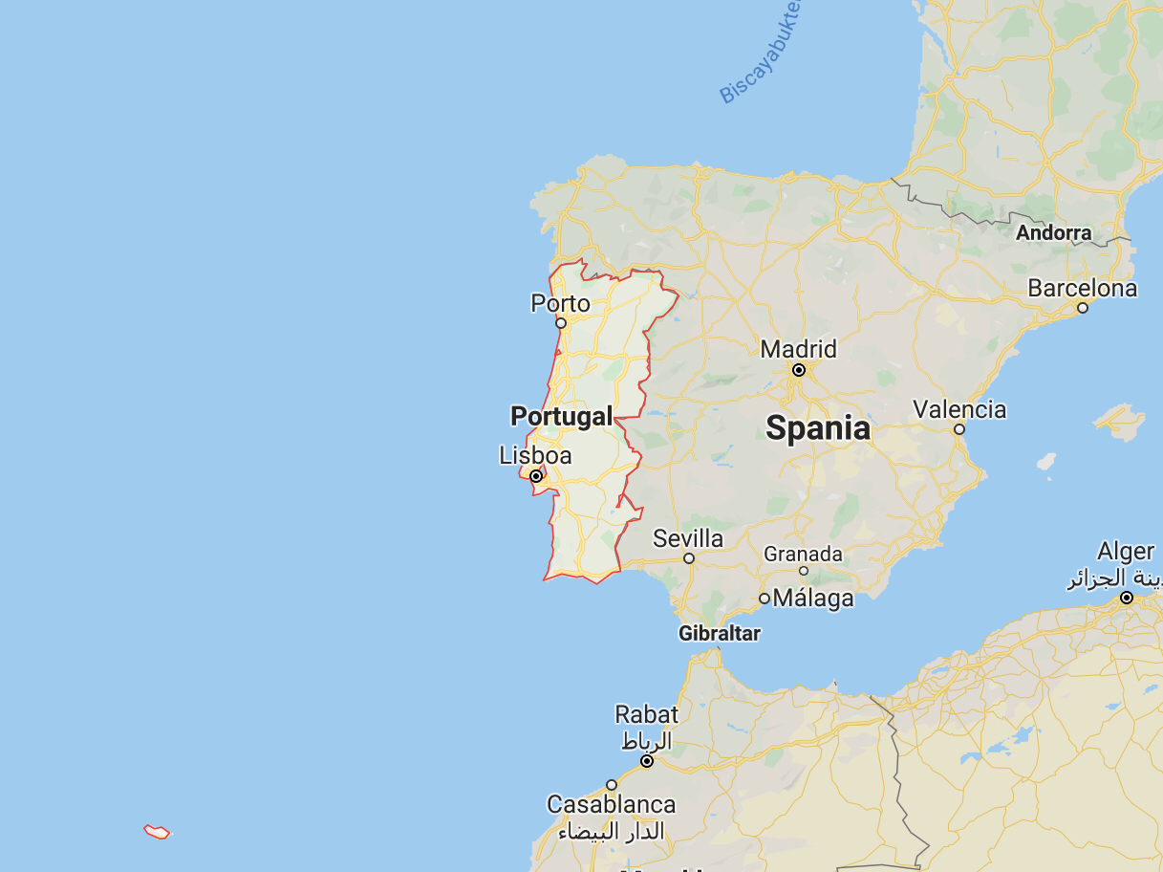
Portugal

Slide 2
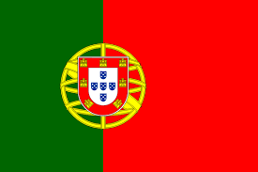
Previous knowledge about Portugal
The Iberian Peninsula
Relatively warm climate
Cristiano Ronaldo is Portuguese
Vasco da Gama
Notes:
We know that Portugal is located on the Iberian Peninsula
Portugal has a relatively warm climate
Cristiano Ronaldo is portuguese
Vasco da Gama was a famous explorer

Slide 3
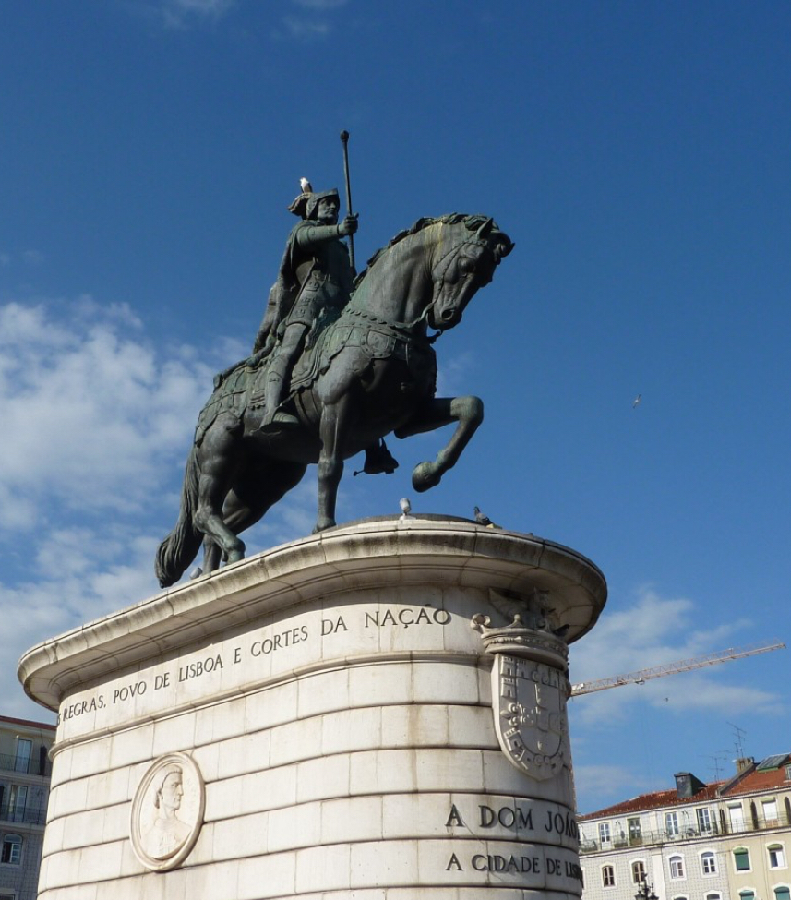
History
One of the first and biggest empires
Half of the new world
Oldest nation-state Europe
Lisbon earthquake
Notes:
Today im going to talk about the history of portugal! Before I start I want you to know that I am sorry if I mess something up. I dont really know much about the history of portugal but this is somethings i found. Portugal was one of the first global empires! And also one of the biggest empires. Half of the new world once belonged to portugal. Portugal is also the oldest nation-state in Europe. Lisbon was also hit by one of the most powerfull earthquakes in european history on the first of november 1755.

Slide 4
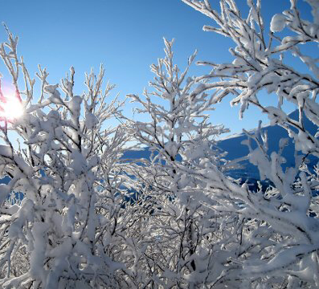
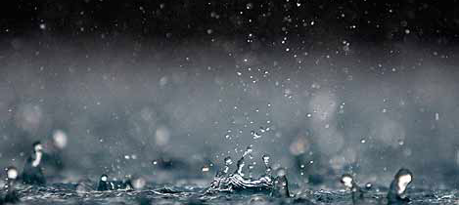
Weather and climate
January — March
April — June
July — September
October — December
Atlantic Ocean
Best time to travel
Notes:
I am going to talk about the climate and weather in Portugal. I am not an expert, but I have tried the best I can. So before I start, I’m sorry if my information is wrong. In January to March the average temperature is 17.0 degrees. from April to June the average temperature is 22.4 degrees. from July to September the average temperature is 27.3 degrees and from October to December the average temperature is 17.7 degrees. And I have to say, as a Norwegian girl, the weather here is amazing! In Norway right now it is about 0 degrees, which is a BIG difference. The climate is influenced by the Atlantic Ocean and from what I have read it is cool and rainy in the north and warmer and sunnier in the south. What comes up a lot when searching about the climate and weather in Portugal is what month is the best time to travel to Portugal, and it says the best time is May, June and September, so maybe I have to consider traveling to Portugal in September!

Slide 5
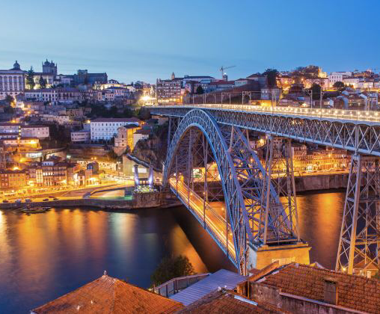
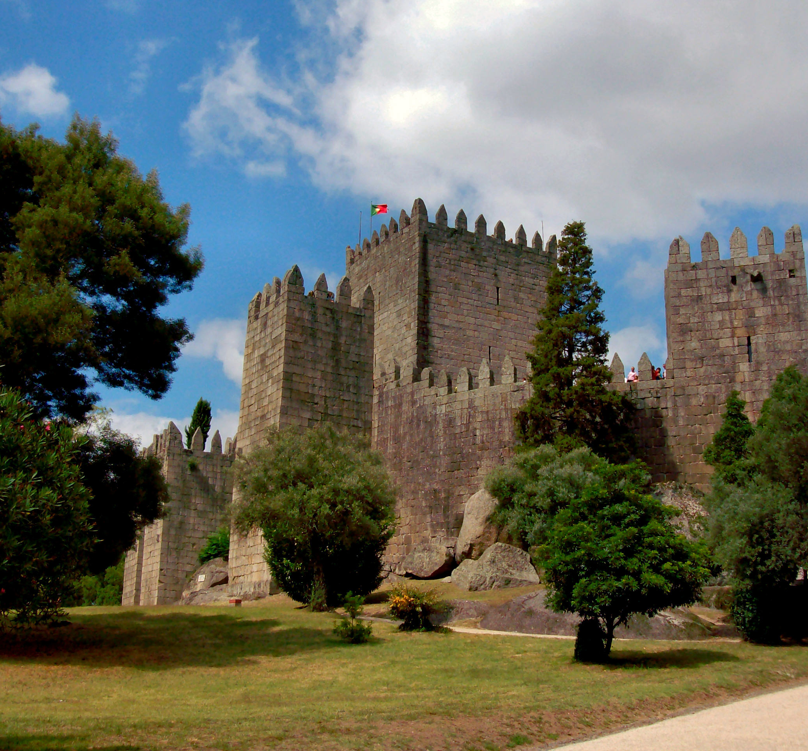
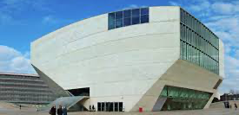
Tourist attractions
Castelo de Guimaraes
Casa de música
Dom Luís Bridge
Notes:
I am going to talk about.
Gastelo de Guimaraes is in the northern region of Portugal. It was built under the orders of Mumadone Dias in the 10th century to defend the monastery from attacks by Moors and Norsemen. Casa de mùsica was designed to mark the festive year of 2001. Dom Luìs I Bridge is a double deck metal arch bridge that spans the River Douro between cities of Porto and Vila Nova de Gaia.

Slide 6
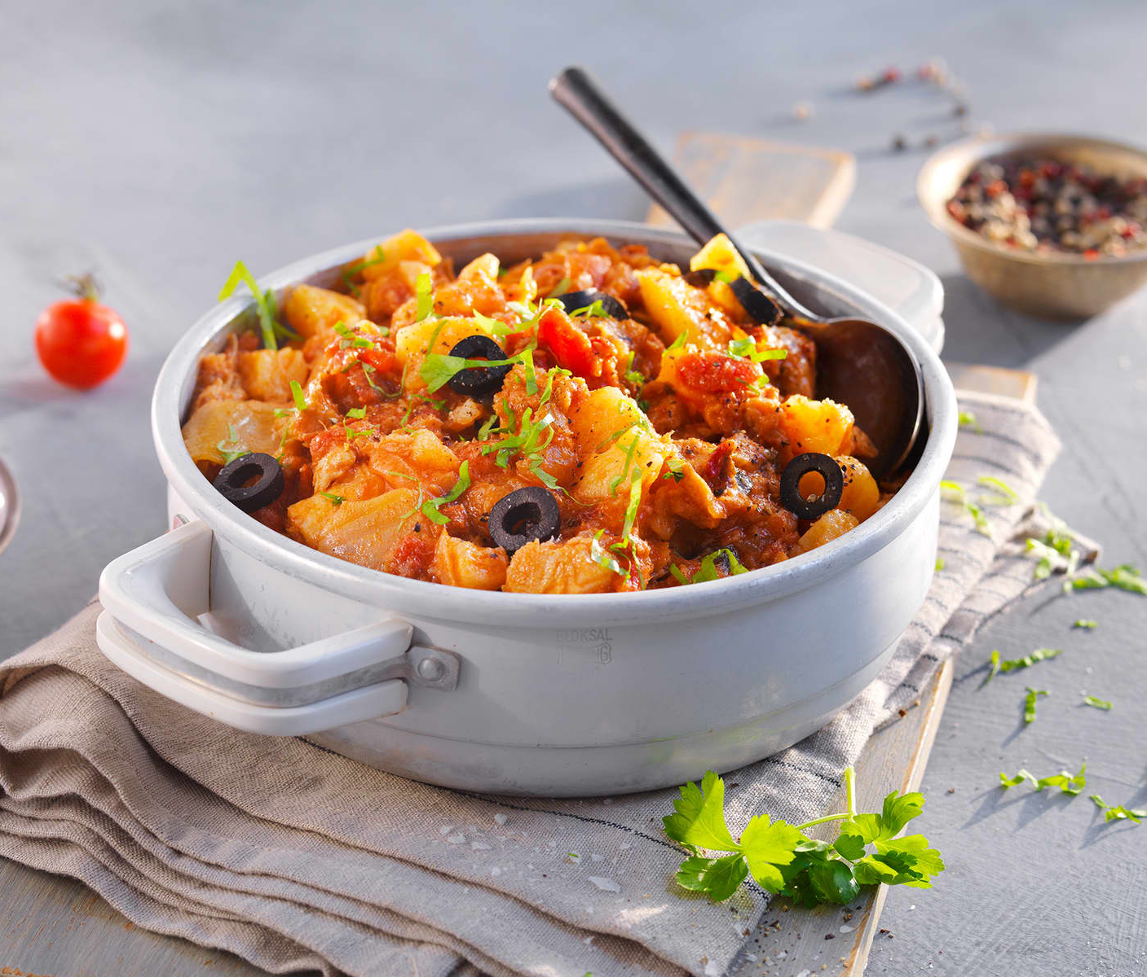
Food
Bacalao
Notes:
Bacalao is made from Norwegian Cod, one of the most abundant and sustainable stocks in the world.
To create bacalao, Norwegian Cod is gutted, cleaned, washed and skinned.
Originally, the fish were then flattened out and stacked-with layers of salt between each fish to aid the maturing process-to dry for over 2-3 weeks.
Today, the salted fish is left to dry indoors in special hot air dryers from February to April, but generations ago, the cod would have been left on rocks to dry naturally.
Salt quality directly impacts the quality of the bacalao. Therefore, Norwegians use only fresh, clean salt throughout the process. In fact, it is illegal to reuse salt once it has been used to make Bacalao.
Bacalao can also be made from frozen cod, allowing for year-round production.
To ensure consistent, high-quality bacalao is exported all over the world
Since the 18th century Norway has exported great amounts of salt cod and even before that stockfish (dry unsalted cod) was a major commodity from the time of the Vikings. Salt cod gained popularity in Catholic countries like Spain and Portugal as days of fasting required a meat-free diet, it was affordable food and extremely smart food as it defies the laws of decay.
Drying is one of the oldest methods of food conservation and results in a fish extremely rich in protein and with durability that makes it possible to be transported to the end of the world. Soaking the cod in water for a few days brings its freshness back as if it was just dragged off a fishing boat. This is the miracle of salt cod. It is a miracle fish but to us it has been more of an economic miracle than a gastronomical one.
he epicentre of salt cod production in Norway is the Northwestern region and two small towns, Kristiansund and Ålesund. From the onset people here had an entrepreneurial spirit and went north to participate at the biggest migration of cod in Norway, the Lofotfiske. They sailed home to the Northwest coast in their small boats filled with salt cod.
The sociologist Eilert Sundt described in the19th century fishers from the Northwest coast as frugal. Whereas fishers from the north would feast on the best parts of the cod once home, north westerners would only allow themselves to eat the cod’s head. The would not eat money! The rest of the fish they would salt and dry. Traditionally salt cod was laid out to dry along the seashore, a laborious method that now is replaced by indoor halls. Still, making salt cod requires the skills and love of an artisan.

