Slide 1
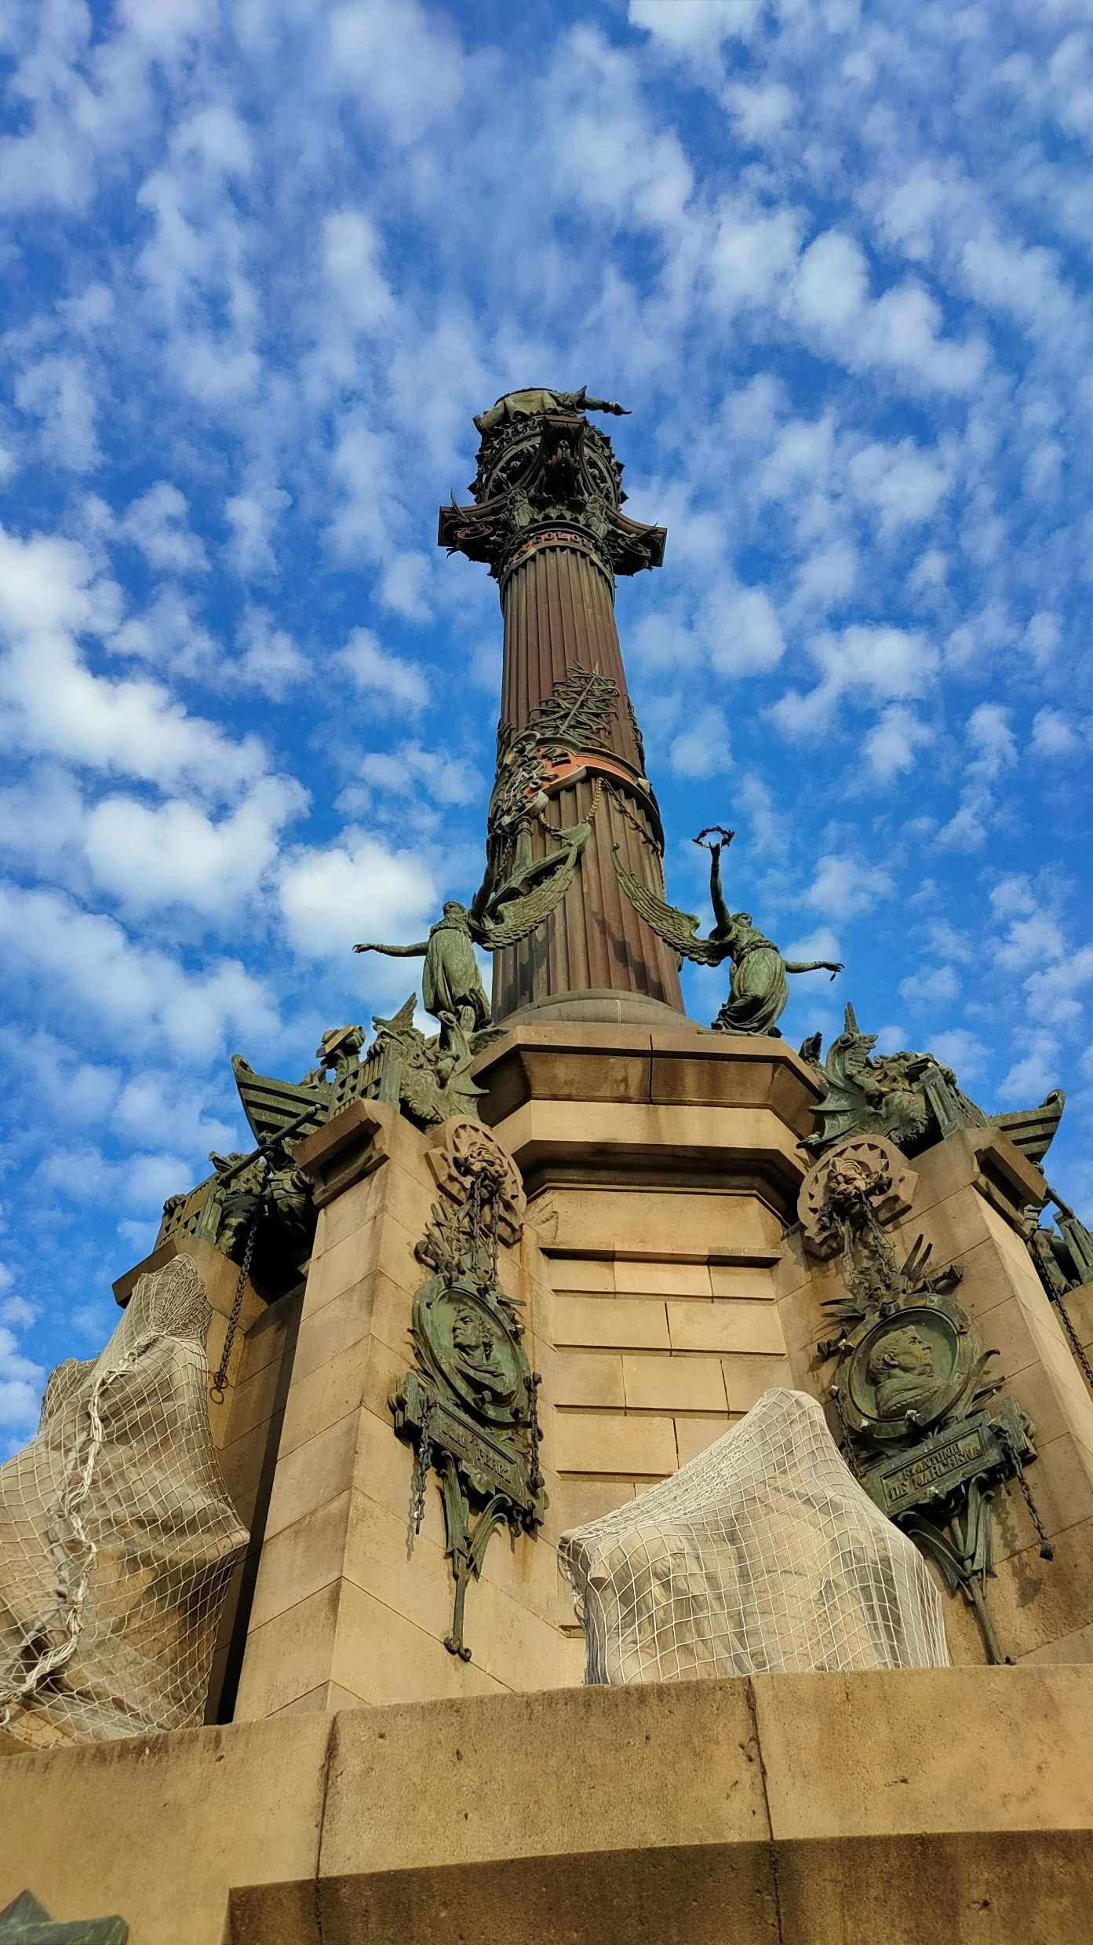
the Columbus monument in barcelona
Revisions of the past

Slide 2
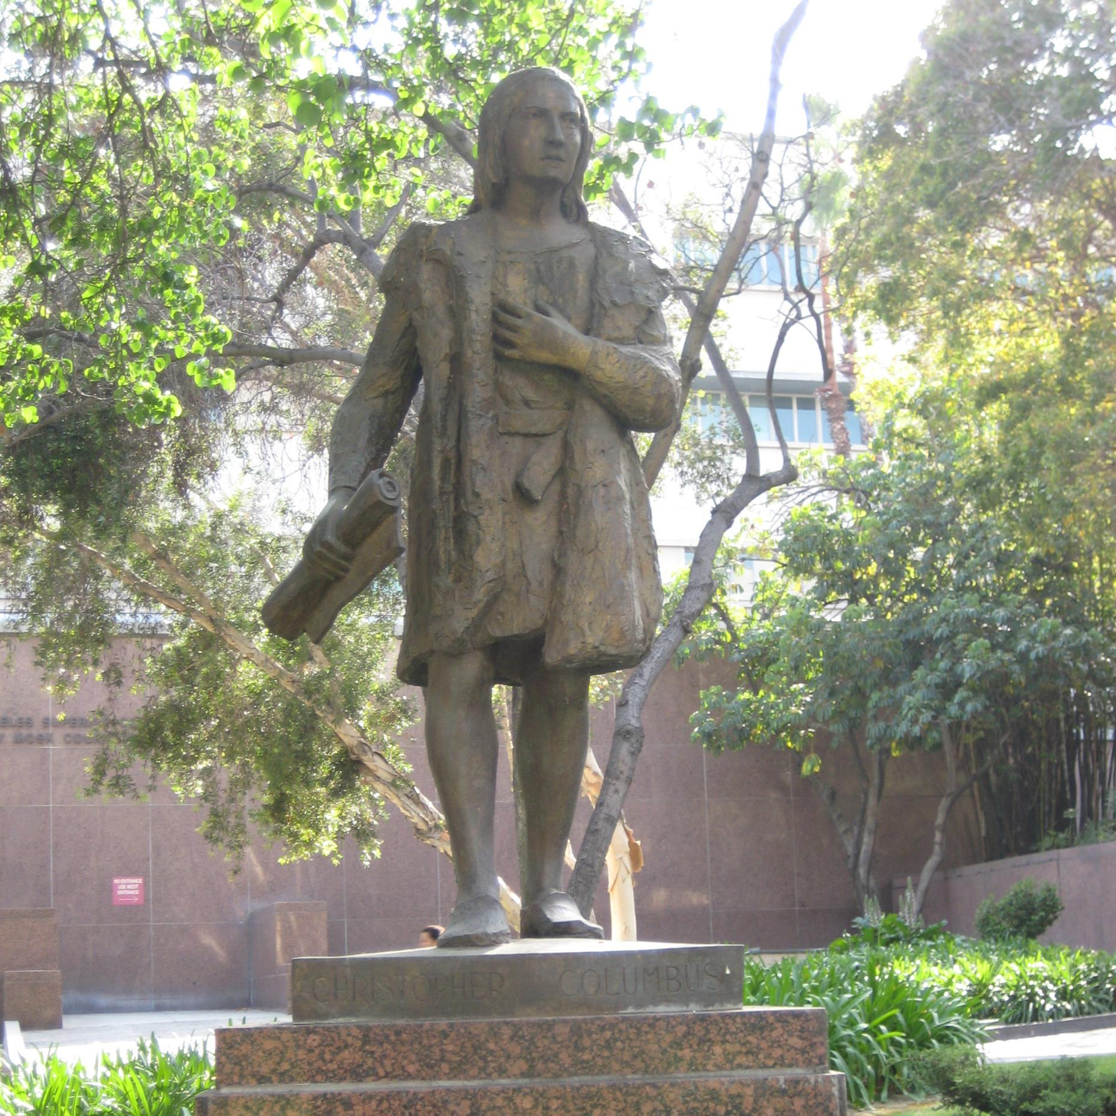
The Columbus monument in Los Ángeles
F. Perotti (1973)

Slide 3
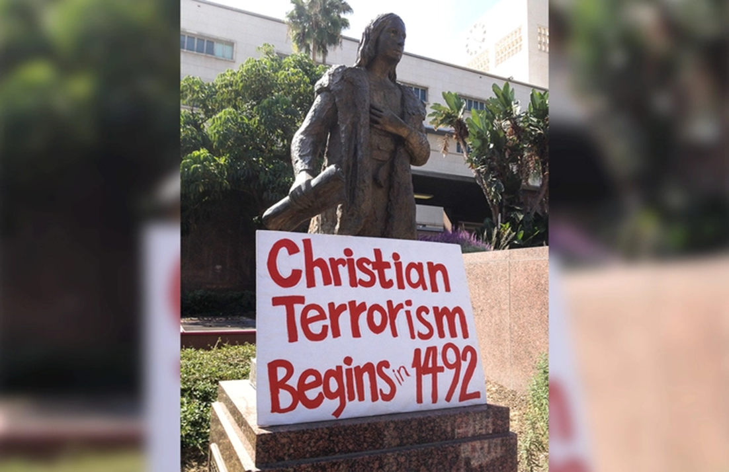
https://www.youtube.com/watch?v=c0rOIWEBT_U

Slide 4
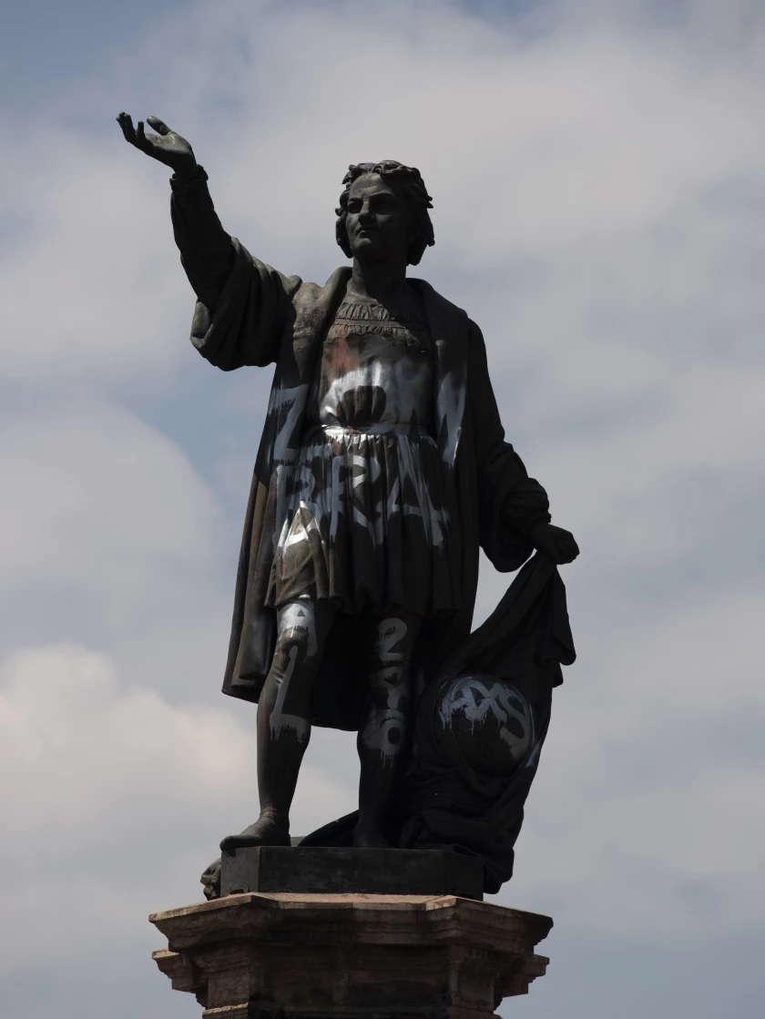
More than 500 monuments devoted to C. Columbus in all the world.
México D.F. ->

Slide 5
The symbolic value of Bcn’s Columbus Monument

Slide 6
Natives being submissive to the military

Slide 7
Natives being submissive to representatives of the church

Slide 8
Activity
1) Would you be for or against taking down the Christopher Columbus statue in Barcelona, as it celebrates racism?
If yes: What would you do in the spot that was left?
If not: Would you be in favour of taking any other kind of action?

Slide 9
Representations of white supremacy are ubiquitous in modern day Barcelona

