Slide 1
A stroll around the Rambla

Slide 2
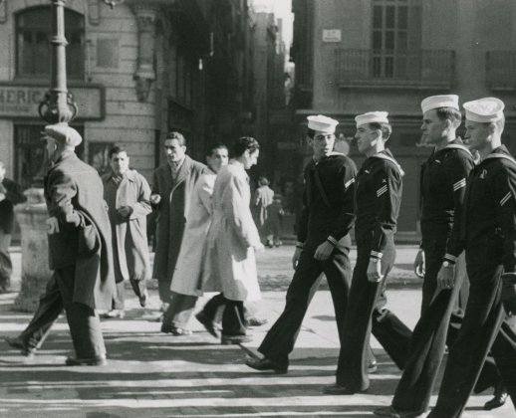
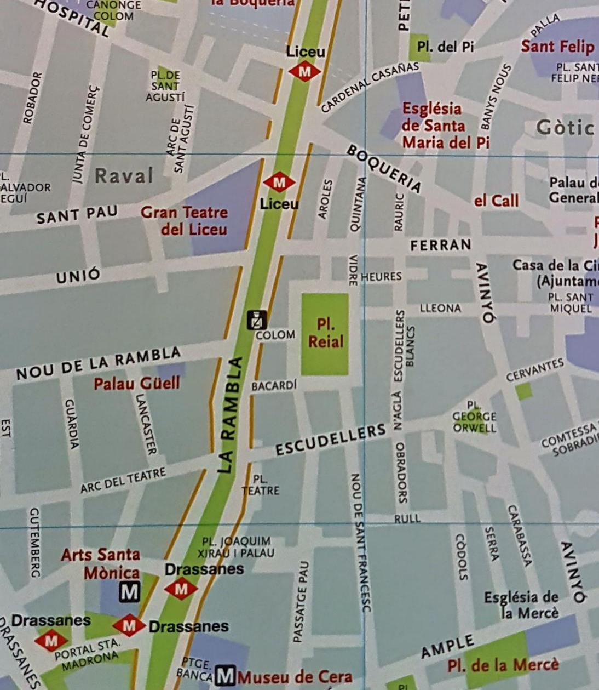
The Rambla in terms of social change (“bed of a river” in Arabic)
City wall and market until 18th c.
Street in 1766
Florists and greengrocer’s stalls in the 19th c.
First important example of foreigners taking over: US sailors (1950-1987)
Massive tourism. 2019: 125 million international visitors.
Commercialisation of public spaces (private interests to the detriment of public interest)
Gentrification
Tourist pressure
Loss of character

Slide 3
Activities:
Are phenomena similar to these happening in the area where you live too?
Think of ways tourists and locals can live side by side, without any of them denying the needs of the other.
Take pictures during our walk of examples of contrasts old/new, rich/poor, public/private and shops for tourists/shops for locals.

Slide 4
Today’s itinerary. Send pictures to nuria.asghar@conselldecent.com
Columbus monument
Rambla
Bosc de les Fades
Plaça Reial
Carrer Ferran
Plaça Sant Jaume
Carrer Paradís (Roman columns)
Carrer del Bisbe
Cathedral – Meeting point by the façade at 17.15

