Slide 1
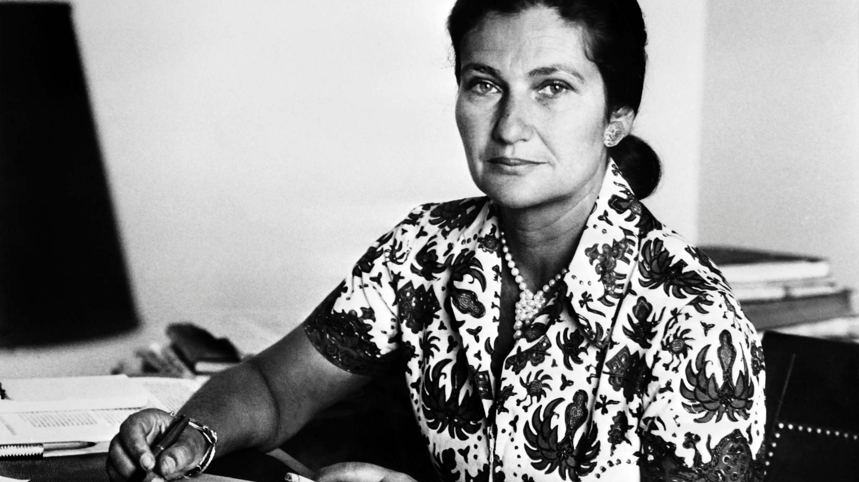
Who was Simone Veil?

Slide 2
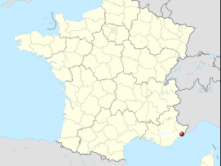
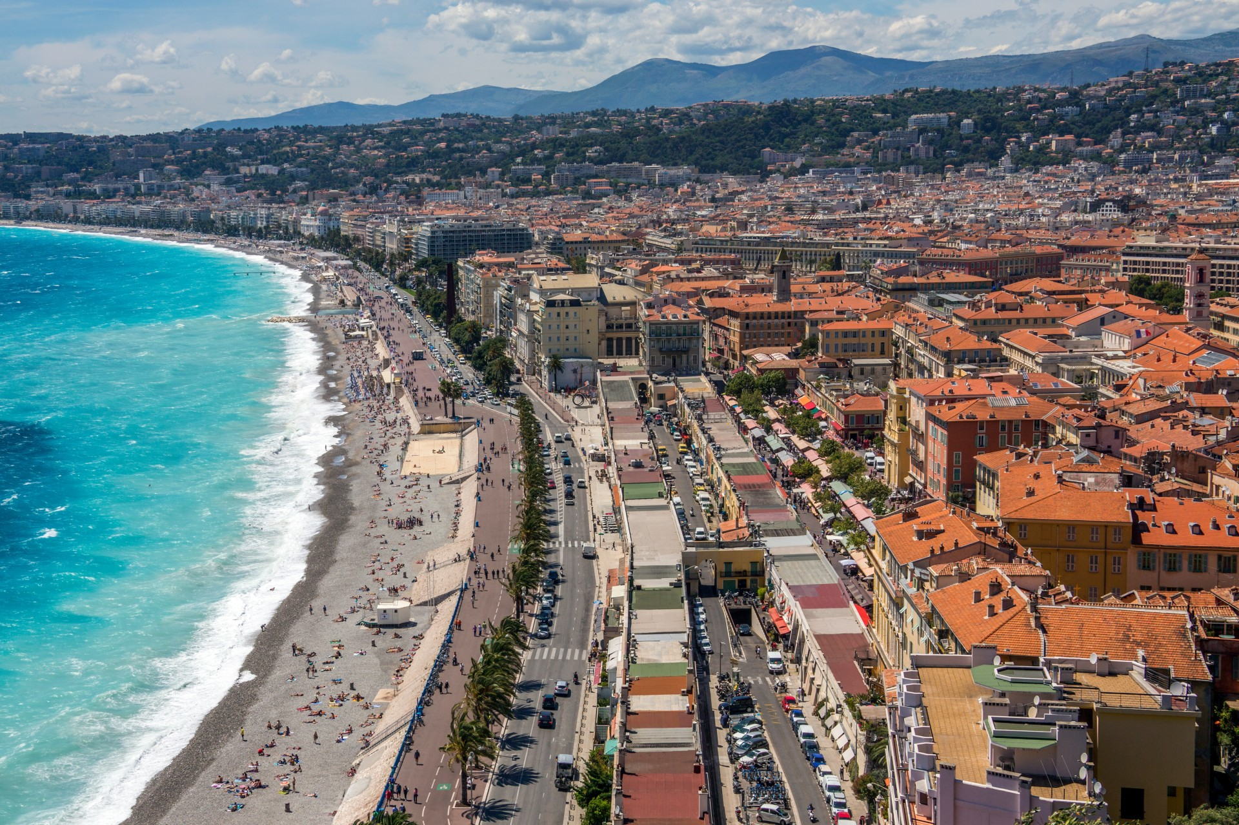
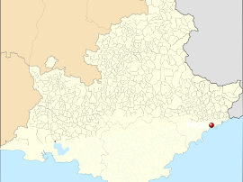
Simone Veil was born on July 13th, 1927, to a Jewish family in Nice, France.

Slide 3
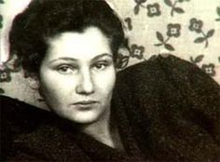
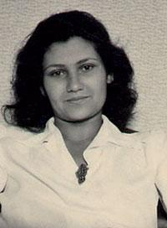
Veil’s early life
Simone was educated at the Nice’s high school and successfully completed her final exams in 1944. Two days later she was arrested by the Nazi regime.
Once arrested, she and her family were sent to the Auschwitz, Bobrek, and Bergen concentration camps.
While she and her two sisters survived, her parents and brother died.
After the war, she returned to Paris and began her studies in law and political science.

Slide 4
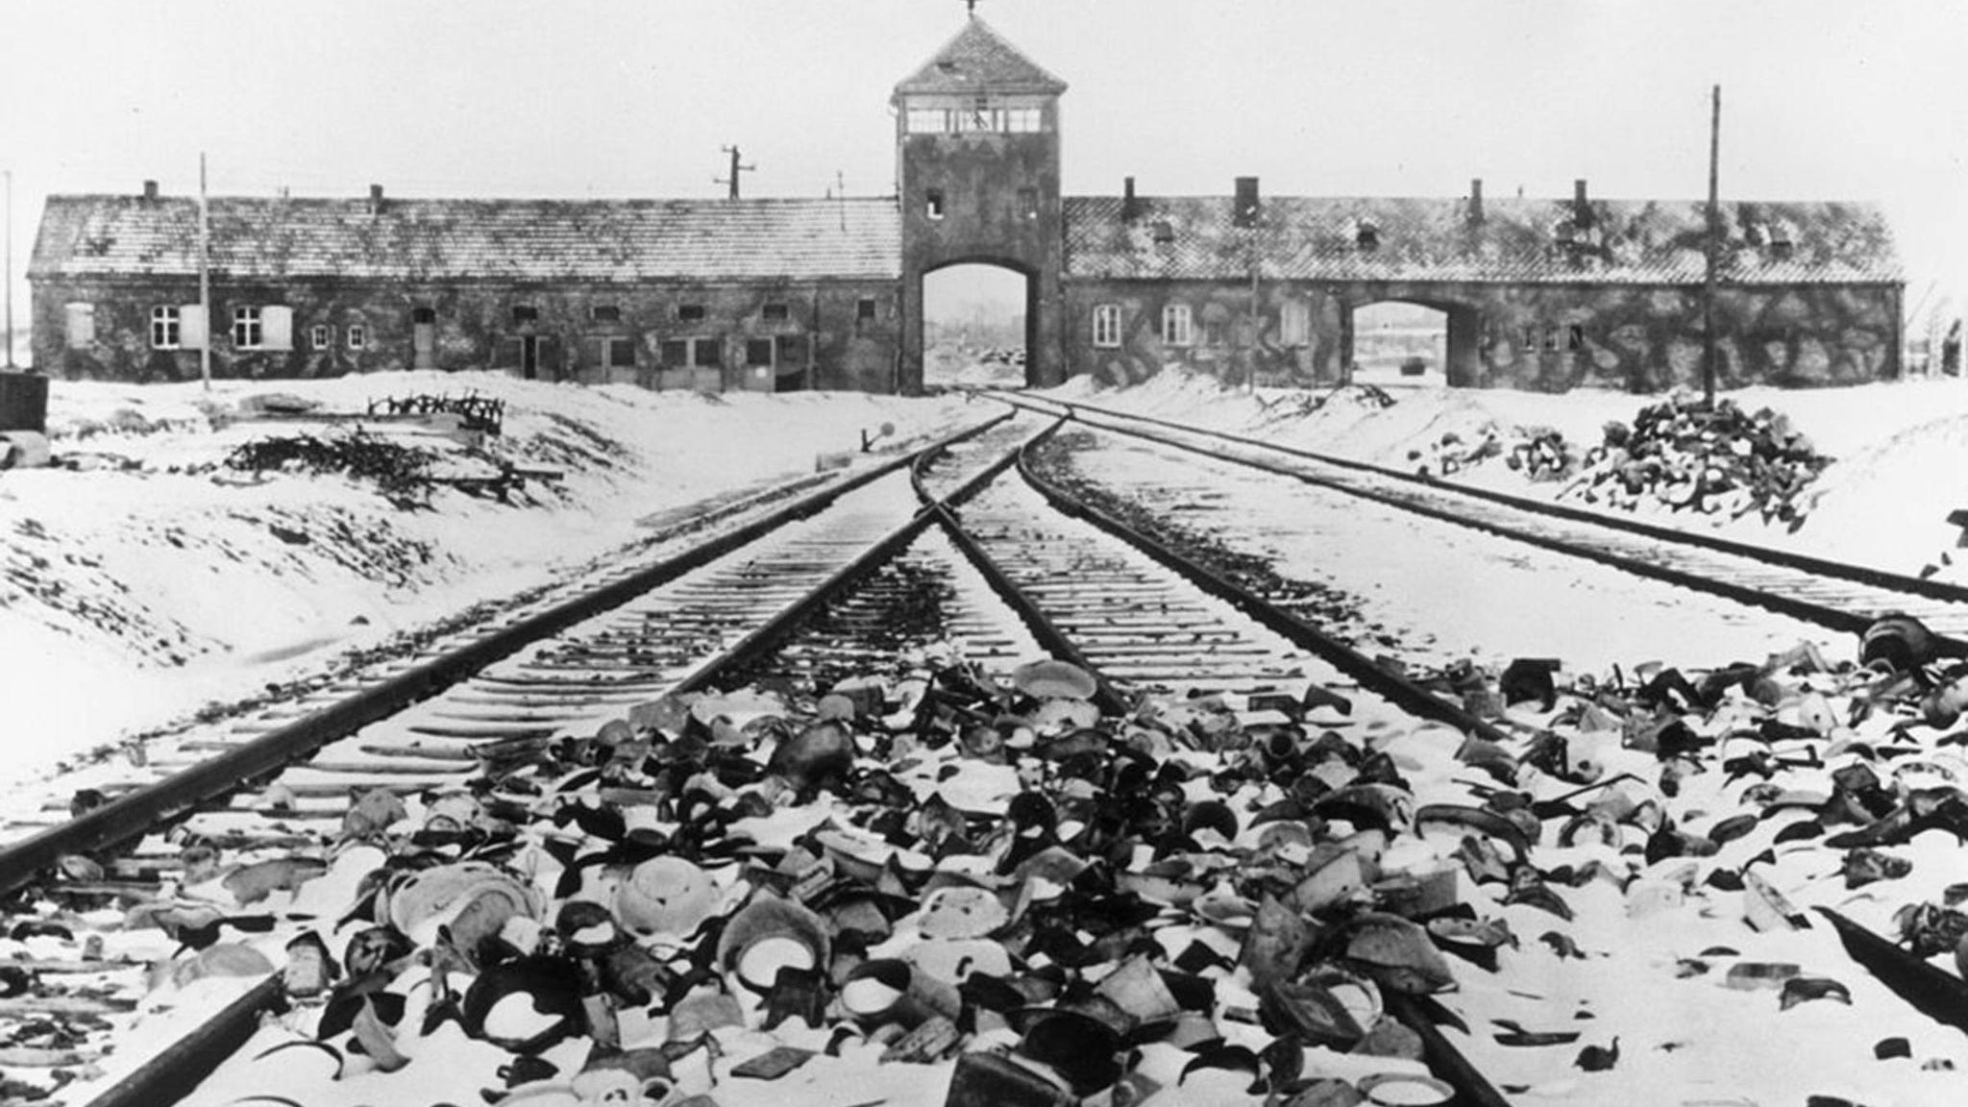
Auschwitz-Birkenau Concentration Camp

Slide 5
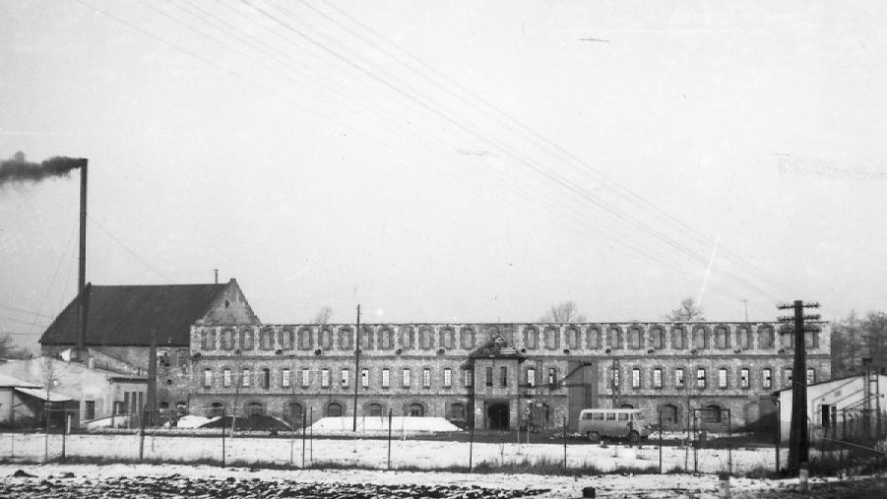
Bobrek Concentration Camp

Slide 6
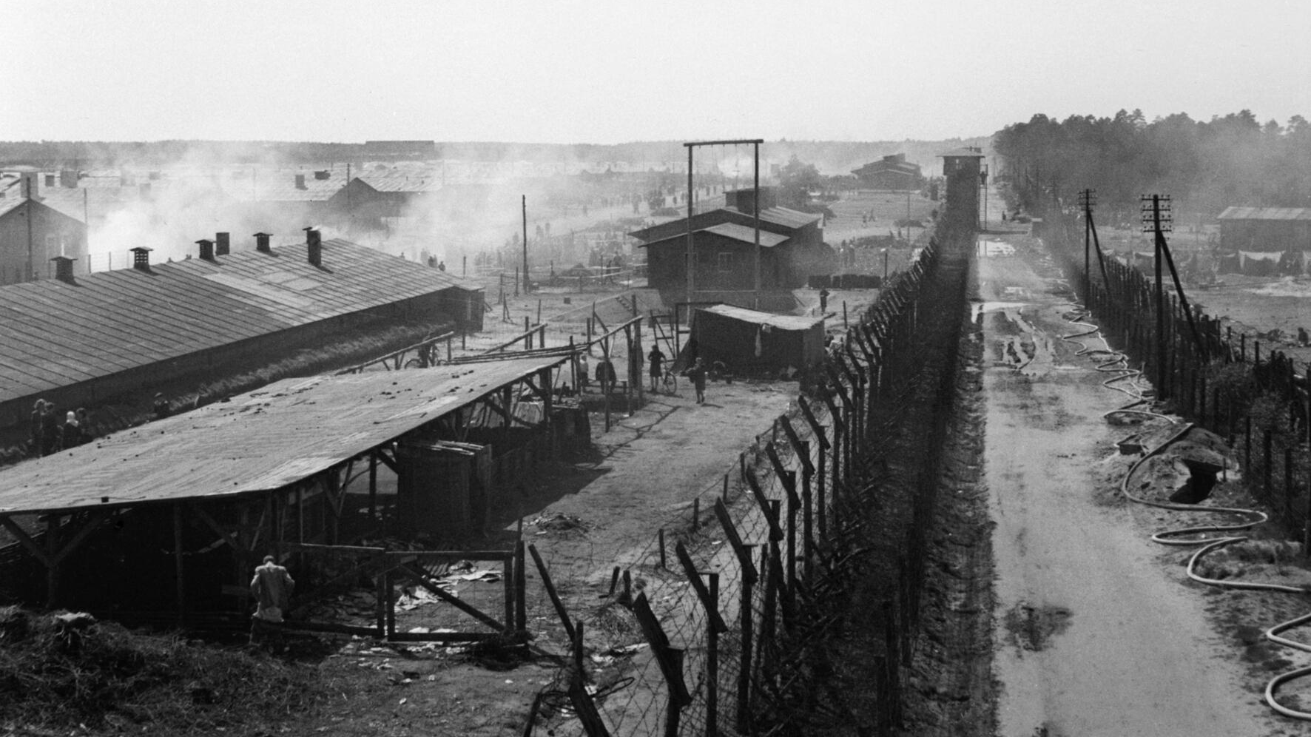
Bergen Concentration Camp

Slide 7
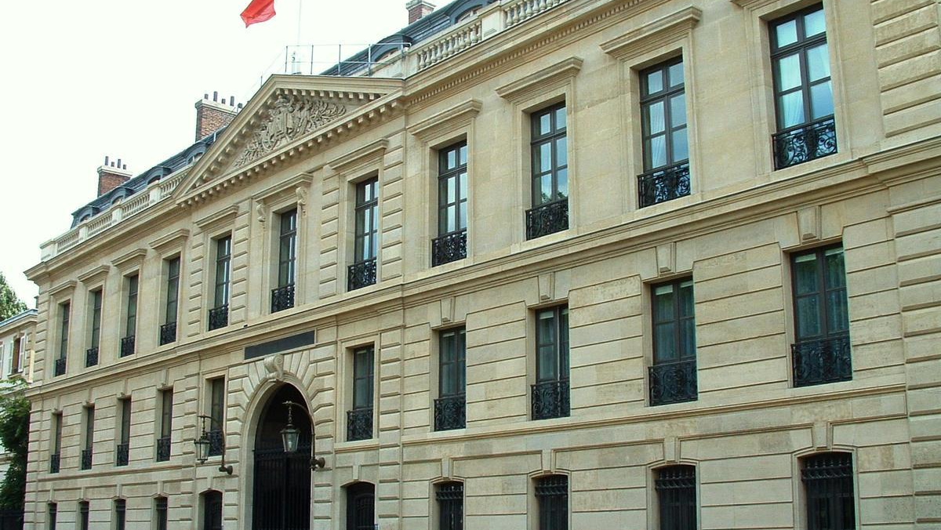
She married Antoine Veil in 1946.
After finishing her studies, she begun advising various ministers. In 1970 she became the first female secretary general of the French Council of magistrature.

Slide 8
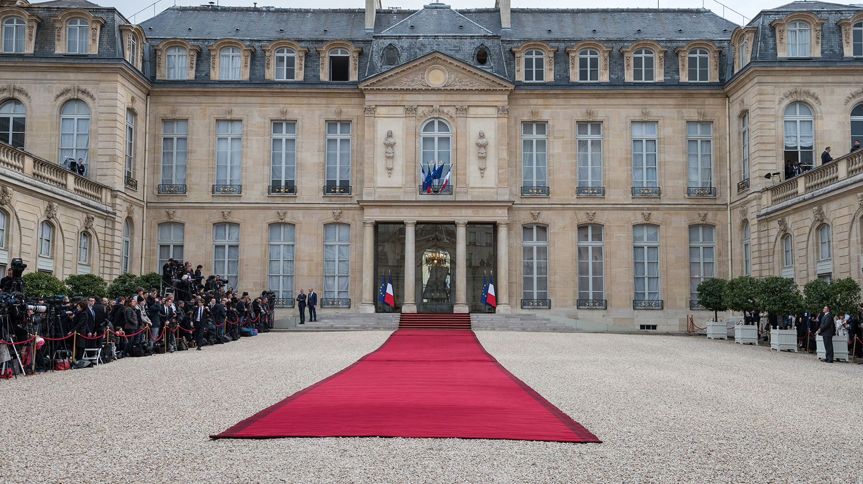
Legend has it that in 1974 the President
of France went to Antoine Veil’s house with the intention of inviting him to join his new government. But instead, the President chose his wife Simone.

Slide 9
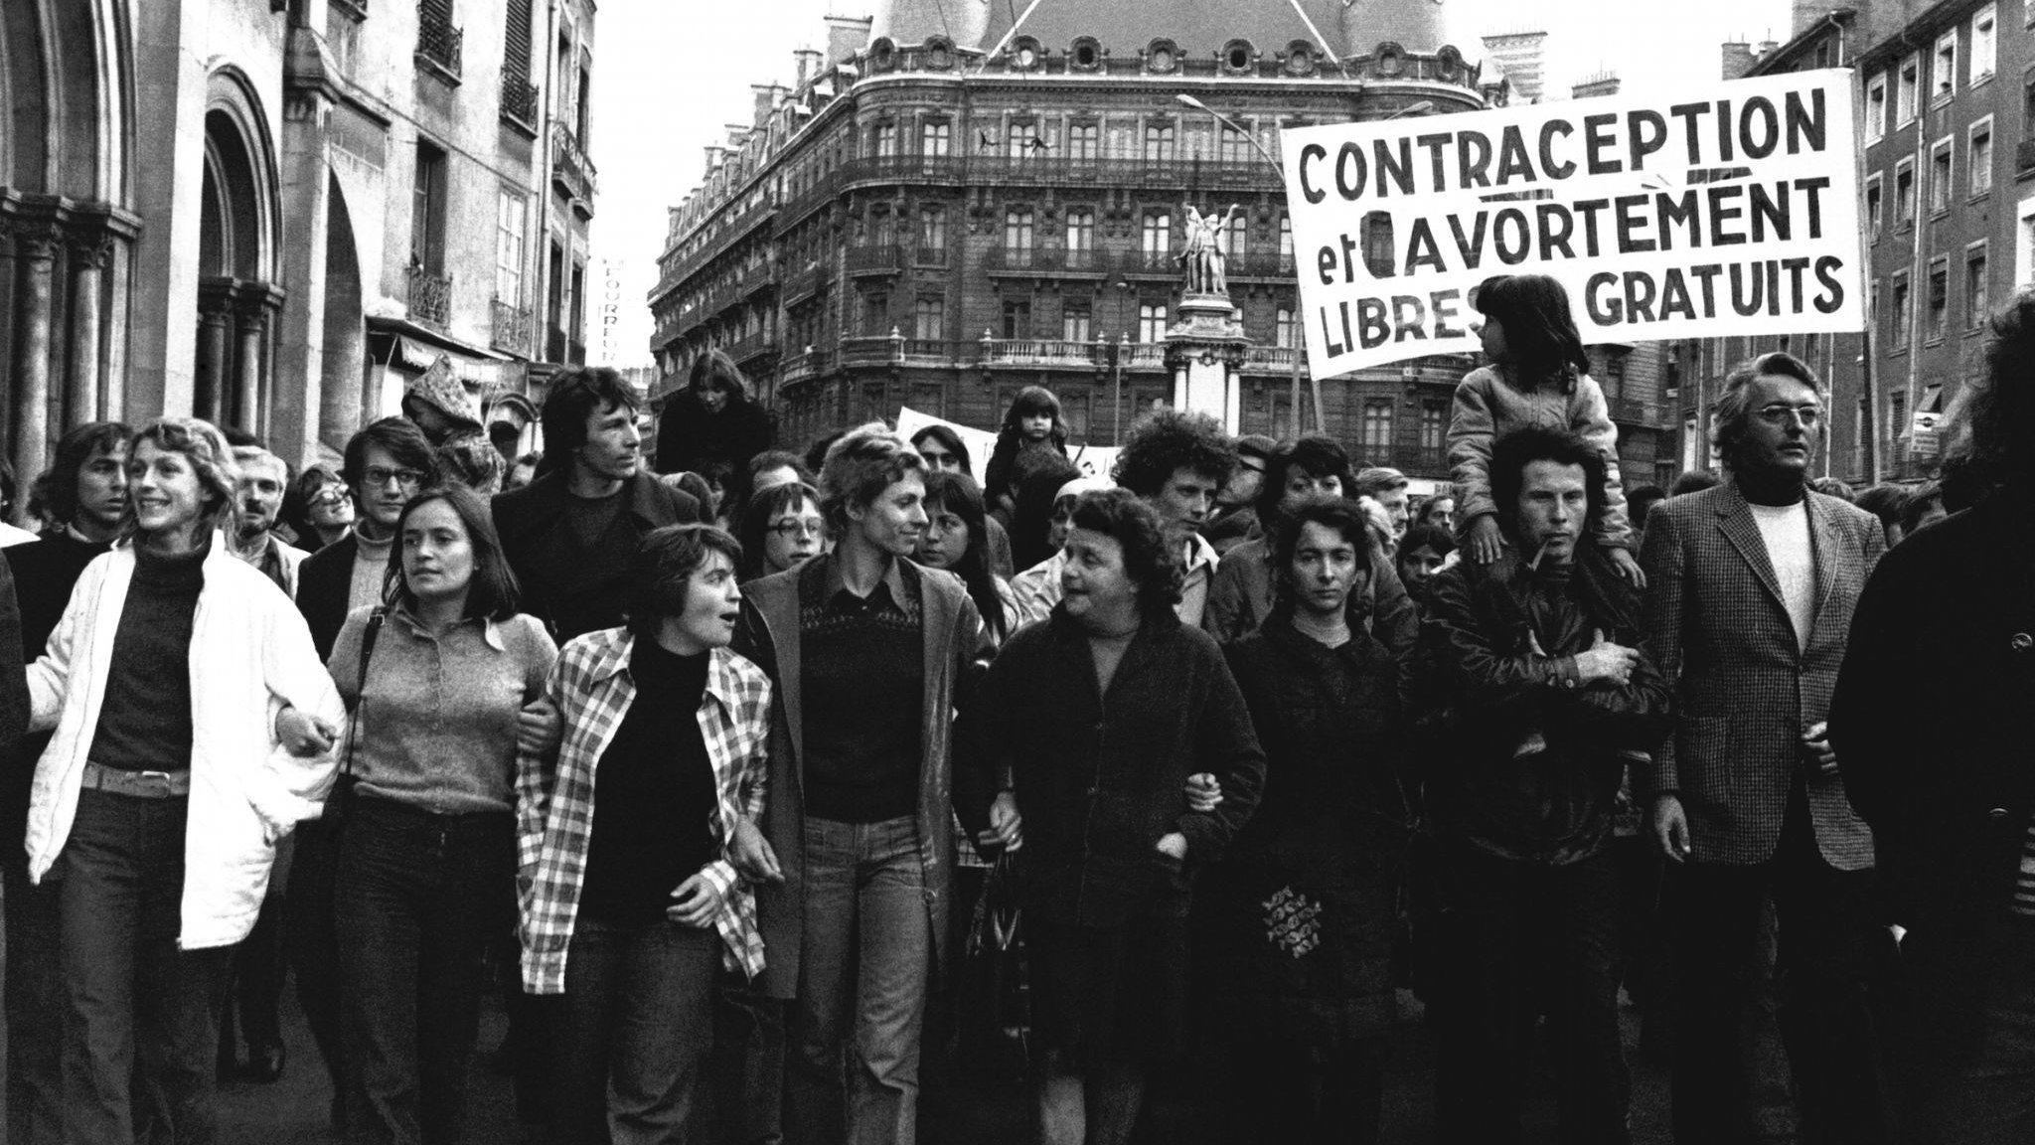
Veil then became the Minister for Health.
Soon after her appointment, she fought a bitter battle to legalise abortion in France.
It was seen as a significant achievement and the law would become widely known as “Loi Veil”, or “Veil’s Law” in English.

Slide 10
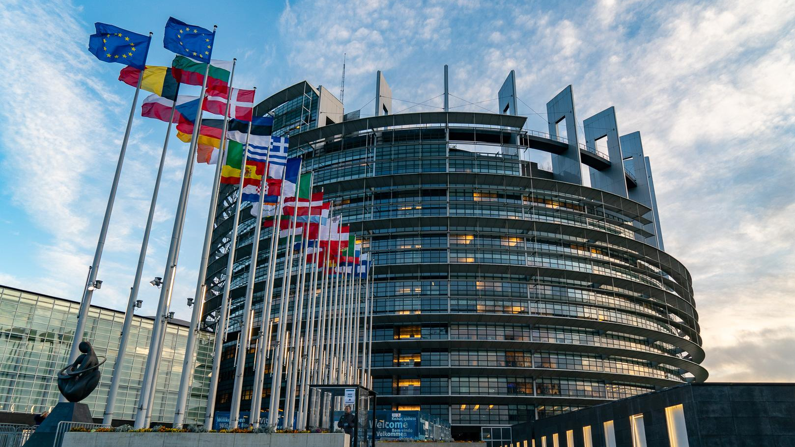
As a survivor of the Holocaust, Veil found it hard to understand how one European country could wage war on another. She became committed to the idea of a Europe in which such atrocities could never happen again.
This is why in 1979, she participated in the European Parliament elections.

Slide 11
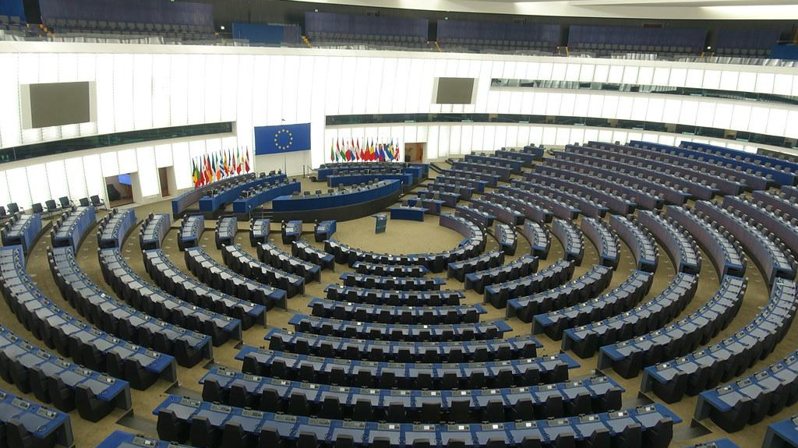
Veil was successfully elected to the European Parliament, which chose her as its President, thus becoming leader of the first directly elected European Parliament and the first woman at the head of any EU institution.

Slide 12
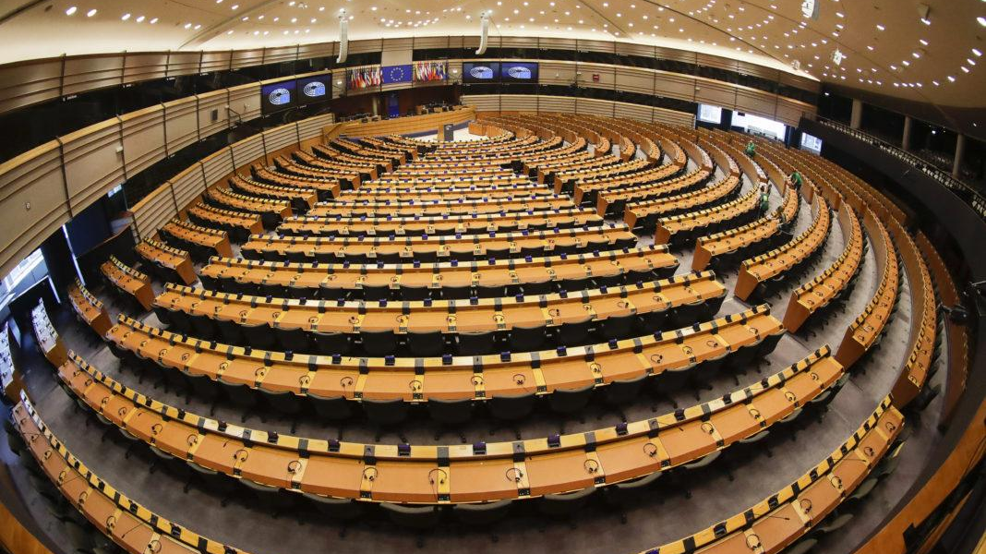
During her time at the Parliament, she won the Charlemagne Prize, the award given to honour a person’s contributions to European unity.
While in Parliament, she strove in other ways to help women, for example, she was able to expand health coverage, monthly stipends for childcare, maternity benefits, and so on.

Slide 13
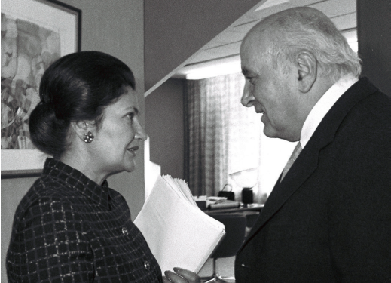
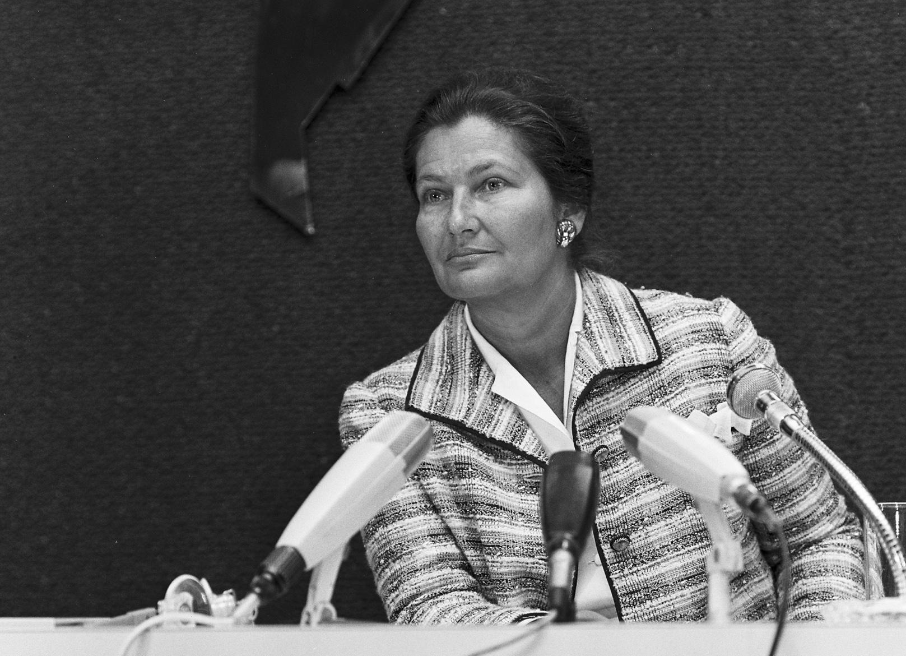
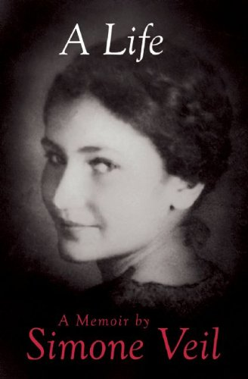
Veil’s later life
After 14 years in the European Parliament, Veil returned to French politics, serving as Minister of State and Minister of Health.
In 2005 she campaigned in favour of the idea to establish a Constitution for Europe.
Veil also published an autobiography titled “A Life”.

Slide 14
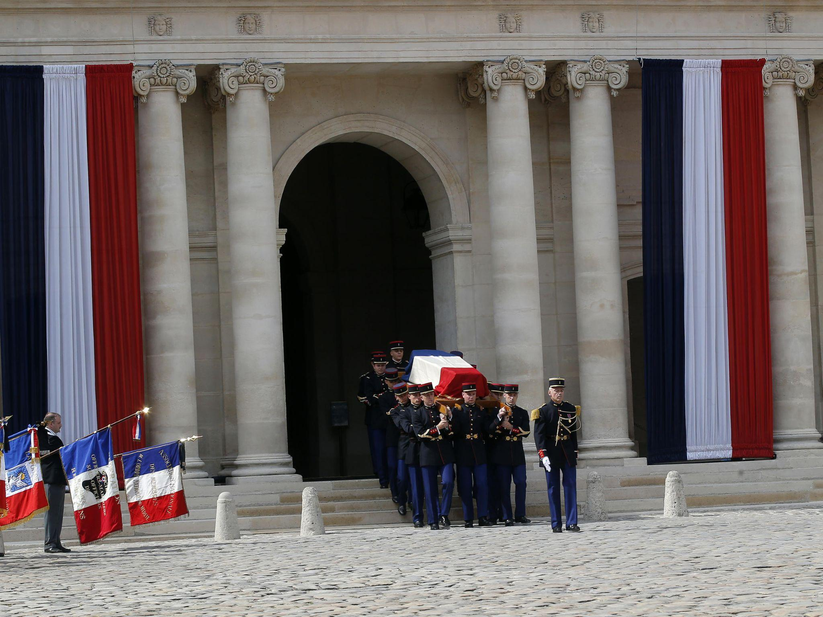
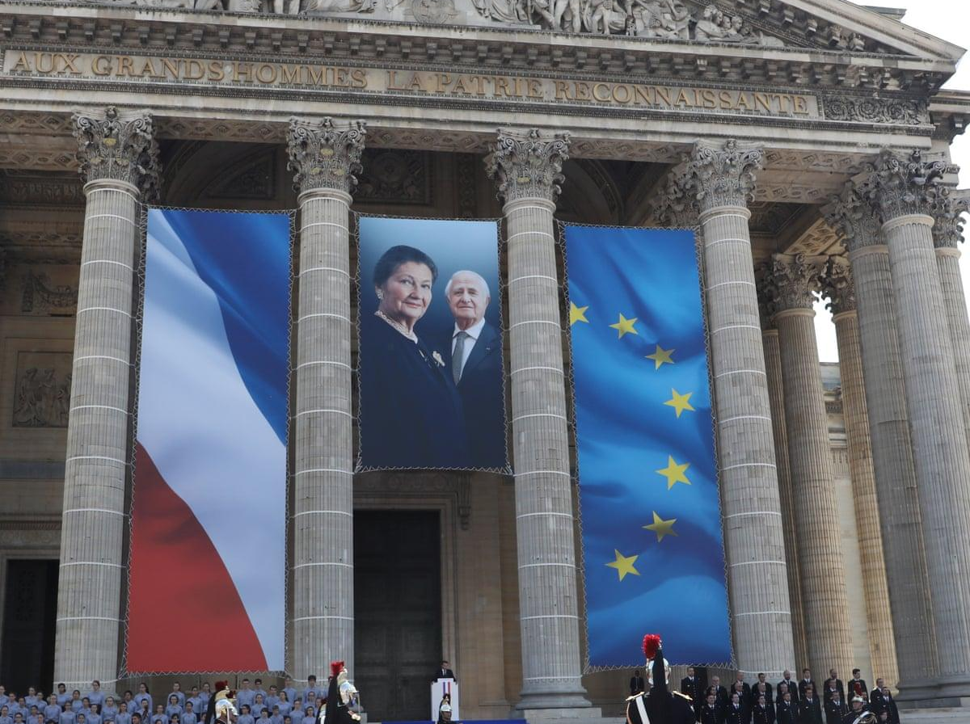
Veil passed away on June 30, 2017. She lived for 90 years.
When Veil was elected to the French Academy in 2008, she had three things engraved on the ceremonial sword that is crafted for each member of the academy. These were:
Her Auschwitz tattoo number,
The motto of the French Republic, ’Liberty Equality, Fraternity’,
And the European Union motto, ‘United in Diversity’.

Slide 15
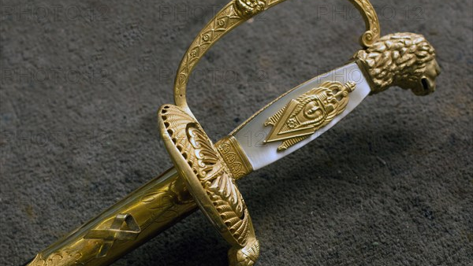
Thank you!

