Slide 1
Salazarism
26 April, Beatriz Rocha e Leonor Silva, AECCB

Slide 2
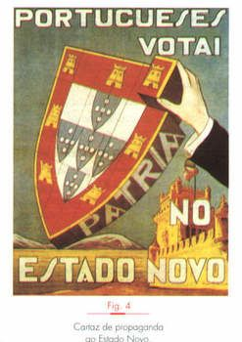
The Beginning
Once at the head of the Government, Salazar prepared a new constitution, The Constitution of 1933
With the approval of the Constitution, the period of the Military Dictatorship (1926-1933) ended, giving way to the Estado Novo
Estado Novo: With this designation, Salazar and his followers intended to say that a new political phase in the country was beginning, opposite to what they called “Old Republic”
Estado Novo poster

Slide 3
Propaganda poster, 1934
Celebratory poster, 1949
Propaganda poster

Slide 4
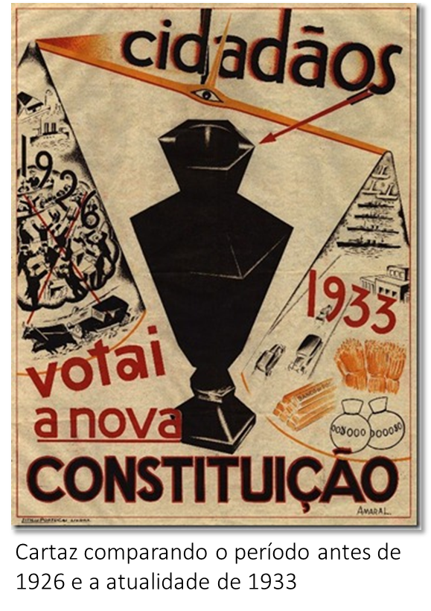
Constitution of 1933
Executive power: belonged to the President of the Republic, elected by universal and direct suffrage, every 7 years and to the government
(which the President could freely
appoint and dismiss).
Legislative Power: belonged to the
National Assembly, formed by
deputies elected every 4 years.
Poster compared to the period before 1926 and current 1933

Slide 5
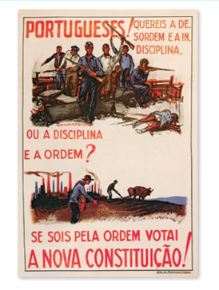
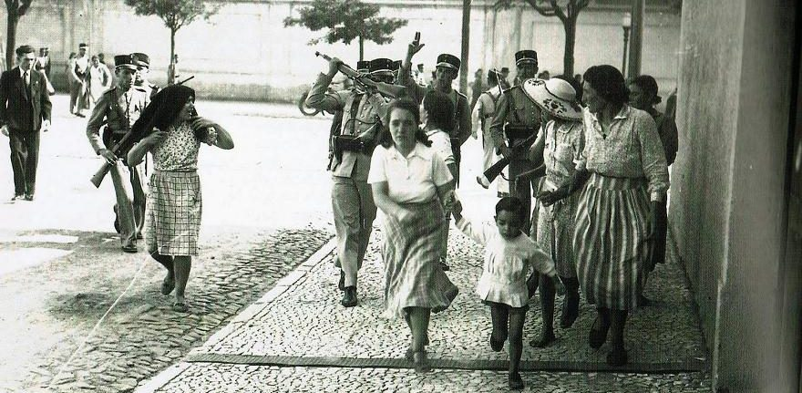
Constitution: problems
Citizens' rights were not respected, and elections were not free, and all kinds of illegalities were practiced.
The national assembly has
always had very limited power
vis-à-vis the government
Poster to encourage voting in the 1933 constitution

Slide 6
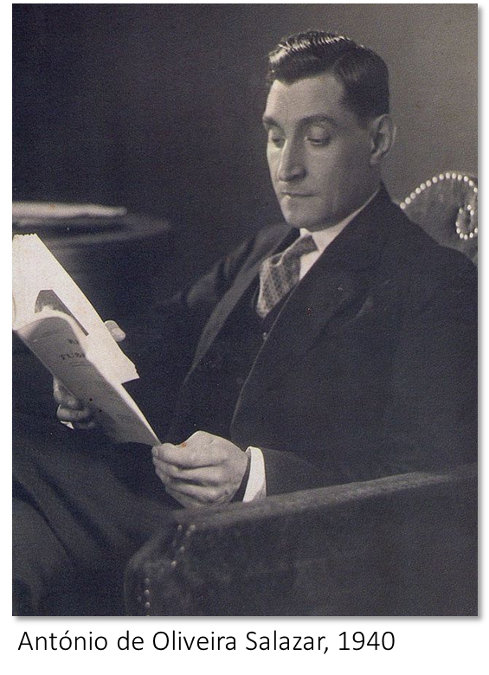
Constitution: problems
Salazar's authority during the Estado Novo was almost unlimited, his effective power was superior to that of the President of the Republic
So great was Salazar's influence, that the regime then created became known as Salazarism
Salazarism was a fascist-type authoritarian regime, with many similarities to the Italian regime from which it is distinguished, however, by its conservative and Catholic character

Slide 7
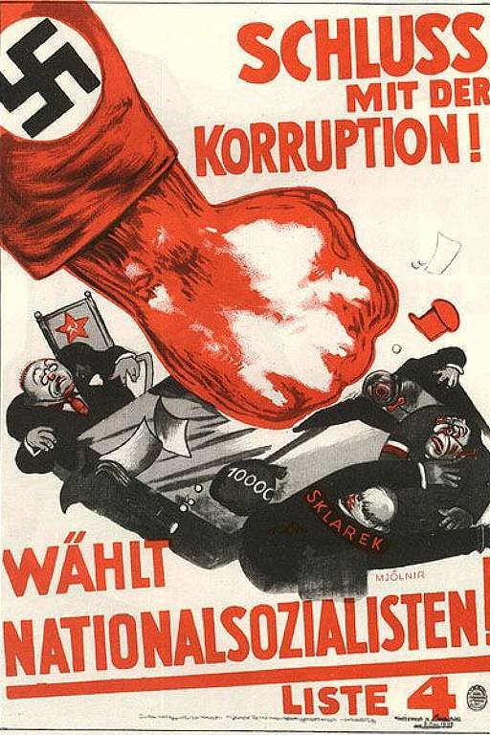
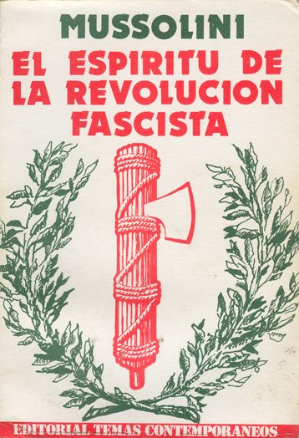
Estado Novo
As previously mentioned, Salazarism was quite similar to the Fascist and Nazi regime
Fascist propaganda poster
Nazi propaganda poster

Slide 8
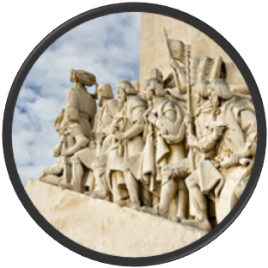
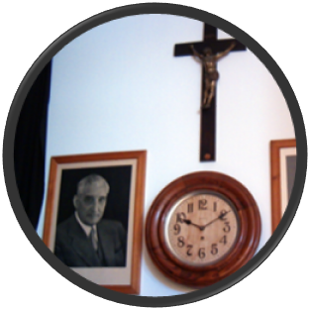
Similarities
Strong and authoritarian state
Cult of the leader: Salazar
Nationalism
Youth Doctrination: Portuguese Youth
Corporatism
Repression: Censorship and political police (PIDE)
Single political party: National Union
Nationalism
Cult of the leader
Corporatism
Single Political Party
(national union poster, 1934)
biarocha

Slide 9
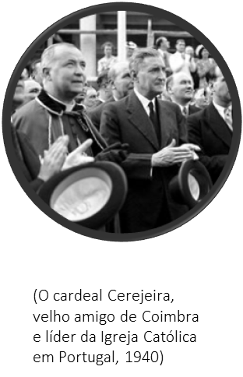
Differences
Conservatism: defending traditional values:
God, Fatherland and Family
Catholicism
Colonialism: intends the
maintenance and not the
expansion of the Imperio
It is not openly violent
It is not ideologically racist
Catholicism
(Cardinal Cerejeira, leader of the Catholic Church, 1940)
Conservatism
Colonialism
(National Propaganda Secretariat poster)

Slide 10
Estado Novo Organizations
Political police PVDE / PIDE
Militias “Legião Portuguesa”
Youth “Mocidade Portuguesa”
Women “Obra Mulheres Educação Nacional”

Slide 11
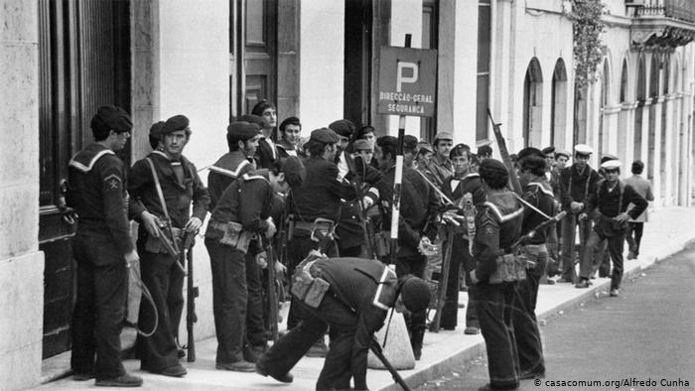
Political Police
The political police, which came to be called PIDE (International Police and State Defense), persecuted all those who showed the slightest sign of disagreement with the Salazar regime.

Slide 12
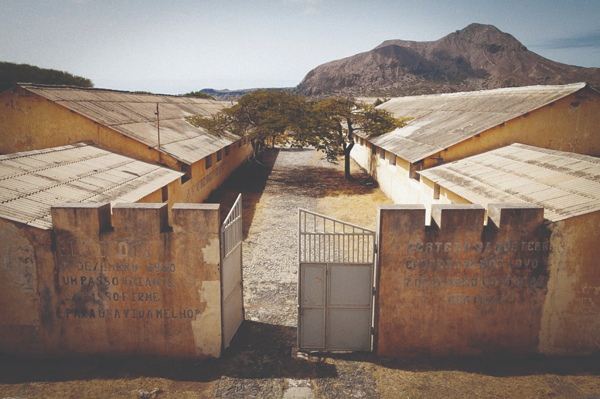
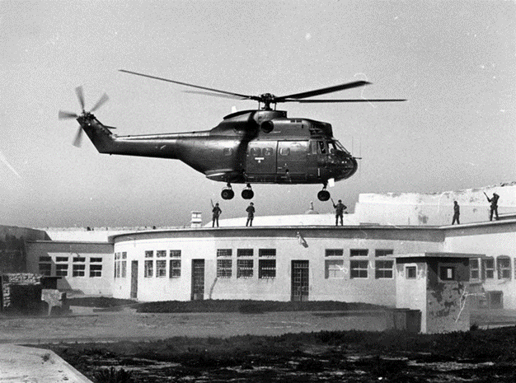
Political Police
Thousands of opponents were sent, most of the time without trial, to special prisons (EX: Peniche or Caxias) or to the Tarrafal concentration camp in Cape Verde.
Tarrafal Concentration Camp Peniche Prision

Slide 13
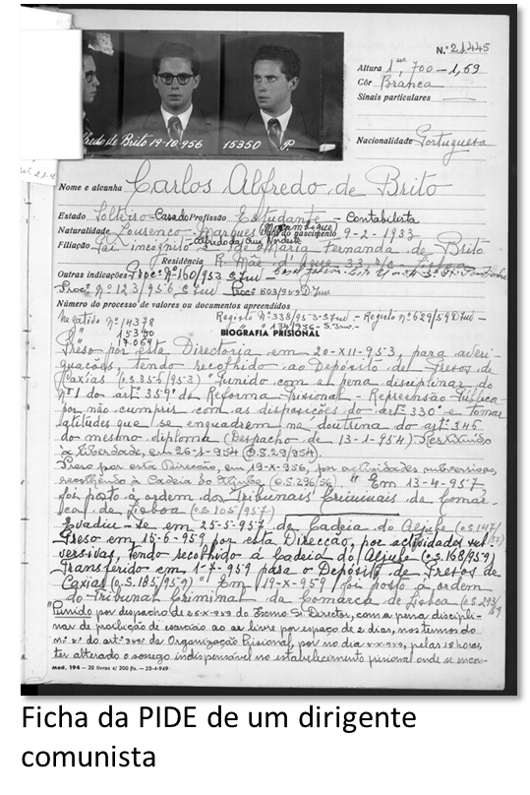
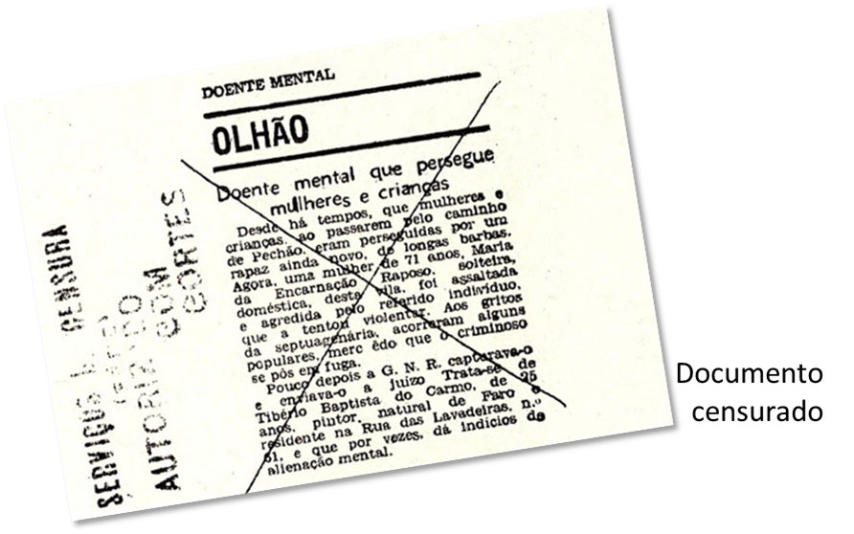
Political Police
Censorship was established for the press, radio and all shows
Censored
Documents
PIDE file of a communist leader

Slide 14
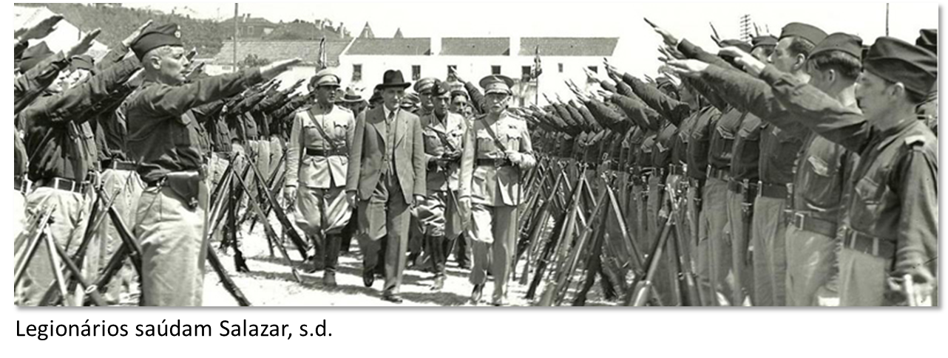
Legião Portuguesa
In order to defend the regime and combat communism, an armed militia, the “Legião Portuguesa” (Portuguese Legion ),
was created in 1936.
“Legião Portuguesa” symbol
Legionaries salute Salazar

Slide 15
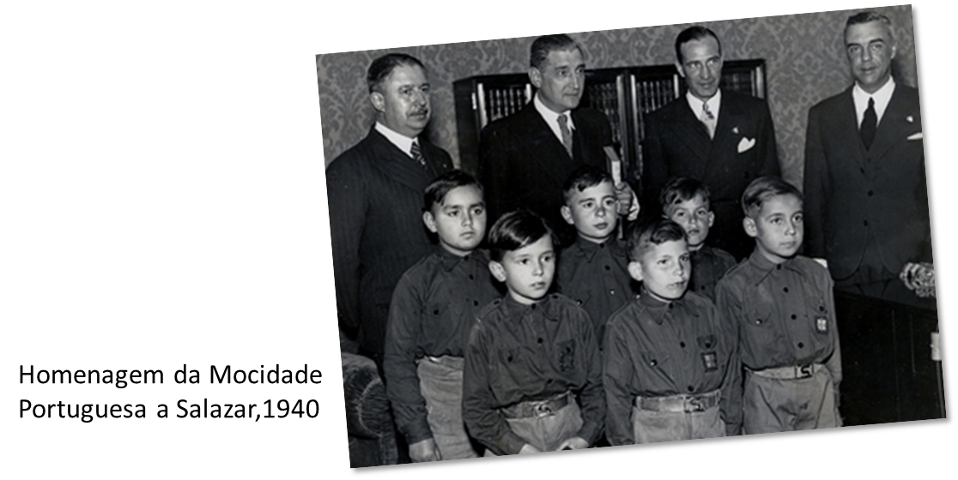
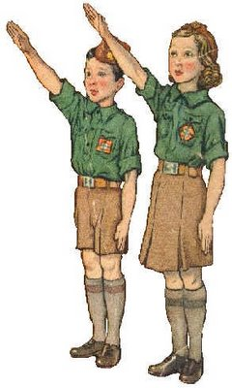
Mocidade Portuguesa
The youth in school age must belong to an official organization, the “Mocidade Portuguesa” (Portuguese Youth ), founded in 1936, with the aim of instilling in the young people a nationalist spirit and a sense of obedience to the Chief Salazar.
Tribute of the “Mocidade Portuguesa” to Salazar

Slide 16
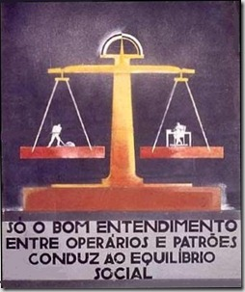
Salazarism: Corporatism
The Estado Novo intended that all economic and social life in Portugal should be based on corporations
Each major economic area was organized into a corporation (EX: agriculture corporation)
that was to represent workers and
entrepreneurs in defense of common
interests
Corporatism served to establish a
tight watch over unions and employers'
associations.

Slide 17
The End…

