Slide 1
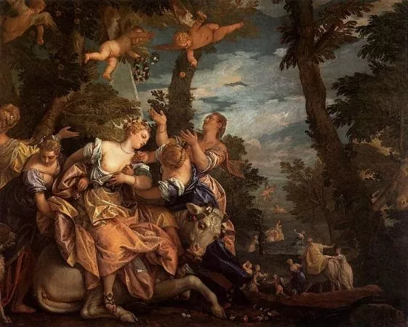
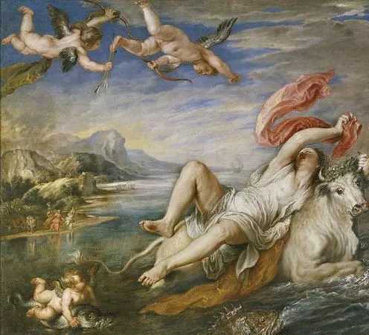
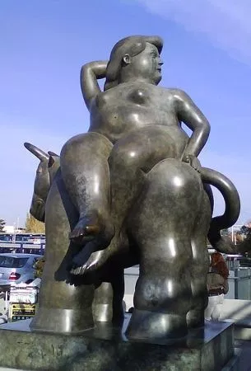
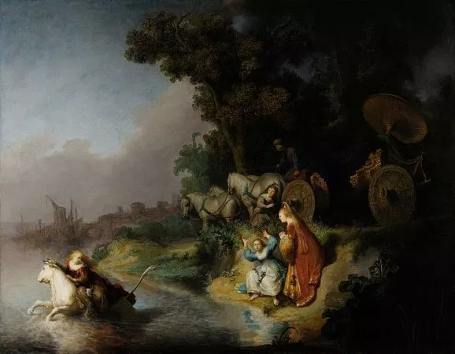
EUROPE´S MYTH IN ART
STUDENTS NAMES: OIHANE SANTAMARÍA, MARKEL TRINIDAD
1ST ARTWORK
2ND ARTWORK
Rapto de Europa, Veronés, 1580, Palacio Ducal de Venecia.
Rapto de Europa, Pedro Pablo Rubens, 1628-29, Museo del Prado, Madrid.
3RD ARTWORK
4TH ARTWORK
Rapto de Europa, Rembrandt, 1632, J. Paul Getty Museum, Los Ángeles.
Rapto de Europa, Fernando Botero, Barajas, Madrid, 2011.

