Slide 1
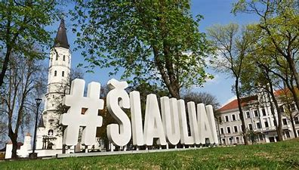
Lithuania
C3
18/10/2021-23/10/21

Slide 2
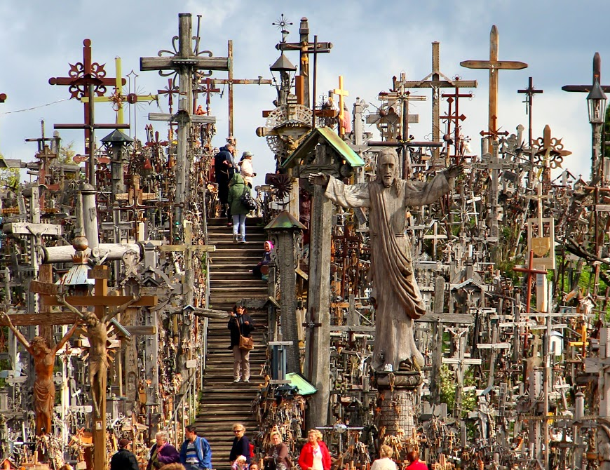
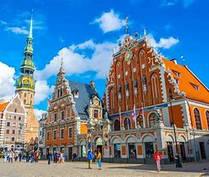
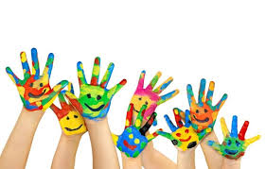
18/10/2021
Meeting in Riga and Riga Airport
The Hill of Crosses
Accommodation in families

Slide 3
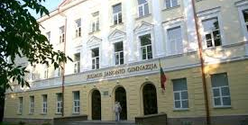
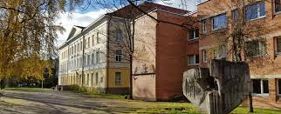
19/10/2021
Meeting with the gymnasium administration and the official opening of the project mobility.
Tour of the gymnasium.
Project activities...
Excursion around Šiauliai

Slide 4
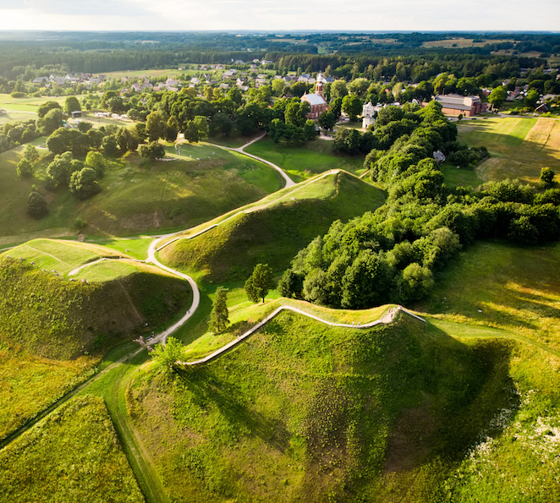
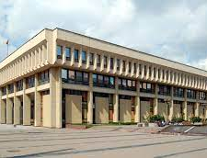
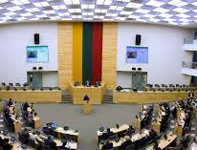
20/10/2021
Excursion to Vilnius, the capital of the Republic of Lithuania: Parliament of the Republic of Lithuania,
The Duke‘s Palace
Kernavė- the first capital of Lithuania ....

Slide 5
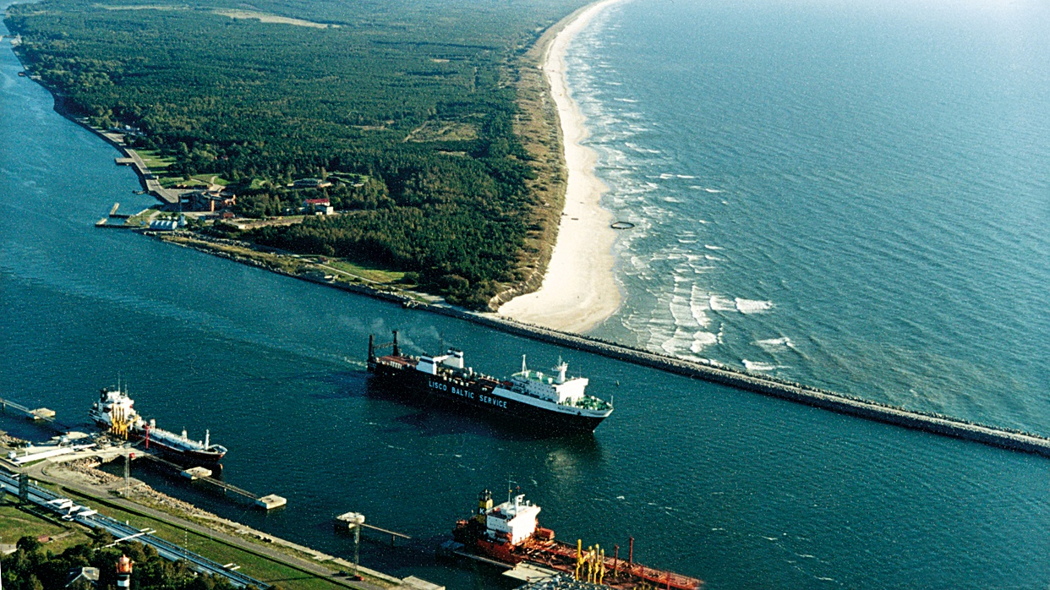
21/10/2021
Excursion to the seaside:
Boating in the Curonian Lagoon,
Food tasting,
Book carriers‘ roads ....

Slide 6
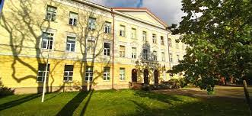
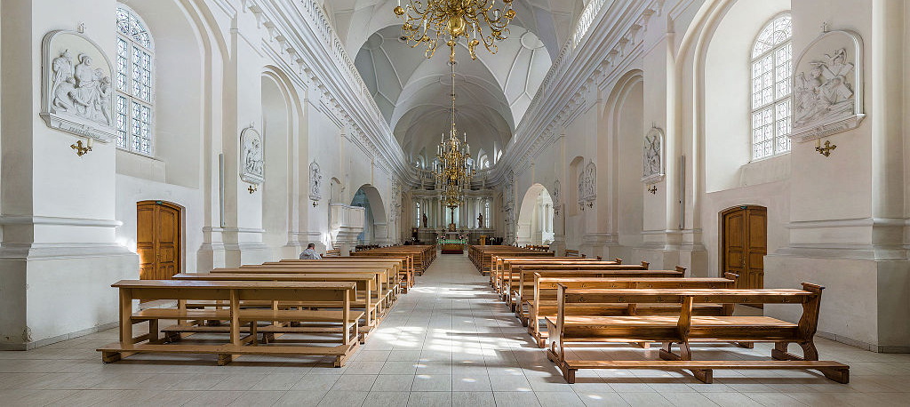
22/10/2021
Project activities in the gymnasium
170th anniversary celebration of the gymnasium
Closing ceremony of the project mobility

Slide 7
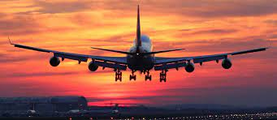
23/10/2021
Departure

