Slide 1
local youth policies and project impacts
Vila Nova de FAMALICÃO
INTERVIEW WITH City COUNCILLOR SOFIA MACHADO FERNANDES AND MAYOR MÁRIO PASSOS

Slide 2
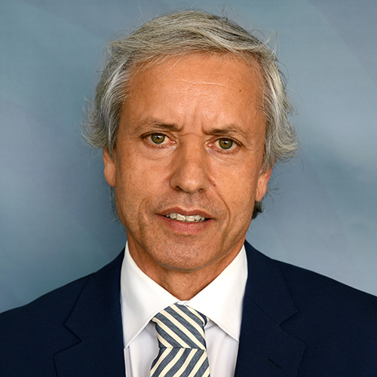
the interviewees
Sofia Fernandes
City Councilor
Mário Passos
Mayor

Slide 3
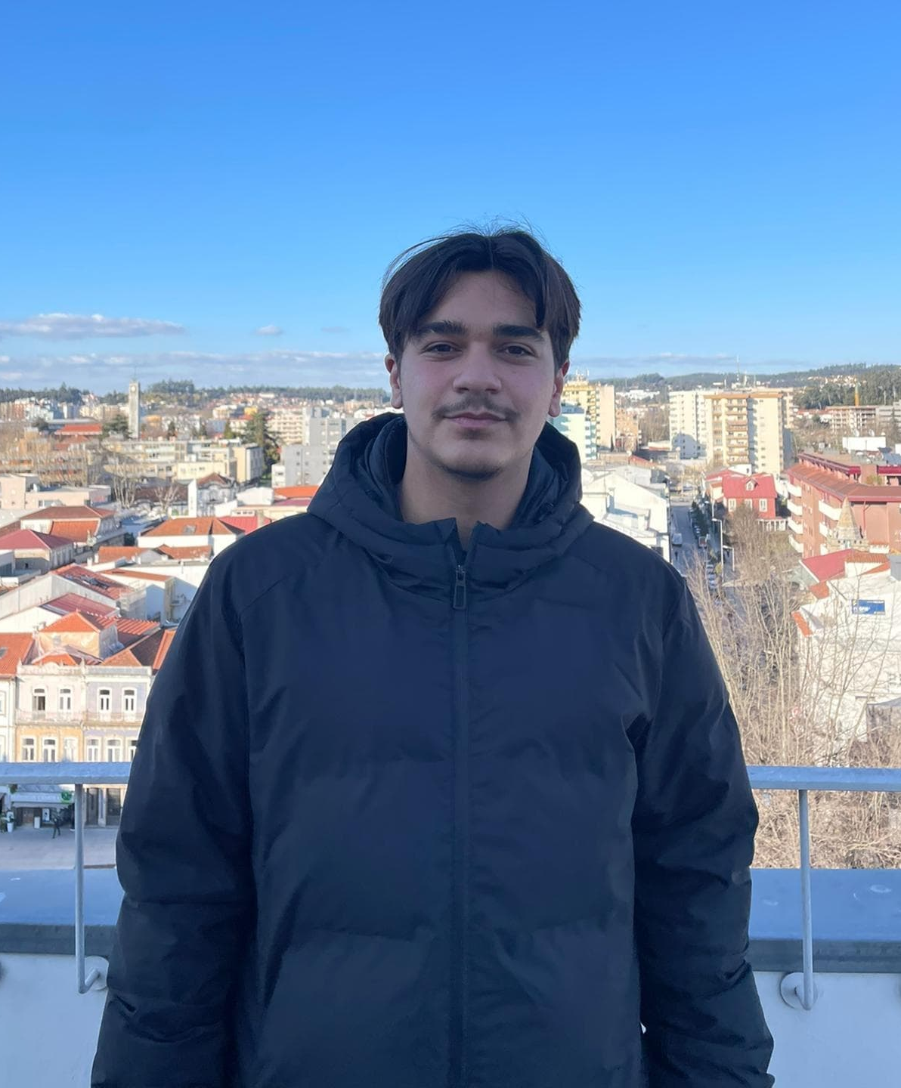
the interviewers
Álvaro Castro
Simão Costa

Slide 4
THE QUESTIONS

Slide 5
1ST-
According to data from the European Social Survey (ESS), 2019, young Portuguese participate politically less than most of their European counterparts when it comes to voting, but also in three "unconventional" forms of participation: boycotting products for political reasons, signing petitions and participating in demonstrations. What is your portrait of the political and civic participation of young people in Vila Nova de Famalicão?

Slide 6
2ND-
What spaces/programs/platforms do the young people of Famalicão have at their disposal in order to have an active citizenship?

Slide 7
3RD-
Knowing that the youth vote has decreased, but that in the last 20 years there was a generalized increase of the remaining forms of political participation, how did the City Hall of Vila Nova de Famalicão integrate the new forms of digital democratic participation to stimulate the democratic experience and the active citizenship?

Slide 8
4TH-
What strategies do you consider to be the most effective in promoting active citizenship among young people?

