Slide 1
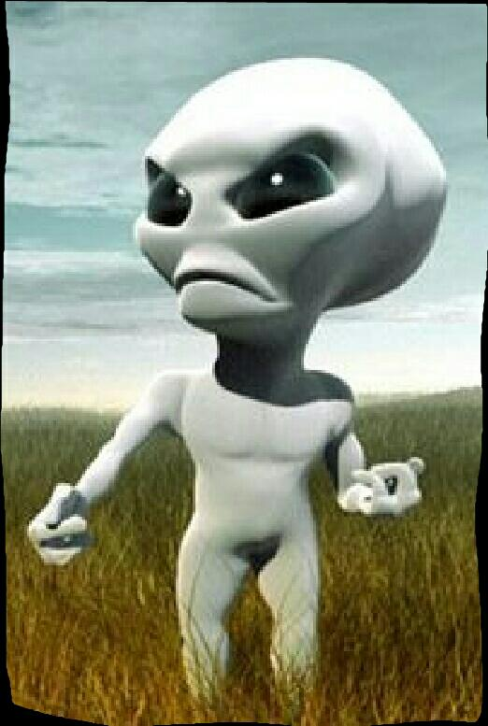
^{INCLUSO ETI, EVEN}
#Grombalia high school

Slide 2
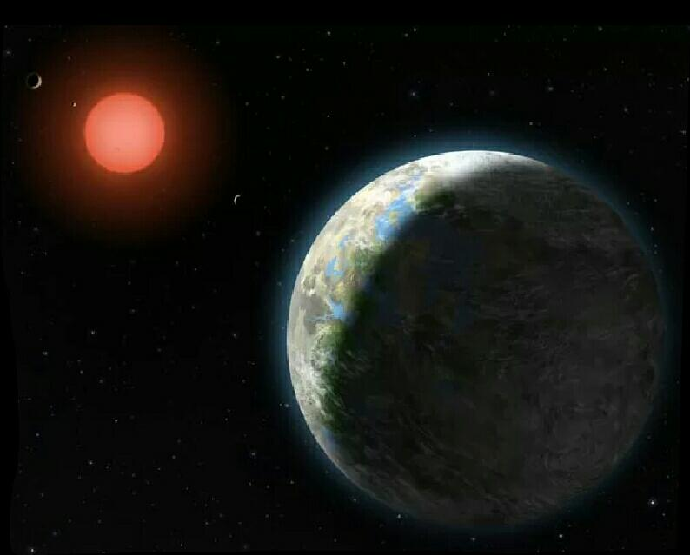
Glisse 581 G
Discovery: Gliese 581G could be the first real habitable planet, resembling Earth.

Slide 3
*A planet the size of the Earth has been located in orbit around a nearby star, at a distance that makes it neither too hot nor too cold, comfortable enough for life to exist, according to a September 29 announcement.If confirmed, the exoplanet, called Gliese 581G, would be the first Earth-like planet residing in the habitable area of a star, a region where the temperature of a planet could retain water in its liquid state on its surface.

Slide 4
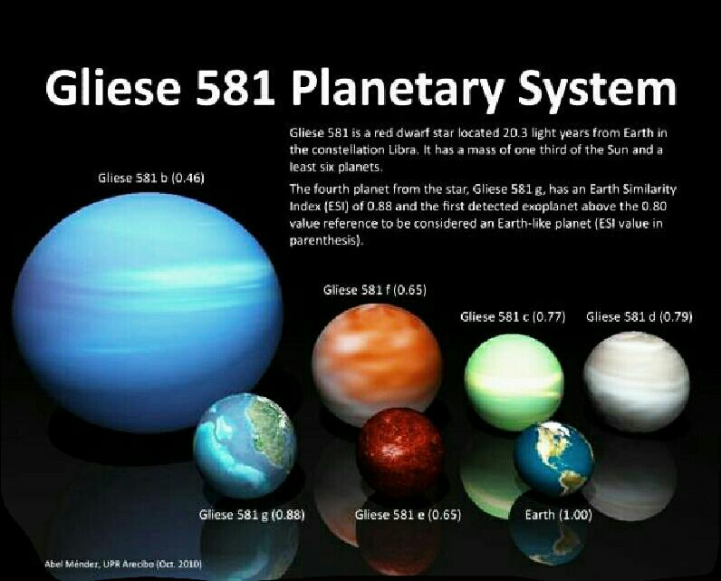

Slide 5
* Astronomers are very optimistic about the prospects of finding life in this system.Steven Vogt, Professor of Astronomy and Astrophysics at the University of California, Santa Cruz, USA, at a press conference on 29 September.S), said "Personally, given the omnipresence of life and its propensity to thrive wherever it can, my personal feeling is that the chances of life on this planet are 100 percent, I have almost no doubt.

Slide 6
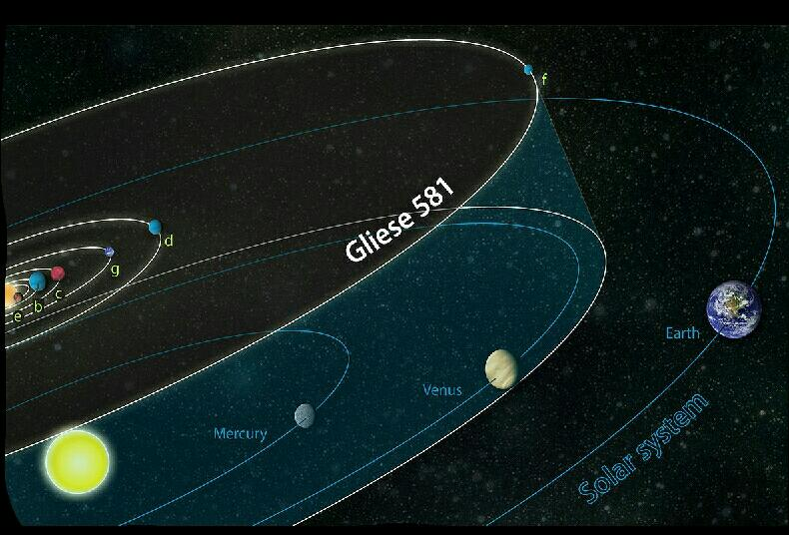
*Gliese 581G revolves around its star, a red dwarf called Gliese 581, which is about 50 times weaker than our sun making the habitable area closer (compared to our solar systems). Another planet recently discovered in this same system, Gliese 581F, is outside the habitable zone, according to researchers.The star (581G) is located 20 light-years from Earth in the Libra constellation. A light-year equivalent to 1,000 billion km.

Slide 7
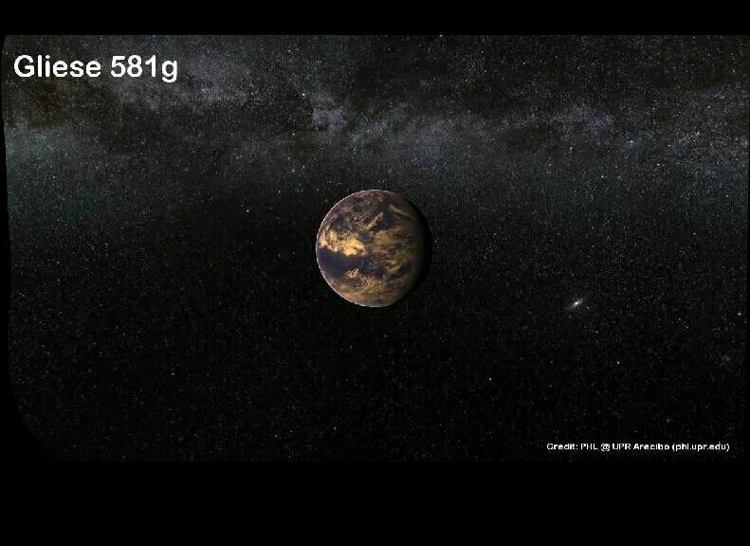
*According to estimates, Gliese 581G is at 0.15 astronomical unit of its star, close enough to its Sun to be able to complete an orbit in just under 37 days. An astronomical unit is the average distance between the Earth and the sun, which is about 150 million km.With support from the National Science Foundation and NASA, scientists and members of the Survey, Lick-Carnegie Exoplanet, took 11 years to collect data on the radial velocity of the star. This method consists in studying the tiny movements of a star due to the gravitational attraction of bodies in orbit, allowing researchers to estimate its mass and the time it takes to travel around its star, with the conclusion that its gravity is sufficient to preserve an atmosphere.

Slide 8
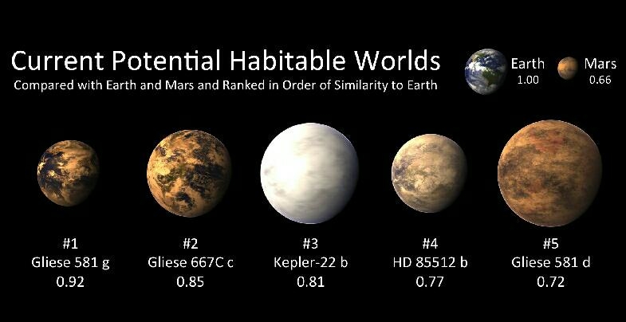
Sarah Laouini 😊

