Slide 1
Safety on the internet
created by Ladybirds from Brno

Slide 2
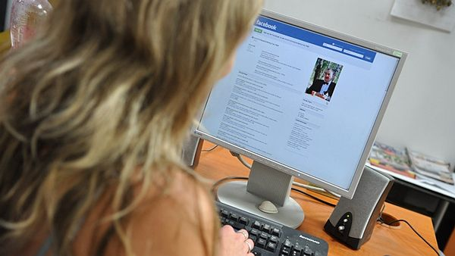
1)
Don't give anyone your address or telephone number. You don't know who is hiding behind the monitor on the other side. Use a nickname.

Slide 3
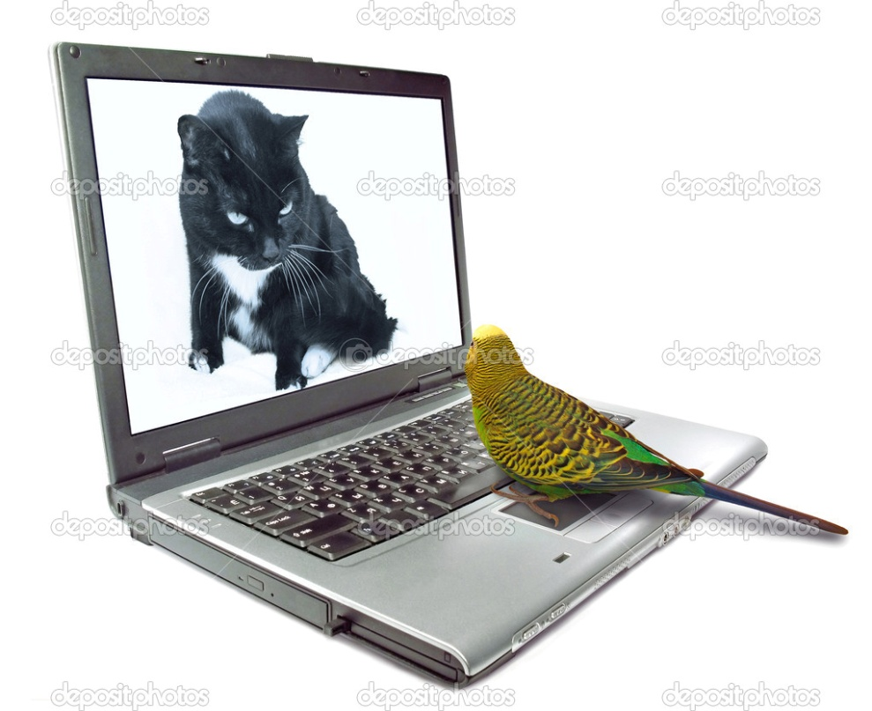
2)
Don´t send anyone who you don´t know your photos. Don´t send your intimate photos even to your friends, you don´t know what they can do with them.

Slide 4
3)
Keep your password safe, don’t say it even to your best friend. The password should be long, choose from all keyboard keys, don’t use everywhere the same password.

Slide 5
4)
Never respond to bad or vulgar emails or memos. Ignore them!

Slide 6
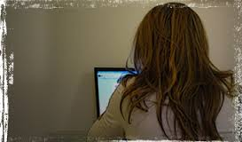
5)
Don´t arrange any meeting with someone who you know from the internet unless you tell someone about it.

Slide 7
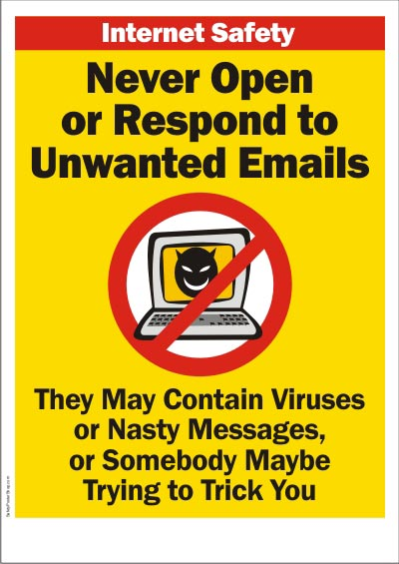
6)
Don´t give a chance to viruses. Do not open mail attachements, which came from an address that you don´t know. You should buy an antivirus program.

Slide 8
7)
Don´t trust every information that you get on the internet.

Slide 9
8)
If you don´t want to talk to someone, don´t.

Slide 10
9)
If you encounter cyberbullying, contact the provider of the website, the police or parents.

Slide 11
10)
When you use a webcamera, set it up to show only a small part of the background behind you.

Slide 12
11)
Never write on the internet that your family is going on holiday or so and that your house (flat) is going to be empty.

