Slide 1
Crete
Robin Schork
Max Kaiser
Louisa Spröhnle

Slide 2
Crete
Structure
general information
capital city
buildings and special sights
animals
food
famous people
music and dance

Slide 3
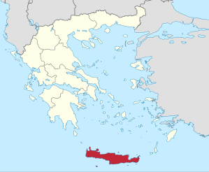
General information
location: eastern mediterranean
population: 623.000 (2011)
area: 8300 km²
capital city: Heraklion
highest point: Mount Ida

Slide 4
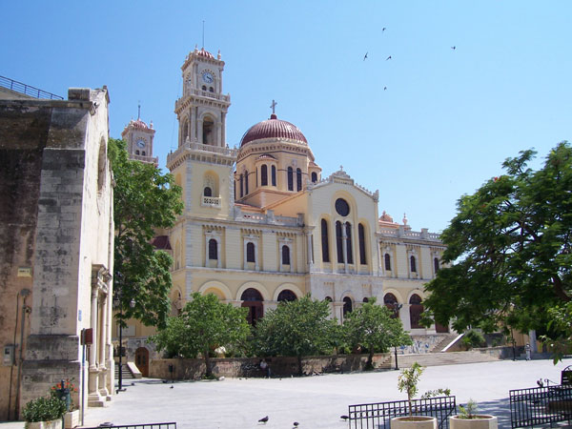
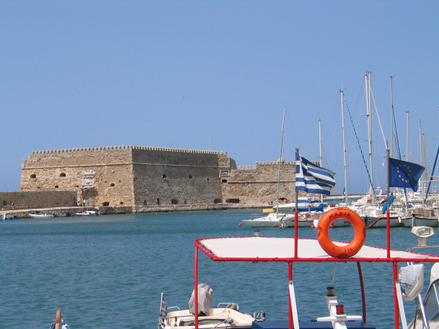
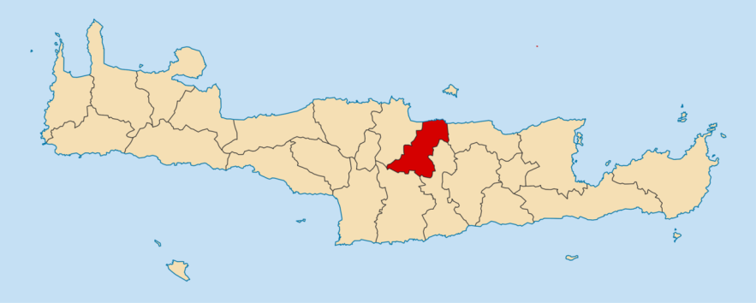
Heraklion
capital city of Crete
population: 173.450 (2011)
area: 245,12 km²
mayor: Giannis Kourakis

Slide 5
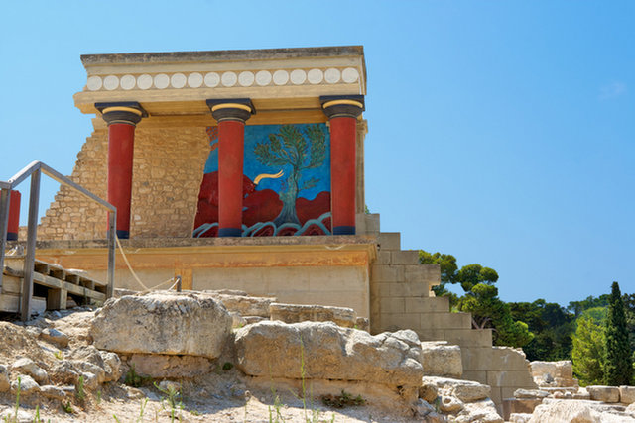
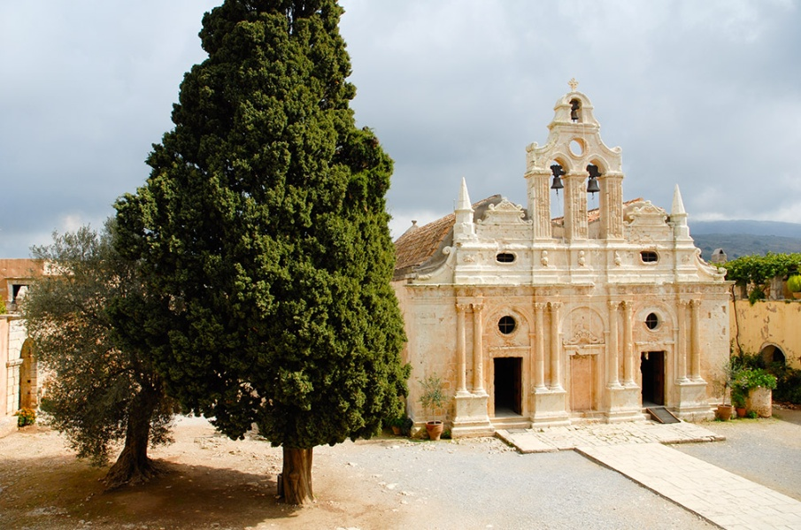
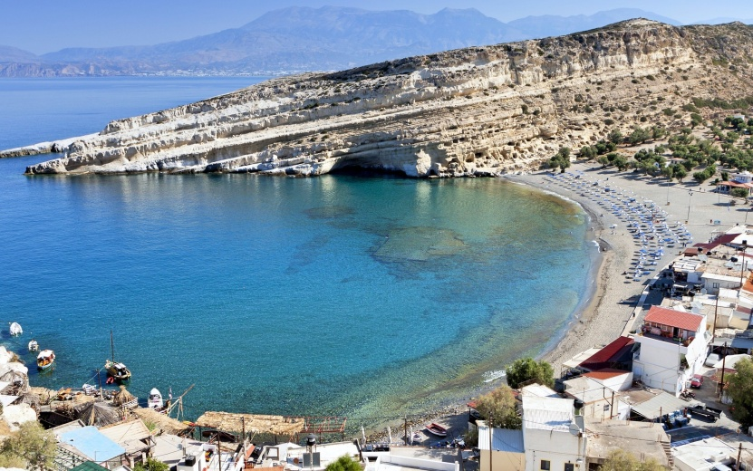
Buildings and special sights
Matala
Archeological Museum (Iraklion)
Palace of Knossos
Monastery Arkadi

Slide 6
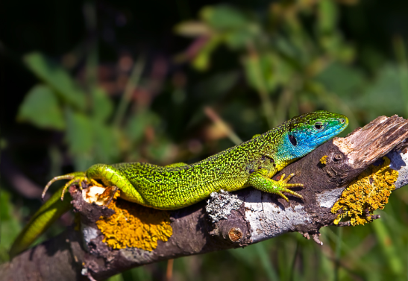
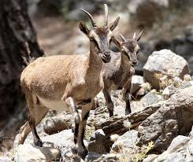
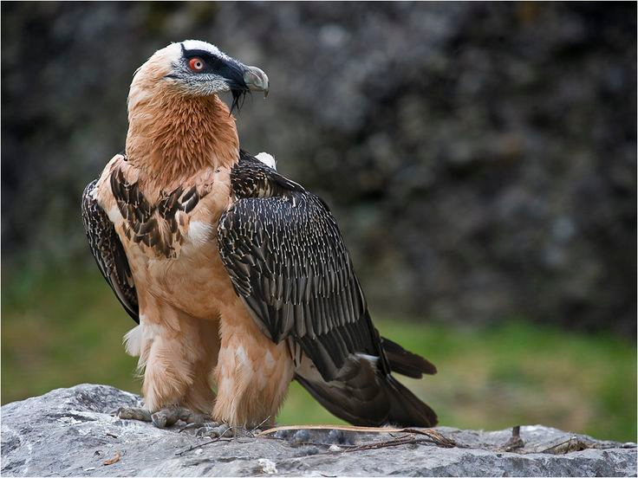
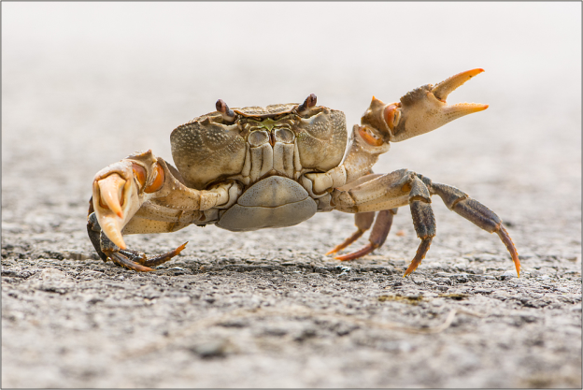
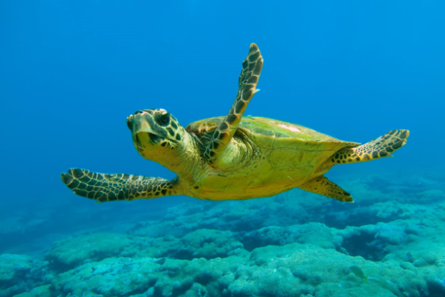
Animals
Kri Kri goats
Bearded vulture
Green lizard
Freshwater crab
Loggerhead sea turtle

Slide 7
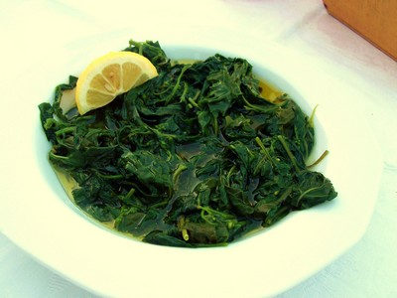
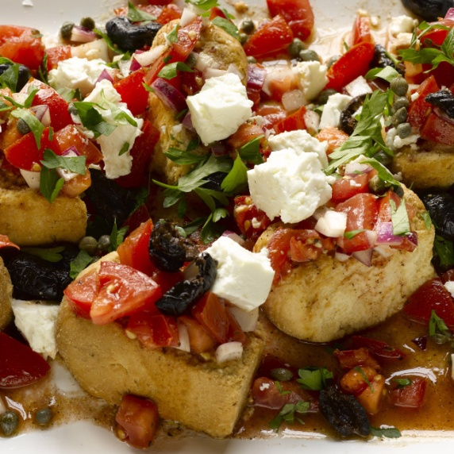
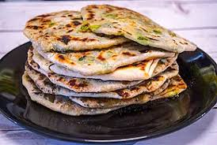
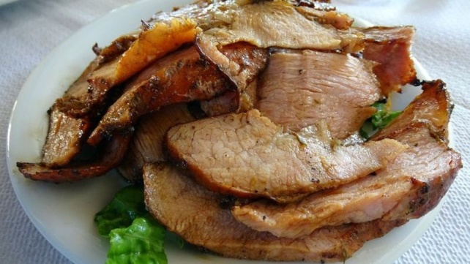
Food
Dakos
Stamnagathi
Apaki
Marathópita

Slide 8
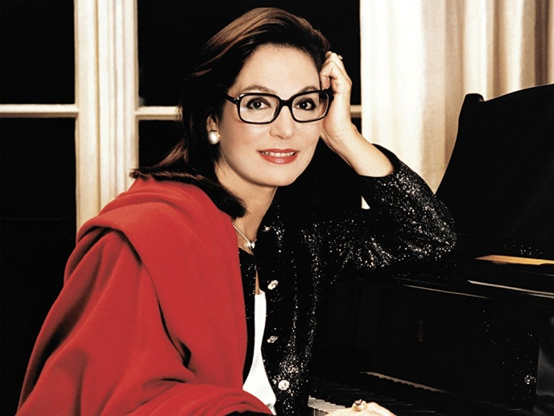
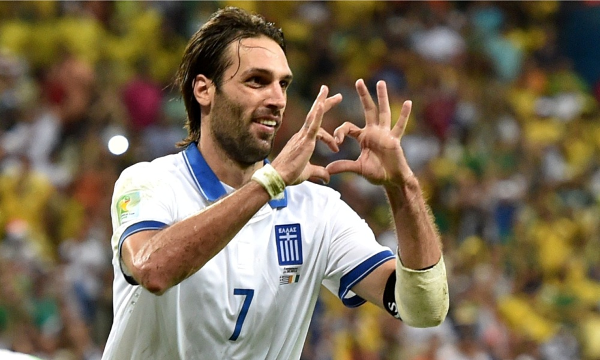
famous people
Nana Mouskouri
Georgios Samaras

Slide 9
music and dance
Kastrinos or Maleviziotis
https://www.youtube.com/watch?v=GWbUXGSEd7I
Nana Mouskouri
https://www.youtube.com/watch?v=yEoK5PmzPpo

Slide 10
Quellen
https://www.tripadvisor.de/Attractions-g189413-Activities-Crete.html 06/12/17
http://www.kreta-reise.info/Hauptseiten/Essen.htm 06/12/17
https://de.wikipedia.org/wiki/Nana_Mouskouri 06/12/17
https://www.transfermarkt.de/georgios-samaras/profil/spieler/6855 06/12/17

