Slide 1
The students from Crete

Slide 2
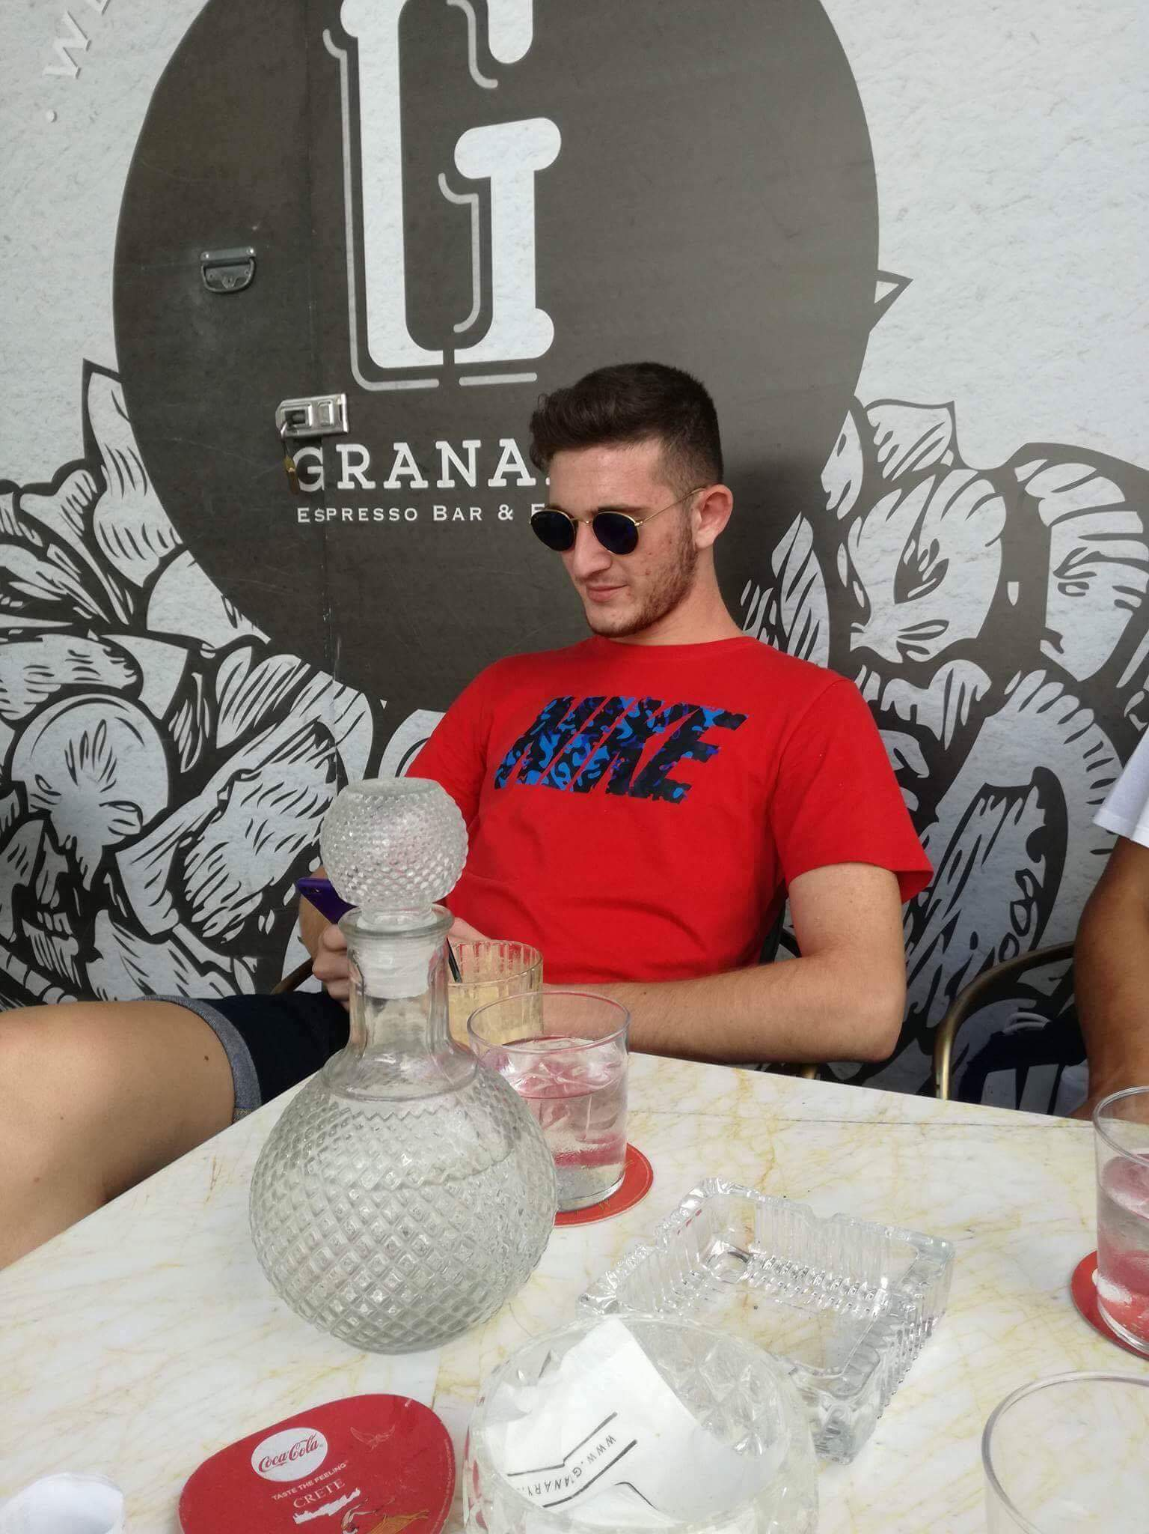
Name: Nikolaos Xristakis
Age: 16
Siblings: 1 brother (21)
Hobbies: basketball; going to the gym; hanging out with friends
Pets: -
Quiz solution: likes to drink coffee
He likes to drink coffee and loves food.

Slide 3
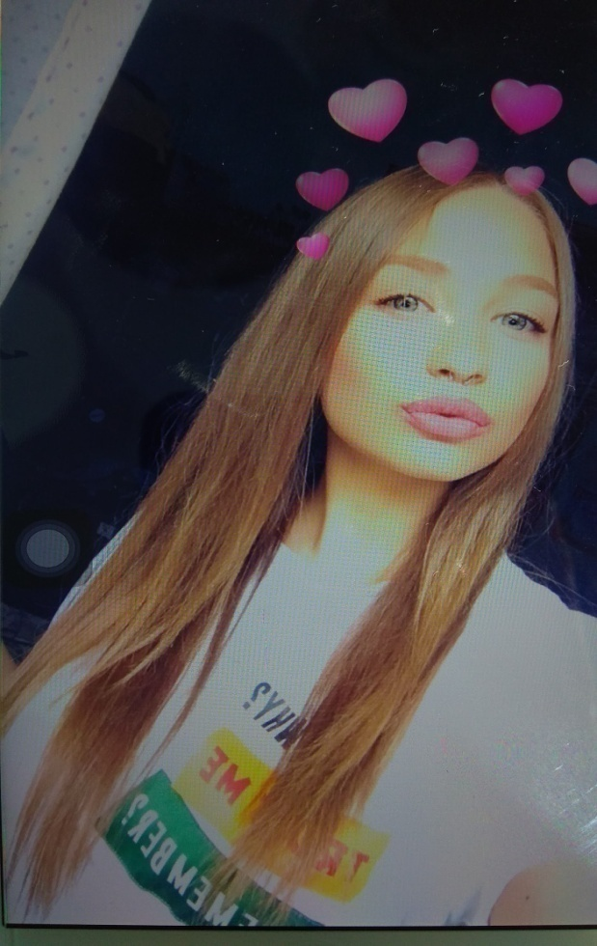
Name: Jenny Galetaki
Age: 17
Siblings: 1 brother (21) and 1 sister (25)
Hobbies: taking photos; hanging out with friends
Pets: 1 dog and 1 cat
Quiz solution:
Her favourite subjects are mathematics, gymnastics and chemistry. Also she likes hip hop and rock music.

Slide 4
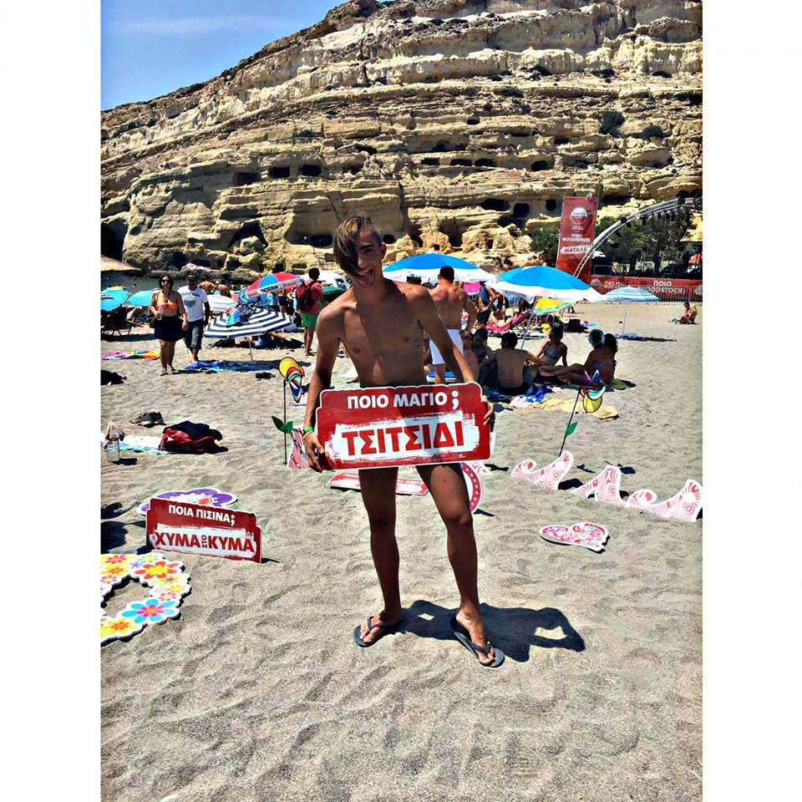
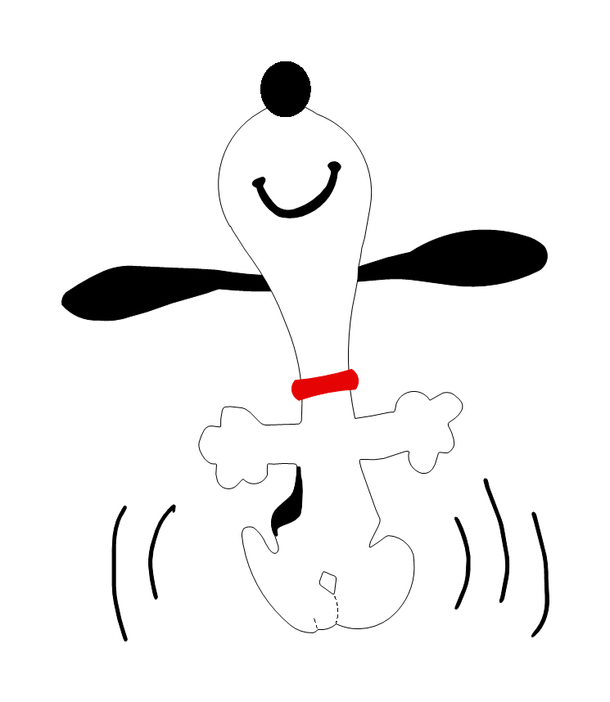
Name: George Vasilakis
Age: 17
Siblings: -
Hobbies: dancing (for 7 years)
Pets: 1 cat
Quiz solution: He´s the hacker from Greece
He also likes computers and listening to music.

Slide 5
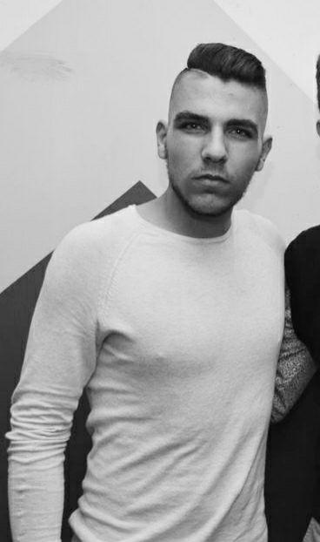
Name: Stelios Troulis
Age: 17
Siblings: 1 little brother
Hobbies: taking photos; hanging out with friends; likes to repair and build things
Pets: -
Quiz solution: He likes sports
He´s interested in all kinds of sports but his favourite one is swimming.

Slide 6
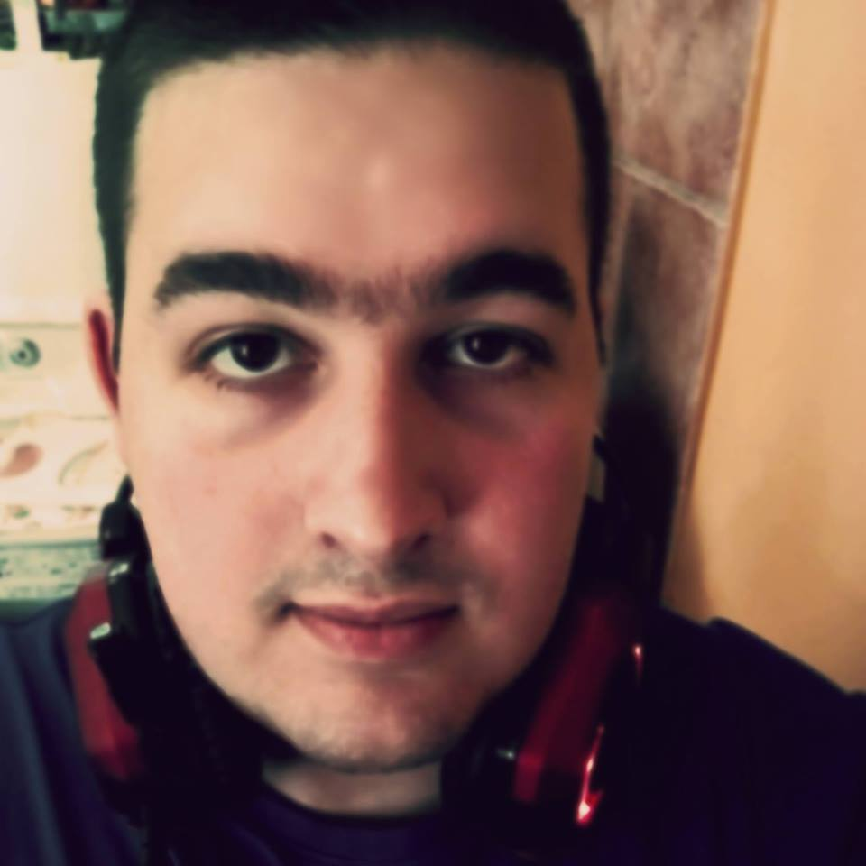
Name: Giannis Migiakis
Age: 17
Siblings: -
Hobbies: listening to music; painting/graffiti
Pets: 3 dogs and 2 cats
Quiz solution: likes to paint
He´s learning how to read programming languages.

Slide 7
WELCOME
TO
GERMANY☺

