Slide 1
Heraklion
Madeleine Jerzabek, Christopher Neumann, Sandra Bride, Silas Müller and Lena Münch

Slide 2
structure
quick facts
location
the school
Knossos
famous sights
famous people
sources

Slide 3
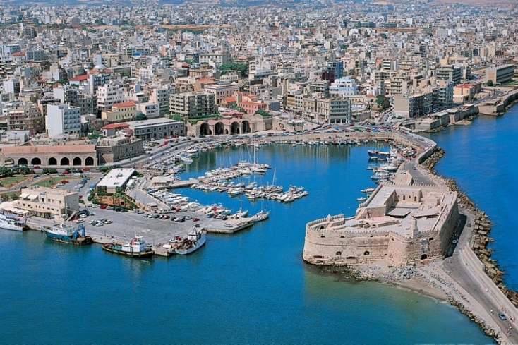
quick facts
the capital city of Crete
fourth biggest city in Greece and biggest in Crete
173.450 inhabitants
from April to October famous tourist destination

Slide 4
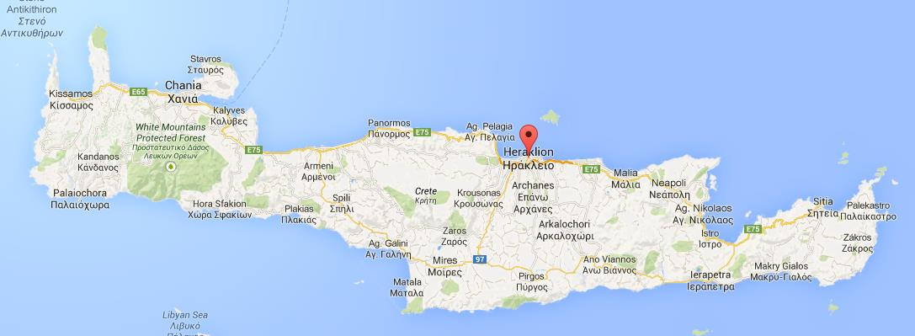
location
an average of 70% hours of sunshine between May and September

Slide 5
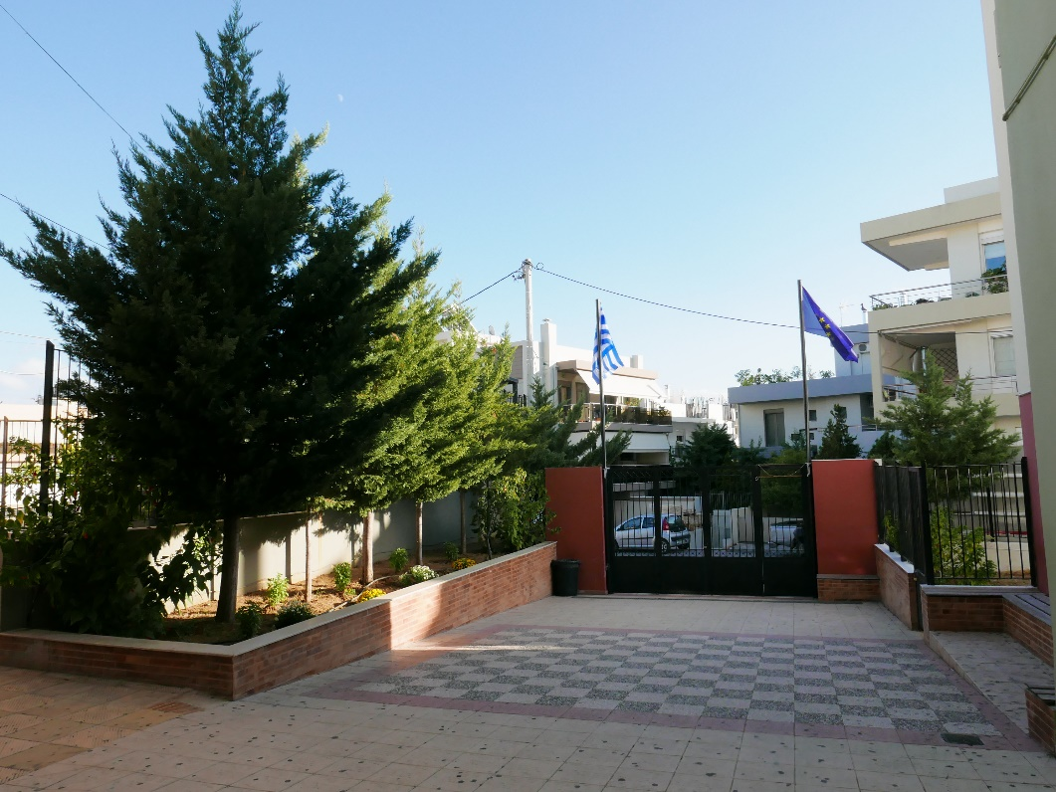
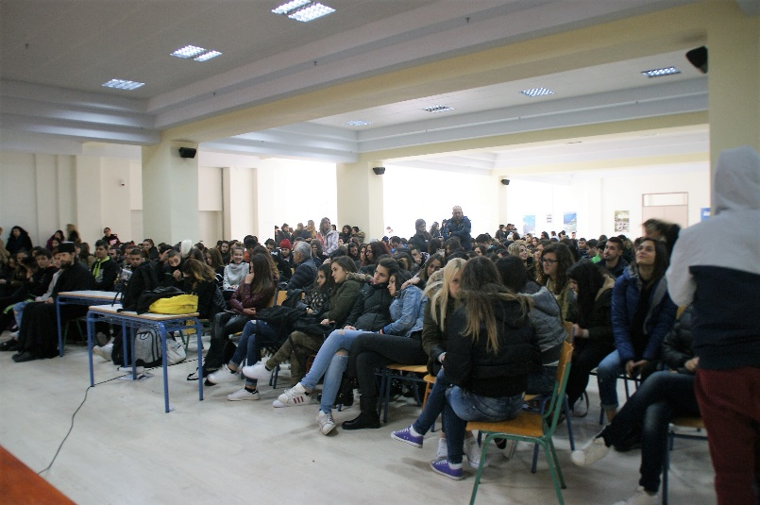
the school

Slide 6
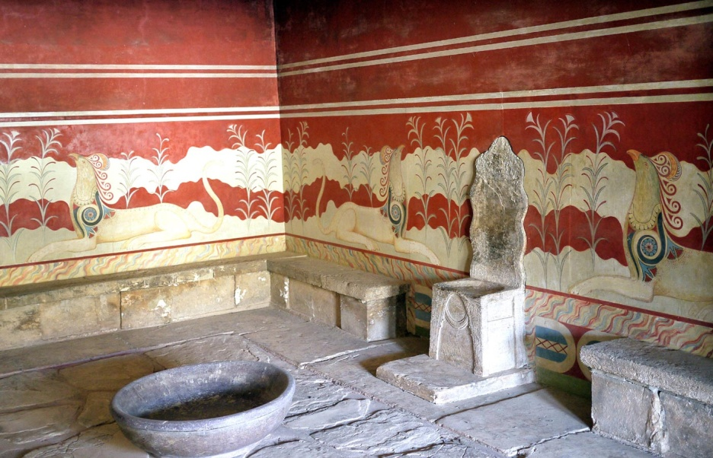
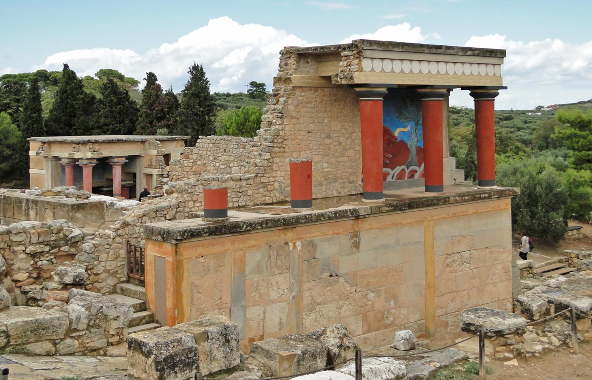
Knossos
population: 100.000 people
ceremonical and political center for Minoan civilization and culture

Slide 7
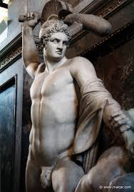
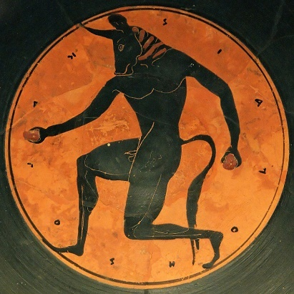
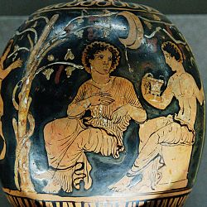
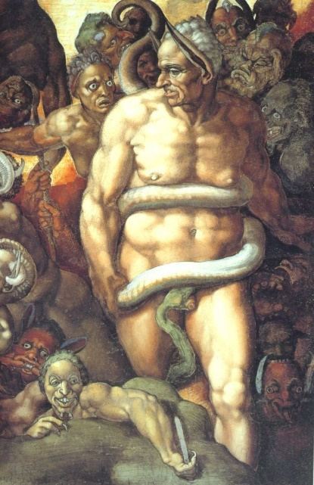
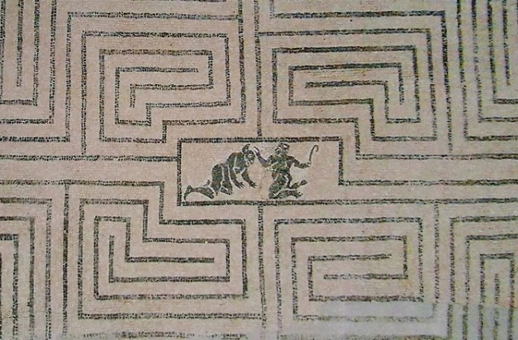
Knossos
Theseus
Minotaur
Ariadne
King Minos

Slide 8
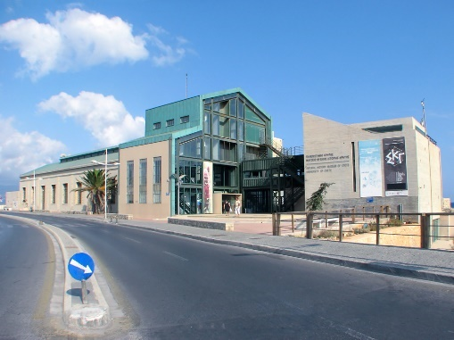
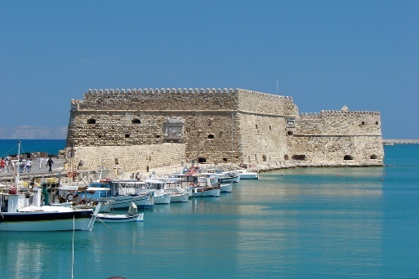
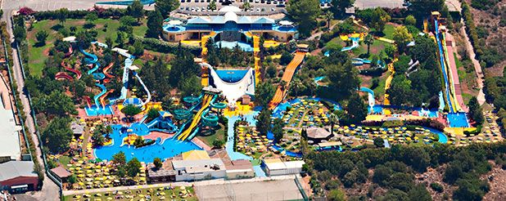
famous sights
The National History Museum of Crete
earthquake simulator, life-size dinosaurs, vivid animals, and a lot more
Castello del Molo (Koules)
Fortress located at the entrance of the old harbour
Crete aqua plus water park
Over 50 water slides, games and facilities

Slide 9
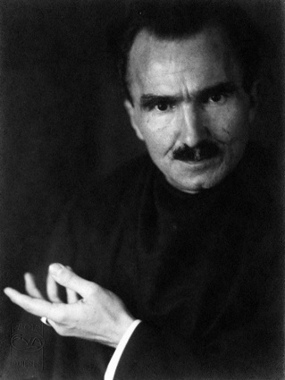
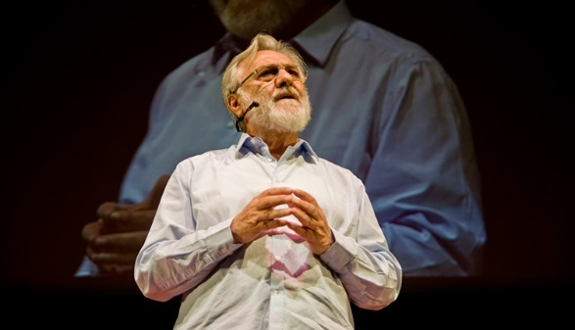
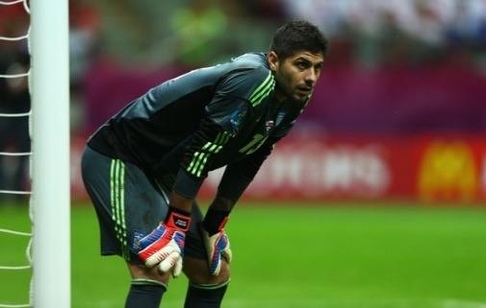
famous people
Nikos Kazantzakis (1883-1957)
Giant of modern Greek literature, 1946 Nobel Prize for Literature
Iannis Smaragdis (*1946)
Greek film director, “Director of the Year“ in Status Magazine in 2008
Michalis Sifakis (*1984)
Goal keeper for Samsunspor(Turkish football club)

Slide 10
Thank you for listening

Slide 11
sources
https://www.armoniabeach.gr/de/location.php (11.12.2017)
https://www.rossilena-tours.gr/de/ausfluege/69/acqua-plus.htm (11.12.2017)
https://www.storyblocks.com/stock-image/illustration-of-the-national-flag-of-greece-shaped-like-a-heart-bfz8glsh3ej0ybqytc (11.12.2017)
http://greekspiti.com/en/classical/from-heraklion/heraklion-knossos-rethymno-chania-one-day-tour (11.12.2017)
http://www.hephaestuswien.com/2017/10/blog-post_51.html (11.12.2017)
https://www.thehotel.gr/info/el/%CE%9A%CF%81%CE%AE%CF%84%CE%B7/%CE%97%CF%81%CE%AC%CE%BA%CE%BB%CE%B5%CE%B9%CE%BF/%CE%9A%CE%BD%CF%89%CF%83%CF%83%CF%8C%CF%82 (12.12.2017)
http://antiquatedantiquarian.blogspot.de/2015/04/the-minoans-labyrinth.html (12.12.2017)
http://www.spiegel.de/fotostrecke/fotos-bilder-griechenland-vor-dem-fussball-duell-mit-deutschland-fotostrecke-83846-9.html (12.12.2017)
http://www.kainowska.com/sito/very-friendly-ematologi-cannibali-assassini-seriali-ed-altri-demoni-illustri/ (11.12.2017)
https://www.armoniabeach.gr/de/archaelogical.php (12.12.2017)
http://download-wallpaper.net/content/theseus-against-the-minotaurus.html (11.12.2017)
http://thegreekobserver.com/greece/culture/article/16684/scenes-yannis-smaragdis-new-film-nikos-kazantzakis-screened-days-ago-crete-exclusive-scenes-soon-thegreekobserver-com/ (12.12.2017)
http://www.maicar.com/GML/000Images/tim/theseus0509.jpg (14.12.2017)
https://upload.wikimedia.org/wikipedia/commons/f/ff/Michelangelo-minos2.jpg (14.12.2017)
https://de.wikipedia.org/wiki/Ariadne#/media/File:Dionysos_Ariadne_Sydney_46.48_Painter_Louvre_G588.jpg (14.12.2017)

