Slide 1

Think future
Brooke Garrod
Ana Andreea Stah
Alexandra Pintilie
Estera Dumitrache
Lilli Schmitt
Mia-Madeleine Goebel
Ann-Kathrin Müller
Giannis foukakis

Slide 2

Our aims and aspirations
Our business aims:
That many people benefit from the product and it is useful in everyday life
Through introducing the product it will help the environment
To replace traditional plastics with bioplastics, benefiting the future
Our aspirations:
We are creating cool eco-friendly lunch bags, suitable both for teenagers who take their lunch to school and for employees who don’t have time to leave the office for a consistent meal. We produce them in mass, for local businesses, such as bakeries, supermarkets and cafeterias. They can then be purchased in a variety of ways.

Slide 3
Recipe
90 ml water
food colouring
1-2 teaspoon Na-Alginat
120 ml 1%ige Glycerol solution

Slide 4
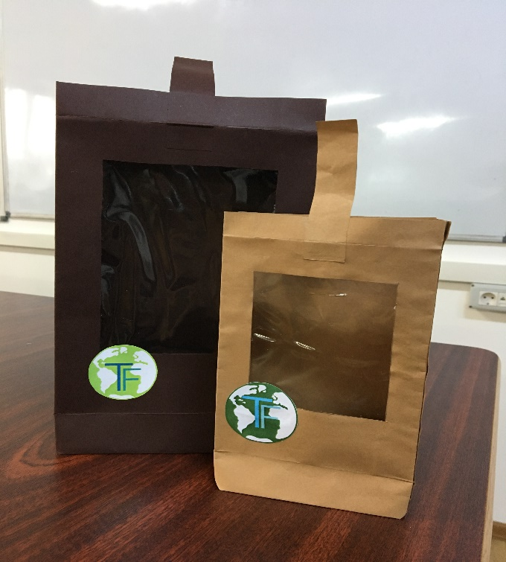
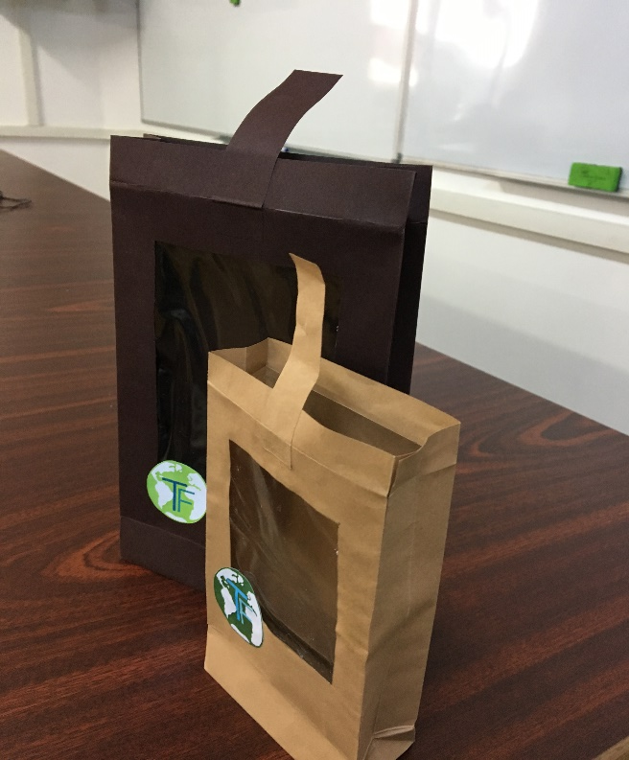
Our product
This is our bag,our final product with all necessary improvments in order to be more resistant,better looking and still eco-friendly. For this,we’ve added a manual seal made out of paper and a computer made logo. Also,we’ve used a thicker material and ecological glue.

Slide 5
SWOT ANALYSIS
FOR OUR PRODUCT
Strengths
-It has a window so you can see what is inside
-It has an appealing design
-It comes in different sizes
-It has a locking system
Opportunities
-our target customers are big companies which need such bags for their own product,but also regular customers
Weaknesses
-It is not waterproof
-It can sustain only up to 1kg products
Threats
-environmental awareness among people have increased massively in the last 3 years, therefore there is an important number of companies which are leading this industry

Slide 6
Market research
A possible target group for our product could be bakeries, independent sellers, cafeterias and supermarkets.
A good promotion technique would be to emphasise the benefit of bioplastics on our future
Lunch bags that are on the market are currently made from a thin plastic made from low density polyethylene, it is estimated that 500 billion to 1 trillion plastic bags are used worldwide each year.
On average we only recycle 1 plastic bag for every 200 we use

Slide 7
Market strategy
1.Choosing our target market :We have chosen to do lunch bags because of the big range of people that can use it,and also for partnerships with big companies who promote healthy lifestyles and better alternatives for the future
2.The need that our product fulfils: Every product should have an utility. Our product should be used because is eco-friendly and it has a good price.
3.Competitors:Our competition is represented by other businesses doing the same products.We have to prove though that ours is the one to choose and to make it as close as possible to our clients desires.
4.Feedback:This is the key to a good relationship with our customers. People should be able to give their opinion, and to create a healthy relationship with them.

Slide 8
Competitor analysis
Name, location and business size | Product/service | Price | Strengths | Weaknesses
Bio Futura Disposable Discounter | Biodegradable waste bags Carry bags, snack bags, cups, plates, cutlery | 0.07835 euros per bag 0.34 euro per snack bag | -flexible -they have made themselves a name in this area -cheap -bioplastic -large quantity | -cannot withhold a large quantity -flimsy

Slide 9
Unique selling points
-100% bioplastic
-uses raw materials
-comes in a wide range of sizes
-has an organic appearance
-has combined materials
-has an original logo

Slide 10
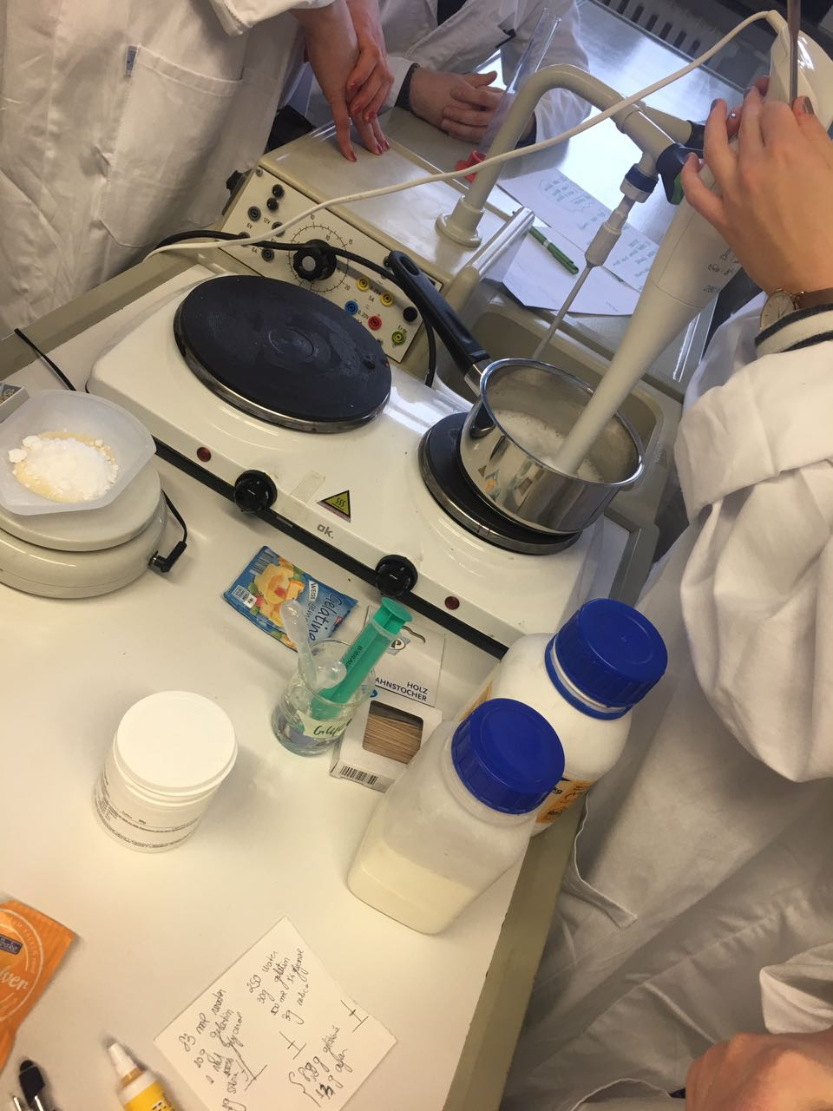
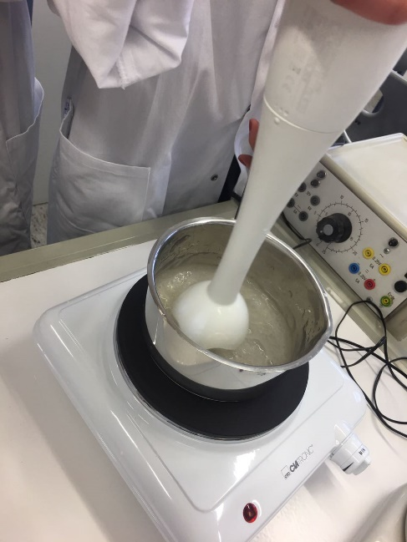
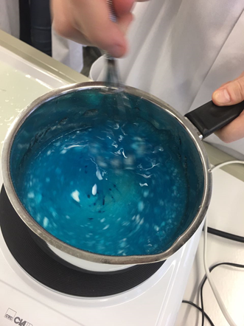
STEP 1: Preparing
We added the water, glycerol solution and Na-Alginat.
Mix well while the pan is on the heated stove.
When the mixture gets to a thick consistency turn off the stove.

Slide 11
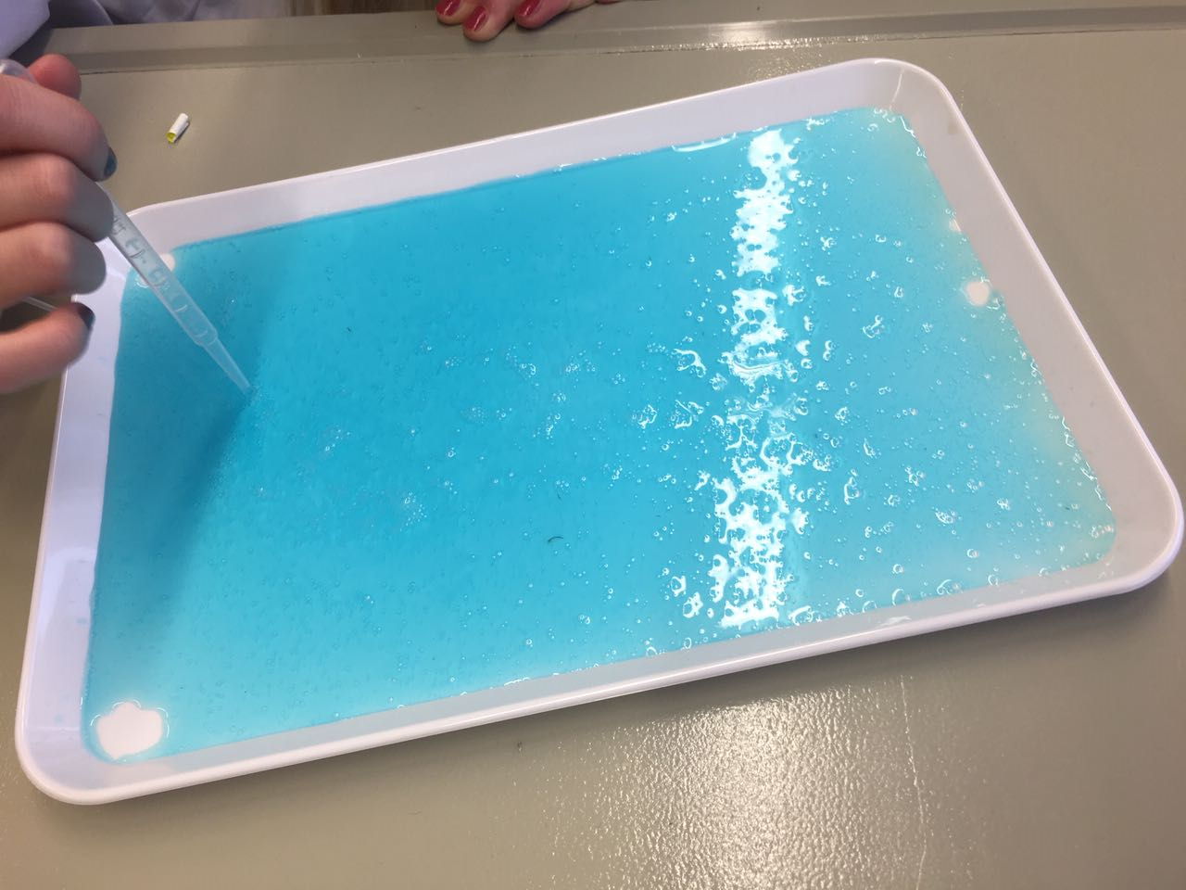
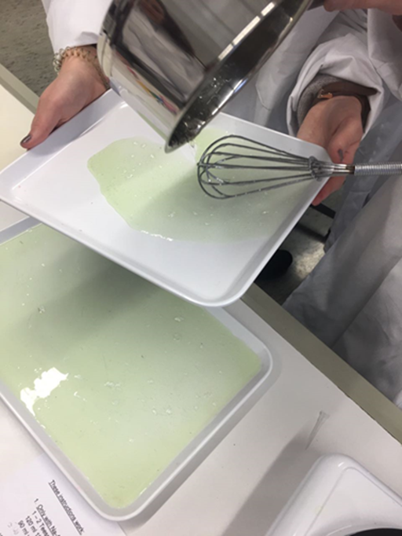
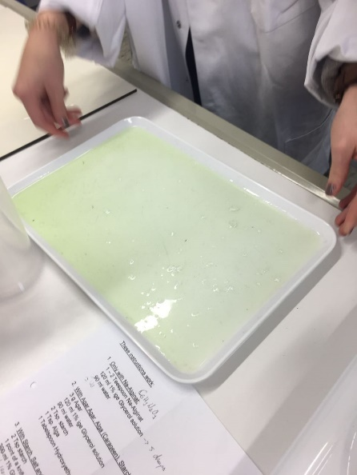
Step 2: Shaping
Quickly pour the mixture on a flat surface
Tilt the tray until the mixture is spread evenly
Pop the bubbles in the end if necessary

Slide 12
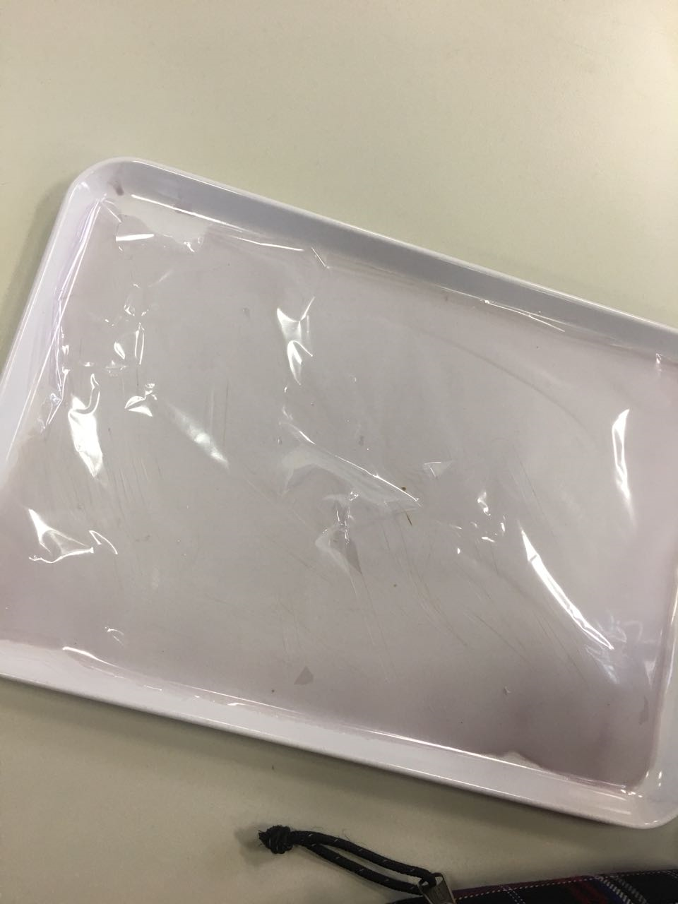
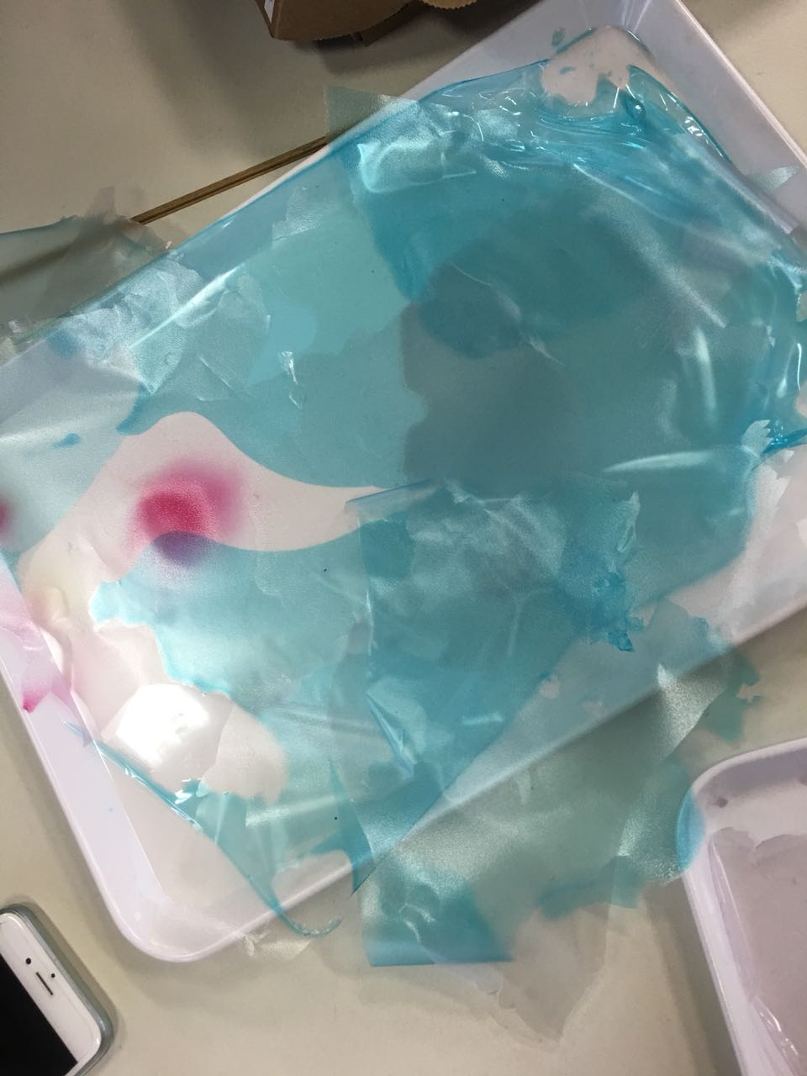
STEP 3:DRYING
The process of drying the bioplastic can take between 2 to 3 days
Also,for faster results you can put it into the dryer

Slide 13

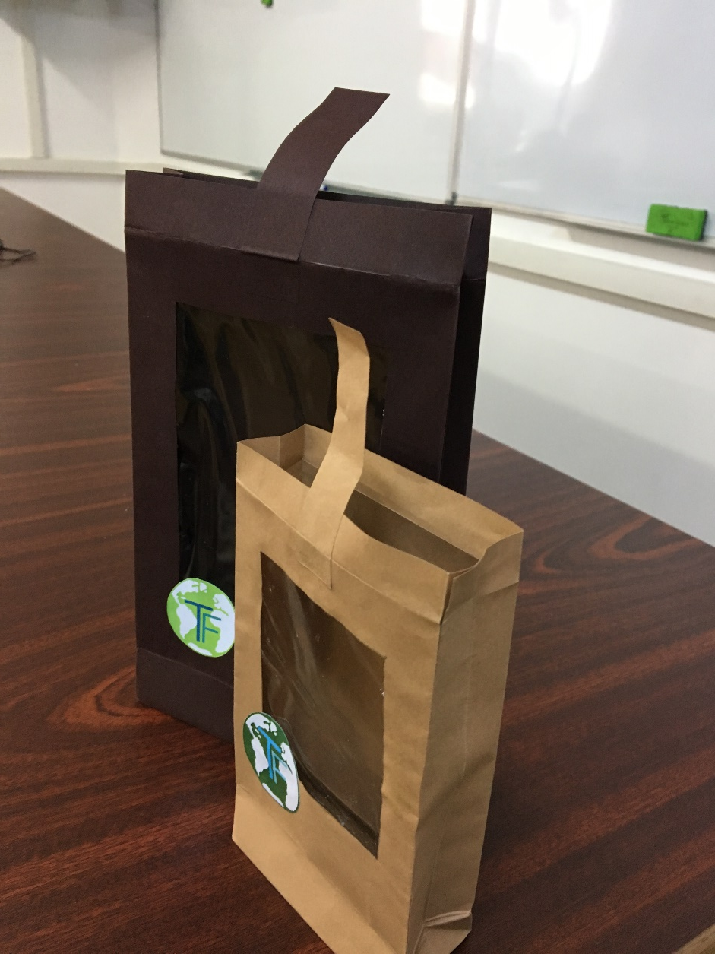
Final result

Slide 14
Chemical reaction
+
Na-Alginat

Slide 15
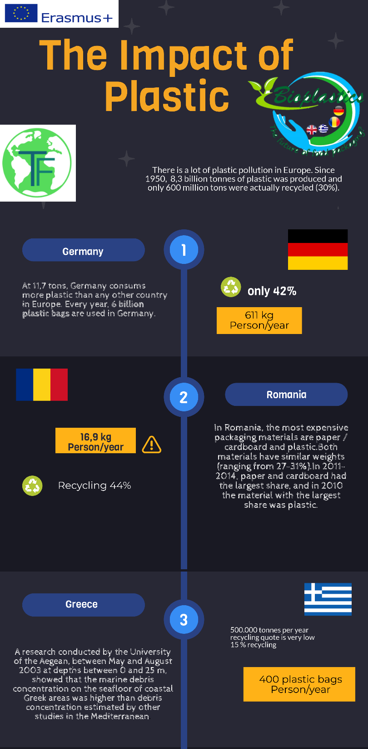


Slide 16
