Slide 1
The impact of plastics
upon Romania &
the whole world

Slide 2
Unfortunately, Romania does not count among the first countries at recycling, with a waste collection rate under 20%. Sweden and Norway are top ranked, with a rate of 85%, followed by Germany (70%), Austria (60%) & Belgium (55%).
In spite of this controversial situation, it is said that it has got to this point due to the fact that each country has different opportunities, such as: the recycling technologies, infrastructure and awareness brought to the citicenz.

Slide 3
The most common types of materials used for primary packaging are paper or pulp-based materials, glass, metals (e.g. aluminium and steels) and plastics.
As of 2014, bioplastics represented approximately 0.2% of the global polymer market (300 million tons).
For instance, Activia has introduced the bidegradable yougurt cups.

Slide 4
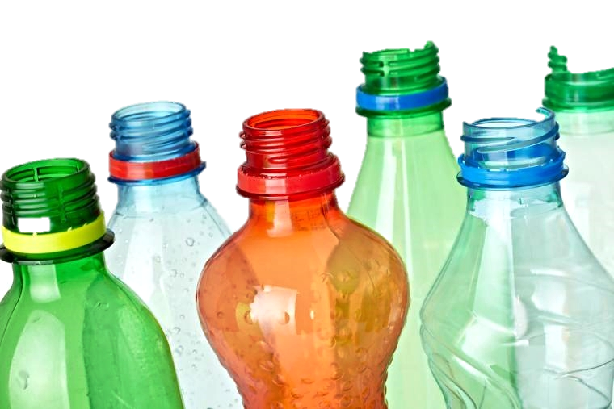
After being banned at an international level by the European Comission, plastic bags will finally be prohibited in Romania starting from january 2019. Even though the use of recyclable materials has been more encouraged since 2018, the new year will bring us a law regarding compulsory biodegradable bags.

Slide 5
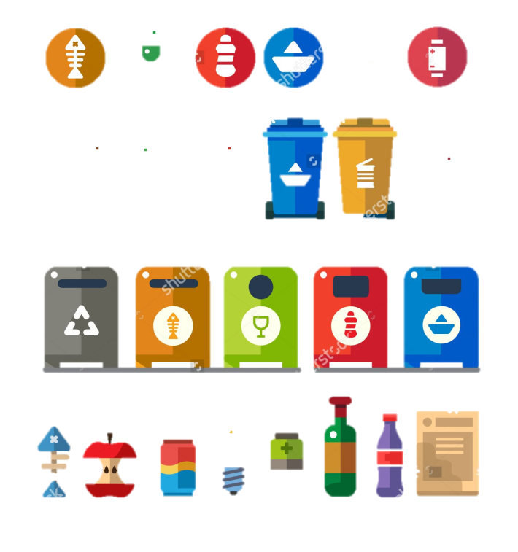
The eco-packaging tends to be the next target of unprecedented interest in reducing consumption of raw material to protect food and other products. The packaging itself is responsible for about 10% of the environmental impact of any object purchased. In addition, almost 30% of the food sold in different stores gets untouched in the citizen garbage, and at the same time were recorded losses of money.

Slide 6
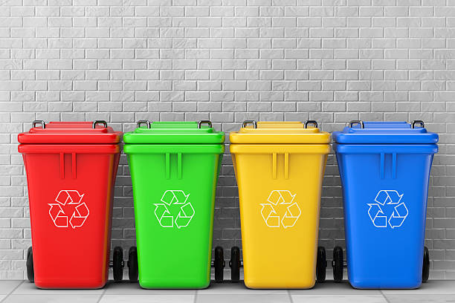
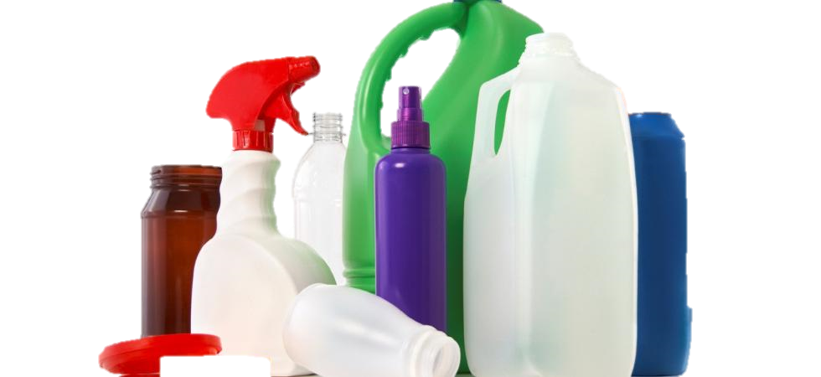
Most Romanian organisations have implemented environmental management system (EMS) that allows them to comply with legislation and environmental requirements. One of these requirements is the selective waste management (plastics, paper and cardboard, electrical and electronic equipment, household, etc.)

Slide 11
It is known that environmental indicators are based on statistics and accounts. Not only do they allow comparisons over time, but also provide warning signals and help in making decisions. According to www.eurostat.com, 2014 has registered the following outcomes:

Slide 12
“Heal the world Make it a better place For you and for me And the entire human race There are people dying If you care enough for the living Make it a better place For you and for me”
–Michael Jackson

