Slide 1
Erasmus Project Bioplastics
Jana Seyfang & Natalie Englert | 26 January 2018
© 2018 FrieslandCampina

Slide 2
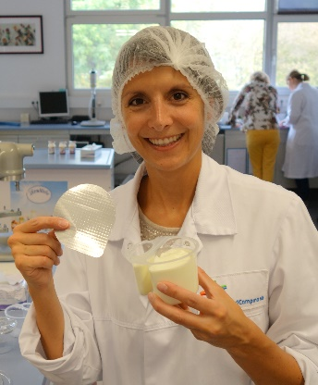
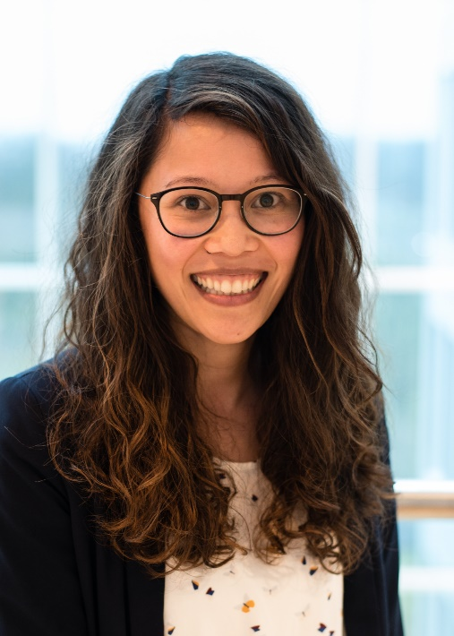
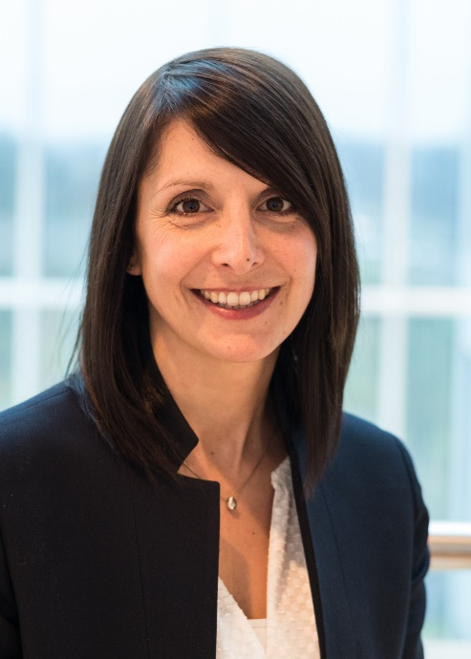
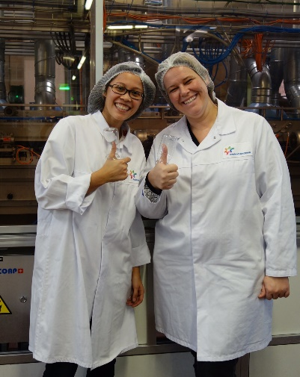
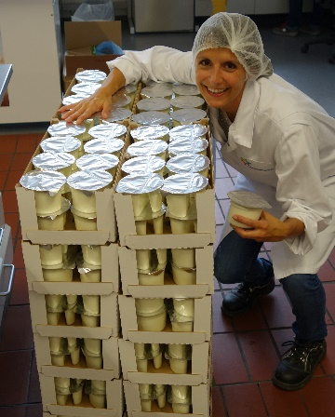
Who are we?
Natalie Englert
Jana Seyfang
Packaging Development Manager

Slide 3
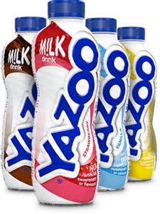
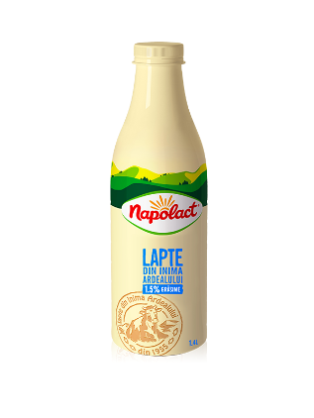
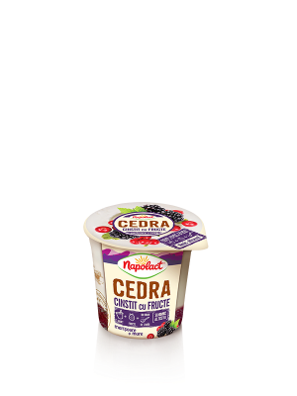
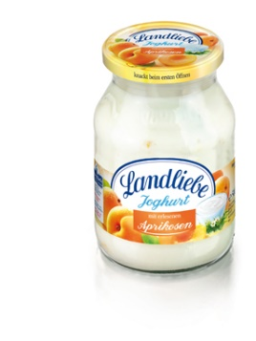
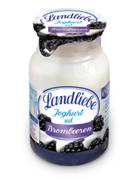
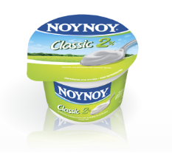
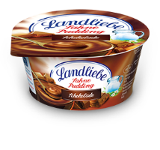
Do you know our products?

Slide 4
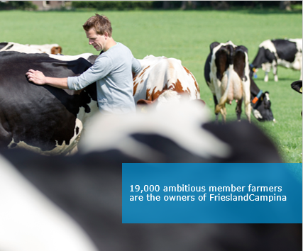
FrieslandCampina
Facilities in
21,927
18,906
Every day
33
millions
Export to over
countries
employees
member dairy farmers
of consumers
100
countries
Consumer
Foodservice
Ingredients

Slide 5
Functions of packaging
Convenience
Communication
Protection
Containment

