Slide 1
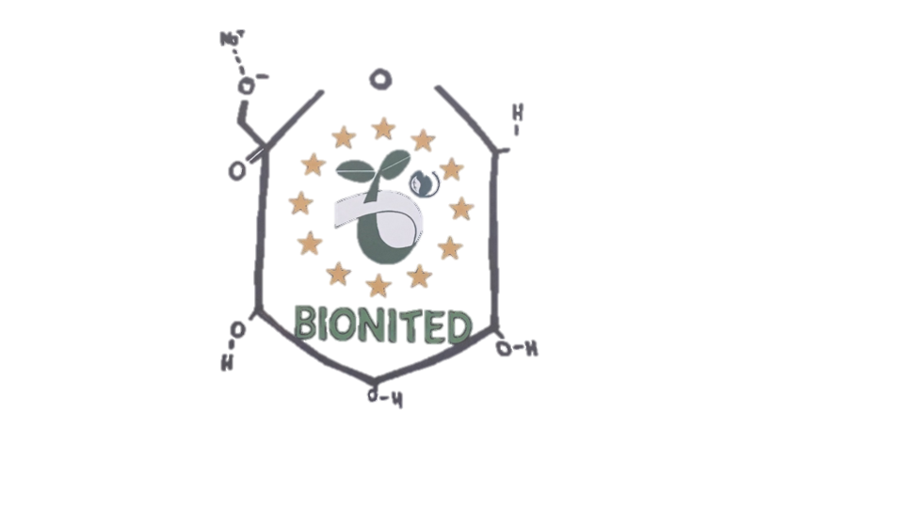
Bionited
Erasmus + Project: The future of food packaging?

Slide 2
Who are we?
Position | Names
Group Leader | Mike Stavrakopoulos
Vice-president | Lena Schadt
Press | Madeleine Jerzabek
Press | Thierry LeMasonry – Bennet
Minutes | Gavriluta Iustina
Minutes | Malina Cojocaru
ChemSketch | Lily Wicketts
ChemSketch | Andreea Mitroi

Slide 3
A brief description of what our business will do:
-we produce a bioplastic packaging
-we produce a sustainable product for future use
- we imporve the idea that nature is very important
-it reminds you that YOU are part of NATURE and you should take care of yourself
Business aims?
- Save nature in the oceans - Save the enviroment
- Beneficial to the enviroment
- Reduce pollution
- Create a better world

Slide 4
Business summary:
We want to produce eco-friendly bioplastic for everyday use. We also want to improve the idea that nature and our environment are very important and that we have to protect it. The future is for everyone!
Business aims (what does your business aim to achieve?):
We want to stop polluting our environment and preserve nature. We also want to produce sustainable and affordable bioplastics to save to future of upcoming generations.
Elevator Pitch
If you found yourself in a lift with Bill Gates, what would you tell him about your business? Remember, he has lots of money he might want to invest, so it is important to impress him!
We would say:” We want to save the environment and the future of upcoming generations with our bioplastic products, because the future is for everyone! We want to start selling our products in continents like America and Asia, as we believe it will create the biggest impact, due to their large populations. 50% of the plastic Americans use are thrown away after one use. This means the average American throws away approximately 185 pounds of plastic per year. We aim to change this and reduce the pollution that is caused by the consumption and production of regular plastic.”

Slide 5
Vision Statement (What is the perfect end goal, e.g. product? The elevator pitch can help you to define your goal.)
We want to create a product that is affordable, sustainable and available to all, in order to reach our goal. We aim to preserve and protect the environment, as well as influencing a movement, which enforces mandatory use of bioplastics in everyday life.
What makes your customers buy your product/service?
The use of the bioplastics and the reasoning behind our products would be one of the selling points, as well as the environmental benefits. We also aim to create affordable products, which people can easily obtain and use for a reasonable price.
Recipe used to make bioplastic:
310 mL of water
1 ½ tsp of Na-Alginate
5-7 drops of glycerine

Slide 6
3. Products and services
What are you going to sell?
a product
Describe the basic product/service you are going to sell:
Chinese boxes/ oyster pails
4. The market
Our customers are both individuals and companies.
Describe your typical customer:
Our typical customer would be someone who has an interest in environmental preservation, but we hope in the future that everyone will use bioplastics as a mandatory product in their everyday life.
Where are your customers based?
We hope that our product will be consumed worldwide, but ideally, North America and Asia, as they have very large populations.

Slide 7
5. Market research
Go online and look for information concerning your product (material, shape, possible target group, customer awareness, materials that you can use, promotion techniques, etc.)
Key findings from internet research:
Folded, wax or plastic covered paperboard containers
Found primarily in American Chinese culture, but has recently been seen in European countries like Germany and the UK
The younger generation is more likely to consume our product but anyone can have the opportunity to try it
Promoting Techniques:
Internet promotion – Advertise our products on websites or social media since it is being used almost all over the world.
Point-of-sales promotion – Put up banners on public means of transport.

Slide 8
How are you going to advertise your product? | Why have you chosen this marketing method?
Celebrity endorsement Internet/ media Radio Advertisement | Influential people are able to spread awareness quickly and more effectively A lot of people use social media and technology so, the chance of the product being seen and spoken about is more likely People listen to the radio while they are in their car.

Slide 9
SWOT Analysis
Strengths Popular product Biodegradeable Many uses Eco friendly Easy to transport | Weaknesses The strength of the box. Quite limited Range of sizes Not waterproof
Opportunities The different shapes and sizes we can possibly create Branch into other foods. | Threats The chinese market Competition between existing companies

Slide 10
Short-term plan(The first year):
Have our products sell, and possible improve the design if suggested or needed.
Long-term plan(The first 2 years):
Branch out into different food markets to expand the customer base.
Plan B:
We’ve already changed our products so we would be able to adapt and alter our product to suit the situation.
We could possible alter the design or change the product completely depending on the severity of the failure.

Slide 11
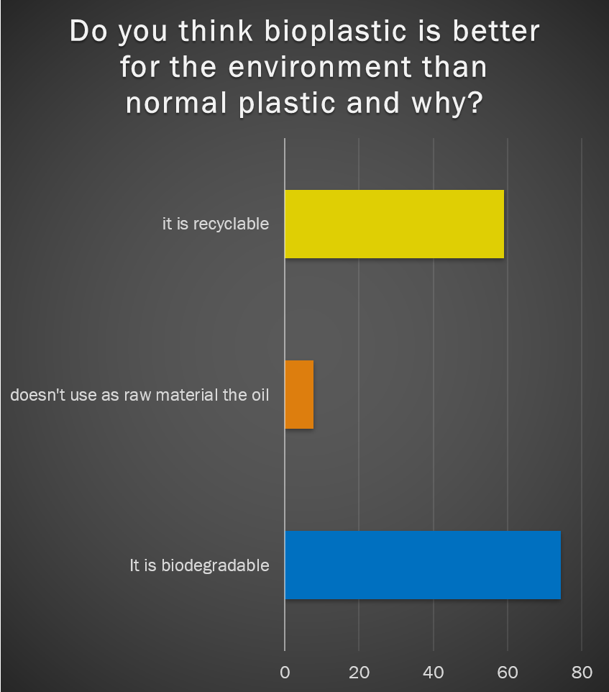

Slide 12
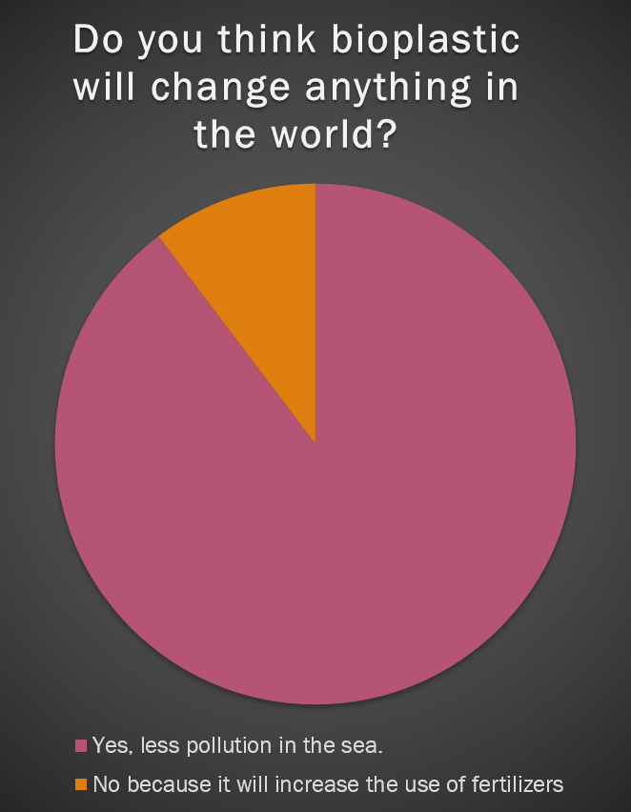
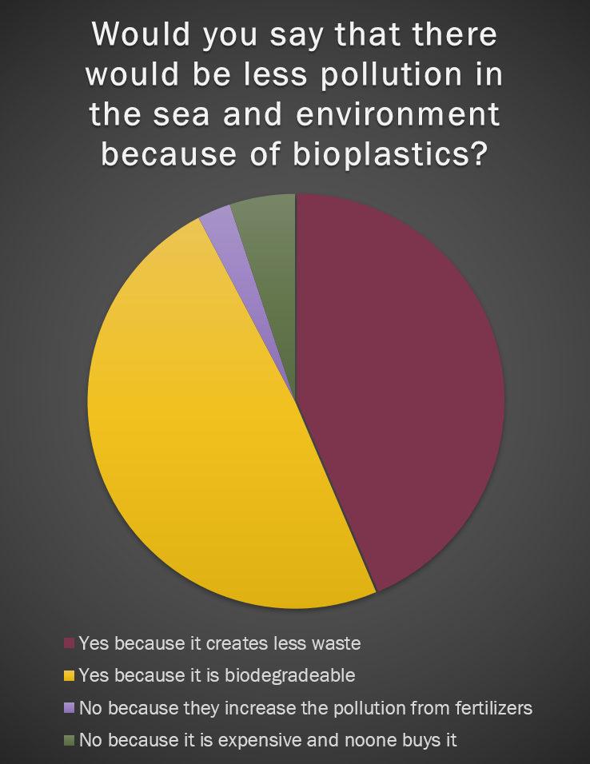

Slide 13
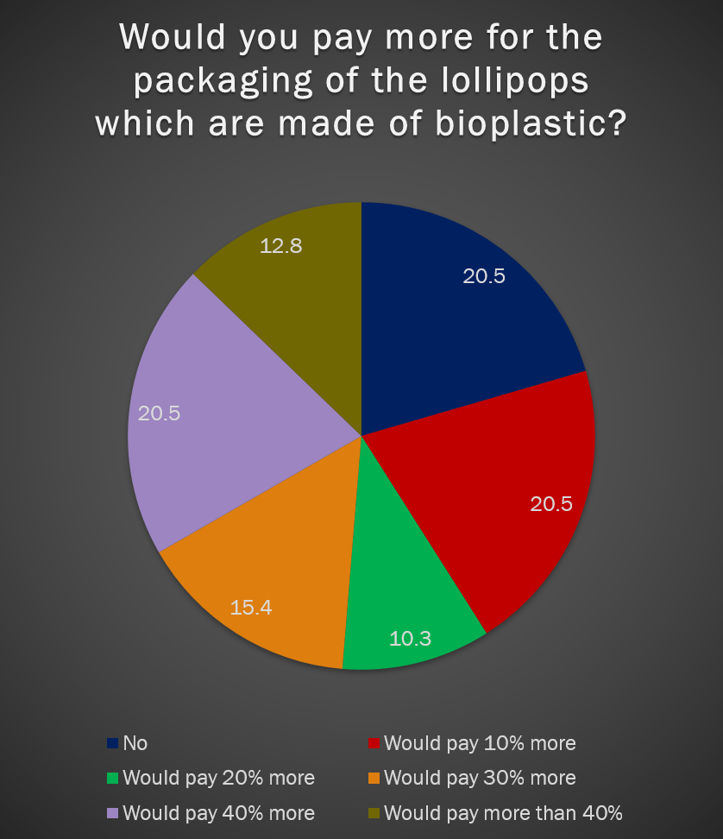

Slide 14
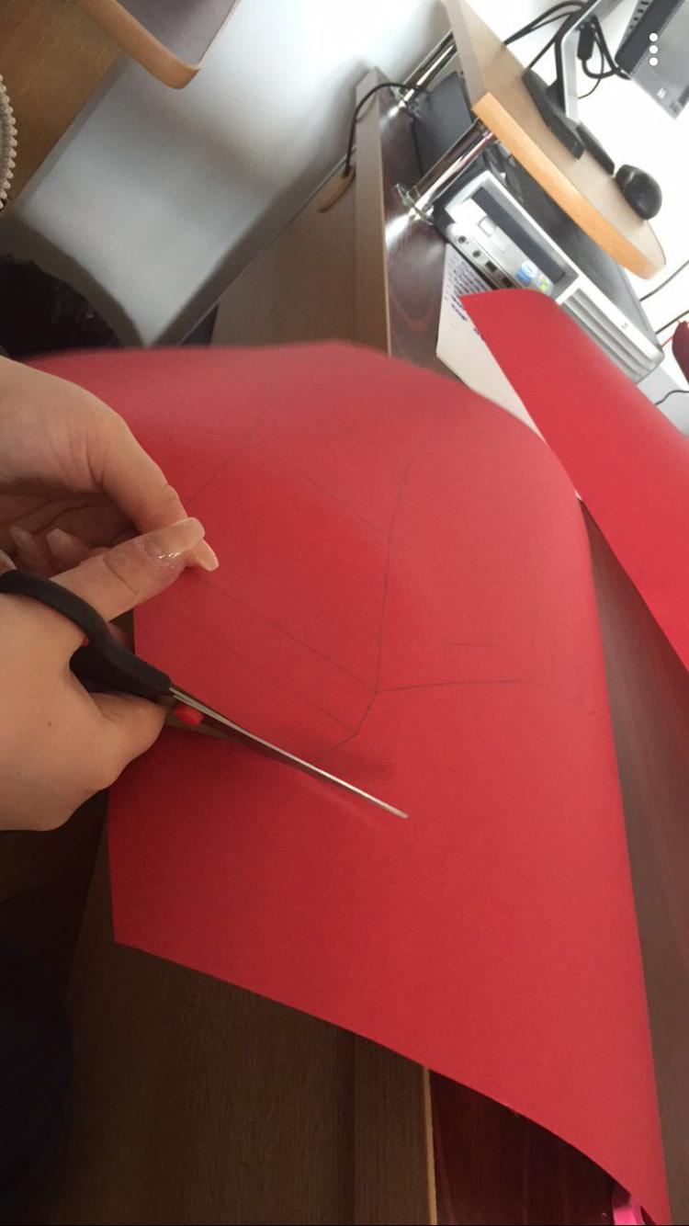

Slide 15
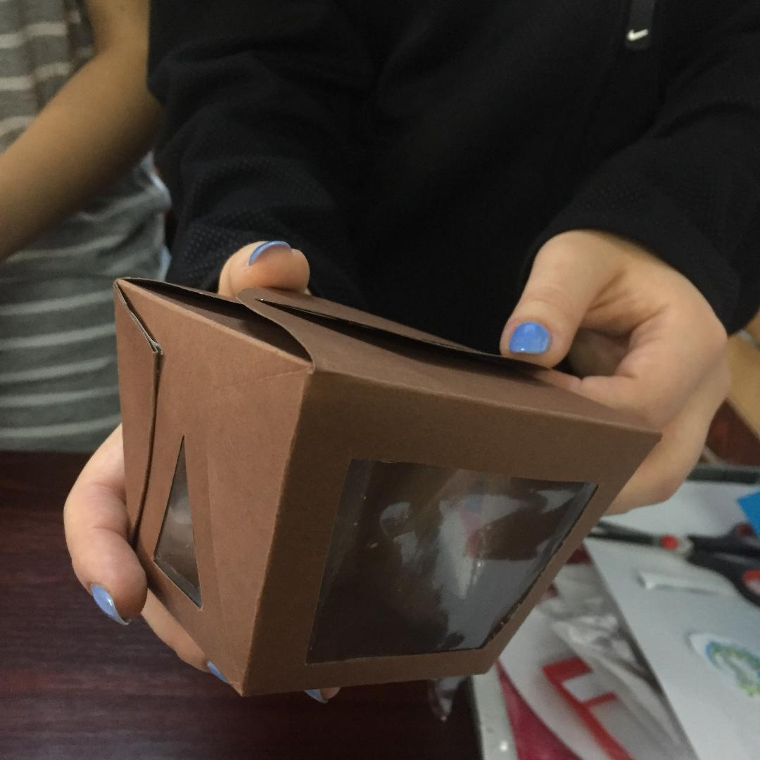

Slide 16
Infographics

Slide 17
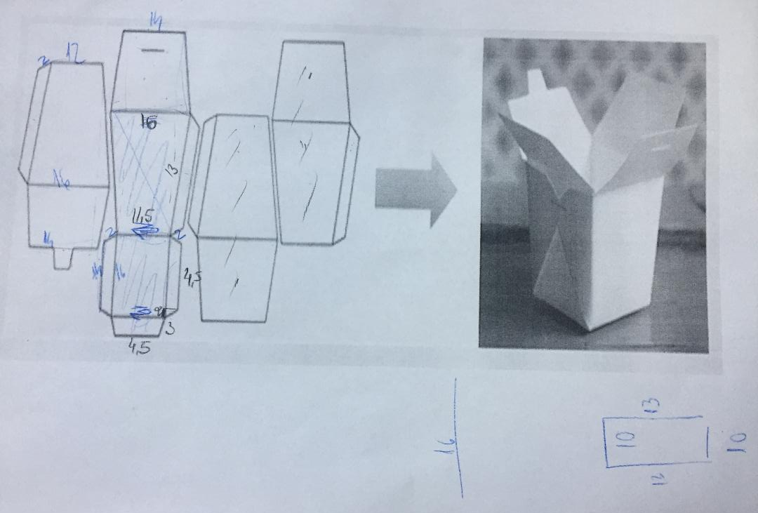

Slide 18
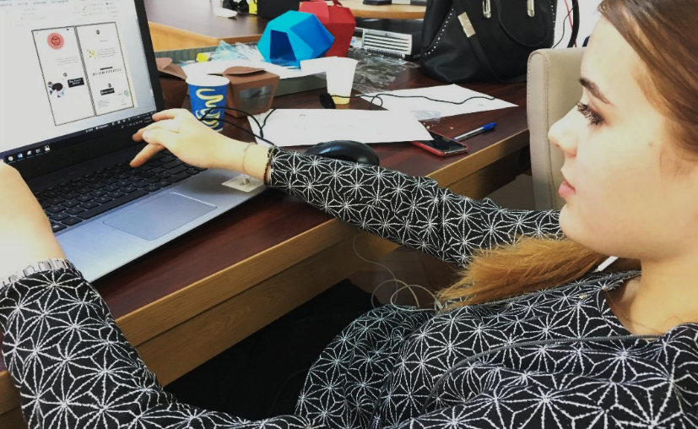
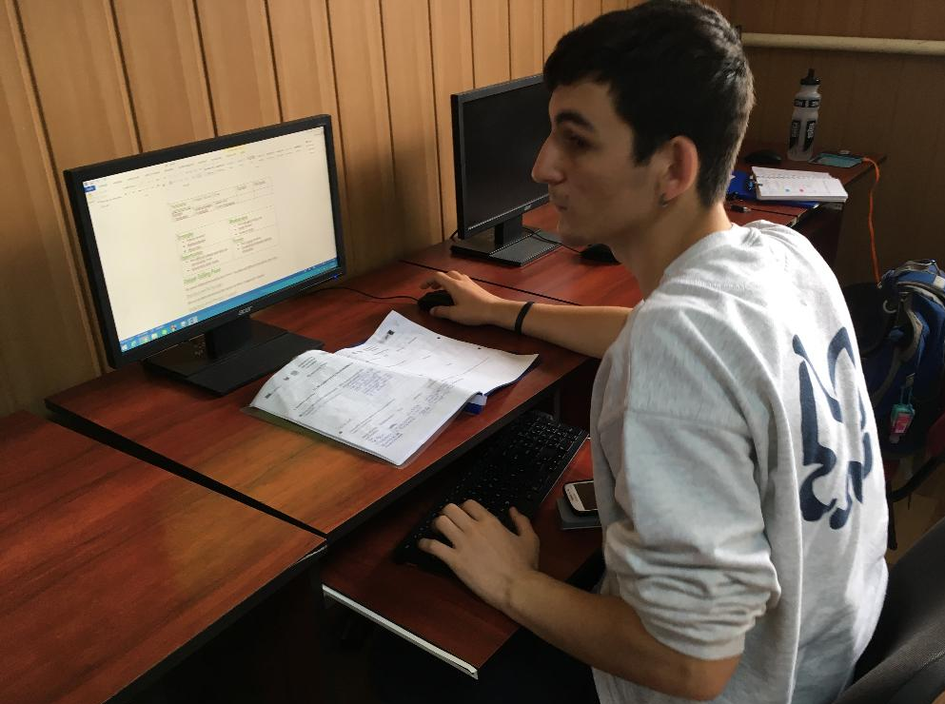
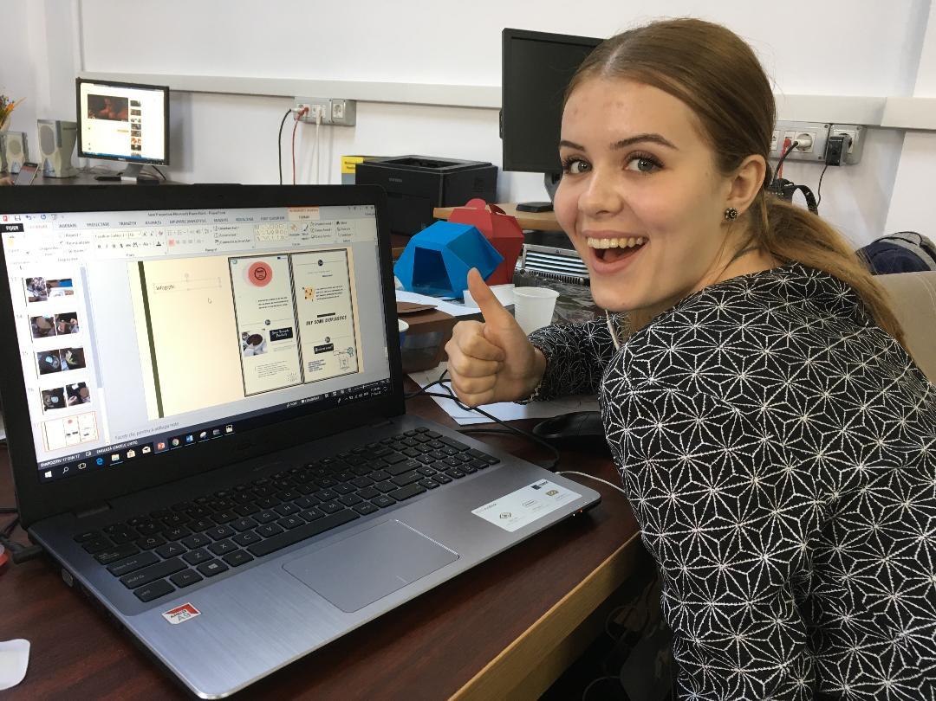
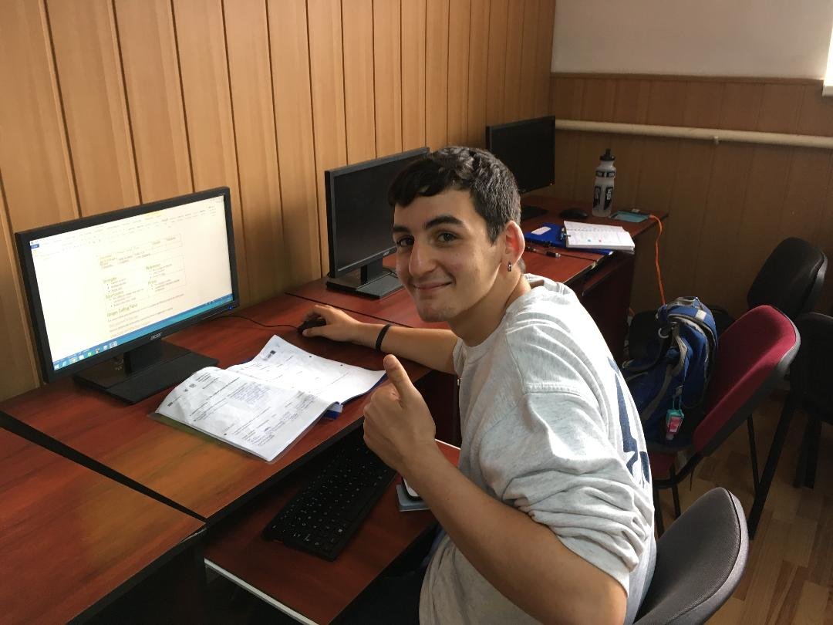

Slide 19
Thank you for your attention!

