Slide 1
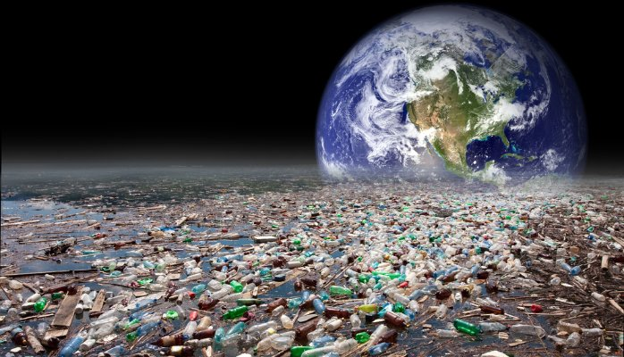
The use of plastics and contamination in Greece

Slide 2
The Hellenic reality - The issue with uncontrolled landfills.
The Mediterranean sea.
Common ways of waste disposal.
Why bioplastics?
The 3Rs principle.

Slide 3
According to surveys, every Greek produces an average of 500kg of rubbish per year

Slide 4
Between 2014 and 2016, Greece has paid a fine of 51.8 million € for violating the European legislation on the operation of Uncontrolled Waste Disposal Sites
In 2017 there were still dozens of landfills that burdened the environment and public health.
Notes:
By "uncontrolled landfills" we mean disposal of waste in areas that do not comply with environmental protection rules to prevent the emission of gaseous pollutants or contamination of aquifers.

Slide 5
The definition of the location of Waste Disposal Sites in Greece is a difficult process since no one wants such a facility near his residence.
The causes of this reaction are :
The degraded and often hazardous nature of waste.
The public concern of the inappropriate design of such spaces.
The fact that just recently Greece has begun the process of building waste disposal sites according to international health standards

Slide 6
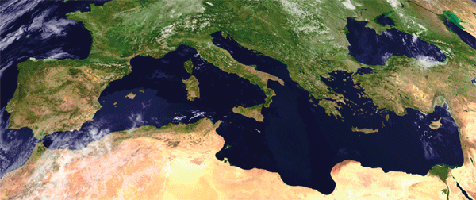
The Mediterranean sea
is now in an advanced stage of degradation

Slide 7
Once in the water, plastic never fully biodegrades, but breaks down into smaller and smaller pieces, eventually being dubbed a "microplastic”.
Cousteau from his observations in the Mediterranean had estimated that almost 10,000 fish die every day from the ingestion of caps and "rings" of soft drinks thrown into the sea by ships and coastal settlements.

Slide 8
150 million inhabitants being concentrated in just 46,000 km of coastline
110 million live in urban centers
200 million tourists
per year
More than 80 large rivers transport huge volumes of pollutants from the hinterland

Slide 9
Today, only 60% of coastal areas are served by sewage treatment plants
Every year, 66 million cubic meters of industrial wastewater penetrates the sea.
The Mediterranean has the most intense tanker traffic in the world
In the Mediterranean exist more than 200 petrochemical , energy facilities and chemical plants

Slide 10
ESTIMATED DECOMPOSITION RATES OF COMMON MARINE DEBRIS ITEMS
Newspaper | 6 weeks
Cigarette but | 1-5 years
Waxed carton | 3 months
Aluminum can | 200 years
Tin can | 50 years
Disposable diaper | 450 years
Plastic bottle | 450 years
Plastic grocery bag | 10-20 years
Styrofoam cup | 50 years
Source: National Oceanic and Atmospheric Administration – NOAA US

Slide 11
COMMON WAYS OF WASTE DISPOSAL
SOLUTIONS ?
DUMPING
RECYCLING
COMPOSTING
INCINARATING
ADOPTION OF NEW TECHNOLOGIES
CITIZEN 'AWARENESS

Slide 12
Landfill/Garbage dump
The amount of waste generated has tripled since 1960.
About one-third of an average dump is made up of packaging material!
Plastic bottles put into the landfill will take thousands of years to decompose since they are shielded from sunlight.
Organic decomposition of matter in landfills produces various types of gases impairing the health of the environment.
Wildlife comes into contact with dangerous chemicals in landfills.

Slide 13
Recycling
Reduces the amount of waste sent to landfills and incinerators.
Conserves natural resources such as timber, water and minerals.
Increases economic security by tapping a domestic source of materials.
Helps creating jobs in the recycling and manufacturing industries.
Prevents pollution by reducing the need to collect new raw materials.
Saves energy.
Each ton of paper recycled can save three cubic yards of landfill space.
Notes:
Ύπαρξη αγοράς των ανακυκλώσιμων υλικών (ώστε να υπάρξει οικονομικό όφελος για τη χρηματοδότηση του προγράμματος)

Slide 14
Composting
Waste is transformed into a valuable soil amendment.
Saves space in landfills.
Saves money on trash disposal.
Composting can clean contaminated soil.

Slide 15
Incineration
(controlled burning at high temperatures)
Reduces mass
Produces energy
Transforms waste in safe for the environment ash
Emission of monoxide gas and dioxins
Production of heavy metals

Slide 16
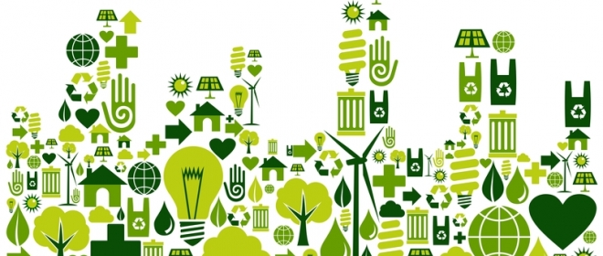
New technologies ? Let’s talk about bioplastics

Slide 17
Bioplastics
Derived from renewable biomass sources, are used for disposable items such as packaging, cutlery, pots, cups and straws.
They could replace many applications for petroleum-derived plastics and produce less hazardous waste.
Costs and performance remain problematic.
Few commercial applications exist for bioplastics.
Notes:
παράγονται από ανανεώσιμες πόρους βιομάζας, όπως
εδώδιμα λίπη και έλαια
Λιγνίνη
άμυλο καλαμποκιού
αρακά ή μικροβιακή χλωρίδα.

Slide 18
The 3Rs principle
(Reduce, Reuse, Recycle)
Avoid disposable items.
Buy products in bulk instead of individually wrapped or single-serving sizes.
Buy products that you can reuse. For example , get glass containers instead of flimsy plastic ones.
Buy durable products.
Donate items you no longer need instead of throwing them away.
Mend and repair rather than discard or replace.
Reuse items like envelopes, folders and paper clips.
Don't use plastic bags - use cloth
Buy rechargeable batteries for devices used frequently.
Copy and print on both sides of paper.
Use recycled paper.

Slide 19
Resources
https://www.epa.gov/recycle/recycling-basics
http://www.wrfound.org.uk/articles/incineration.html
https://acespace.org/blog/10-facts-about-composting
http://keenforgreen.com/b/10-fun-composting-facts
https://www.usi.edu/recycle/solid-waste-landfill-facts
http://www.johnsrefuse.com/blog/bid/328025/20-Horrifying-Waste-Management-Statistics-and-Facts-About-Landfills
http://infomory.com/facts/facts-about-landfills/
https://www.thebalance.com/how-long-does-it-take-garbage-to-decompose-2878033

