Slide 1
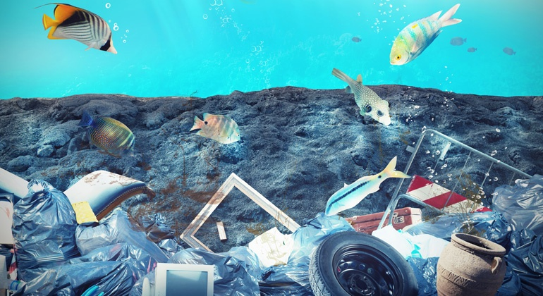
Impacts of plastic in Germany

Slide 2
Table of contents
What do we use plastic for?
Impacts of plastic
Numbers and facts
Plastic bag consumption of the EU members
Impacts on our health
Impacts on animals
How can you stop the use of plastic?
Solutions in Germany
Conclusion
Sources

Slide 3
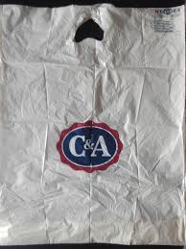
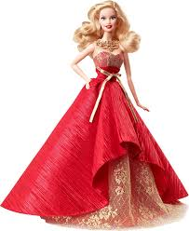
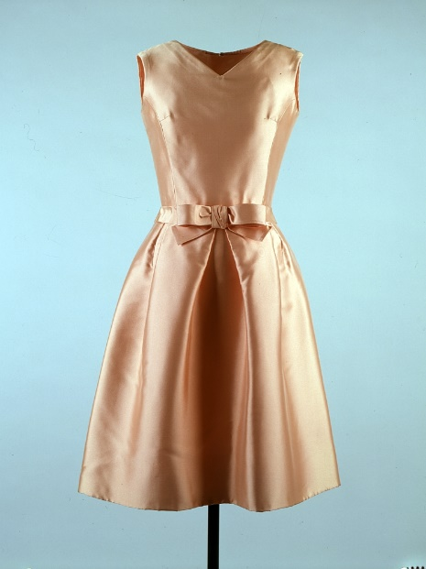
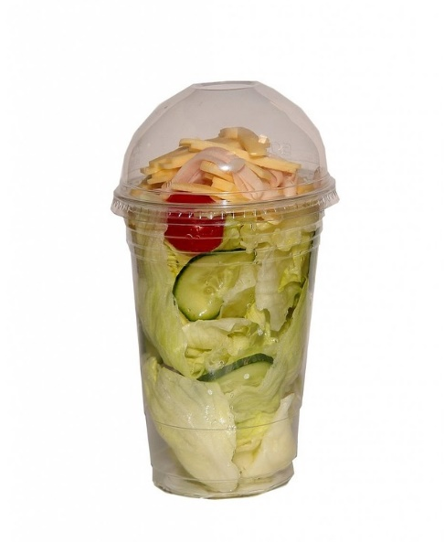
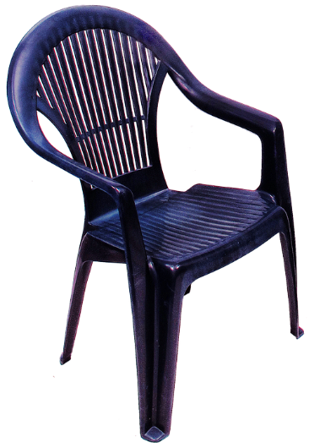
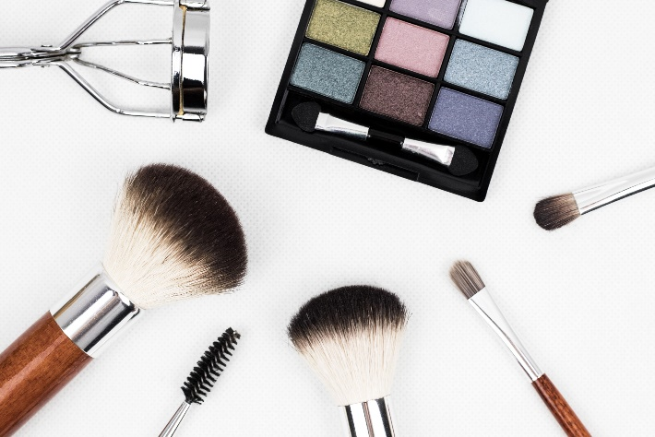
What do we use plastic for?

Slide 4
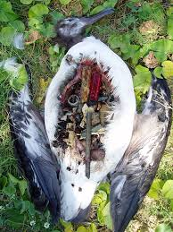
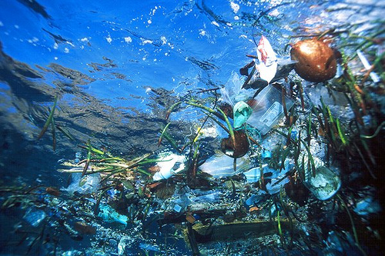
Impacts of plastic
More than 10 million tons of trash in the ocean
Animals think it´s food → die from eating it
Decomposition → dangerous substances
20,000 tons of trash in the North Sea
Animals and humans poison themselves

Slide 5
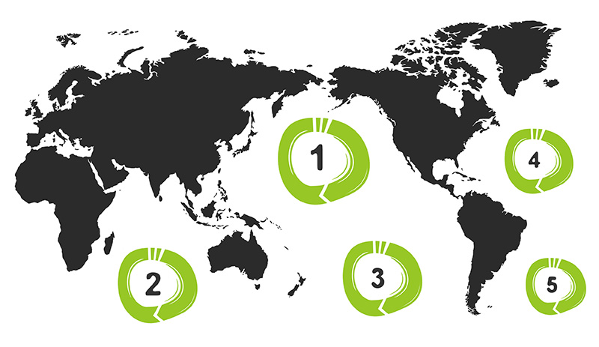
Numbers and facts
2050: more plastic than fish
1950: 8.4 tons of plastic per year
2016: 11.7 tons of plastic
Every German citizen uses 37kg plastic per year
1 million seagulls and 100,000 animals in the sea die per year
One plastic bottle needs 450 years to decompose
Only 42% are recycled
5 trash swirls: →

Slide 6
Plastic bag consumption of the EU members
The average number of plastic bags used per person per year in EU countries

Slide 7
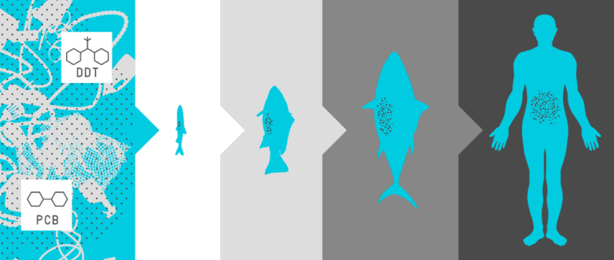
Impacts on our health
Dangerous substances inside of plastic
→ impacts on the function of our genes
→ can change every information in our bodies
Examples PCB, DDT, BPA

Slide 8
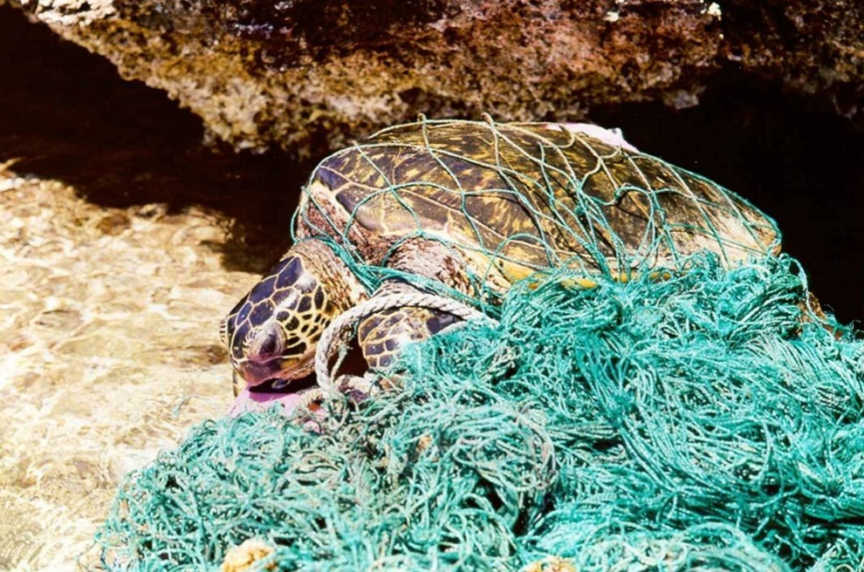
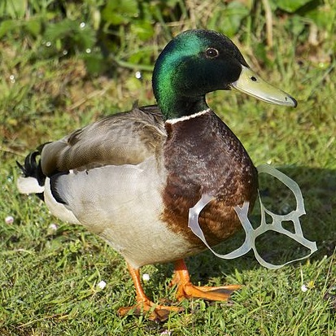
Impacts on animals

Slide 9
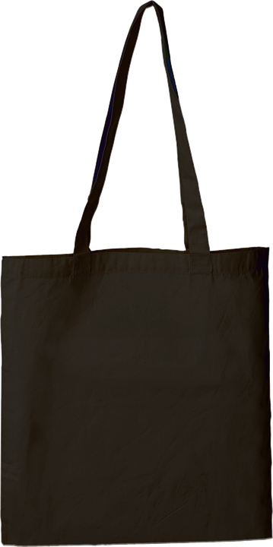
How can you stop the use of plastic?
EU members: 200 plastic bags (2015)→ 49 plastic bags (2019) → 40 plastic bags (2025)
Plastic bags cost 10-20 cents
REWE doesn´t sell plastic bags anymore → only paper or cotton bags
Buy without plastic
Visit shops without plastic

Slide 10
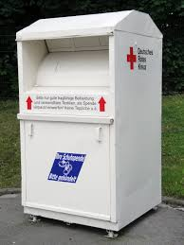
Solutions 1. Recycled clothes
H&M
25.000 containers
Give your old clothes to them
Recycle clothes
Protect environment

Slide 11
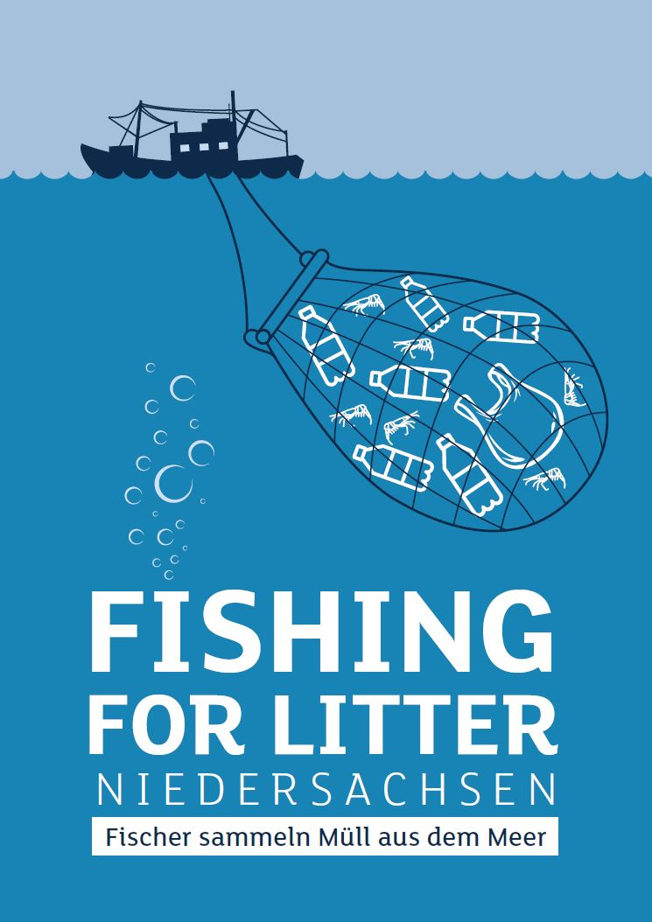
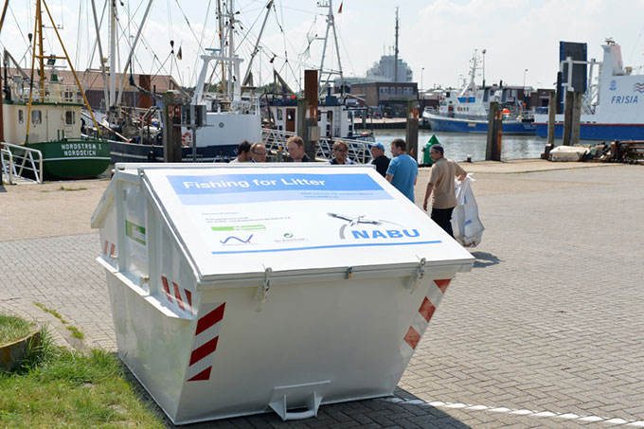
Solutions 2. Fishing for Litter
Trash lands in the net → fishermen throw them back into the sea
Fishing for Litter → gives trash bags to fishermen for free
Containers at the harbor (in Germany as well)
Fishermen are paid when they catch plastic

Slide 12
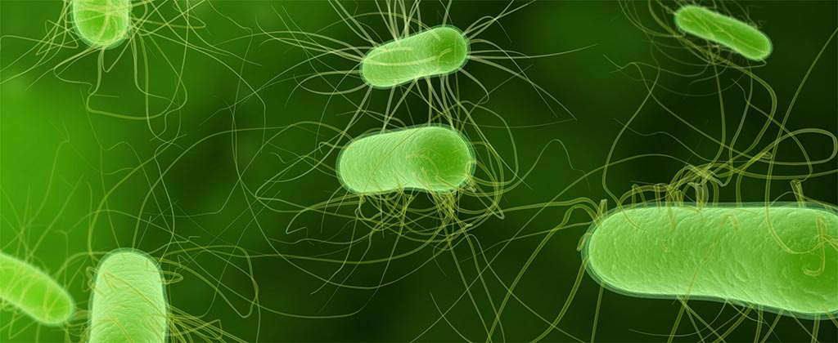
Solutions 3. Microorganisms
Garbage-eating microorganisms
Scientists found out that microorgansims eat plastic
Want to place them into the water
Problem? → no one knows the impacts on the environment
Could use in sewage treatment plants

Slide 13
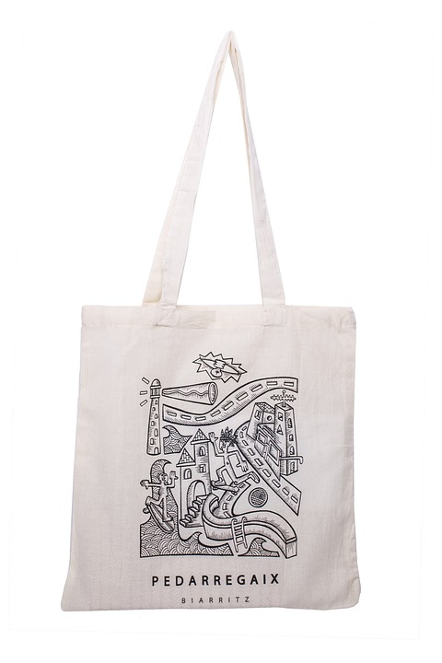
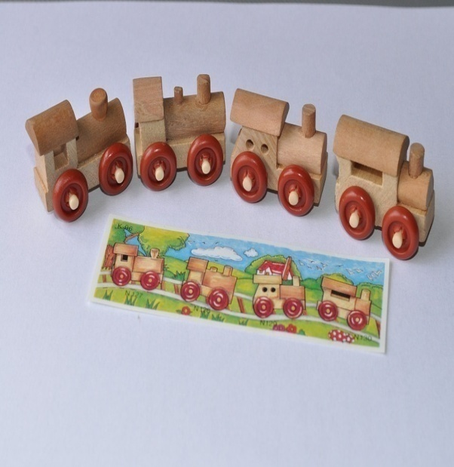
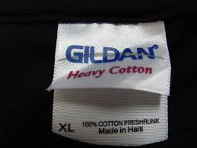
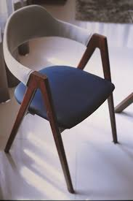
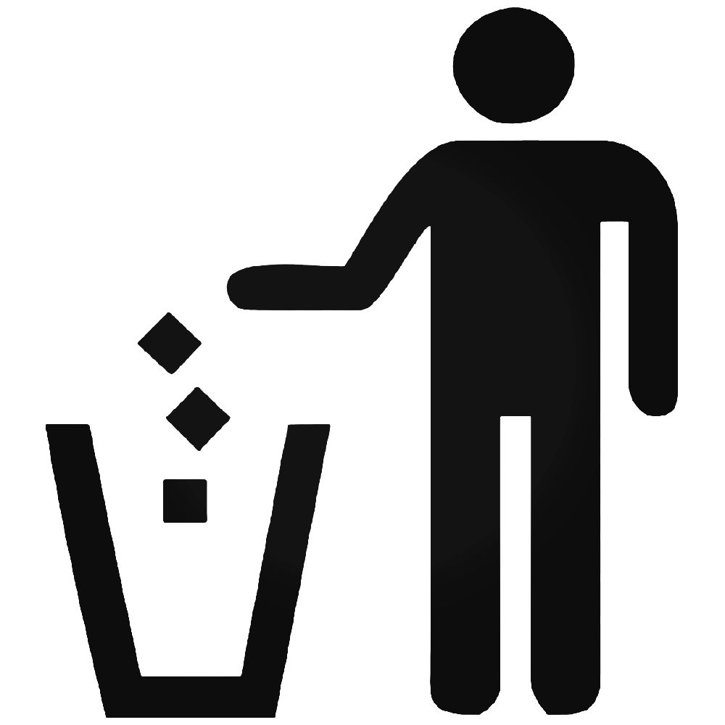
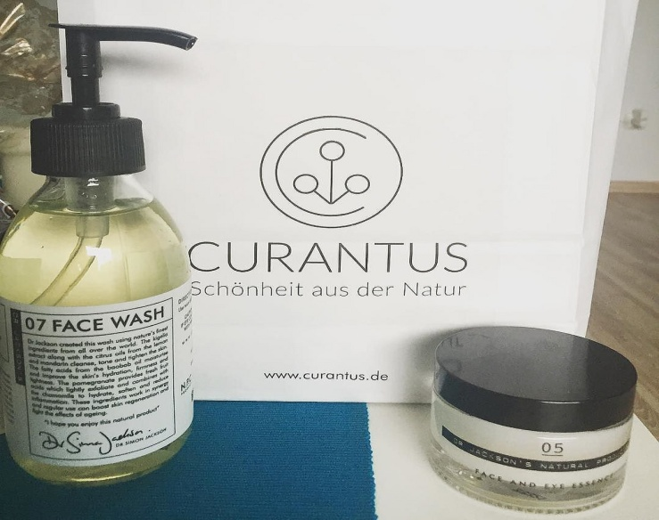
Conclusion

Slide 14
Sources
https://www.nabu.de/natur-und-landschaft/meere/muellkippe-meer/muellkippemeer.html
http://www.dw.com/en/germans-slow-to-bin-plastics-habit/a-42355554
https://www.theepochtimes.com/eu-ban-on-plastic-bags-making-impact_2147559.html
https://www.nabu.de/umwelt-und-ressourcen/oekologisch-leben/alltagsprodukte/14058.html
http://www.dw.com/en/six-data-visualizations-that-explain-the-plastic-problem/a-36861883
https://www.careelite.de/plastik-muell-fakten/
https://www.wiwo.de/technologie/green/kampf-gegen-muell-im-meer-fuenf-innovative-ideen-fuer-saubere-ozeane/13548878.html
https://pixabay.com/de/fast-food-salat-fertigsalat-74324/ (15.04.2018)
https://pixabay.com/de/barbie-spielzeug-babypuppe-3118097/ (15.04.2018)
https://www.flickr.com/photos/131903412@N05/16500823514 (15.04.2018)
https://pixabay.com/de/stuhl-monobloc-spritzguss-2828465/ (15.04.2018)
https://en.wikipedia.org/wiki/Dress (15.04.2018)
https://www.pexels.com/de/foto/lidschatten-make-up-make-up-makeup-bursten-208052/ (15.04.2018)
https://de.wikipedia.org/wiki/Datei:Laysan_albatross_plastic_filled_stomach.jpg (15.04.2018)
https://www.flickr.com/photos/worldworldworld/3314227532 (15.04.2018)
http://www.noaanews.noaa.gov/stories2005/s2429.htm (17.04.2018)
http://www.eunomia.co.uk/determining-the-sources-of-river-litter-for-cen/ (17.04.2018)
https://pxhere.com/en/photo/494509 (17.04.2018)
https://pixabay.com/de/tasche-geldb%C3%B6rse-einkaufen-1036915/ (17.04.2018)
https://pixabay.com/de/tasche-baumwolle-modus-schwarz-1431448/ (17.04.2018)
https://de.wikipedia.org/wiki/Datei:Logo_REWE.svg (17.04.2018)
https://de.wikipedia.org/wiki/H%26M (18.04.2018)
https://pixabay.com/de/tasche-baumwolle-nat%C3%BCrliche-baumwolle-2765441/ (20.04.2018)
https://pixabay.com/de/spielzeug-kinderspielzeug-162931/ (20.04.2018)
https://www.flickr.com/photos/sarrisarri/14592489559 (20.04.2018)
https://pxhere.com/en/photo/13780 (20.04.2018)
https://ballzbeatz.com/product/trash-can-sign-3-vinyl-decal-sticker/ (20.04.2018)
https://www.flickr.com/photos/elschy/21878984278 (20.04.2018)
https://commons.wikimedia.org/wiki/File:Basst%C3%B6lpel_auf_der_Nordseeinsel_Helgoland_mit_Plastikm%C3%BCll.jpg (20.04.2018)
https://de.wikipedia.org/wiki/Textilrecycling (20.04.2018)

Slide 15
Thank you for your attention!

