Slide 1
Bioplastics- the future of food packaging?
GerRom Bioplastics
BY: Jennifer Keim, Madita Naumann, Maria Pavalau,
Alessia Cazan, Viviana Budis, Lea Rüggeberg, Vivien Heck

Slide 2
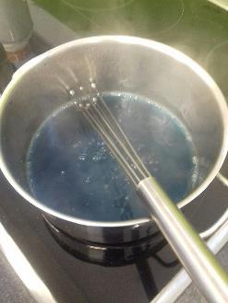
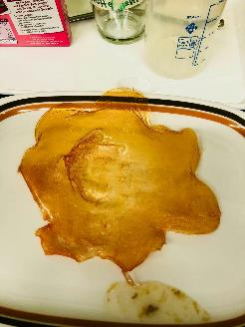
DAY 1
First attempt to create bioplastics and trying different recipes
the gelatine based
bioplastics

Slide 3
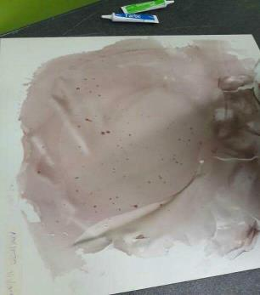
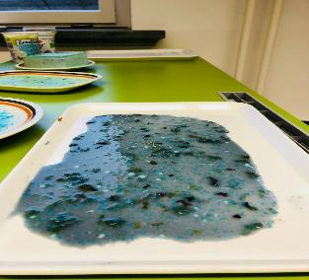
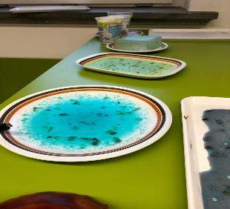
DAY 2
Deciding which bioplastic is the best for our company
Discovering new recipes for the final product

Slide 4
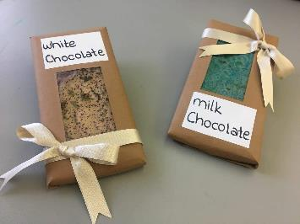
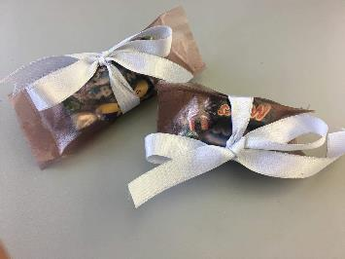
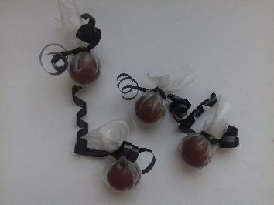
Day 3
Making use of our bioplastic
ChemSketch

Slide 5
H
O
O
H
H
O
2
1. Only with Na-Alginat
2
H
O
H
O
O
2
O
O
H
H
O
-
+
H
O
H
O
O
Na
O
H
H
H
+
H
C
C
C
H
H
O
Na
O
2
H
O
O
H
O
H
O
H
H
H
H
O
H
-
O
H
C
C
C
H
Na-Alginat
Glycerol
Water
O
H
O
H
O
H

Slide 6
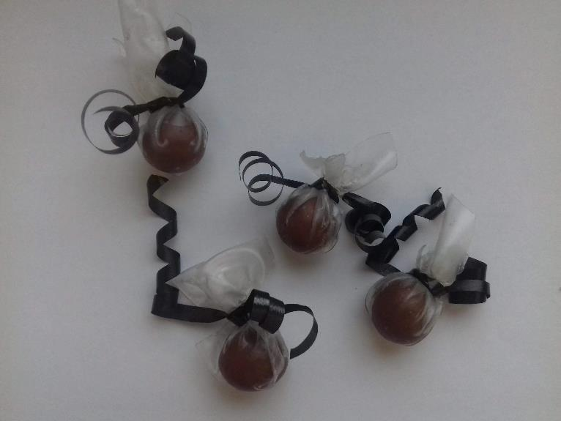

Slide 8

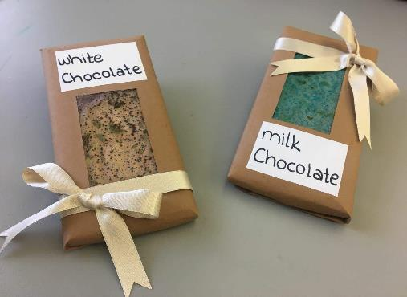
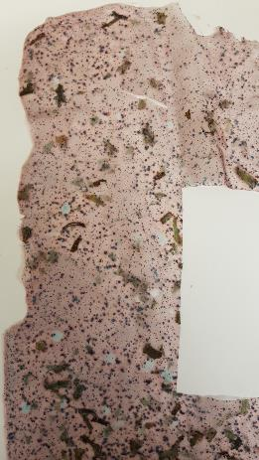

Slide 10
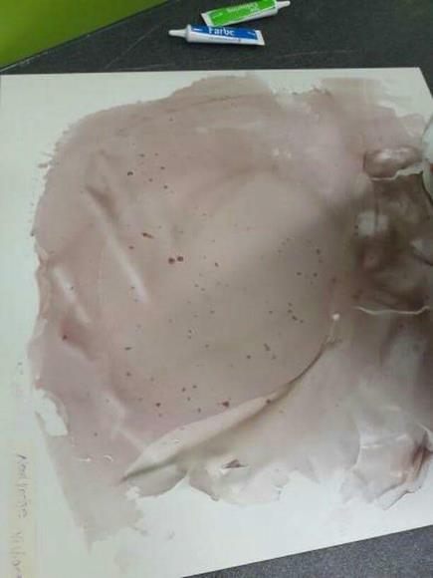


Slide 11
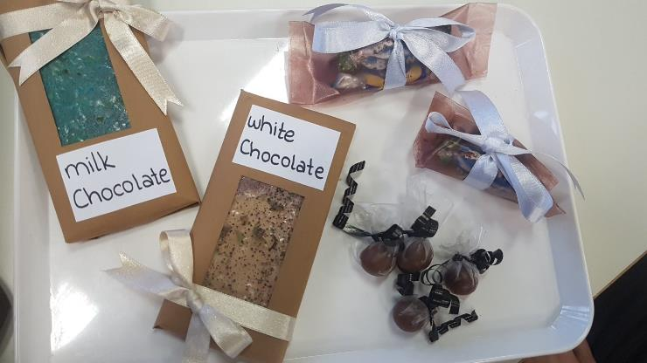
RESULTS

Slide 12
SOURCES
- 1. Na-Alginat: https://www.mpbio.com/product.php?pid=05218295&country=81
- 2. With Agar Agar: https://en.wikipedia.org/wiki/Agar
- https://en.wikipedia.org/wiki/Starch
- https://de.wikipedia.org/wiki/Hydroxyethylcellulose
3. With Starch: http://www.merckmillipore.com/DE/de/product/Methyl-4-hydroxybenzoate-sodium-salt,MDA_CHEM-106756?ReferrerURL=https%3A%2F%2Fwww.google.de%2F
- https://www.dreamstime.com/stock-photo-red-candy-wrapper-white-background-hard-plastic-reflective-image56578281
- https://www.bulkcandystore.com/bright-pink-wrapped-candy.html

Slide 13
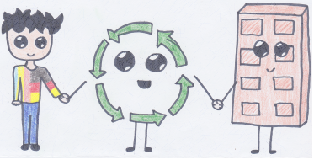
THANK YOU
FOR YOUR
ATTENTION! ☺

