Slide 1
BUSINESS PLAN (Primary Source: My Business.org)
Session 1 A
Fall 2017 Introduction and Context
Dr. Thomas Queisser
(Ph.D. Northwestern Univ. USA)

Slide 2
Goals of the „Business Plan“ Module (ca. 8 hours)
Think analytically about how to design an organization & to encourage students to “found” their organizations.
Recognize how teachers and students (“founders”), play a critical role in shaping an organization’s future.
Understand what needs to be done to build a successful organization for the long-term.
Build actual components of a business plan and present them as a „work in progress“ (overnight!)
Prepare to teach your students how to create a full written business plan
Prepare for compare and learn „best practices“ from multiple business plans (2018)

Slide 3
Key Elements of our Module
Introduction & why create a business?
What is a business plan (short)?
Business plan methodology*
Market & customer analysis
Finances**
E-Commence (short, ref. Crete)
*Appendix: The 9-point Business Plan
** Appendix: xlx spreadsheets, formatted for plan
Questions so far?

Slide 4
Secondary (back-up) Elements of our Module
Various second-priority topics including:
Insurance, licensing & administrative aspects
Location strategy
Legal aspects, corporate srtucture
Going international
Etc.
These „nice to have“ or „may apply in special cases“ materials are included in a separate file.

Slide 5
BUSINESS PLAN: What is it, why do it?
A strategic exercise
Test your ideas as prototype: before building it!
Will your project turn out exactly as planned? No, but you will have a “measuring stick” to compare
A concrete proposal and roadmap to gain support
Used to persuade sponsors, internal & external
Used to raise money (funding, budget, etc.)
Entrepreneurship Vs Intrepreneurship
Do you want to run your OWN business?
Do you want to run a BUSINESS UNIT (SBU) inside a private or public organization?

Slide 6
“ALL” BUSINESSES & PRODUCTS START “SMALL” SOMETIME
EXAMPLES: General Electric (light bulb), Bosch (spark plug), HP (scientific equipment), Microsoft software+), Apple (originally a computer), Google (search engine), etc.
Tomorrow’s new discovery now being built in someone’s garage (metaphor for an inexpensive, secluded place to invent)
Why is the garage so famous as a start-up location (HP, Apple, etc.)?
What are common success factors of start-ups? (Exercise)
What is the “story” behind your company (key product)

Slide 7
„Rules of the Garage“ (HP Website)
Believe you can change the world.
Work quickly, keep the tools unlocked, work whenever.
Know when to work alone and when to work together.
Share tools, ideas. Trust your colleagues.
No politics. No bureaucracy. (These are ridiculous in a garage).
The customer defines a job well done.
Radical ideas are not bad ideas.
Invent different ways of working.
Make a contribution every day. If it doesn’t contribute, it doesn’t leave the garage.
Believe that together we can do anything.
Invent.

Slide 8
A major characteristic of planning a business/new product launch: taking personal and team responsibility for success or failure! The business is your „baby.“

Slide 9
Questions before going further? Break assignment: form teams, begin to plan a business overnight….

Slide 10
The actual HP garage where Hewlitt & Packard invented their first product

Slide 11
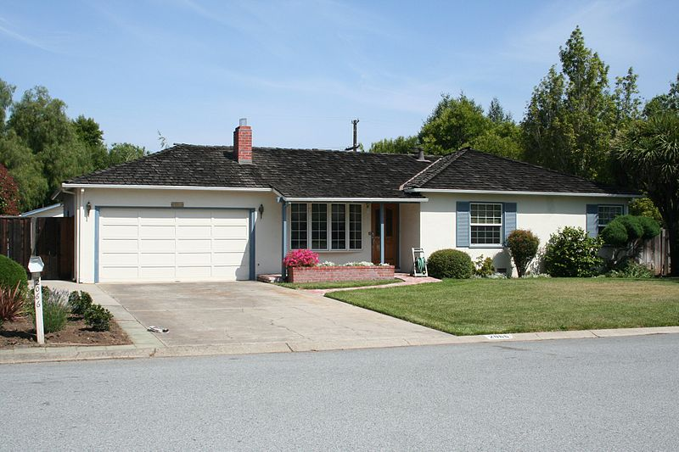
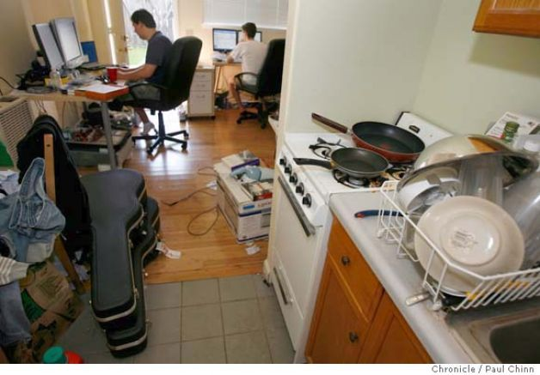
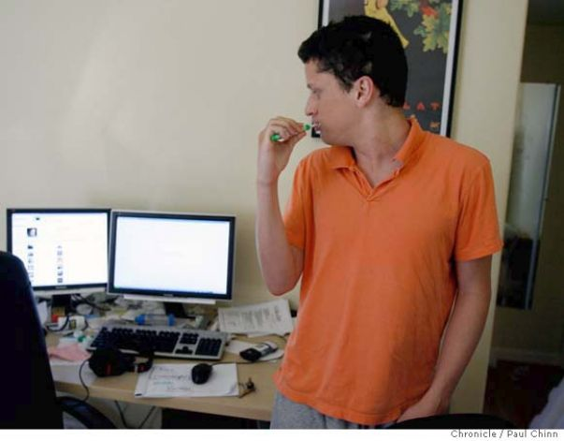
Inventions started in garages…. (HP, Apple, and Box (cloud computing)

Slide 12
EN- & IN-trapreneurship
Important: Remember, a business plan is an excellent „tool“ for both:
A new start-up enterprise (ent-) or
A new initiative/market/launch/product undertaken by employees of an established firm (intrepreneurship done INSIDE the firm)
Sometimes, employees get the opportunity to split off and form their own company (SAP and many other examples) – IN- and EN- or…
EN- then IN- when founders sell their company but stay on as a creative force.
A possible structure for bio-plastic could be a public-private partnership

Slide 13
Outline of the Business Plan Module: Outline and other Handouts
Business plans follow an established outline in almost all cases, answering a predictable sequence of questions that will be asked by supporters and investors
(Small issue if „technology“ should be a separate chapter or integrated – in our case technology is not a separate chapter)
The Business Plan Outline is a „cookbook“ – you just have to supply the detailed cotents within the framework.
Review the documents, apply them to yourself.
Exercise: what is/are the MOST IMPORTANT chapters of the business plan?????

Slide 14
Selection Strategy
Selecting the wrong business is the most frequent mistake.
Even within a specific “product” (bio plastic, etc.) there can be many variations of the actual business.
Take your time.
Long-term economic potential?
Look for pricing power.
Avoid competing entirely on price.
Most service businesses have pricing power.
Consider a “hollow corporation” (provide strategy and coordination but leave the concrete production to a vendor)

Slide 15
Things to Watch Out For (a “need” does not automatically translate into success!)
Impatience (typically a much lengthier and more complicated path than expected)
Overconfidence
Be Realistic

Slide 16
Haven’t Decided on a Business Yet? Or haven’t decided on the specific aspect of a business (resources, production, distribution, marketing, etc.
Write an activity you like to do (or a specific aspect of the field you are in).
List businesses and activities related to that activity.
Score based on:
Fill need?
Something I love to do?
Specialize?
Learn it and test it?

Slide 17
Evaluate a Specific Business
Enjoy?
Expanding need?
Specialized?
Enough capital?
Can I learn it first?
Operate without a factory?
Can I test first?
Consider partner?
Government encouragement and support?
Marketing assistance?
Other outside help?

Slide 18
More Tips
Before you start, get completely qualified
Go to work for someone in the same business.
Attend all classes you need.
Read "How To" books.
Ask questions and seek advice.
Use open sources (Internet), library, government and related information so tha you can build on a successful model (don’t have to invent a “new” model).

Slide 19
Session 1 – Deciding on a Business
Top Ten Do’s (especially fior start-ups)
Live frugally and begin saving.
Work for someone else first.
Consider a moonlight business.
Consider a family business.
Potential competition?
Subcontracting to low cost suppliers?
Test market first.
Make "for" and "against" lists.
Seek out advice.
Compare opportunities.

Slide 20
Session 1 - Deciding on a Business
Top Ten Don'ts
Don't quit your job too soon.
Don't start a business you don’t enjoy.
Don't risk all the family assets.
Don't moonlight against your employer.
Don't be in a hurry.
Don't select too high a hurdle.
Don’t need lowest price to succeed.
Don’t ignore the negative aspects.
Don't overlook careful due diligence.
Don't skip testing first.

Slide 21
Slide Index Next Slide

