Slide 1
BIOPLASTICS:
THE FUTURE OF
FOOD-PACKAGING
GROUP NUMBER 2
George Vasilakis, Lena Schadt, Kim Häring, Madeleine Jerzabek, Malina Cojocaru, Lily Wicketts, Andreea Mitroi

Slide 2
STRUCTURE
Introducing ourselves
General information about bioplastic
Benefits
Process → recipes → preperation (video/ some pictures)
Results → pros and cons
Products
Advantages of our products
Sources

Slide 3
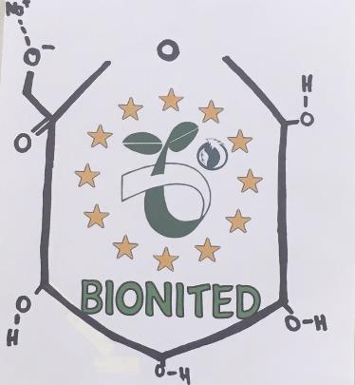
INTRODUCING OURSELVES
George Vasilakis
Lena Schadt
Kim Häring
Madeleine Jerzabek
Malina Cojocaru
Lily Wicketts
Andreea Mitroi

Slide 4
GENERAL INFORMATION
ABOUT
BIOPLASTICS
DERIVED FROM BIOLOGICAL SUBSTANCES
Renewable raw materials
Biodegradation doesn‘t produce any toxic material
Can not be identified in compost
60% in 180 days
Less than 10% remain in screen within 120 days
Decompose back into:
Carbon dioxide
Water
biomass

Slide 5
Benefits
Renewable resources
Degrade far faster than oil based polymers
Much lower carbon footprint
Lower energy costs in manufacturing
Reduction in litter
Improved compostability
Technical advantages → improved printability → client satisfaction → greater water vapour permeabbility

Slide 6
Ingredients
Reciepe nr. 1:
150 ml of water
Glycerine
1 teaspoons of Agar
½ teaspoon of Na-Alginat
Reciepe nr.2:
150 ml of water
Glycerine
1 teaspoons of Agar
½ teaspoon of Na-Alginat
Reciepe nr. 3:
2g starch
2g gelatine
2g agar
160 ml of glycerine solution of C=1%
210 ml water
Reciepe nr. 4:
1 teaspoon of starch
45 mg of salt
160 ml of glycerol solutin of C=1%

Slide 7
Process
We almost doubled up the ingredients from most of the reciepes, if not all of them. Therefore, we have done the measurements by eye because only this way we could get the results we were initially aiming for.
Because of the chemical compounds mixed together, we suspect that there are physical bounds formed between the molecules, rather than chemical bounds, like ionic bounds. If it were to be ingredients such as alcohols and salts it may have been different, but in such cases, it is not known what is actually happening with the molecules.

Slide 8
Advantages & disadvantages
Pro: → thin → flexible → strong → waterproof → transparent → easy to color
Con: → some were easy to tear → thick consistency made drying difficult → cracking

Slide 9
Our products
Packaing for sweets
Lollipop packaging
Disolving bag for gravy powder

Slide 10
The advantages of
our products
Some of them are waterproof
Packaging for gravy powder disolves in water
Easy to color
Transparent plastic
Solid and strong

Slide 11
Chemical compounds
We almost doubled up the ingredients from most of the reciepes, if not all of them. Therefore, we have done the measurements by eye because only this way we could get the results we were initially aiming for.
Because of the chemical compounds mixed together, we suspect that there are physical bounds formed between the molecules, rather than chemical bounds, like ionic bounds. If it were to be ingredients such as alcohols and salts it may have been different, but in such cases, it is not known what is actually happening with the molecules.

Slide 12
Chemical equations

Slide 13
Sources
http://www.jocpr.com/articles/bioplastics-and-their-role-in-achieving-global-sustainability.pdf
http://www.irochemical.com/product/Alginates/Sodium-Alginate-I.htm
http://www.theenergyofchange.com/advantages-bioplastics
http://www.european-bioplastics.org/bioplastics/standards/
http://worldcentric.org/biocompostables/bioplastics

Slide 14
Thank you
for
the attention!

