Slide 1
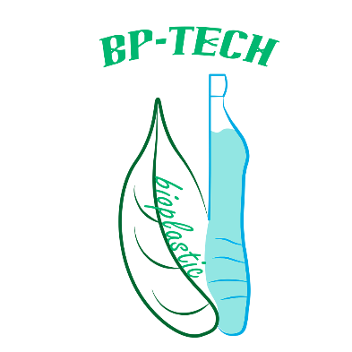

Slide 2
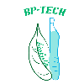
Company overview
_{Founded: January 2018}
_{Number of employees: 7}
Founders: Rares Miron, Sude Yakut, Tim Pascher, Vlad Gubendreanu, Maddie Smith, Giannis, Malina Mueller
Business summary: Producing bioplastic packaging for dry foods

Slide 3
Aims and vision
Offering an alternative to the conventional plastics like PET, PP, etc. used in the food packaging industry and raise awareness of the environmental impact
Our vision for the future would be to create the most efficient, cheap and environmentally friendly bioproduct as possible, thus help fighting the pollution of the world

Slide 4
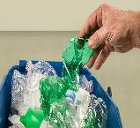
The impact of conventional plastics on the environment
It is well known that plastic is probably the world‘s leading pollution cause. A plastic bag can kill numerous animals because they take so long to disintegrate. Most plastics are made from petroleum or natural gas, which will eventually deplete
The interest in environmental issues is growing and there are increasing demands to develop materials which do not burden the environment significantly

Slide 5
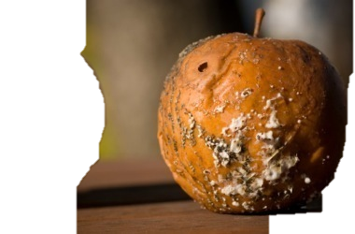
The effects of oxygen on food spoilage
#Fact: Air consists of 78% nitrogen, 21% oxygen, and a 1% mixture of other gases
One leading cause of food spoilage is air and oxygen. Because air is colorless, odorless, and tasteless, it is often forgotten as a means to cause food to spoil

Slide 6
Products and services
Firstly, we initiated a research and development department. We started experimenting on various readily available recipes. However, after a few unsuccesful experiments, we came to the conclusion that the recipes needed some improvements
Recipe 2 failed nevertheless, with no considerable results whatsoever
Recipe 1: sodium alginate + glycerol
1 tsp Na-Alginat
200 ml (2/3 cup) of 1% glycerol solution
Recipe 2: starch + salt + glycerol + sorbitol
3.0 grams (1 tsp) starch
45 mg salt
120 ml (1/2 cup) of 1% glycerol solution
0.75 grams (1/4 tsp) sorbitol

Slide 7
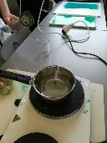
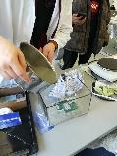
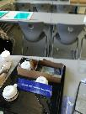
Production
(1)
(2)
(3)
Photo (1) - Making the mixture of glycerin, starch and salt and bringing
the solution to the boiling point. When it hits 100 °C, the mixture begins to
gelify and, thus, molten bioplastic is being formed.
Photos (2), (3) - As shown, Tim Pascher is pouring the molten bioplastic
into the mold. The bioplastic needs some days to solidify and properly set.

Slide 8
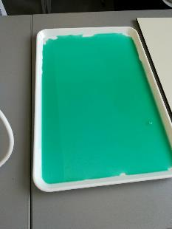
Final results
In two days time, the moulded plastic didn`t dry completely, so the desired form couldn`t be achieved. However, the attempt to produce bioplastic protective film was successful. We chose to dye the plastic in light green. In two days time the plastic was not completely dry, but it is usable.

Slide 9
Advantages and disadvantages of our product
It causes no harm to the environment
It is made out of recyclable and bio-degradable materials
It is a good food protector
The production process is not complicated
Advantages
Disadvantages
The oxygen absorbtion rate of the bioplastic film needs further research
It is not known how durable the package is in the long run
Needs further testing regarding damage, high temperatures, pressure

Slide 10
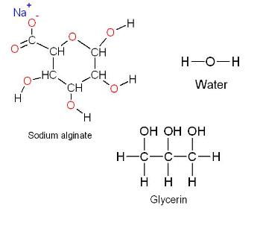
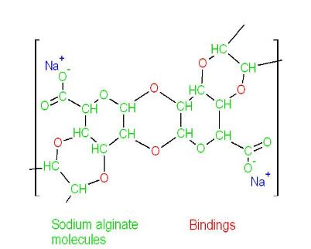

Slide 11
Our customers
We aim to get in contact with businesses all across the world,
especially packaging factories because our company intends to wholesale
the bioplastic products.
Our company is fond of entrepreneurs and would gladly support people that
are eager to be the game changers.

Slide 12
What makes our customers ask for our services?
1.The desire to change the world
Bioplastics are the future of the world food packaging. By bringing bioplastic to the public through our customers, we encourage people to choose what is best for the future of this planet.
2. Bioplastics have a small but growing market
Even though bioplastics are not so known and promoted, they receive a lot of attention from research institutes. There is always place for innovation and that`s what our company is looking for.
3. Low costs
Bioplastics are created using very simple and cheap chemicals. Also, the production process doesn`t require high energy consumption and it is environmentally friendly.

Slide 14
Questionnaire
1. Do you think that bioplastics are the future?
2. We will produce packaging for Tic-Tac sweets. What other products do you want to see with bioplastic packaging?
3. In the future, what other colors for bioplastic do you want to see?
4. Would you buy bioplastic-only packaged foods? Explain!
5. Would you produce bioplastic at home, given the right recipes?
6. Bioplastics are a growing market. Would you invest in bioplastic companies stocks?
7. Our product is made out of recyclabe carton and bioplastic film. After further research, should we make the whole package out of bioplastic?
8. Should our company make the bioplastic foil thicker? Why?
9. Would you end using conventional plastics and switch to bioplastic-only products?

Slide 15
Sources
https://www.sciencedirect.com/science/article/pii/S0734975008000141
https://news.nationalgeographic.com/2017/07/plastic-produced-recycling-waste-ocean-trash-debris-environment/
http://www.foodsafetysite.com/educators/competencies/general/spoilage/spg1.html
https://www.lifewithoutplastic.com/store/how_plastics_affect_the_environment#.aWmmad6NQQww
http://www.nytimes.com/2007/11/02/your-money/02iht-mplastics.1.8159693.html

Slide 16
Thanks!
Any questions?

