Slide 1

An eco-friendly cereal packaging

Slide 2

Recipe
310 ml water
1.2 ml glycerine
1 teaspoon sodium alginate
instructions: heat and stir/mix!

Slide 3
Chemical Structure
water
sodium alginate
glycerine

Slide 4
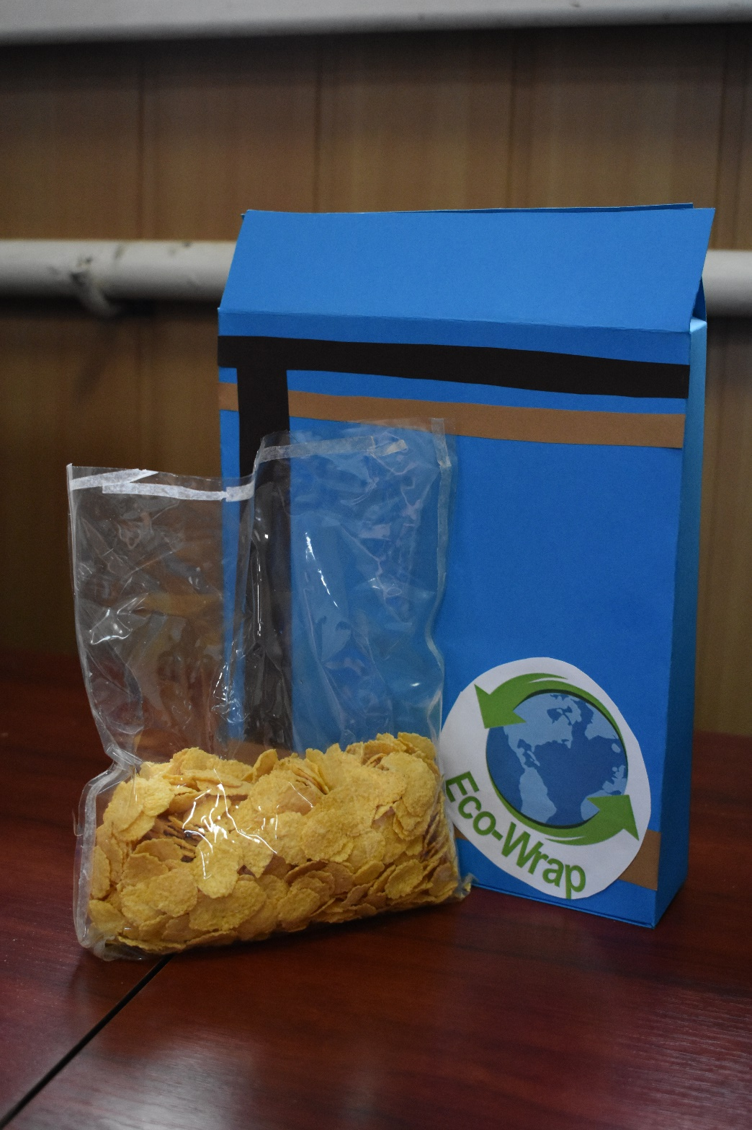
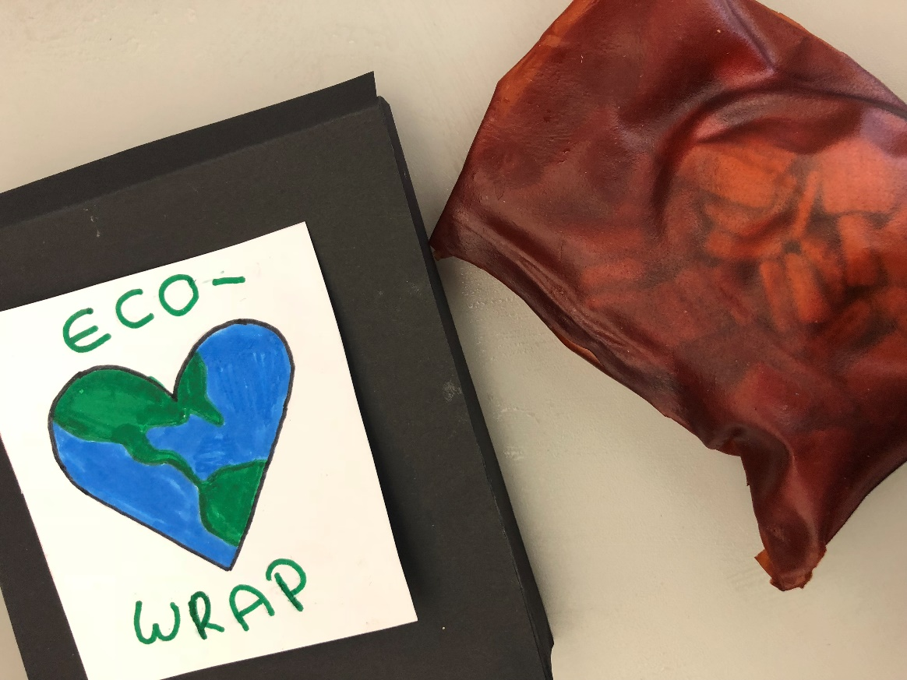
Our improvement
Now, it is flexible, it doesn’t smell at all, it looks nice and it doesn’t break easily
Unflexible
Bad odour
Unappealing to the eye
Easily broken

Slide 5
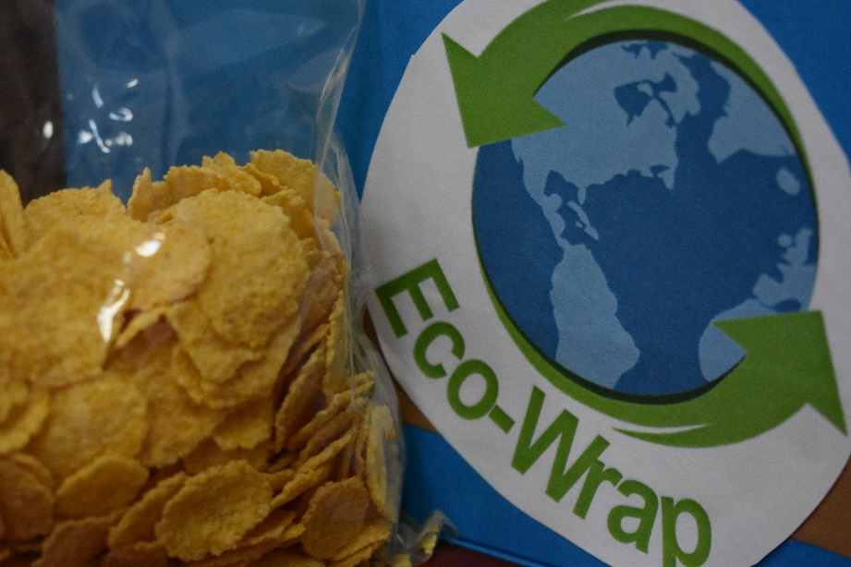
Business aims
Improve our environment
Reduce waste
Save the planet
Clear the waters of plastic waste

Slide 6
Product benefits (elevator pitch)
The future of food packaging
Crude oil, which plastic is made of, will be gone in around 50 years
Normal bioplastics cannot disintegrate in composting plants because they need too much time to disintegrate
Our bioplastic is unique because it will disintegrate when it’s in contact with water
So, by using our bioplastic, there will be no waste problem

Slide 7
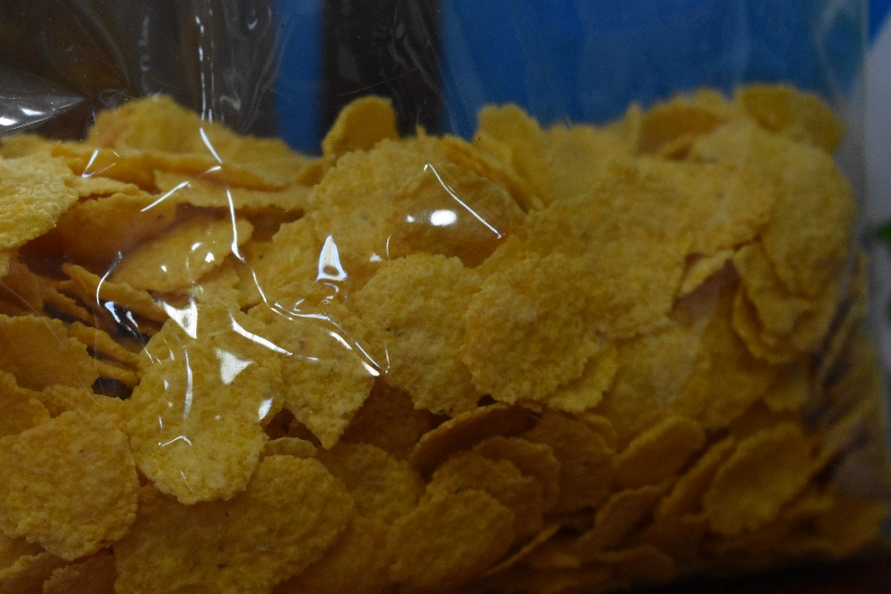
Our business
Cereal companies from all over the EU will request us to sell them the recipe. As well as giving them the bioplastic package, we will also pack their product
Our customers will first be based in Europe then it will become global

Slide 8
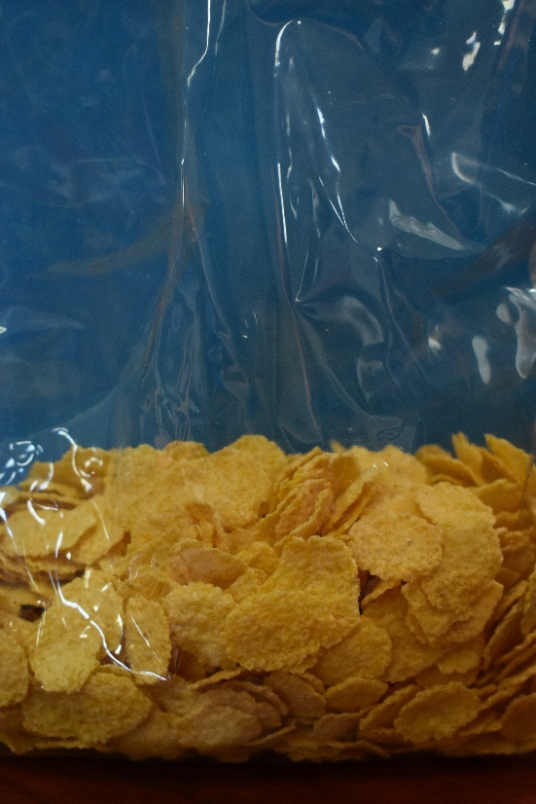
Reasons many businesses will want to buy our product…
It is environmentally friendly
It is durable
It is a renewable product
It is non-toxic
The card is 100% recyclable
The plastic is 100% Bio-degradable
It‘s not only for cereals (crisps, nuts, sweets, etc.)

Slide 9
Price and advertising
It costs a maximum of 1.80 Euro for 1 kg of our plastic (It could be less if we buy more ingredients at once)
The advertising will be on social media, on our own website or with business cards to reach a wider audience
Website: (https://www.ecowrap.weebly.com)

Slide 10
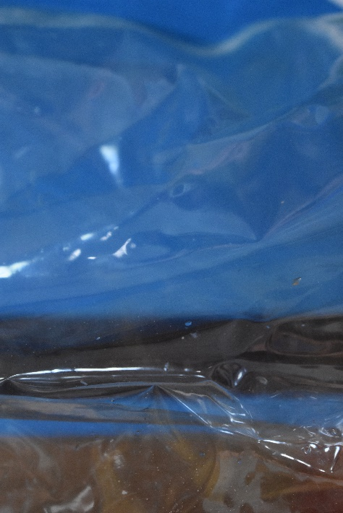
Strengths and weaknesses of our product
Strengths:
        Flexible
        Bio-degradable
        Easy to produce
        Dissolves in water
Weaknesses:
        - it isn’t water resistant
        - it easily breaks when it’s ripped

Slide 11
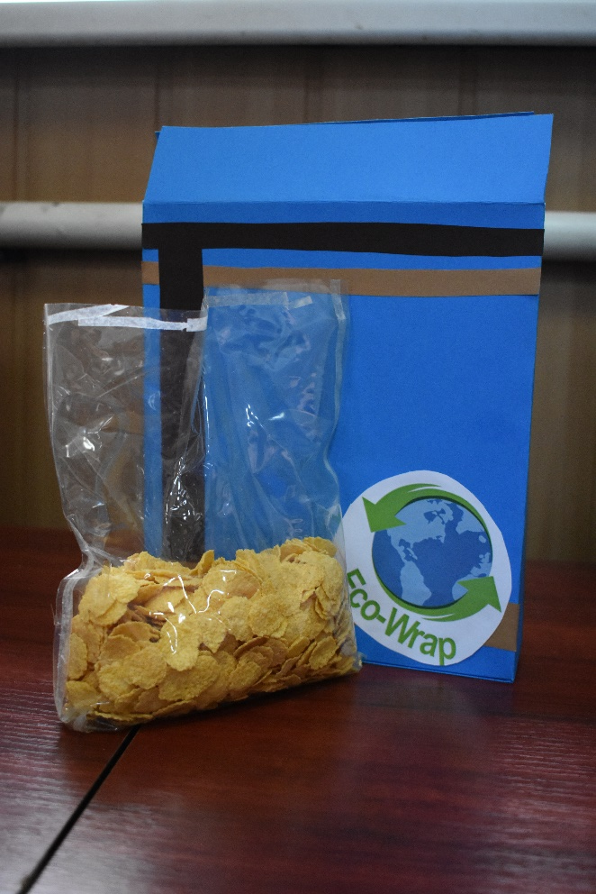
Opportunities and Threats
We could reduce plastic waste and pollution
We could be the future of food packaging
But:
It’s not fully tested yet, so we have to spend more time in testing the product and the ingredients

Slide 12
Our plans for the first and second year
First year:
Improve our product
Make our product more popular
Try to find a company which uses our product
Second year:
Find more companies which will use our product (all over the EU)
Try to make more different plastic types (e.g.: water bottles)

Slide 13
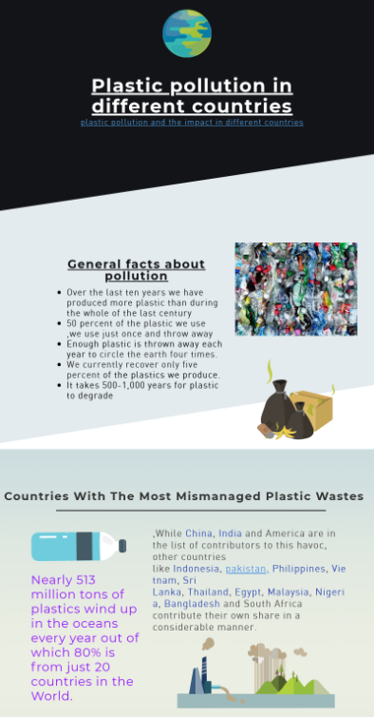
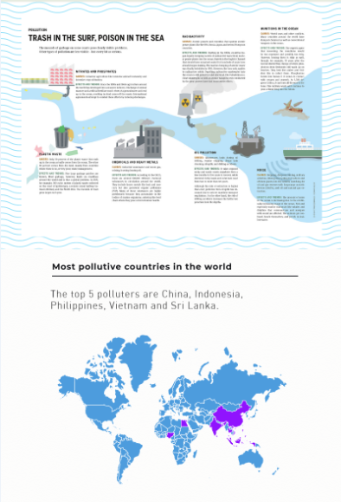
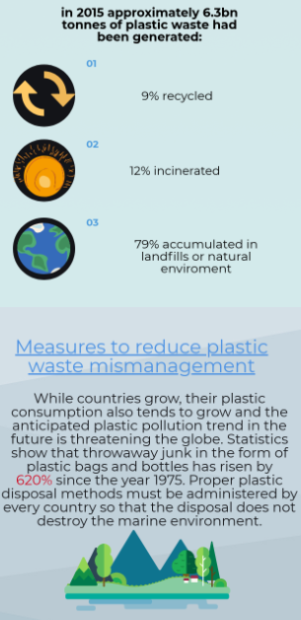
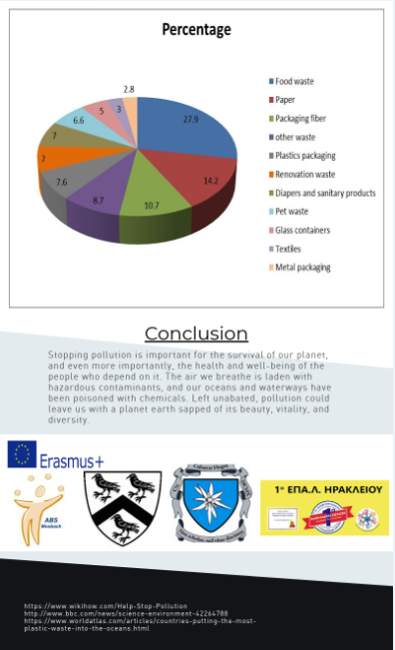

Slide 14
links
https://www.pexels.com/photo/nature-sky-clouds-field-9198/
https://www.pexels.com/photo/atmosphere-bio-biology-bonsai-56009/

Slide 15
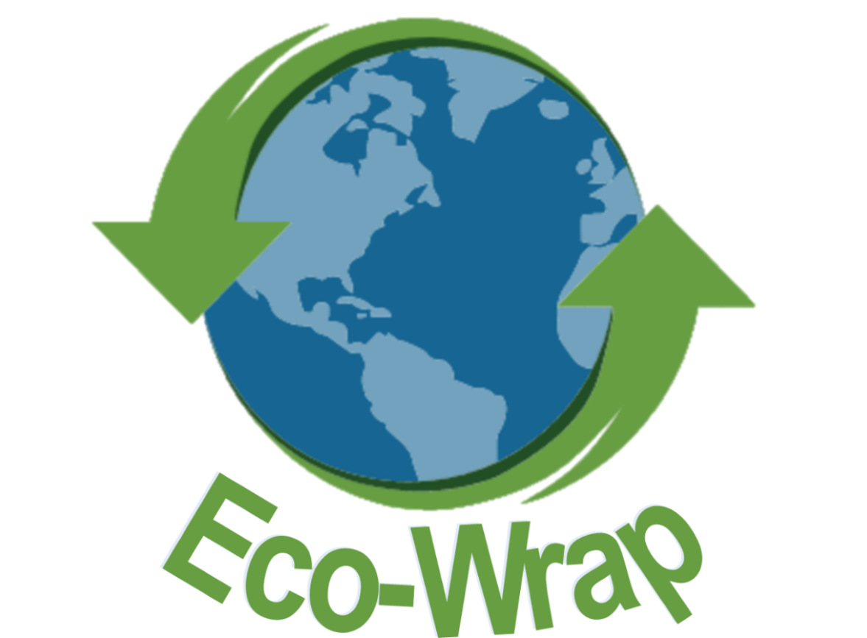
THANK YOU

