Slide 1
UK BASED COMPANY
Erasmus+: Romania, Greece, United Kingdom and Germany
Notes:
The british bio plastics company we researched was biome bioplastics limited. We have a video to show you

Slide 3
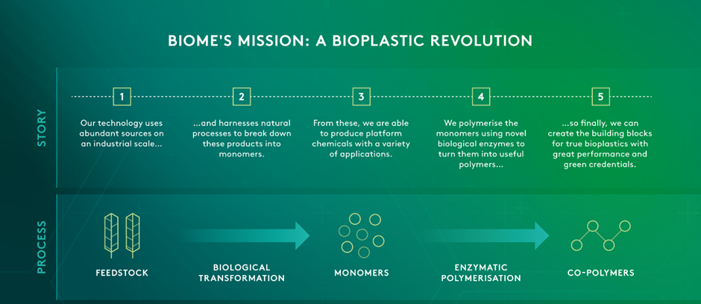
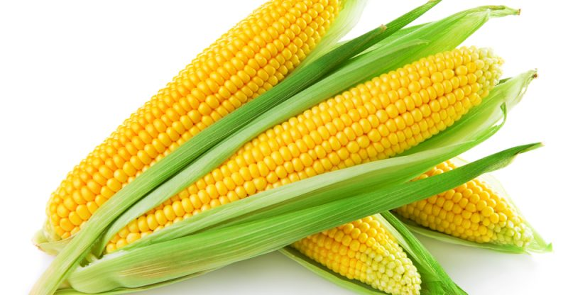
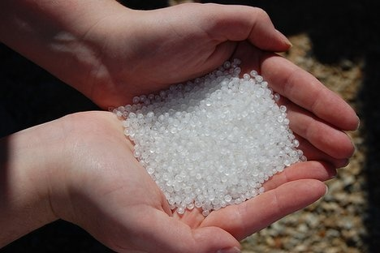

Slide 4
Timeline

Slide 5
Recognition
“Biome Bioplastic is the number 1 supplier of bioplastics in the UK and one of the leading suppliers of bioplastics worldwide.”

Slide 6
Producers Analysis and prime Sellers of world Biodegradable Plastics Market 2017:
1. Metabolix
2. BASF
3. BIO-ON
4. Biome Bioplastics.
5. Corbion
6. FKuR
7. MHG
8. NatureWorks
9. Mitsubishi Chemical Corporation
10. Plantic Technologies

Slide 7
Samples
Cutlery
Pens
Bag
Pellets

Slide 8
Thank You for listening

