Slide 1
German students presentation

Slide 2
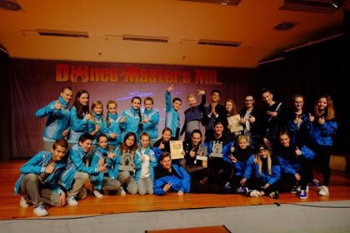
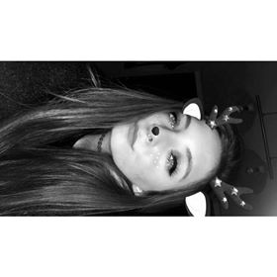
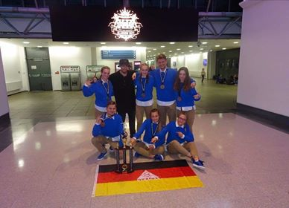
Hilal Baydemir
Hilal is 19 years old and loves to dance . She is part of a dance group named “stracxs crew” with which she takes part in many national and international dance competitions such as “UDO street dance championships”.
Her crew and her have won many trophies and they all are very talented. Hilal loves music as much as she loves dancing and her favorite artist is Justin Bieber . She enjoys listening to his songs and even went to many of his concerts and festivals in which he performed live.

Slide 3
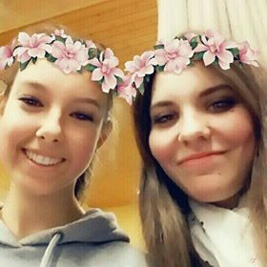
Sandra Bride
She is 17 years old, she likes animals a lot (but not spiders) and her favourite animals are horses. Her hobbies are singing in a choir, reading books and horse riding. Her favourite music is Pop and Rock. And she has 1 sister - she's 25.

Slide 4
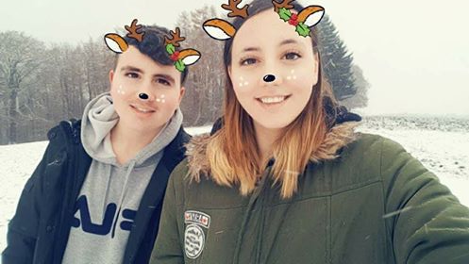
Jennifer Keim
Her name is Jennifer.She is 17.She has a younger brother who is 15 and her father is a cop.She lives in a house and she likes BTS.She has 3 cats and one dog and she loves video games.She wants to learn Italian and maybe Romanian.She is shy,cute,funny and usually brave.She is very curious about Romania and wants to visit it very much.

Slide 5
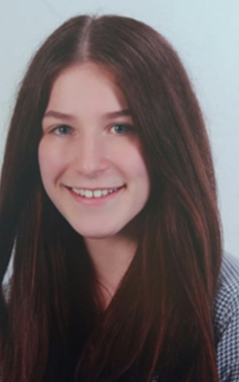
Lena Münch
Lena that she is a great girl. She's 17 years old and she has two siblings:a brother and a sister,which are both older than her. Also,she has two cats and a boyfriend.
In her free time she does a lot of school stuff, she's hanging out with her friends and when she was younger she was a gymnastic trainer for little children.

Slide 6
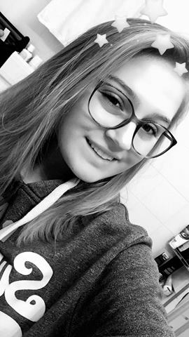
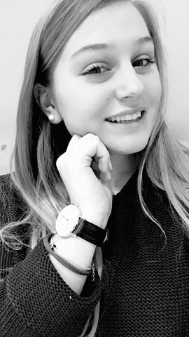
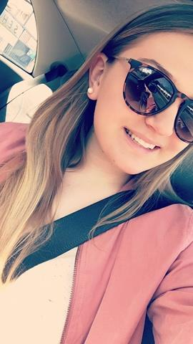
Alisa Jürgensen
She is 19 years old. She has a big sister that is 21 years old and a little brother that is 18 years old. She is a beautiful and smart girl who gives very good advices which literally brightens your day. She goes to the gym often because she likes to keep herself fit even though when she studies the sweets aren’t missing. She is the type of person that will work hard to achieve what she wants and she'll never give up on anything. She loves going skiing but the last time she went skiing she broke her thumb and it's basically the first time that she had her bone broken...

Slide 7
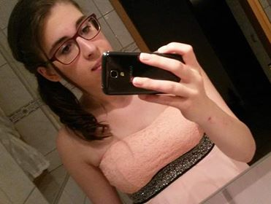
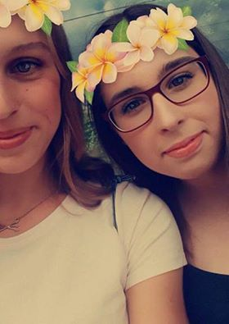
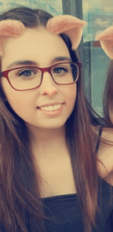
Madeleine Jerzabek
Madeleine is 17 years old and she has a sister.Her sister has 24 years.She likes to go shopping and going out with friends.She also likes to do sport or go to the gym , listening to music and watching TV series. She really likes pop music and the music that is played in the charts .She loves pets ,but she can't has any animals because her mum has animal hair allergy.

Slide 8
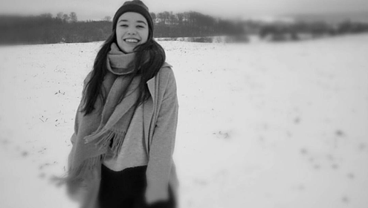
Kora Modes
Kora is 17. She does kickboxing and loves going to parties,hanging out with her friends.She also loves hiking. She likes languages or nutritional science as school subjects.

Slide 9
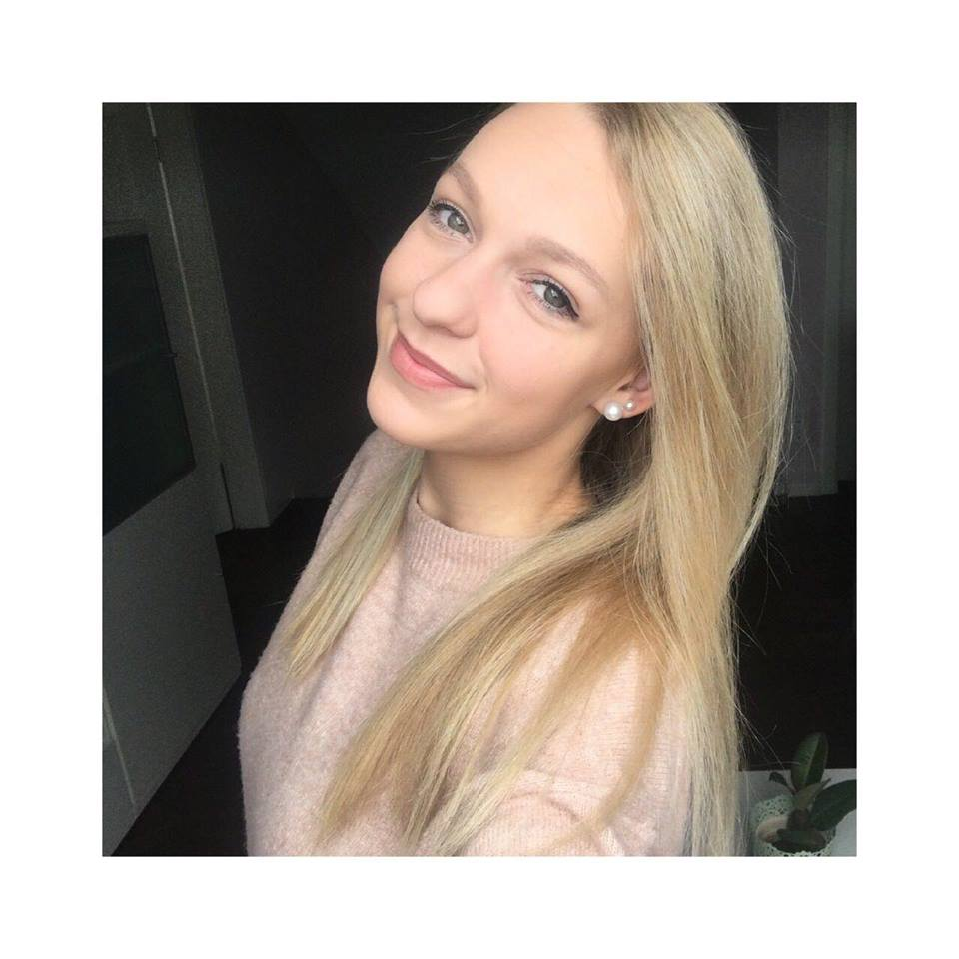
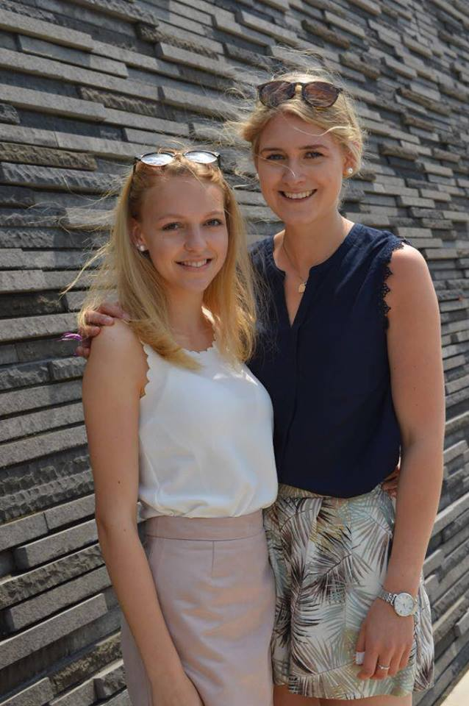
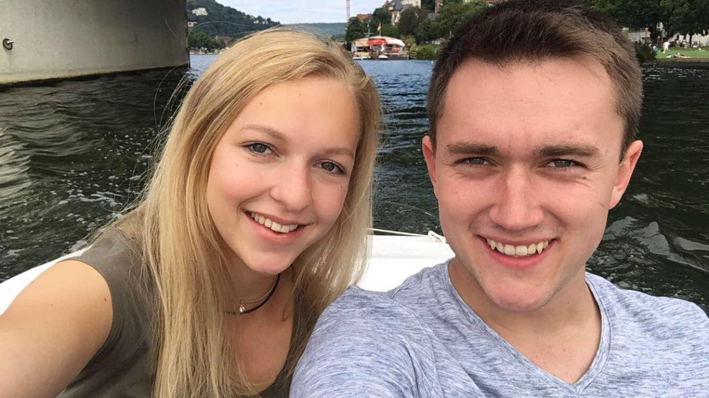
Mia-Madeleine Goebel
Being 17 years old,Mia is really smart and resourceful,as she can manage her time for school(likes chemistry,but doesn’t like economy) and also hanging out with her friends and boyfriend.She is very caring and nice. She loves dogs and even has one,called Eomer.Her hobbies are zumba and horse riding.

Slide 10
Silas

Slide 11
Anna Nohe

Slide 12
Luisa Lobe

Slide 13
Lena Schadt

