Slide 1
biodeck
A romanian company of bioplastic

Slide 2
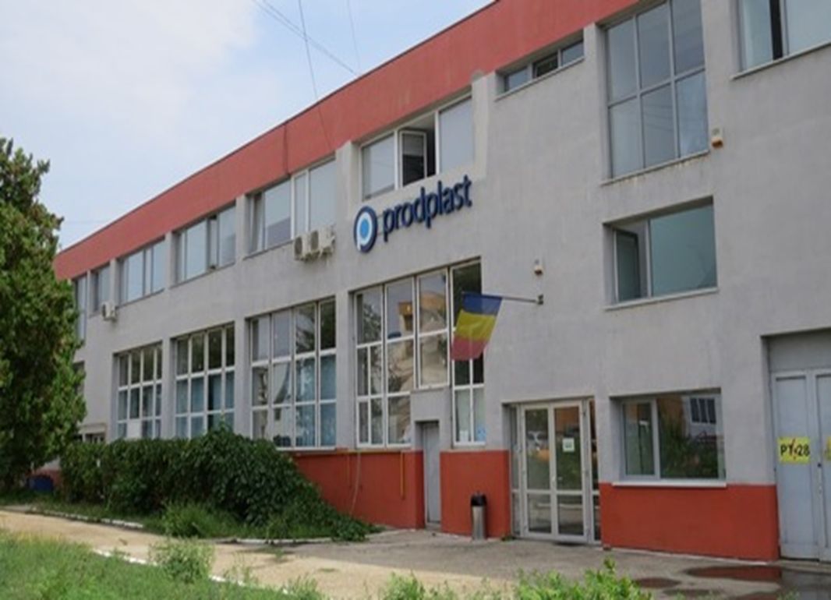
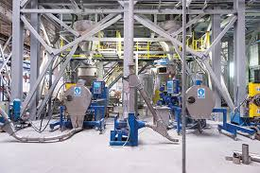
About the company
OUR STORY
Who knows better the perils of plastic than the people who have handled it daily for over 60 years? Biodeck is the offspring project of PRODPLAST, the first plastic processing factory in Romania, SE Europe. After decades of activating in the industry, we decided to part with plastic when it comes to single-use packaging. And so should you.

Slide 3
aims
We strive to leave this world better than we found it. That’s why we plan to change the packaging industry and culture. It shouldn’t be a secret: there is a sustainable alternative to single-use plastic and foam. Our ideal is a system where nothing is lost and everything is reused. Sounds impossible? We told you we love challenges.

Slide 4
Values
Years from now we want to look back on the milestones we passed and proudly say that Biodeck was part of the change. But to get there we need to set our principles straight. There are three core values that will lead us.

Slide 5
intergity
From start to finish, we plan to provide packaging that comes from responsible and renewable sources. “100% made from plants” is not just a motto, it’s a promise we keep. From the raw materials to the ink we use, everything is certified compostable and biodegradable.

Slide 6
Responsibility
There is no planet B. We are responsible for the well being of our world and a way to preserve the nature for our children is necessary. It’s a responsibility we have for the environment and generations to come.
With Biodeck, we plan to educate, change mindsets and shift consumption patterns.

Slide 7
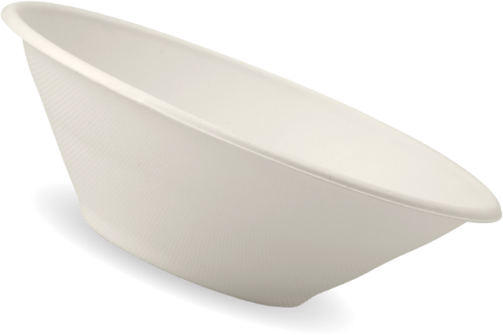
simplicity
We believe doing good is simple. You don’t have to set-up your environmental association or dedicate your life to saving the planet. Making a difference comes with simple choices, such as enjoying your sip of coffee from a compostable cup instead of plastic. It might look like a small move but it has a big impact.

Slide 8
All you see here is made from plants

Slide 9
For example these plates are made from sugarcane.

Slide 10
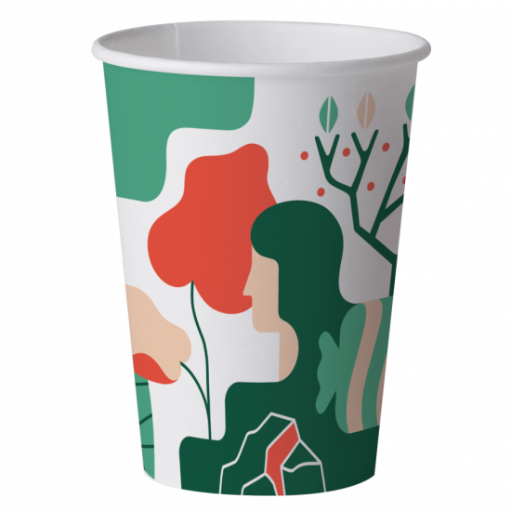
Biodeck artwork cups
from 7.99RON(approx. 1,72€)
Description
Biodeck cups use only sustainably sourced paper from managed plantations with a bioplastic lining made from plants not oil. These superior quality cups are perfect for you coffee takeaway. They are resistant to high temperatures and they make a good match with our hot-drink compostable lids. Make sure to check them out.
Capacity available: 4 oz (120 ml), 8 oz (240 ml), 12 oz (360 ml)
Packaging: a sleeve contains 50 pieces
Minimum order quantity: five sleeves
Shelf-life: up to three years
Break down time in composting facilities: 2-3 months
Storing conditions: avoid direct sunlight and temperatures higher than 35°C

Slide 11
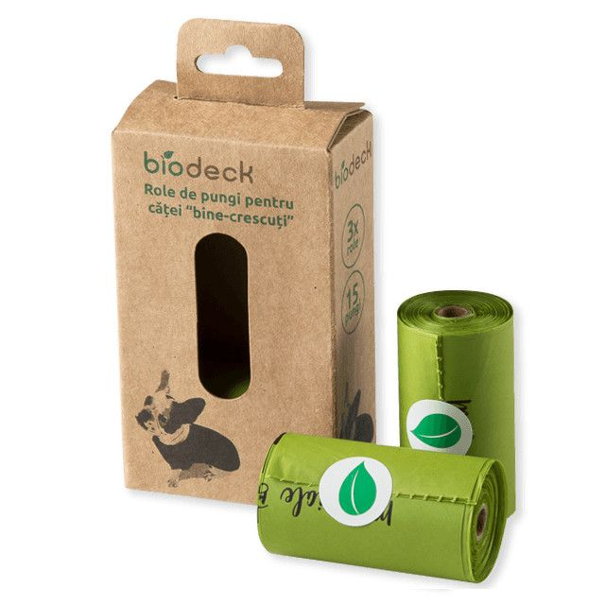
In the left side is a bio trash bag and in the right side are bio trash bags for dogs.

Slide 12
7 oz glasses (50 pcs)
4¹⁰ LEI(approx. 0,9 €)
Automated Cardboard City Cans 7 oz / 150ml
Size: 7,50 cm high glass
Usage: hot or cold beverages
Packaging: set 50 pcs
The cover in the photo has a separate price.

Slide 13
Thanks for watching!

