Slide 1

ThinkFuture
Brooke Garrod
Ana Andreea Stah
Alexandra Pintilie
Jenny Galeteki
Lilli Schmitt
Mia-Madeleine Goebel
Ann-Kathrin Müller

Slide 2
Aims and aspirations
Our business aims:
That many people benefit from the product and it is useful in everyday life
Through introducing the product it will help the environment
To replace traditional plastics with bioplastics, benefiting the future
Our aspirations:
We are creating cool eco-friendly lunch bags, suitable both for teenagers who take their lunch to school and for employees who don’t have time to leave the office for a consistent meal. We produce them in mass, for local businesses, such as bakeries, supermarkets and cafeterias. They can then be purchased in a variety of ways.

Slide 3
RECIPE
90 ml water
food colouring
1-2 teaspoon Na-Alginat
120 ml 1%ige Glycerol solution

Slide 4
OUR PRODUCTION

Slide 5
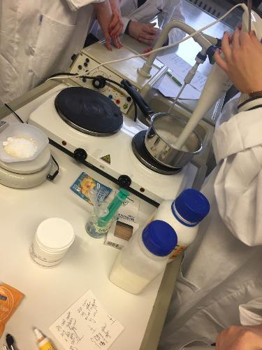
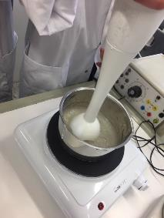
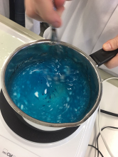
STEP 1: Preparing
We added the water, glycerol solution and Na-Alginat.
Mix well while the pan is on the heated stove.
When the mixture gets to a thick consistency turn off the stove.

Slide 6
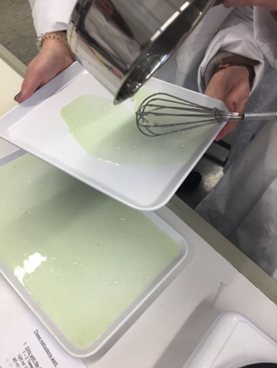
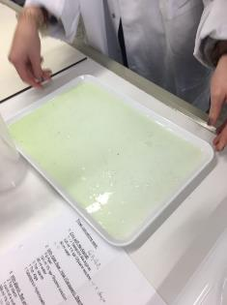
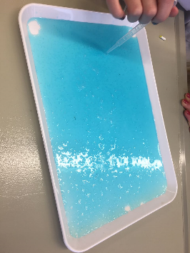
Step 2: Shaping
Quickly pour the mixture on a flat surface
Tilt the tray until the mixture is spread evenly
Pop the bubbles in the end if necessary

Slide 7
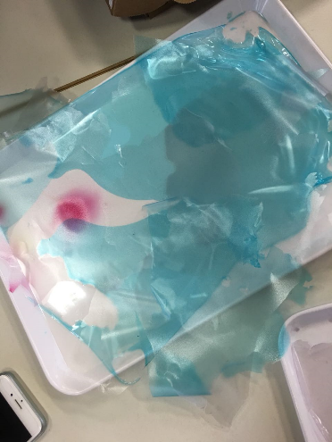
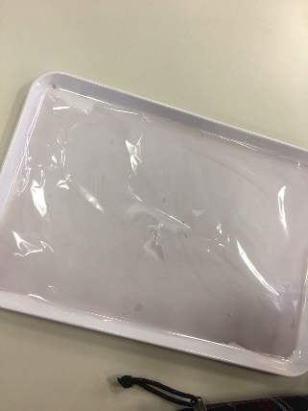
Step 3: Drying
The process of drying the bioplastic can take between 2 to 3 days
Also,for faster results you can put it into the dryer

Slide 8
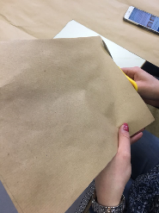
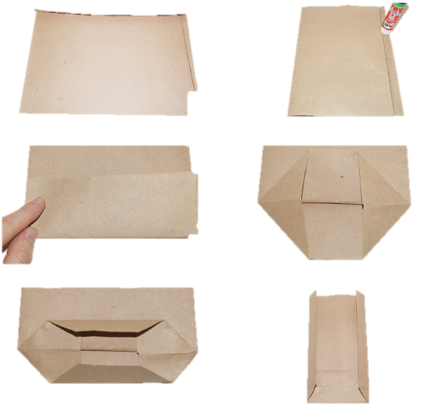
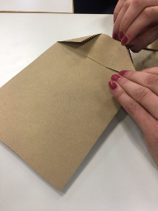
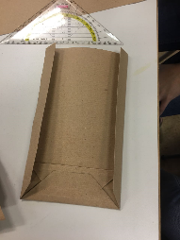
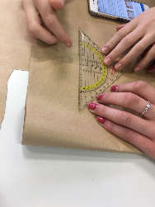
Step 4: Assembling
https://www.danato.com/magazin/valentinstag/diy-geschenktuete-mit-herzen.html

Slide 9
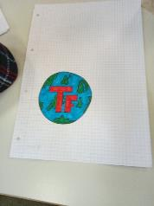
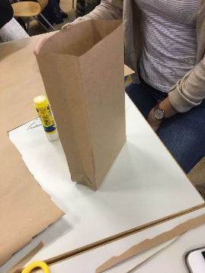
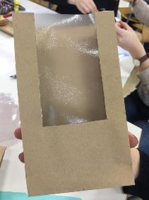
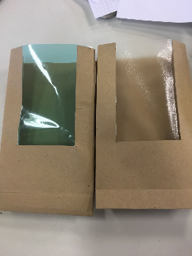
Step 5: details
Cut a small window into the bag
Cut the bioplastic into the shape of the window
Stick it to the bag
Design a logo and add it to the bag

Slide 10
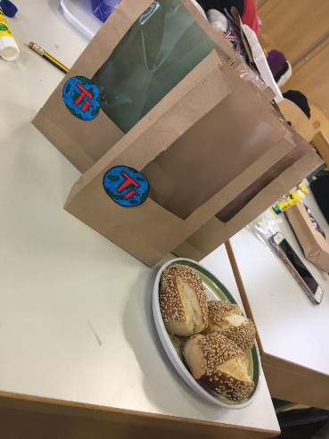
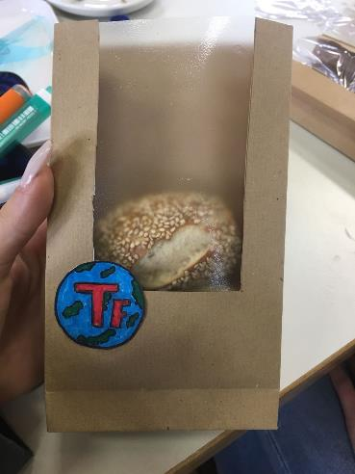
Final result
This is our bag in its best shape, ready to be used. It is suitable for any kind of lunch, being a safer substitute for regular lunch boxes.

Slide 11
Chemical reaction
+
water
Na-Alginat

Slide 12
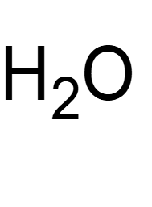
δ+
δ+
δ-
δ-
δ-
δ+
δ-
δ+

Slide 13
Reasons to use our product
Lunch bags that are on the market are currently made from a thin plastic made from low density polyethylene, it is estimated that 500 billion to 1 trillion plastic bags are used worldwide each year.
On average we only recycle 1 plastic bag for every 200 we use
https://conservingnow.com/plastic-bag-consumption-facts/

Slide 14
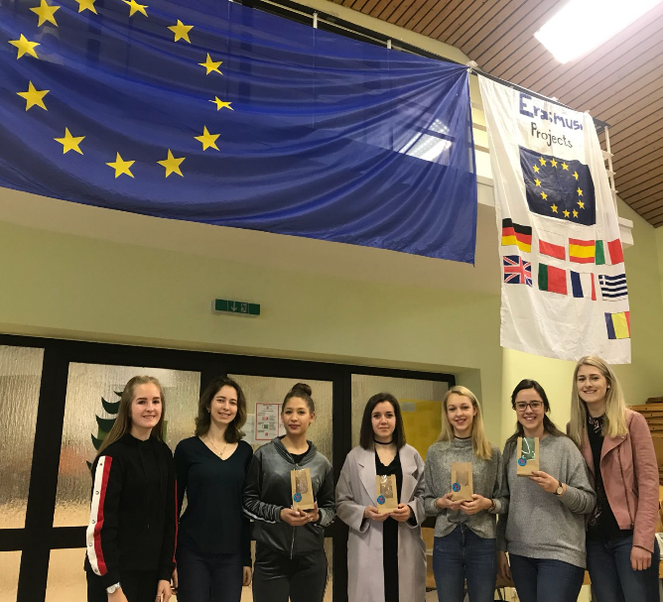
Sources
Our team

Slide 15
Thank you for your attention!

