Slide 1
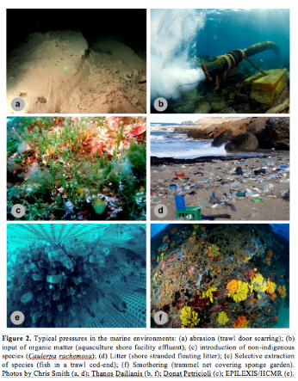
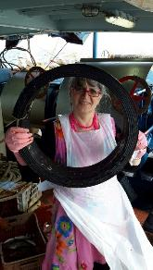
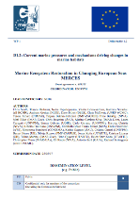
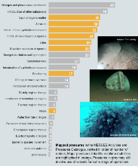
Marine litter on the beach and the sea
Nadia Papadopoulou, HCMR Crete, nadiapap@hcmr.gr
Member of Steering Committee of MERCES &
WP 1 Leader on marine ecosystems, degradation and restoration
MERCES
www.merces-project.eu/
H2020 MERCES 'Marine ecosystem restoration in changing European Seas'

Slide 2
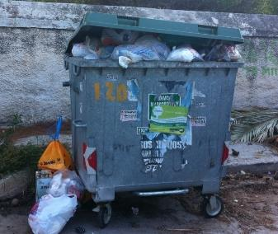
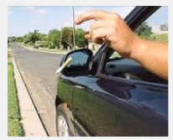
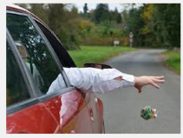
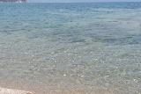
The size of the problem!
The problem! From the land to the sea and from the sea to the beach!
Marine litter at sea: 80% bad land management (e.g. open bins, trash aout of bins, wind/water/, ανεμοι, ρεματα, leaching), wrong attitude, lack of environmental awareness
Ignorance, negligence, accidents: 20%, tourism, marine transport, passenger and commercial vessels, recreational vessels, yachts, fisheries!
80%
MERCES

Slide 3
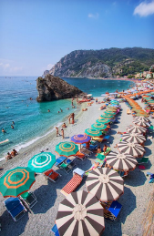
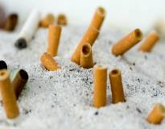
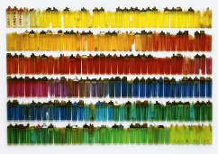
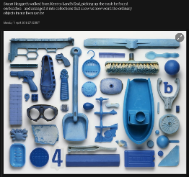
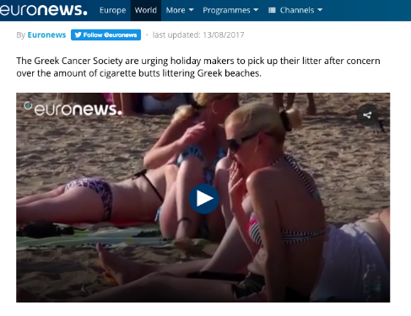
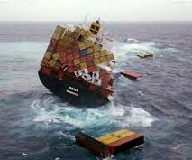
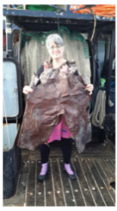
On the beach: classic sources!
Tourism, shipping, fisheries

Slide 4
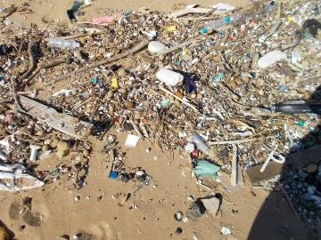
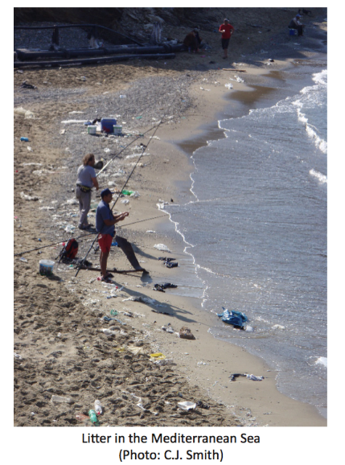
The size of the problem!
It is everywhere in the coastal and marine environment and everywhere in the world. It is a local and a worldwide problem!
Ag Nik, Crete
Issos, Corfu
On the beach!
Whatever does not sink at the sea botton can drift 100’s of miles away from original input source (from Athens to Mykonos!)

Slide 5
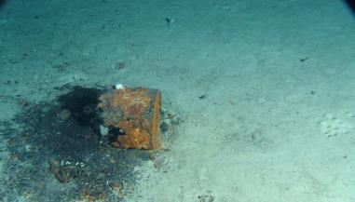
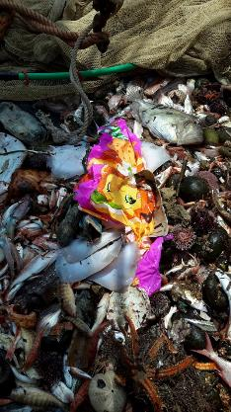
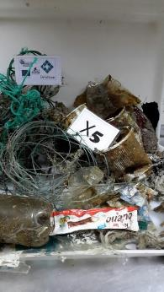
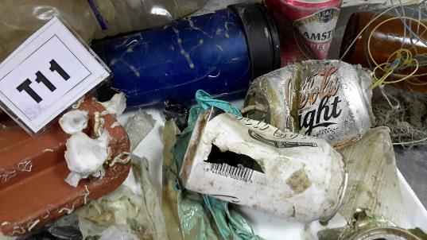
The size of the problem!! On the sea bottom!
στο θαλάσσιο και παράκτιο περιβάλλον σε όλο το κόσμο.
Αποτελούν τοπικό και παγκόσμιο πρόβλημα.
It is everywhere in the coastal and marine environment everywhere in the world. It is a local and a worldwide problem!
Ionian Sea, 1000m depth
In all the greek seas and depths!
Cofu, 80 m depth
Heraklion, 200m depth
EPILEXIS Project
BENTHIS Project

Slide 6
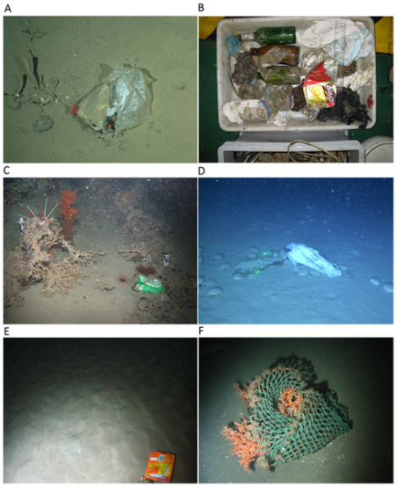
The size of the problem!! !
στο θαλάσσιο και παράκτιο περιβάλλον σε όλο το κόσμο.
Αποτελούν τοπικό και παγκόσμιο πρόβλημα.
It is everywhere in the coastal and marine environment and everywhere in the world. It is a local and a worldwide problem!
At the sea bottom
In all the european seas and depths!!
Pham CK, Ramirez-Llodra E, Alt CHS, Amaro T, Bergmann M, et al. (2014) Marine Litter Distribution and Density in European Seas, from the Shelves to Deep Basins. PLoS ONE 9(4): e95839. doi:10.1371/journal.pone.0095839
http://journals.plos.org/plosone/article?id=info:doi/10.1371/journal.pone.0095839
European seas
Figure 2. Litter items on the seafloor of European waters.

Slide 7
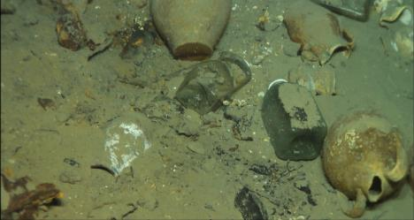
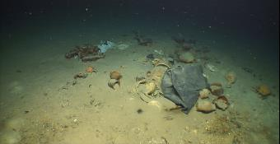
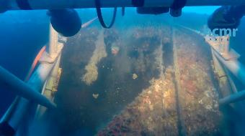
The size of the problem!! !
It is Old and new, small and huge
Traces of Ancient and recent civilization
Wrecks (archaeological findings), 2nd WW wrecks, (Heraklion, german bike, recent wreck (Siteia)

Slide 8
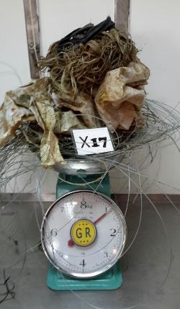
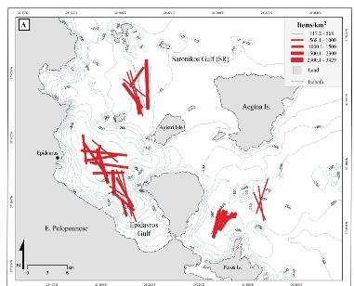
The size of the problem!! On the sea bottom!
1,211±594 items/km²
Ioakeimidis et al, Marine Pollution Bulletin, 2014
100-150 kg/km2
Number of litter items at sea per square km
Not all areas and seasons are the same!
Cyclades approx 150 items/km² (Papadopoulou et al. 2015)
Heraklion Bay approx 350-450 items/km² (Papadopoulou et al. 2015)
Saronikos Gulf in some areas >1500 items/km² (Ioakeimidis et al, Marine Pollution Bulletin, 2014)

Slide 9
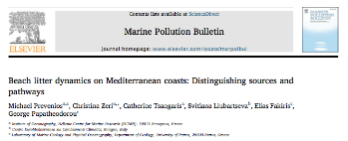
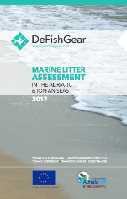
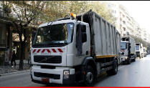
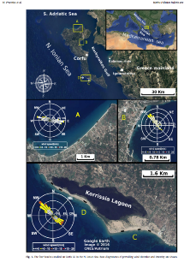
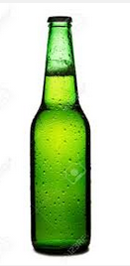
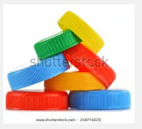
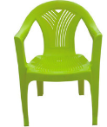
The size of the problem!! ! On the Beach
Corfu
July 2014 – Feb 2015
Sampling on 4 beaches
300 m per beαch
Collected ~ 1 tonne rubbish
For the total beach length in Corfu this means >200.000 items and 6.5 tonnes rubbish!
Not all areas and seasons are the same!

Slide 10
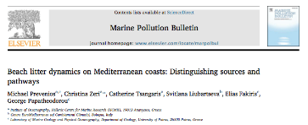
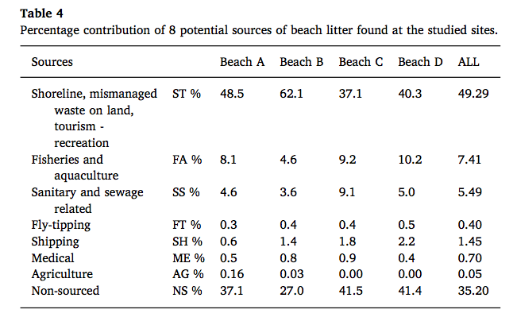
The size of the problem!! ! On the Beach
30-60% from bad land management, tourism, recreation, attitudes linked to street/beach food and single-use-items!

Slide 11
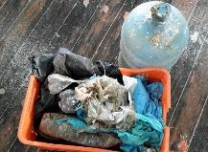
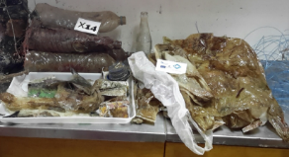
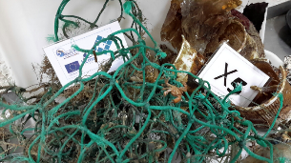
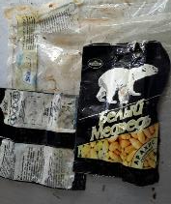
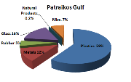
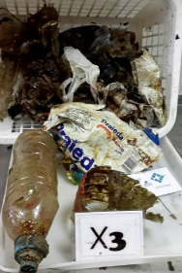
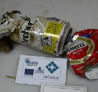
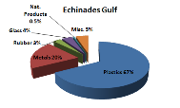
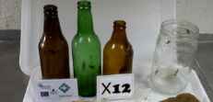
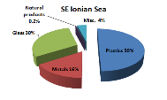
The size of the problem!! ! At the sea bottom
Plastic bags
Plastic water bottles and caps
Plastic food packaging
Plastic coffee cups!!
Fishign ropes, nets, lines
Other materials:
Glass and metal, textile, paper
>75% plastics!!

Slide 12
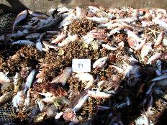
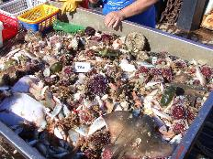
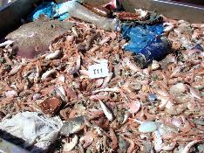
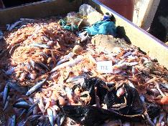
The size of the problem!! !
Heraklion bay, 70 m depth, Gournes
Plastic bottles, plastic bags, glass bottles, beer cans, fishing lines, food and candy/biscuit/nut/cigarette pack wrappers, coffee shakers, and many more types of litter!
Heraklion bay, 200 m, Dia island
BENTHIS PROJECT, Chris Smith
csmith@hcmr.gr

Slide 13
The size of the problem!! !
Aegean Sea, MEDITS PROJECT

Slide 14
Other aspects of the problem!
Entanglement and Ingestion
It is well known that marine turtles eat plastic bags (they confuse them for medusae)
1000’s birds and mammals live and die with plastics in their stomachs!
Νεκρό δελφίνι που ‘ξεβράστηκε’ στις ακτές της Κροατίας τον Μάιο 2014

Slide 15
Other aspects of the problem!
Plastic nets and lines that cause trauma and death
EPILEXIS project, Photo C Smith
EPILEXIS PROJECT,
Saronikos gulf 2015

Slide 16
Other aspects of the problem!
Litter, how long does it ‘live’ at sea ?
www.helmepa.gr

Slide 17
Other aspects of the problem!
Litter, how long does it ‘live’ at sea ?
1-5 χρονια
Plastic bag 10-20 years
50-80 years, plastic cups, cans, shoe soles
50 years later still there! 80+

Slide 18
Solutions of the problem!
Garbage management
Less rubbish
More recycling
Targetted actions
Smart applications/technologies
Participation in Voluntary actions
Tablet/phone app for LitterWatch!

Slide 19
Solutions of the problem!
Greek and European EXAMPLES, some good, some bad ☹
(not good!)
MERCES

Slide 20
EU Solutions of the problem!!
http://ec.europa.eu/environment/waste/plastic_waste.htm
MERCES

Slide 21
Solutions of the problem!
http://ec.europa.eu/environment/waste/plastic_waste.htm
EU PLASTICS STRATEGY!
MERCES

Slide 22
Solutions of the problem!
EU PLASTICS STRATEGY!
Τop 10 plastics found on Europe's beaches and seas!
Clean seas litter free! no litter and plastics on the beach! use less single use plastics! recycle, protect the marine environment!
MERCES
http://www.merces-project.eu/
https://www.facebook.com/merces.eu.project/
www.hcmr.gr HCMR education team

Slide 23
Thank you!
Life is full of choices, make a good one today! Start making a difference!
MERCES
Nadia Papadopoulou, HCMR Crete, nadiapap@hcmr.gr
http://www.merces-project.eu/

