Slide 1
Bioplastic
Business plan

Slide 2
Eureco est.2018
Group 5- Alisa Jürgensen, Theodor Nichifor, Jonas Dürnsteiner, Lisa Reinhard, Yagmur Karaoglan, Carla Balan, Nikolaos Xristakis
Notes:
Alisa

Slide 3
Business Summary
Our business will work as a binder between all of the departments, tertial companies and factors in order to get the bioplastic from the production point to the customer and then recycle it properly using its degradable properties.
Notes:
Theo

Slide 4
Business Aims
By creating a bridge between the factory, logistics, marketing, research&development, client and the waste disposal companies, Eureco aims to achieve sustainability, help the environment and create renewable plastic with a biodegradable formula.
Notes:
Yagmur

Slide 5
Mission Statement
Our aim is to improve our formula by partnering with companies that will fund the development. After we achieve this, we can sell the formula to a company/corporation/enterprise/individual that will use it.
Notes:
Theo

Slide 6
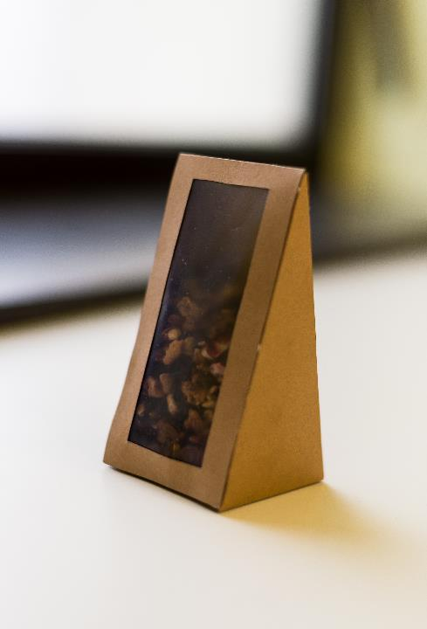
Target Clients
Supermarket
Franchise
School cafeteria
Manufacturer (recipe)
Notes:
Alisa

Slide 7
Market Analysis
From the Top 15 Importer Countries, only 4 are in the EU (UK, Germany, France, Netherlands) with an added up total of $876.6 (EURO 701.28) million.
Since 2012 Netherlands import of tea has gone up 13%
UK’s import has been going down since 2012 by 16,9%. Will Brexit affect the trading and investment?
Notes:
Theo

Slide 8
Top 15
Russia: US$548.3 million (9% of total tea imports)
United States: $483.2 million (7.9%)
United Kingdom: $363.3 million (6%)
Egypt: $282.3 million (4.6%)
Iran: $261.9 million (4.3%)
Saudi Arabia: $256.4 million (4.2%)
Germany: $226.5 million (3.7%)
Morocco: $199.4 million (3.3%)
Japan: $165.1 million (2.7%)
France: $161.6 million (2.6%)
United Arab Emirates: $142.4 million (2.3%)
Canada: $140.9 million (2.3%)
Vietnam: $130.3 million (2.1%)
Netherlands: $125.2 million (2.1%)
Kazakhstan: $112.2 million (1.8%)
Notes:
Yagmur

Slide 9
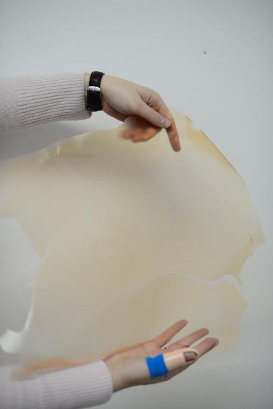
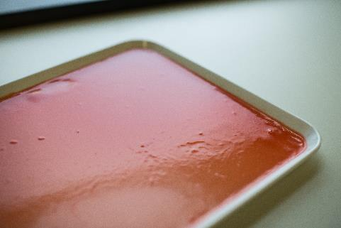
Problems with the formula and the outcome of the plastic
The plastic compressed and got wrinkly
It’s not vegetarian (if you want to eat it)
It’s not really resistant
Notes:
Alisa

Slide 10
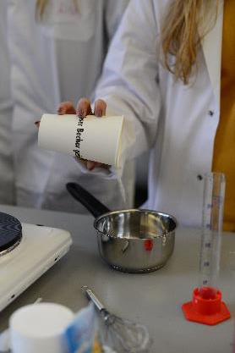
Benefits
100% biodegradable and water solute
Only bio materials
Low cost of production
Aesthetic
Natural
Tea smells good
Candies are tasty
Notes:
Lisa

Slide 11
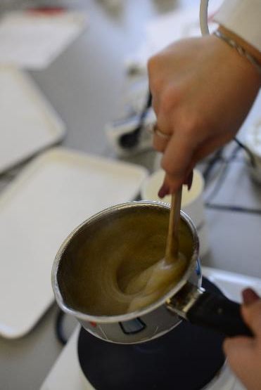
Cost of Production
Gelatine: 1400󠇃€/100 kg
Glycerine: 152€/100kg
Water: +1%
Potato-starch: 96€/100kg
Food color:16€/1kg
Bio Paper:60€/100kg
TOTAL:1664€
SAVES:aprox.5000€ (if you buy the ingredients from manufacturers in mass quantities rather than individually from the supermarket)
Notes:
Theo

Slide 12
Chemical quantity
Notes:
Alisa

Slide 13
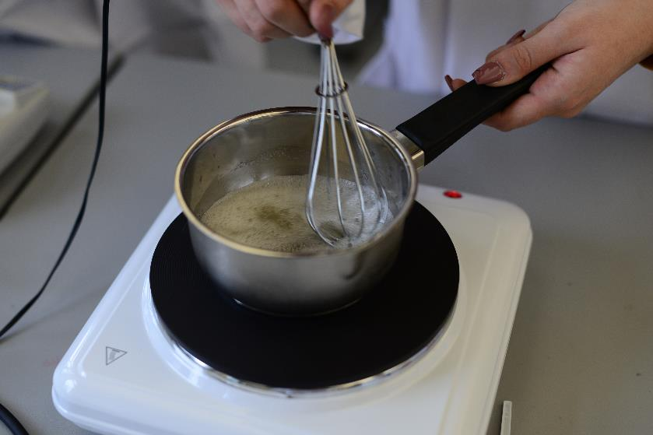
Recipe
400 ml water
9 g alginate
3 drops of glycerin
5 drops of food color
2 teaspoons of potato starch
Notes:
Carla

Slide 14
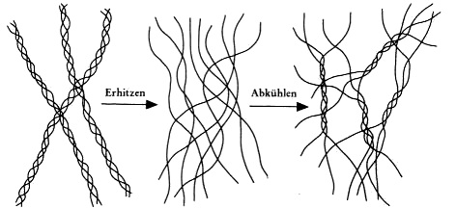
Chemical Formulas
Notes:
Jonas

Slide 15
Works Cited
www.trikot-deal.de/wp-content/uploads/2015/10/zDcMoiHmS1k.jpg
https://s3-eu-west-1.amazonaws.com/fitnext-blog-upload/fr/conseils/wp-content/uploads/2016/12/20141249/acheter-produits-vrac-ecologique.jpg
https://cdn.displays2go.com/images/zoom/bfdwmsslv.rw_preview.jpg
https://images-na.ssl-images-amazon.com/images/I/71R85ZlgaxL._SL1500_.jpg
https://www.candywarehouse.com/assets/item/regular/Triple-Cylinder-Tabletop-Candy-Dispenser-128319.jpg
https://media.istockphoto.com/photos/nuts-and-spices-in-dispenser-picture-id184315635
https://d1alt1wkdk73qo.cloudfront.net/images/guide/71bbab4b563444019e67e9953056aa0e/478x640_ac.jpg
https://odysseyonline-img.rbl.ms/simage/https%3A%2F%2Faz616578.vo.msecnd.net%2Ffiles%2F2016%2F06%2F04%2F6360067444515085251247189315_sugar_2.jpg/2000%2C2000/OfJlgQXvq8n4yA6F/img.jpg
https://images-na.ssl-images-amazon.com/images/I/61V1pb0o0NL._SL1000_.jpg
http://daten.didaktikchemie.uni-bayreuth.de/umat/gelatine/gelatine.htm

