Slide 1
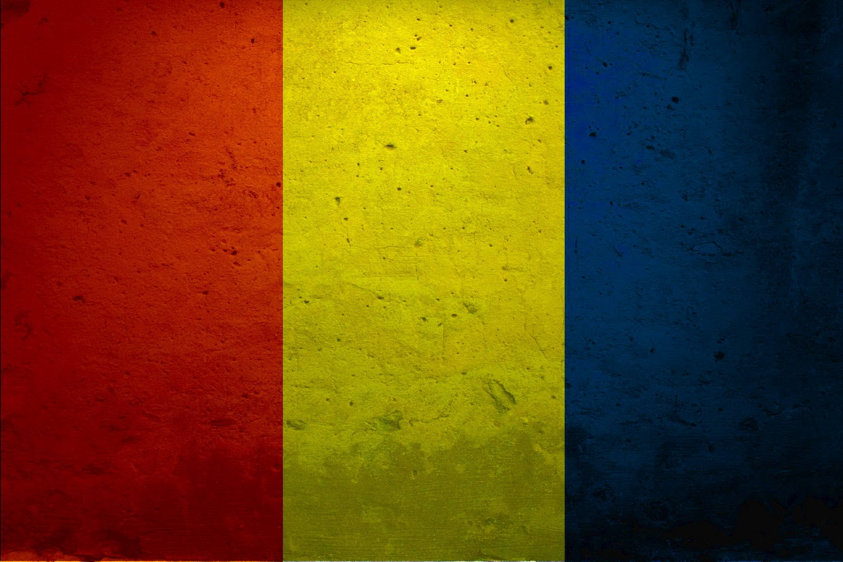
Beautiful Romania
By Theodor Nichifor

Slide 2
Study Abroad and Hosting Opportunities with the U.S. Department of State
Study Abroad with ECA
Host an Exchange Student
The U.S. Department of State offers numerous study abroad scholarships for American and international participants.
Visit exchanges.state.gov to learn about a program for you!
Consider an inter-cultural experience without leaving home by hosting an exchange student.
Visit hosting.state.gov to learn more!
Bureau of Educational and Cultural Affairs, U.S. Department of State

Slide 4
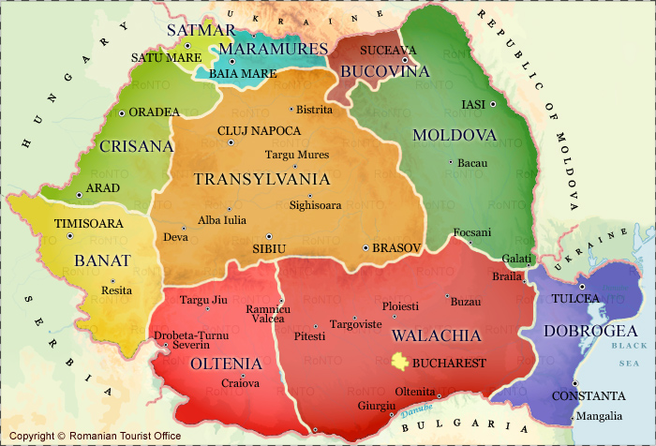
Piatra-Neamt

Slide 5
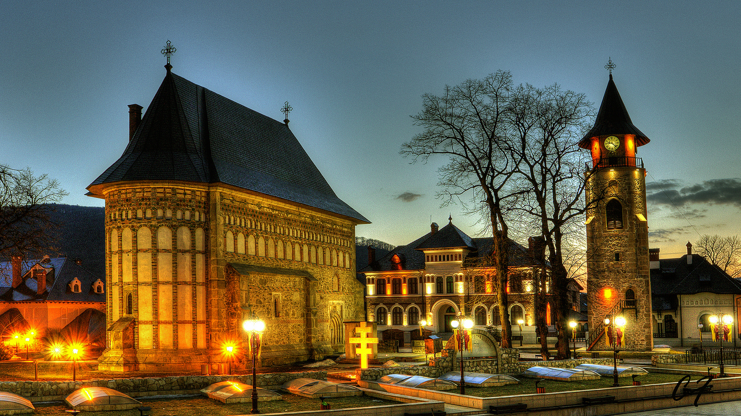
I am from…
PIATRA-NEAMT- (North-East of Ro)

Slide 6
7 things you didn’t know about Romania

Slide 7
#1
The Romanian inventors changed the world
Nicolae Constantin Paulescu- discoverer of insulin.
Petrache Poenaru- inventor of the fountain pen.
Anastase Dragomir- inventor of parachuted chair.
Traian Vuia, Aurel Vlaicu, Henri Coanda- pioneers of the air world, inventing the jet engine or the first self-propelled airplane.

Slide 8
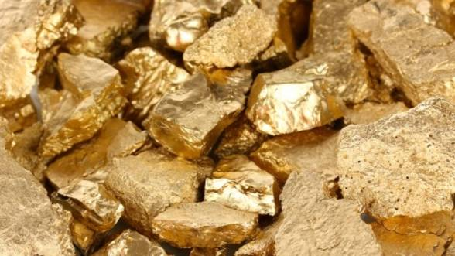
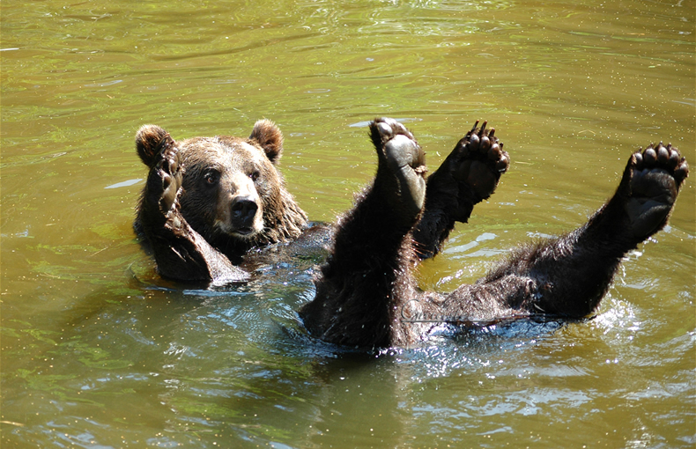
#2
Romania is Europe’s richest country in gold resources and brown bear population

Slide 9
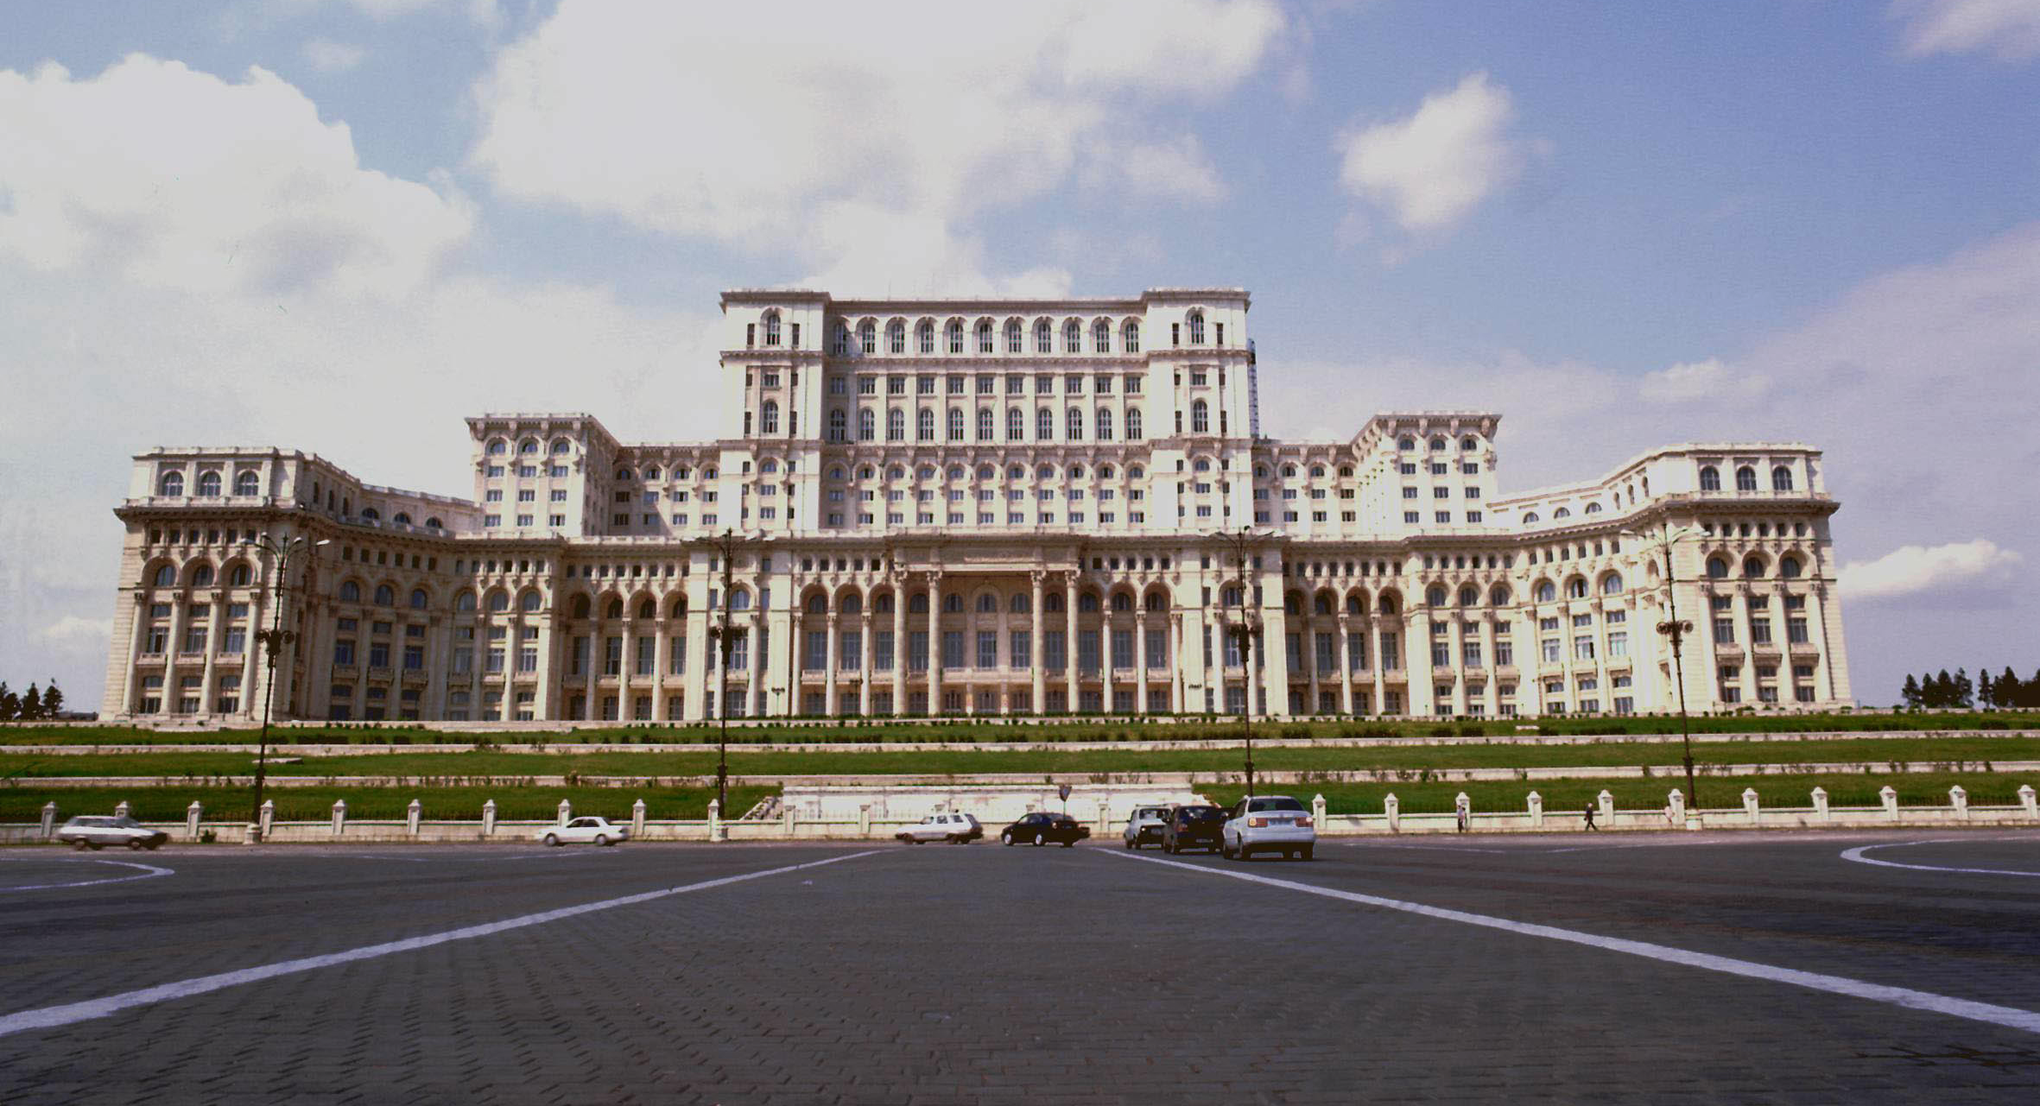
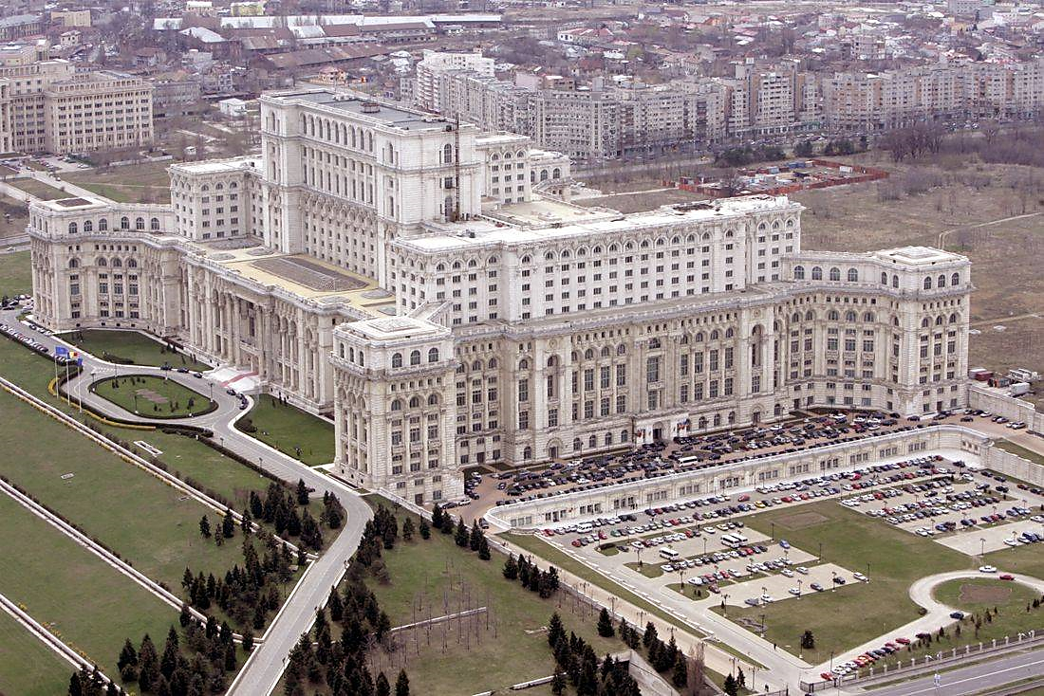
#3
Romania boasts the world’s largest administrative building
First as weight and second after the Pentagon as size, the Romanian Parliament House is an enormous communist work of the 80’s

Slide 10
#4
Best preserved Delta in Europe
3rd in the world as biodiversity, the Danube Delta is the end of the Danube river, which crosses 4 European capitals and 11 countries, being the second longest one on the continent.

Slide 11
#5
Our money is called “LEI”=“Lions”
We don’t have lions in Romania
I don’t know why we call them like that
$1=4.2LEI
1euro=4.5LEI
They are plastic, but don’t try to rip them

Slide 12
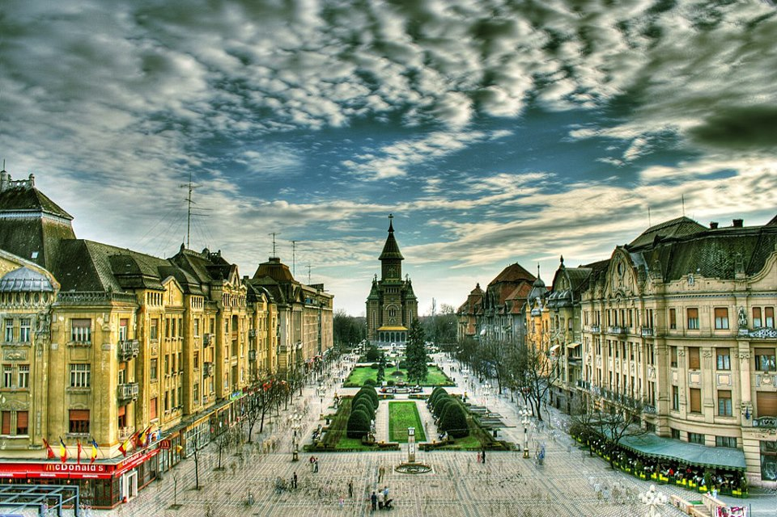
#6
The first city #lit by street lamps in Europe
Timisoara was the first city with street lamps which used electricity and only second in the world after New York City, in 1884.

Slide 13
#7
Dracula Castle
Vlad the Impaler, one of our leaders back in early 1400, is the inspirer of Dracula.
He impaled his enemies in front of his castle and legends say that he drank their blood.
It is located in Transylvania, Western part of the country.

Slide 14
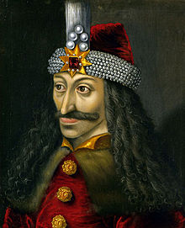

Slide 15
Holidays
December 1st- National Day
Christmas
New Year’s Eve
March 1st - “Martisorul”
Easter
May 1st – Labor Day

Slide 16
Romanian Traditions

Slide 17
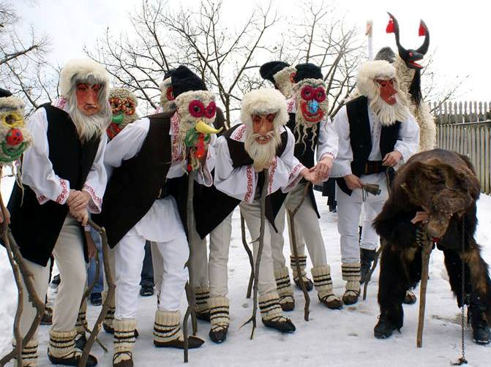
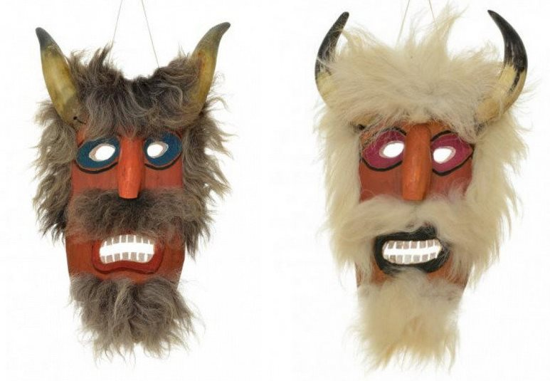
Traditional Masks
The rituals consist in dances and a variety of masks to scare the bad spirits and death
The way you dress up and the mask you wear tells the story

Slide 18
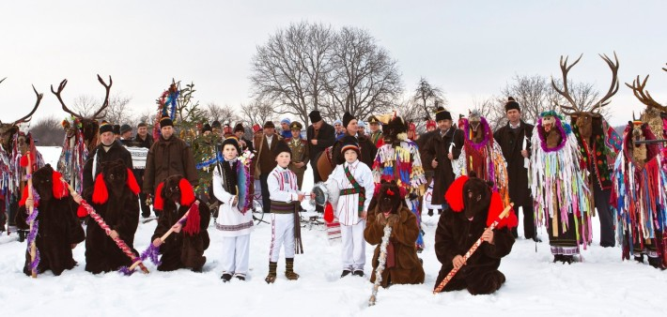
The Goat and The Bear
New Year’s Eve dance traditions
People go from house to house dressed up in costumes and sing

Slide 19
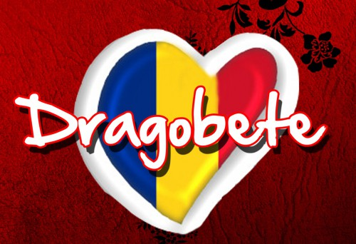
Our own Valentine’s Day (Dragobetele)
Same thing with chocolate and fluffy hearts, but different date (February 23rd) and waaay older (Middle Age).

Slide 20
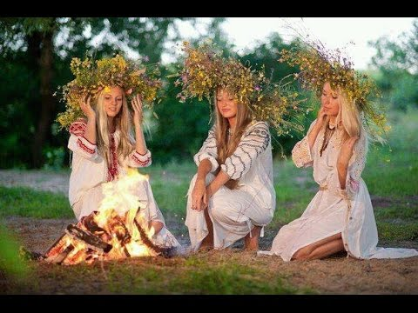
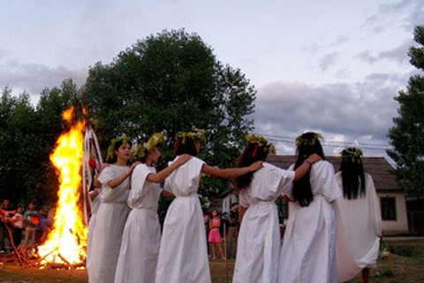
Sanzienele (June 24)
In the Romanian mythology, “sanzienele” are the good fairies, but if you don’t respect their holiday, they turn into bad fairies, cursing you.

Slide 21
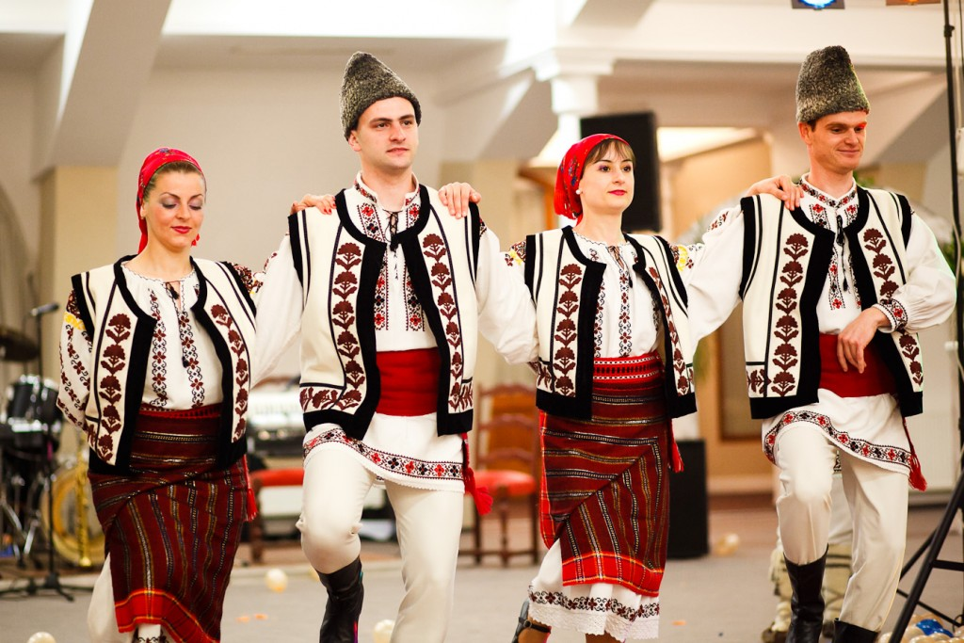
Romanian vintage fashion

Slide 22
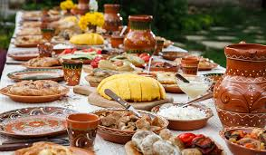
Romanian cuisine
Composed of various cultures, such as Turkish, Slavic, Balkan, Italian and Hungarian

Slide 23
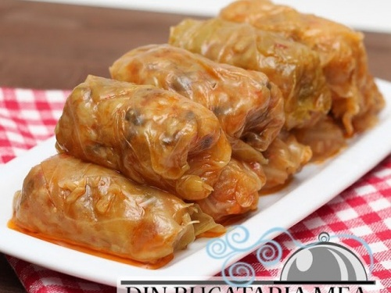
Sarmale
Cabbage rolls with meat and rice

Slide 24
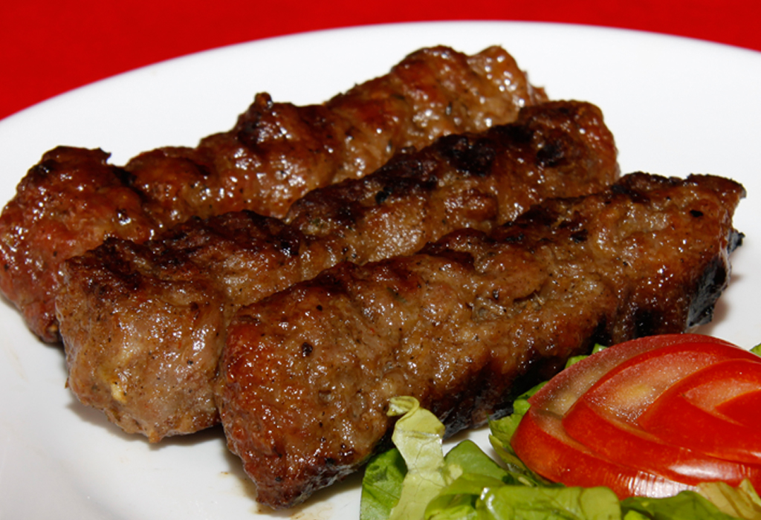
Mici
Barbequed beef and pork meat

Slide 25
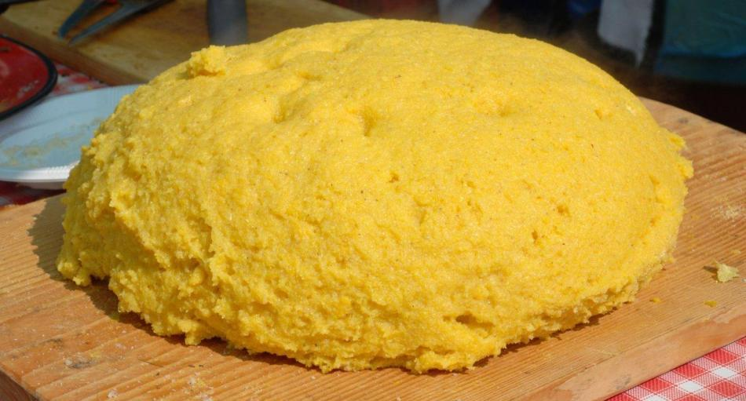
Mamaliga
Polenta or our own Corn Bread

Slide 26
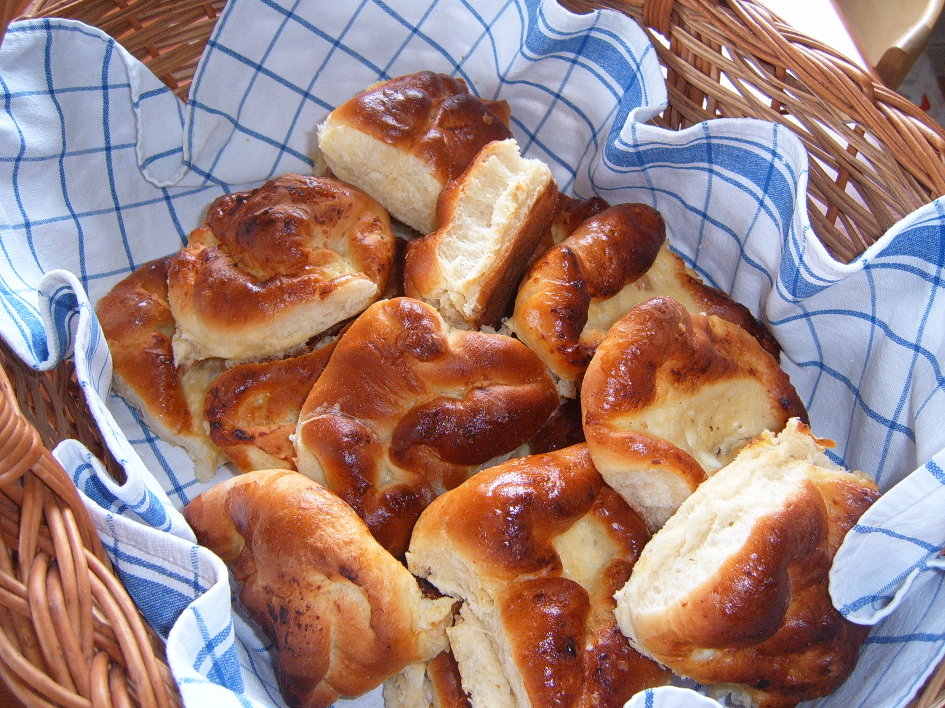
Placinte poale-n brau
“Cheese pie” more like a Cream Cheese Sweet Bread

Slide 27
Romanian sports
Soccer- Quarter Finalist at 1994 USA World Cup (we beat US with 1-0)
Tennis- Simona Halep #4 WTA, played 2014 Singapore Final with Serena Williams
Alina Dumitru- Gold Medalist at Beijing Olympics at Silver Medalist at London Olympics at Judo.
Gymnastics- where Romania excels the most, with the first Perfect “10”, Nadia Comaneci- Montreal ’76.

Slide 28
Funny Romanian Expressions
A Romanian is not “surprised”… his “face has fallen off” (I-a picat fața).
A Romanian won’t “lose temper”…his “mustard will jump off” (Îi sare mustarul).
A Romanian hasn’t just “screwed up”…he “threw his boogers in the beans” (A dat cu mucii-n fasole).
You don’t “drive a Romanian nuts”… you “take him out of his watermelons” (Îl scoți din pepeni).
In Romania, things are not “far away”… they’re “at the devil’s mother” (La mama naibii).
A Romanian won’t tell you to stop “wasting time”… he’ll tell you to stop “rubbing the mint” (Freca menta).

Slide 29
Brief history because Mr. Brown is my fav teacher
After WW2, the Russian influences pushed us in a communism era.
In the Christmas Eve of 1989, a revolution against our dictator, Nicolae Ceausescu spurred.
At least 1000 people died and after a couple of days, our dictator was executed with a fire squad after he got captured; everything was filmed and broadcasted on the news.

Slide 30
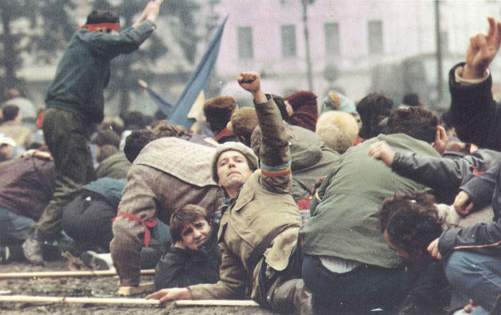
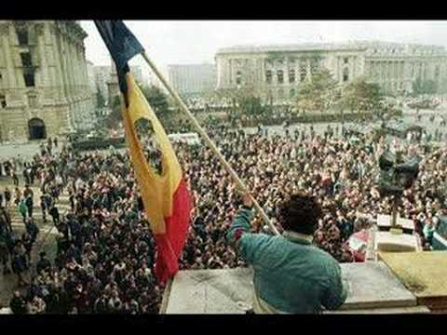
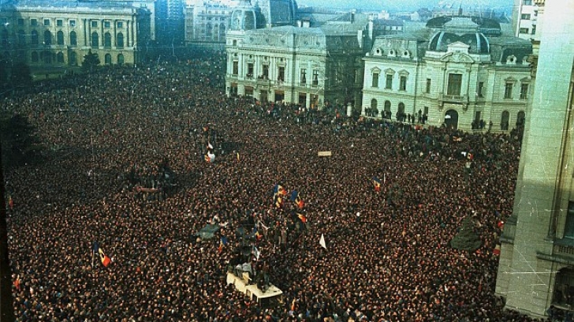

Slide 31
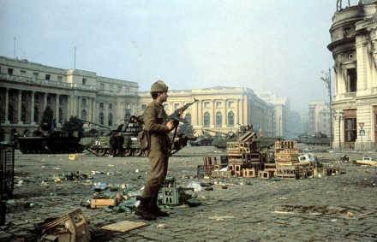
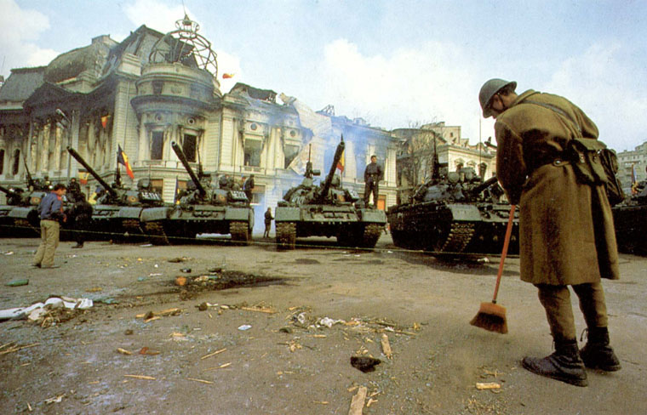
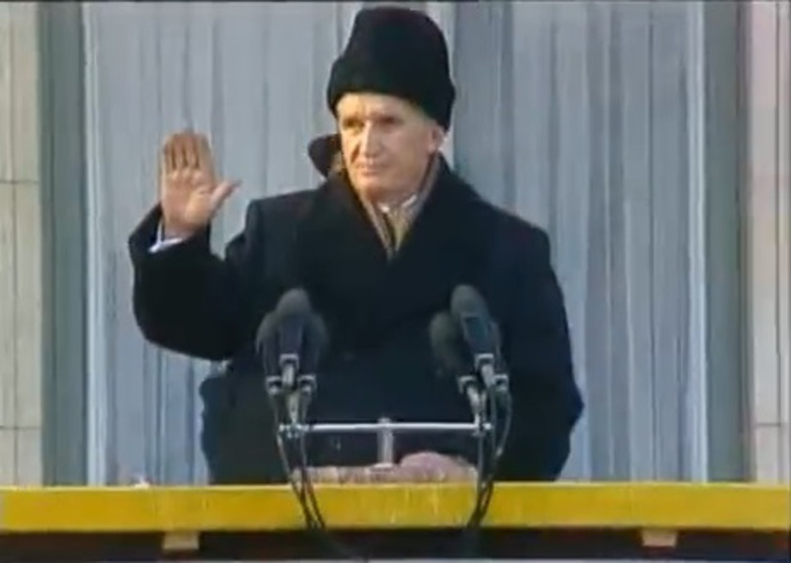
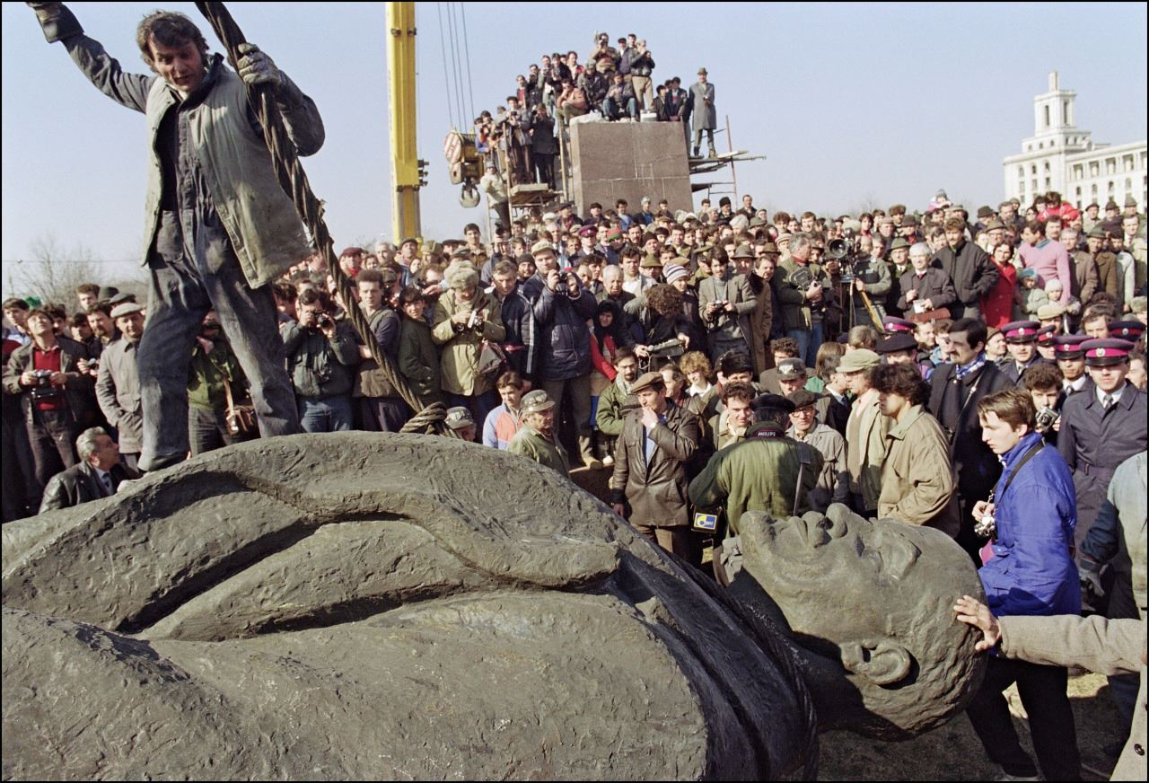

Slide 32
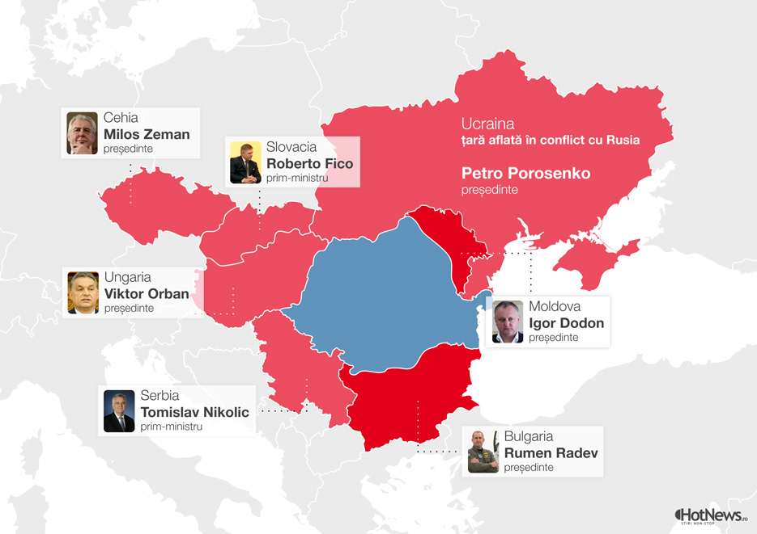
How are things going on now?
Russia has influenced a lot of our neighbors leaders for a pro-Kremlin and anti European government, socialistic mentality, even though they are still in the European Union with us.

Slide 33
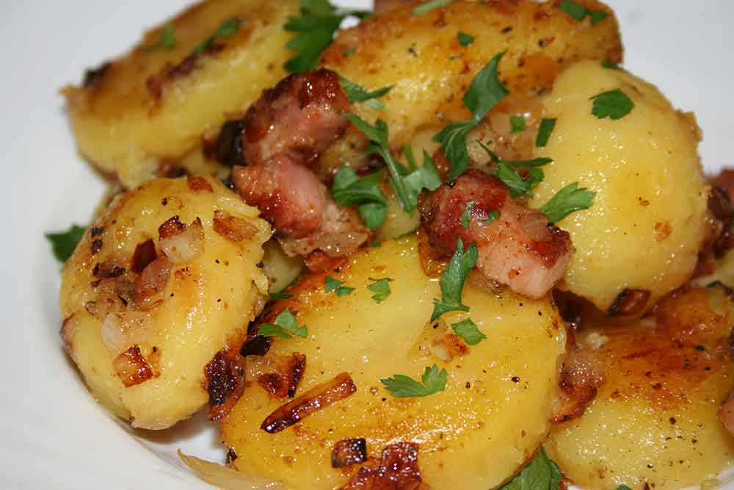
Sorry for the long presentation, here are some “Romanian Peasant Potatoes”
Thank you for your attention!

