Slide 2
Company overview
_{Founded: January 2018}
_{Number of employees: 7}
Founders: Rares Miron, Sude Yakut, Tim Pascher, Vlad Gubendreanu, Maddie Smith, Andreea Cristel, Stefan Cioaric
Business summary: Our business main activity is the production and distribution of bioplastic-based packaging to food manufacturing companies.

Slide 3
Aims and vision
Offering an alternative to the conventional plastics like PET, PP, etc. used in the food packaging industry and raise awareness of the environmental impact.
We aim to have strong collaborations with the aforementioned companies and also protect planet Earth and its resources, raise awareness about the global pollution and also offer educational programs and workshops for international students.

Slide 4
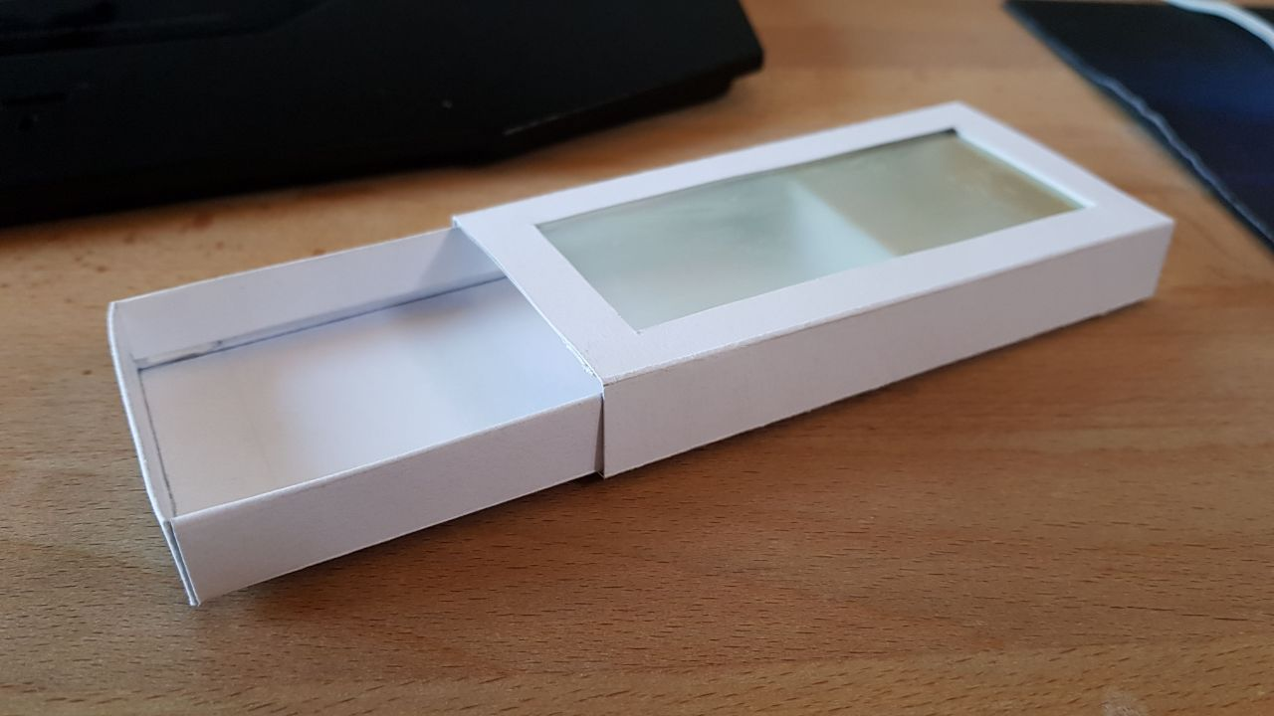
Our product
Momentarily, our main product is a packaging for Tic-Tac mints, but our R&D department is working on perfecting the package. We hope in the future to manage to make food packaging for other foods, like nuts, dry fruit and breadsticks.
Recipe 1: sodium alginate + glycerol
1 tsp Na-Alginat
200 ml (2/3 cup) of 1% glycerol solution
Made out of 100% biodegradable bioplastic and 100% recyclable paper, our product is not only environmentally friendly, but also an efficient packaging.
Our bioplastic film is based on algae extract and glycerol.

Slide 5
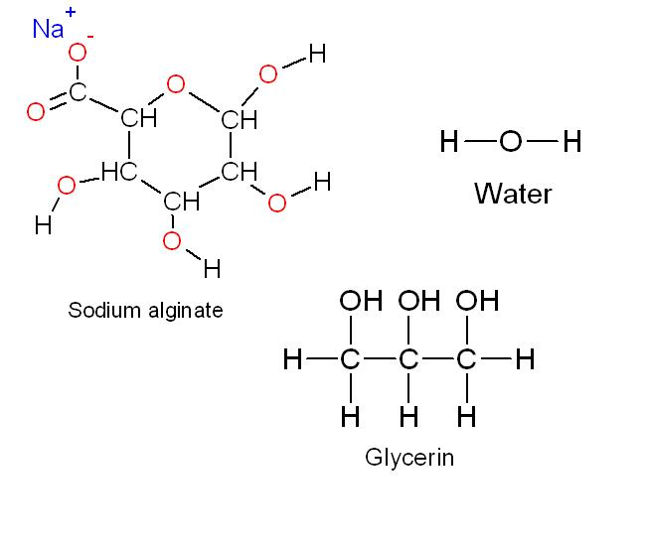
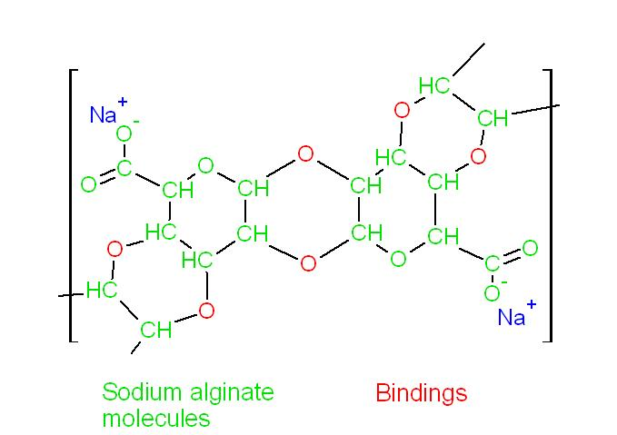

Slide 6
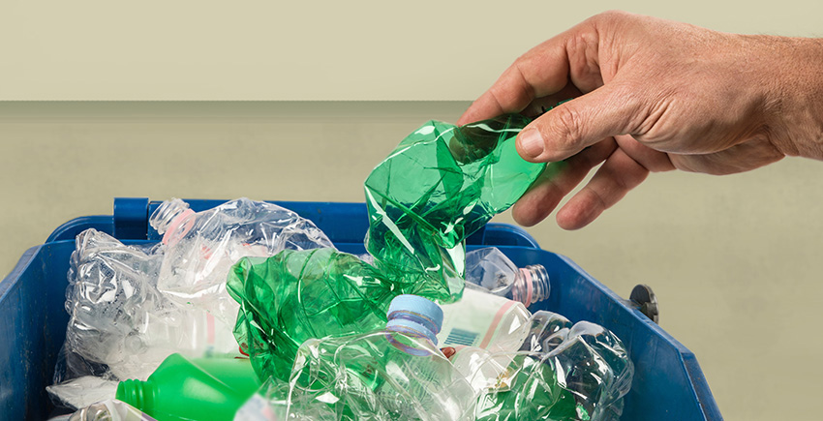
The impact of conventional plastics on the environment
It is well known that plastic is probably the world‘s leading pollution cause. A plastic bag can kill numerous animals because they take so long to disintegrate. Most plastics are made from petroleum or natural gas, which will eventually deplete.
The interest in environmental issues is growing and there are increasing demands to develop materials which do not burden the environment significantly.

Slide 7
Our services
Our logistics department is efficient and ensures the distribution of our product worldwide. We work with the world’s leading transport companies.
Your time is important and we always strive to make the most of it!

Slide 8
THE MARKET

Slide 9
Our worldwide partners
BP-Tech HQ

Slide 10
Our customers
Our typical customer is the Tic Tac brand, but we can also expand to matches, dry nuts and sweets. All in all, we work with food manufacturers that seek an ecological solution to conventional plastic food packaging.

Slide 11
What makes our customers ask for our services?
1.Low production cost
The production cost of the packaging is greatly reduced by the fact that we use refined glycerol, Na-Alginat,, water and bio-degradable paper. Compared to the price of polymers, like PLA(Polylactic acid), PP(Polypropylene) etc. , our product is far cheaper and safer.
2. Bioplastics have a small but growing market
Even though bioplastics are not so known and promoted, they receive a lot of attention from research institutes. There is always place for innovation and that`s what our company is looking for.
3.Low costs
Bioplastics are created using very simple and cheap chemicals. Also, the production process doesn`t require high energy consumption and it is environmentally friendly.

Slide 12
Market research
The aim of the market research is to evaluate the supply and demand, the object in question being our bioplastic-based food packaging .
For this purpose, we used a short questionnaire composed of 6 questions regarding our product.

Slide 13
Questions used
Is our bioplastic product convenient?
Do you think that our bioplastic packaging is effective?
Do you find our bioplastic packaging as a replacement to conventional plastics?
Would you recommend our product to other businesses/friends/relatives?
Do you trust that our product is going to be environmentally friendly?
Do you think we will make other bioplastic-based products?

Slide 15
Conclusion
Judging after our market research, we came to the conclusion that businesses and people are very open to the idea of bioplastic packaging and are actually embracing it.
We at BP-Tech aim to offer a new take on food packaging by offering a bio-degradable and environmentally safe package, protecting planet Earth on the long run

Slide 16
Marketing strategy

Slide 17
How are you going to advertise your product? | Why have you chosen this marketing method? | How much will it cost?
Small Billboards TV Flyers | Easy to spot when you’re outside Almost everyone watches TV at home Flyers are easy to produce and they are an efficient marketing strategy, especially at expo shows | 114€/week 1500€/10s on national television 100€/1000 flyers
TOTAL COST |  | 1714 €/week

Slide 18
SWOT analysis of your own product
Strengths Low production cost Fast production rate Environmentally friendly | Weaknesses Product is in an ongoing improvement process Some companies might not accept the idea Oxygen absorbtion rate is momentarily high
Opportunities Work with important food manufacturers Raising awareness about the global non-degradable plastic pollution Opening new possibilities in the bioplastic-based product industry | Threats Corporate espionage Economic difficulties(taxes, custom tolls, logistic costs) Possible bigger competitors

Slide 19
What makes our business different than the rest?
Healthy marketing strategies
Reliability of our services
The desires to maintain long-term contact with companies all over the world
Providing solutions that help battle the global pollution threat
Offering educational programmes to international students(factory visits, workshops, conferences with our chemists, engineers).

Slide 20
Short-term plan
Solid advertisement at international fair
Making ties with companies all over the world
Building reputation from our services’ reliability, quality and mutual trust

Slide 21
Long-term plan
Making profit
Expand our network to an international level
Attracting public & scientific interest
Offering educational programmes regarding the environmental issues

Slide 22
Plan B
Making partnerships with smaller companies
Changing the design of the product
Marketing our product in schools
Supporting school cafeterias with our environmentally friendly product
Start all over again

Slide 25
Thanks!
Any questions?

